Slide 1
What is Culture?
The beliefs and behaviors of a society Culture consists of abstract ideas, values, and perceptions of the world that inform and are reflected in people’s behavior
Culture is the lens through which we view our world, it “invents” our reality
Iceberg example…

Slide 2
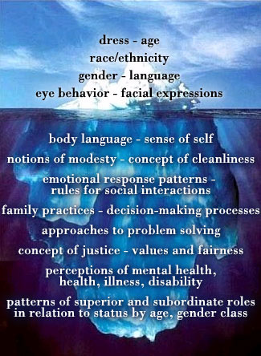
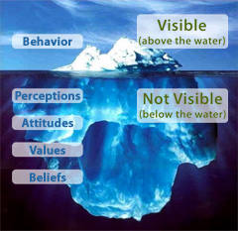
Culture is like an Iceberg…

Slide 3
Culture is…
Culture consists of abstract ideas, values (norms), and materials of the world that inform a group of people, and are reflected in people’s behavior (Bierstedt’s definition).

Slide 4
What is Culture?
Superstructure: A culture’s worldview, including morals and values, oftentimes grounded in religion
Social structure: The rule-governed relationships—with all their rights and obligations—that hold members of a society together. This includes households, families, associations, and power relations, including politics.
Infrastructure: The economic foundation of a society, including its subsistence practices and the tools and other material equipment used to make a living.
The Barrel Model of Culture

Slide 5
Characteristics of Culture
Culture Is Collective
Culture Is Compulsory
Culture Is Essential for Social Life
Culture Is Integrated
Culture Is Dynamic
Culture Is Unique to Humans
The Transmission of Culture

Slide 6
Culture Is Collective
Shared by the members of a group rather than individual

Slide 7
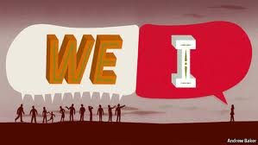

Slide 8
Culture Is Compulsory

Slide 9
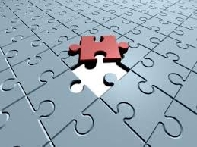
Culture Is Essential for Social Life

Slide 10
Culture Is Integrated

Slide 11
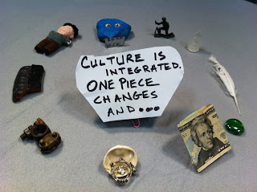
Cultural anthropology offers so many helpful ways to understand why stuff happens the way it does. For example, why can't we just fix the economy and everything will be fine? Because "culture is integrated and when one piece changes..." Well you get the drift.

Slide 12
Culture Is Dynamic
Acculturation :the process by which important changes take place in a culture as a result of contact with another culture

Slide 13
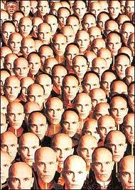
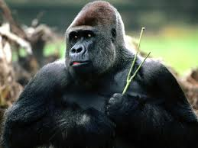
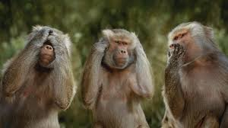
Culture Is Unique to Humans
Humans

Slide 14
The Transmission of Culture
The process of enculturation takes place :through
Symbols
Imitation
Experience
Enculturation: the process by which an individual absorbs the details of his or her particular culture,starting from birth .

Slide 15
Symbols
Symbol:something that stands for something else.

Slide 16
Symbolic anthropology
The anthropological study of symbols is called symbolic anthropology.
Symbolic anthropologists sometimes focus on the use of just one symbol, such as the evil eye ,either within a single culture or cross-culturally

Slide 17
Symbolic:
All over the world right symbolizes goodness and strength whereas left represents the opposite.Thus in cultures in which greetings take the form of handshakes,the right hand is used ,never the left.

Slide 18
Types of Culture
Material culture
Non Material culture
Ideal culture
Real culture

