Slide 1
Advanced TOC
Kleen’s Theorem

Slide 2
Kleene’s Theorem
If a language can be expressed by FA or TG or RE then it can also be expressed by other two as well. It may be noted that the theorem is proved, proving the following three parts
Kleene’s Theorem Part I
If a language can be accepted by an FA then it can be accepted by a TG as well.
Kleene’s Theorem Part II
If a language can be accepted by a TG then it can be expressed by an RE as well.
Kleene’s Theorem Part III
If a language can be expressed by a RE then it can be accepted by an FA as well.

Slide 3
Proof(Kleene’s Theorem Part I)
Since every FA can be considered to be a TG as well, therefore there is nothing to prove.

Slide 4
Proof(Kleene’s Theorem Part II)
To prove part II of the theorem, an algorithm consisting of different steps, is explained showing how a RE can be obtained corresponding to the given TG. For this purpose the notion of TG is changed to that of GTG i.e. the labels of transitions are corresponding REs. Basically this algorithm converts the given TG to GTG with one initial state along with a single loop, or one initial state connected with one final state by a single transition edge. The label of the loop or the transition edge will be the required RE

Slide 5
Step 1
If a TG has more than one start states, then introduce a new start state connecting the new state to the old start states by the transitions labeled by Λ and make the old start states the non-start states. This step can be shown by the following example

Slide 6
Step 2:
If a TG has more than one final states, then introduce a new final state, connecting the old final states to the new final state by the transitions labeled by Λ. This step can be shown by the previous example of TG, where the step 1 has already been processed

Slide 7
Step 3:
If a state has two (more than one) incoming transition edges labeled by the corresponding REs, from the same state (including the possibility of loops at a state), then replace all these transition edges with a single transition edge labeled by the sum of corresponding REs. This step can be shown by a part of TG in the following example

Slide 8
Step 4 (bypass and state elimination)
If three states in a TG, are connected in sequence then eliminate the middle state and connect the first state with the third by a single transition (include the possibility of circuit as well) labeled by the RE which is the concatenation of corresponding two REs in the existing sequence. This step can be shown by a part of TG in the following example

Slide 9
Union of two FAs
Using the FAs corresponding to r1 and r2 an FA can be built, corresponding to r1+ r2 . This method can be developed considering the following examples

Slide 10
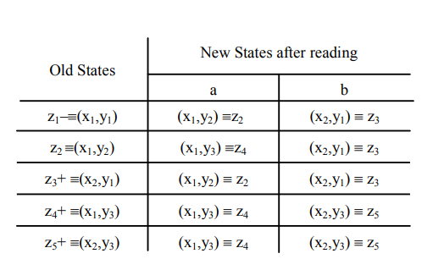
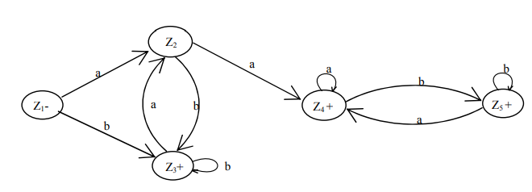
RE corresponding to the above FA may be r1+r2 = (a+b)* b + (a+b )* aa(a+b )* .

Slide 11
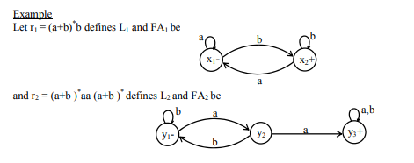
Method2 (Concatenation of two FAs):
Using the FAs corresponding to r1 and r2, an FA can be built, corresponding to r1r2. This method can be developed considering the following examples

Slide 12
Let FA3 be an FA corresponding to r1r2, then the initial state of FA3 must correspond to the initial state of FA1 and the final state of FA3 must correspond to the final state of FA2 .Since the language corresponding to r1r2 is the concatenation of corresponding languages L1 and L2, consists of the strings obtained, concatenating the strings of L1 to those of L2 , therefore the moment a final state of first FA is entered, the possibility of the initial state of second FA will be included as well. Since, in general, FA3 will be different from both FA1 and FA2, so the labels of the states of FA3 may be supposed to be z1,z2, z3, …, where z1 stands for the initial state. Since z1 corresponds to the states x1, so there will be two transitions separately for each letter read at z1. It will give two possibilities of states which correspond to either z1 or different from z1 . This process may be expressed in the following transition table for all possible states of FA3

Slide 13
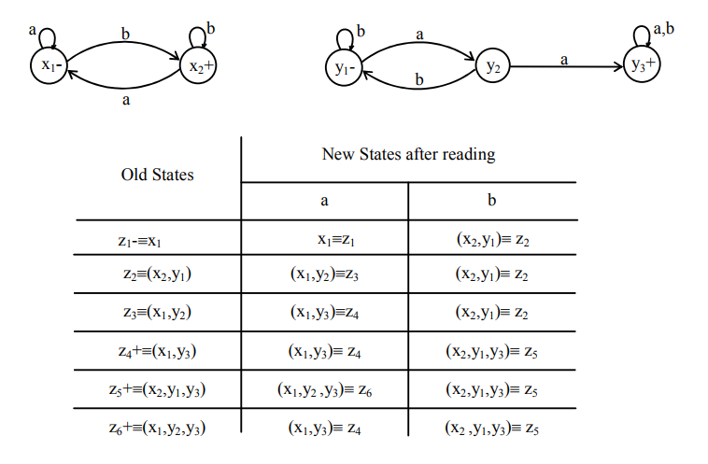

Slide 14
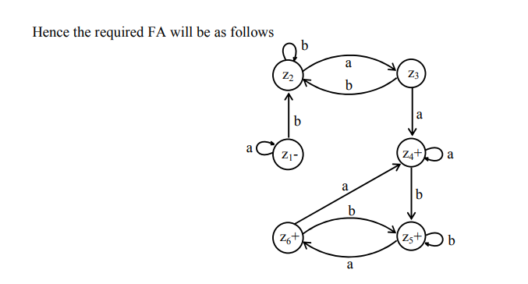

Slide 15
Method3: (Closure of an FA)
Building an FA corresponding to r* , using the FA corresponding to r. It is to be noted that if the given FA already accepts the language expressed by the closure of certain RE, then the given FA is the required FA. However the method, in other cases, can be developed considering the following examples Closure of an FA, is same as concatenation of an FA with itself, except that the initial state of the required FA is a final state as well. Here the initial state of given FA, corresponds to the initial state of required FA and a non final state of the required FA as well.

Slide 16
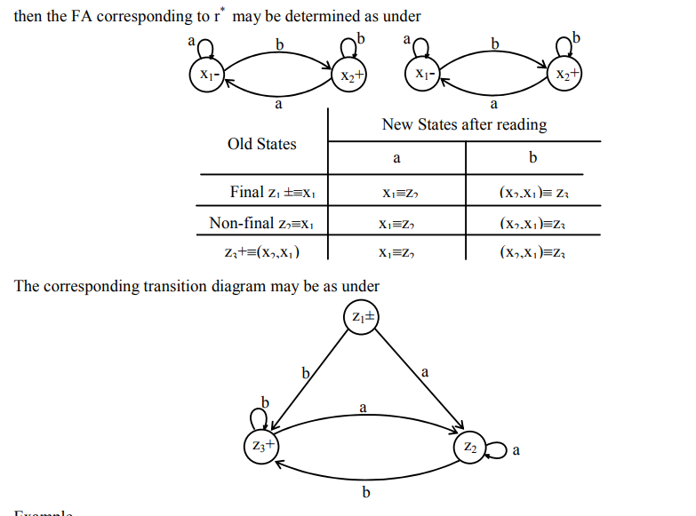

Slide 17
Example Consider the following FA, accepting the language of strings with b as second letter

Slide 18
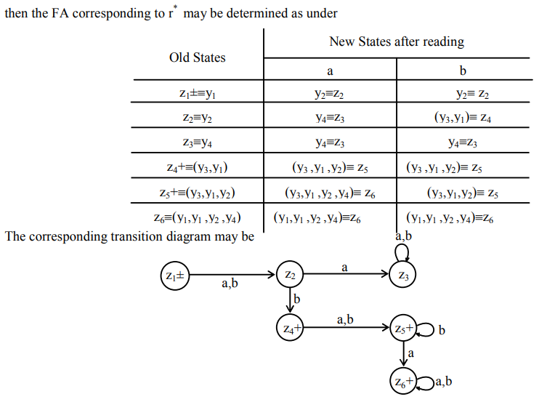

Slide 19
NFA to FA
Method 1: Since an NFA can be considered to be a TG as well, so a RE corresponding to the given NFA can be determined (using Kleene’s theorem). Again using the methods discussed in the proof of Kleene’s theorem, an FA can be built corresponding to that RE. Hence for a given NFA, an FA can be built equivalent to the NFA. Examples have, indirectly, been discussed earlier.

Slide 20
Method 2: Since in an NFA, there may be more than one transition for a certain letter and there may not be any transition for certain letter, so starting from the initial state corresponding to the initial state of given NFA, the transition diagram of the corresponding FA, can be built introducing an empty state for a letter having no transition at certain state and a state corresponding to the combination of states, for a letter having more than one transitions. Following are the examples

Slide 21
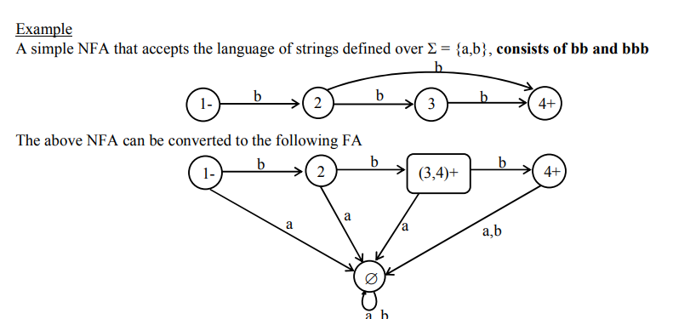

Slide 22
Method 3: As discussed earlier that in an NFA, there may be more than one transition for a certain letter and there may not be any transition for certain letter, so starting from the initial state corresponding to the initial state of given NFA, the transition table along with new labels of states, of the corresponding FA, can be built introducing an empty state for a letter having no transition at certain state and a state corresponding to the combination of states, for a letter having more than one transitions. Further examples are discussed in the next lecture.

Slide 23
