Slide 1
Lecture 1
Introduction to HCI

Slide 2
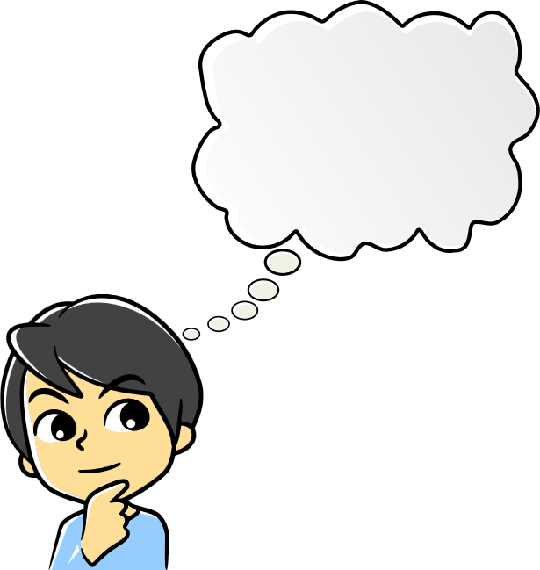
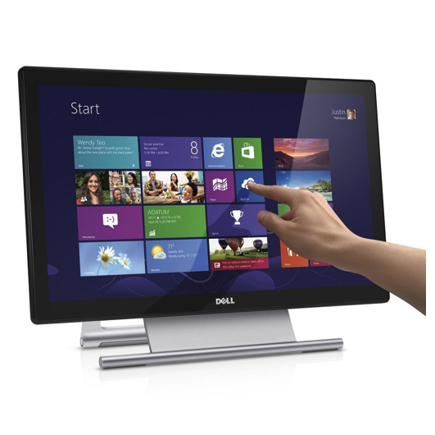
Human
????????
Computer

Slide 3
Why to study?
Social Science
Cognitive Science
Why user experience matters?
Why design matters?
USER VS DEVELOPER
Human-Human Interaction
HCI
Computer Science
Psychology

Slide 4
The Human
Sensors/IO Terminals
  Eyes, Ears, Haptics, parts for movement
Memory
  Sensory, Short term, Long Term
Processor
    Human Brain
Emotions Influences human capabilities
Each person is different.

Slide 5
Vision
Two Stages
  Physical perception of the stimulus
  Processing and Interpretation of Stimulus.
Eye- Physical Preceptor
  Light hits an object and reflect backs. This causes formation of real image (Upside down) over retina.
  Further more retina has rods for low light vision and cons color.
  Ganglion cell detects pattern and movement.

Slide 6
Vision
Size and Depth
  Visual angel
    Relates to size and distance of object
  Visual Acuity
    Ability to perceive the details
Brightness
  Depends on luminance of object
  Increases acuity to certain level
Color
  Three components: Hue, intensity and saturation
  Cones are sensitive to wavelength of color
  Blue has lowest acuity

Slide 7
Vision
Vision system compensates for:
  Movement
  Change in luminance
Over compensation results in optical Illusion

Slide 8

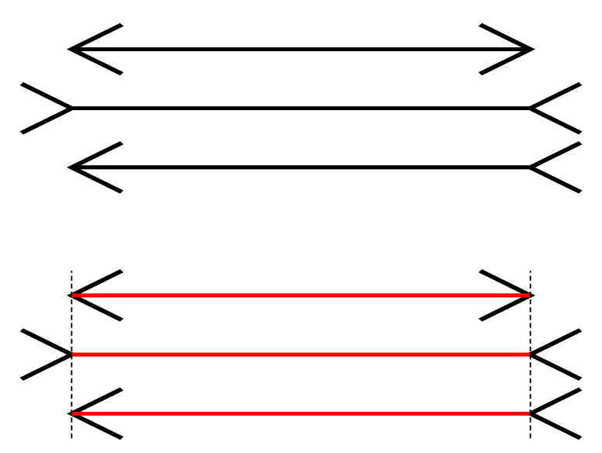
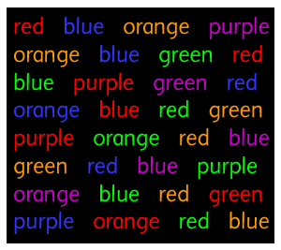
Optical Illusion
Ponzo Illusion
Muller Lyer illusion
Textual Illusions
The quick brown fox jumps over the the lazy dog. The quick brown fox jumps over the lazy dog. The quick brown fox jumps over the lazy dog. The
The quick brown fox jumps over the lazy dog.
FINISHED FILES ARE THE RE
SULT OF YEARS OF SCIENTI
FIC STUDY COMBINED WITH
THE EXPERIENCE OF YEARS.

Slide 9
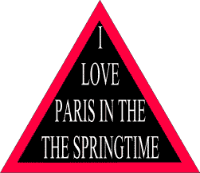

Optical illusions

Slide 10
Optical illusions

Slide 11
Hearing
Physical apparatus
  Outer Ear (Protects inner ear and amplifies the sound)
  Middle Ear (Transmit sound waves as vibrations to the inner ear )
  Inner Ear (Chemical transmitters are released and causes impulses in auditory nerve )
Sound
  Pitch
  Loudness

Slide 12
Hearing
Humans can hear sound of 20 Hz to 20,000 Hz.
Auditory System filters sound
  Can attend to sounds over background noise

Slide 13
Touch
Provides feedback about environment
Can be key sense for visually impaired people.
Stimulus received via receptors
  Thermoreceptors (Heat and cold )
  Nociceptors (Pain)
  Mechanoreceptors (Pressure)
Some areas are more sensitive to others.

Slide 14
Movement
Time taken to response to stimulus:
    Reaction time + movement time
Movement time depends on age and fitness.
Reaction time depends on stimulus type.

Slide 15
Memory
Sensory Memory (Raw)
  Buffers for stimulus received
    Iconic (visual)
    Echioc (auditory)
    Haptic (Touch)
Short term memory
  Scratch Pad for temporary recall. It has fast decay rate.
    Examples: 126kl58ww90164pp527o674r3
Long term memory (Structured)
  Repository for all our knowledge with unlimited capacity and slow decay rate.
  Types:
    Episodic
    Semantic

Slide 16
Memory
LTM- Storage of information
  Rehearsal (Info moves from STM to LTM)
  Total time hypothesis (Amount retained per time frame)
  Practice
  Structure, meaning and familiarity
LTM- Forgetting
  Decay (Information is lost gradually but slowly)
  Interference
LTM- Retrieval
  Recall (Clues, images etc.)
  Recognition

Slide 17
Thinking
Reasoning
  Deductive Reasoning (General to Specific)
  Inductive Reasoning (Specific to General)
Problem Solving
  Process of finding solutions to unfamiliar tasks
  Problem solving involves moving from state to state and performing actions.
  Examples:
    Puzzles Solving
    Trying to solve a physics numerical

Slide 18
Errors
Slips:
  Right intentions, but failed to do
  Cause: poor skills
Mistakes
  Wrong intentions
  Cause: incorrect understanding

Slide 19
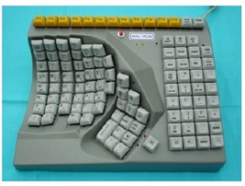
Computers
Computer and its components
Why to have knowledge about computer?
What is interactivity?
        Batch processing vs interactive processing?
        Is faster always better?
Why Position of buttons on various devices matters?
Why trackball if there is mouse?
Hmmmm there are foot mouse too. Do we really need such?
Maltron left handed keyboard

Slide 20
Computers
Why prefer laser printer over dot matrix?
Why standard text use?

Slide 21
What is Design?
Concerns with:
      Goals
      Constraints
      Tradeoffs
Golden Rule
        Understand you material.
        What comes in material?
        Treat user as a physical material. Bcz user behaves under stress.

Slide 22
Good Design Vs. Bad Design

Slide 23
Bad Design
What is wrong with the remote on the right?
Why is the TV remote so much better designed?
  Peanut shaped to fit in hand
  Logical layout and color-coded, distinctive buttons
  Easy to locate buttons
More Examples:
Fivers 5 star Display.
The juicero jucer.
Super long drop down lists.
WhatsApp delete message feature.
Windows 8
https://www.interaction-design.org/literature/article/bad-design-vs-good-design-5-examples-we-can-learn-frombad-design-vs-good-design-5-examples-we-can-learn-from-130706#:~:text=Good%20Design%3A%205%20Examples%20We%20can%20Learn%20From,Friction%20to%20User%20Actions.%20...%20More%20items...%20

Slide 24

Good Design:
Stripes Checkout animation
Elastic Scrolling in iOS
Over-use of animation is curse

Slide 25
Understanding User’s needs:
What the user is good at.
Helping user
Listen to what user want and get them involved
Use tried and tested user centered methods
Use your imaginations.

Slide 26
Keep usability goals in mind.
Effective to use
Efficient to use
Safe to use
Easy to learn
Easy to remember how to use
Self Explainatory

Slide 27
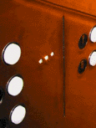
Visibility
• This is a control panel for an elevator
• How does it work?
• Push a button for the floor you want?
• Nothing happens. Push any other button? Still nothing. What do you need to do?
It is not visible as to what to do!
Notes:
<number>
<number>

Slide 28
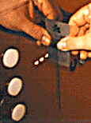
Visibility
…you need to insert your room card in the slot by the buttons to get the elevator to work!
How would you make this action more visible?
• make the card reader more obvious
• provide an auditory message, that says what to do (which language?)
• provide a big label next to the card reader that flashes when someone enters
• make relevant parts visible
• make what has to be done obvious
Notes:
<number>
<number>

Slide 29
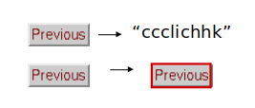
Feedback
Sending information back to the user about what has been done
Includes sound, highlighting, animation and combinations of these
e.g. when screen button clicked on provides sound or red highlight feedback:
Notes:
<number>
<number>

Slide 30
Constraints
Restricting the possible actions that can be performed
Helps prevent user from selecting incorrect options
Physical objects can be designed to constrain things
  e.g. only one way you can insert a key into a lock
Notes:
<number>
<number>

Slide 31
Constraints
Restricting the possible actions that can be performed
Helps prevent user from selecting incorrect options
Physical objects can be designed to constrain things
  e.g. only one way you can insert a key into a lock
Notes:
<number>
<number>

Slide 32
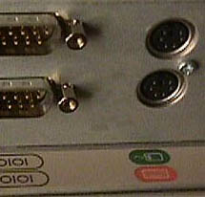
Logical or ambiguous design?
Where do you plug the mouse?
Where do you plug the keyboard?
top or bottom connector?
Do the color coded icons help?
Notes:
<number>
<number>

Slide 33


How to design them more logically
(i) A provides direct adjacent mapping between icon and connector
(ii) B provides color coding to associate the connectors with the labels
Notes:
<number>
<number>

Slide 34
Consistency
Design interfaces to have similar operations and use similar elements for similar tasks
For example:
  always use ctrl key plus first initial of the command for an operation – ctrl+C, ctrl+S, ctrl+O
Main benefit is consistent interfaces are easier to learn and use
Notes:
<number>
<number>

Slide 35
When consistency breaks down
What happens if there is more than one command starting with the same letter?
  e.g. save, spelling, select, style
Have to find other initials or combinations of keys, thereby breaking the consistency rule
  e.g. ctrl+S, ctrl+shift+L
Increases learning burden on user, making them more prone to errors
Notes:
<number>
<number>

Slide 36
Internal and external consistency
Internal consistency refers to designing operations to behave the same within an application
  Difficult to achieve with complex interfaces
External consistency refers to designing operations, interfaces, etc., to be the same across applications and devices
  Very rarely the case, based on different designer’s preference
Notes:
<number>
<number>

Slide 37
Keypad numbers layout
A case of external inconsistency
(a) phones, remote controls
(b) calculators, computer keypads
1
2
3
7
8
9
4
5
6
4
5
6
7
8
9
1
2
3
0
0
Notes:
<number>
<number>

Slide 38
Affordance
Affordances are properties of objects which show users the actions they can take.
Users should be able to perceive affordances without having to consider how to use the items.
For instance, a button can be designed to look as if it needs to be turned or pushed.
For instance, a chair affords sitting on, standing on, throwing, etc.
Notes:
<number>
<number>

Slide 39
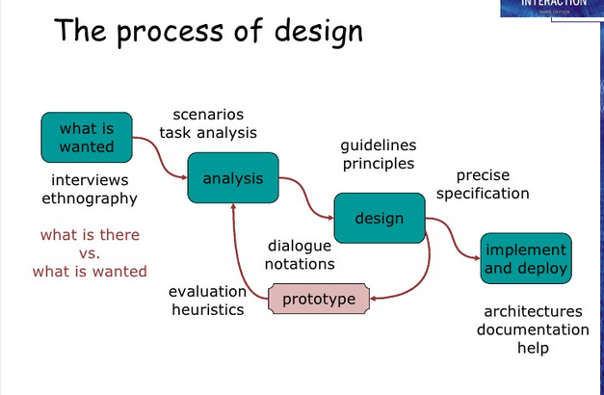
Process of Design:

