Slide 2
REACTION MECHANISM:
Organic Reaction Mechanism:

Slide 3
CANNIZARO REACTION

Slide 4
Arndt-Eistert reaction,
Baeyer-Villiger oxidation,
Diels Alder reaction;
Grignard’s reaction,
Metal Hydride reduction and
Wolff Kishner reduction,
Friedel Craft’s reaction,
Perkin reaction,
Cannizzaro’s reaction,
Mannich reaction

Slide 5
Cannizzaro’s reaction

Slide 6
The Cannizzaro reaction, named after its discoverer Stanislao Cannizzaro, is a chemical reaction that involves the base-induced disproportionation of an aldehyde lacking a hydrogen atom in the alpha position.

Slide 8
Cannizzaro first accomplished this transformation in 1853, when he obtained benzyl alcohol and potassium benzoate from the treatment of benzaldehyde with potash (potassium carbonate). More typically, the reaction would be conducted with sodium or potassium hydroxide:
2 C₆H₅CHO + KOH → C₆H₅CH₂OH + C₆H₅COOK
The oxidation product is a salt of a carboxylic acid and the reduction product is an alcohol.

Slide 9
Mechanism
The reaction involves a nucleophilic acyl substitution on an aldehyde, with the leaving group concurrently attacking another aldehyde in the second step.
First, hydroxide attacks a carbonyl. The resulting tetrahedral intermediate then collapses, re-forming the carbonyl and transferring hydride to attack another carbonyl.
In the final step of the reaction, the acid and alkoxide ions formed exchange a proton.
In the presence of a very high concentration of base, the aldehyde first forms a doubly charged anion from which a hydride ion is transferred to the second molecule of aldehyde to form carboxylate and alkoxide ions.
Subsequently, the alkoxide ion acquires a proton from the solvent.

Slide 10
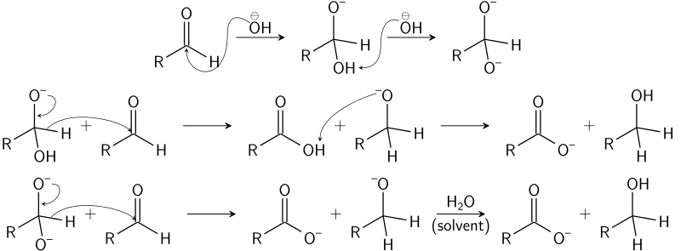
Notes:
The reaction involves a nucleophilic acyl substitution on an aldehyde, with the leaving group concurrently attacking another aldehyde in the second step.
First, hydroxide attacks a carbonyl. The resulting tetrahedral intermediate then collapses, re-forming the carbonyl and transferring hydride to attack another carbonyl.
In the final step of the reaction, the acid and alkoxide ions formed exchange a proton.
In the presence of a very high concentration of base, the aldehyde first forms a doubly charged anion from which a hydride ion is transferred to the second molecule of aldehyde to form carboxylate and alkoxide ions.
Subsequently, the alkoxide ion acquires a proton from the solvent.

Slide 11
Scope
Due to the strongly alkaline reaction conditions, aldehydes that have alpha hydrogen atom(s) instead undergo deprotonation there, leading to enolates and possible aldol reactions.
Under ideal conditions the reaction produces only 50% of the alcohol and the carboxylic acid (it takes two aldehydes to produce one acid and one alcohol). To avoid the low yields, it is more common to conduct the crossed Cannizzaro reaction, in which a sacrificial aldehyde is used in combination with a more valuable chemical. In this variation, the reductant is formaldehyde, which is oxidized to sodium formate and the other aldehyde chemical is reduced to the alcohol. In this scenario, each of the two separate aldehydes can be converted completely to its corresponding product rather than losing 50% of a single reactant to each of two different products. Thus, the yield of the valuable chemical is high, although the atom economy is still low.
A solvent-free reaction has been reported involving grinding liquid 2-chlorobenzaldehyde with potassium hydroxide in a mortar and pestle:

