Slide 1

Chapter Two Strategic Training

Slide 2
Objectives
O Discuss how business strategy influences the type and amount of training in a company
O Describe the strategic training and development process
O Discuss how a company’s staffing and human resource planning strategies influence training

Slide 3
Objectives
O Explain the training needs created by concentration, internal growth, external growth, and disinvestment business strategies
O Discuss the advantages and disadvantages of centralizing the training function
O Explain a corporate university and its benefits

Slide 4
Objectives
O Discuss the strengths of a business- embedded learning function
O Discuss how to create a learning or training brand and why it is important
O Develop a marketing campaign for a training course or program

Slide 5
Training is Strategic
O Training can have both a direct an indirect impact on organizational success
O Business strategy will shape the training function
o Strategic impacts what gets trained, who gets training, and how much training is valued
O The role of training is evolving

Slide 6
The Learning Organization
O A company that has:
o an enhanced capacity to learn, adapt, and change
o carefully scrutinized and aligned training processes with company goals
o training as a part of a system designed to create human capital

Slide 7
4 Steps of Strategic Training
O Identify the organization’s business strategy
O Determine strategic training initiatives
O Translate initiatives into concrete learning activities
O Identify metrics and evaluate

Slide 8
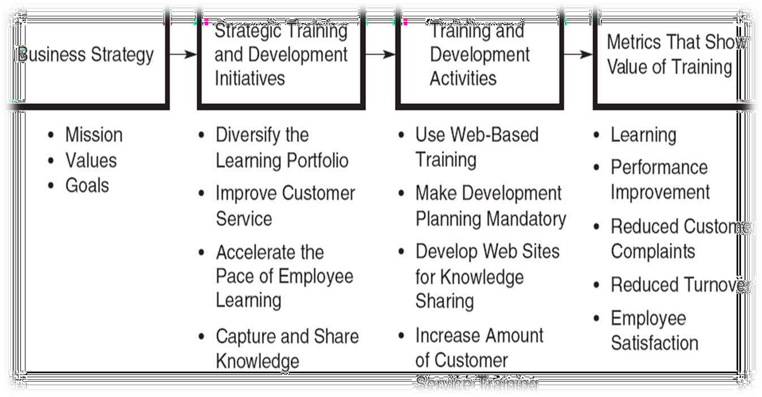
The Strategic Process

Slide 9
1. Identify Business Strategy
O Determine the company’s mission
O Establish goals
O Perform a SWOT—strengths, opportunities, weakness, and threats
O Determine strategic choice

Slide 10
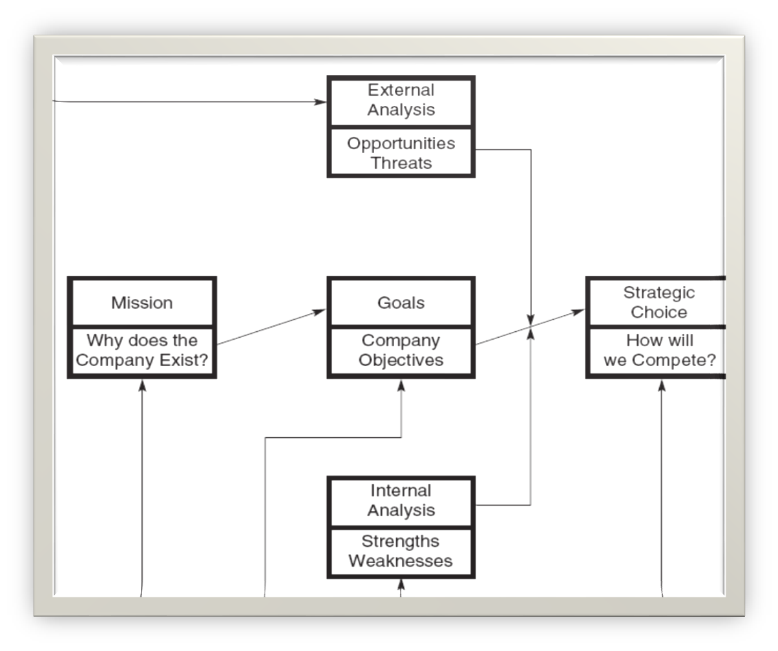
Formulating Business Strategy

Slide 11
2. Determine Strategic Initiatives
O Learning-related actions that a company should take to achieve its business strategy
O A road map to guide specific training activities
O Avoid the disconnect between strategy and execution

Slide 12
Common Strategic Initiatives
O Diversify the learning portfolio
O Expand who is trained
O Accelerate the pace of learning
O Improve customer service
O Capture and share knowledge
O Ensure the work environment supports learning and transfer of training

Slide 13
Questions to Ask
O What is the vision and mission?
O What capabilities are critical for success?
O What types of training will best attract, develop, and retain employees?
O Is there a plan to communicate the link between training and strategy?
O Does senior management support training?

Slide 14
3. Translate Initiatives to Activities
O The next step is to determine specific, concrete activities that align with strategic initiatives
O Such activities will vary based on the initiatives that were developed

Slide 15
4. Identify Metrics & Evaluate
O The final step is to determine if training investments were successful
O Strategic training evaluation is not intended to evaluate the effectiveness of an isolated program, but a set of training activities
O The business-related outcomes examined should be directly linked to strategy and goals

Slide 16
Balanced Scorecard
O Customer (time, quality, performance, service, cost)
O Internal business processes (processes that influence customer satisfaction)
O Innovation and learning (operating efficiency,
employee satisfaction, continuous improvement)
O Financial (profitability, growth, shareholder value)

Slide 17
Organizational Characteristics
Roles of employees and managers
Top management support
Integration of business units
Global presence
Business conditions
Other HRM practices
Strategic value of jobs and employee uniqueness
Unionization
Staff involvement

Slide 18
Roles of Employees & Managers
O Employees now performing roles once reserved for management
O Given the prevalence of teams, employees require more cross-training and interpersonal skills training
O Managers’ jobs are highly complex, requiring greater skill and training

Slide 19
Top Management Support
O Set a clear direction for learning
O Provide encouragement and resources
O Take an active role in governing learning
O Develop and teach new programs
O Serve as a role model
O Promote learning through different channels

Slide 20
Integration of Business Units
O Integration of business units affects the approach to training
O In a highly integrated business, employees need to understand all parts of the company, and training must address those needs

Slide 21
Global Presence
O For companies with global operations, training is needed to prepare employees for overseas assignments
O Companies must decide if training will be coordinated through a central U.S. facility or through satellite locations

Slide 22
Business Conditions
O With low unemployment, it’s difficult to find top talent
O In unstable environments, training may become short-term
O When there is growth, training will be in high demand

Slide 23
Business Conditions
O When trying to revitalize and redirect, there are fewer incentives for training
O When downsizing, training may focus on continued employability

Slide 24
Staffing Strategy & Training
O Fortress—limited resources for training; recruit from the outside
O Baseball team—creativity needed; recruit from other companies or new graduates
O Club—highly regulated industries; develop own talent
O Academy—specialized skills; heavy focus on developing employees

Slide 25
Strategic Value & Uniqueness
O Knowledge-based workers—heavy training
O Job-based employees—less training than knowledge workers
O Contract employees—limited training
O Alliance/partnerships—sharing expertise and team training

Slide 26
Extent of Unionization
O Presence of a union leads to joint union- management programs for preparing employees for jobs
O Given that unions have a significant impact on HRM practices, they must be involved in determining strategic training priorities
O Collaboration is key

Slide 27
Staff Involvement
O Managers need to be involved so training links to business needs and transfer can be supported
O Managers will be more involved if they are rewarded for doing so
O +
O Employees now assume greater responsibility for planning their own development

Slide 28
Training in Different Strategies
O Concentration Strategy
o Skill currency and the development of the existing workforce
O Internal Growth Strategy
o Creation of new jobs and tasks, innovation, and talent management

Slide 29
Training in Different Strategies
O External Growth Strategy
o Integration, redundancy, and restructuring
O Disinvestment Strategy
o Efficiency

Slide 30
Centralized Training
O There are several advantages:
o Stronger alignment with strategy
o Common set of metrics or scorecards to evaluate training
o Streamlined processes
o Better integration of programs to develop leaders
o Easier to manage talent during times of change

Slide 31
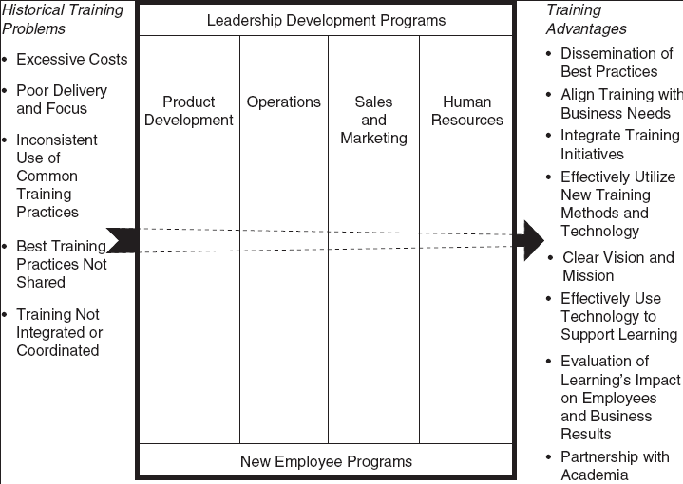
Corporate University Model

Slide 32
Corporate University Model
O There are several advantages :
o Dissemination of best practices
o Alignment of training with business needs
o Integration of training initiatives
o Effective use of new technology and methods
o Clear vision and mission
o Evaluation of learning focused on employee and business results
o Partnership with academia

Slide 33
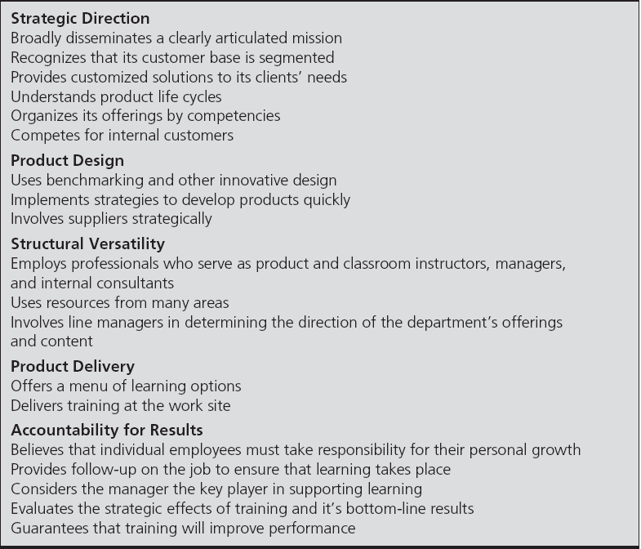
Business-Embedded Function

Slide 34
Change Model Perspective
O Four change-related problems need to be addressed before the implementation of any new training practice.
o Resistance to change
o Loss of control
o Power imbalance
o Task redefinition challenges

Slide 35
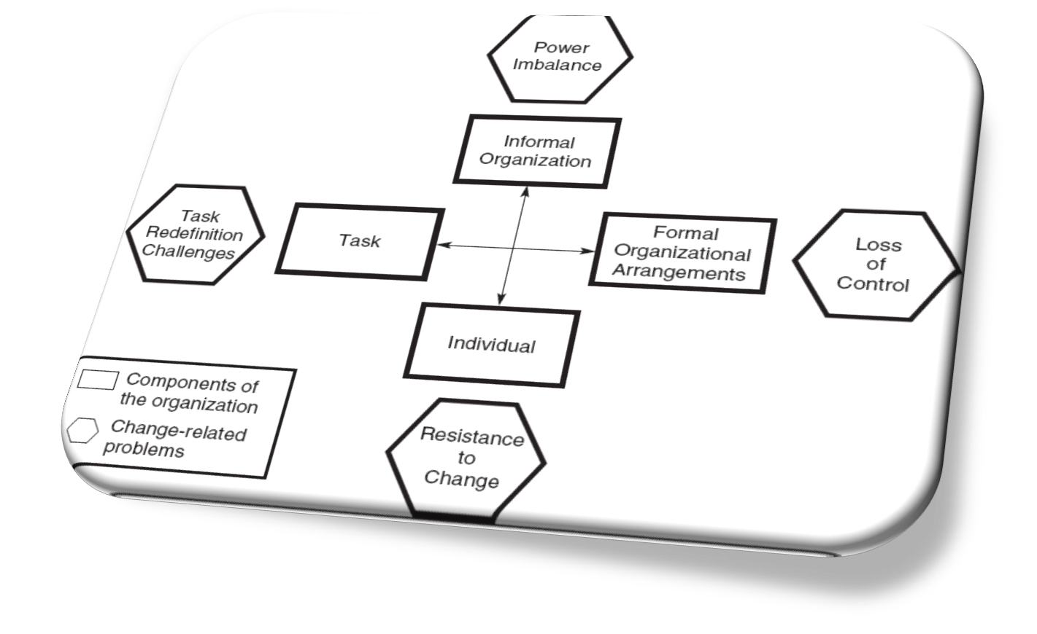
A Change Model

Slide 36
Marketing Training
O Despite its value, some individuals may not necessarily value training
O Training often needs to be marketed so key constituents value learning
O Internal marketing involves making employees and managers excited about training and learning

Slide 37
Internal Marketing Tactics
O Involve the target audience
O Demonstrate how training can solve business problems
O Show examples of previous successes
O Identify a “champion” who supports training
O Advertise through multiple channels
O Speak in terms employees understand

Slide 38
Outsourcing Training
O Reasons for outsourcing:
o Cost savings
o Time savings that allow a company to focus on business strategy
o Improvements in compliance with regulatory training
o Lack of internal capability to meet learning demands
o Desire to access best training practices

Slide 39
Be Strategic
O Outsourcing may not necessarily be the solution
O Be sure to consider:
o the skill set in question
o resources and expertise
o desire for control
o the quality of the potential vendor
o the importance of training in the organization

