Slide 1

Chapter One Introduction to
Training & Development

Slide 2
Objectives
O Discuss the forces influencing the workplace and learning and explain how training can help companies deal with these forces
O Draw a figure or diagram and explain how training, development, informal learning, and knowledge management contribute to business success
O Discuss various aspects of the training design process

Slide 3
Objectives
O Describe the amount and types of training occurring in U.S. companies
O Discuss the key roles for training professionals
O Identify appropriate resources for learning about training research and practice

Slide 4
Importance of Training
O There are many challenges and opportunities in the workplace today
O Training equips individuals with necessary knowledge, skills, and abilities
O Training serves to attract employees to companies, engages, them, and promotes retention
O Training helps to create a competitive advantage

Slide 5
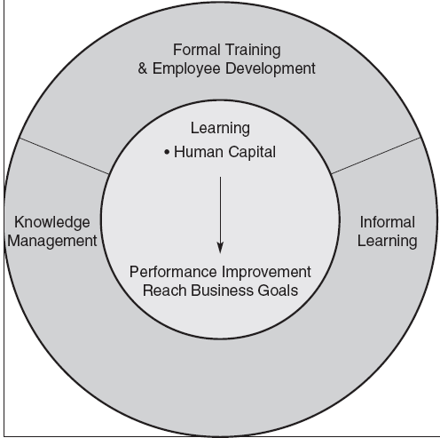
Key Components of Learning

Slide 6
Key Components of Learning
O Learning
o Acquiring knowledge, skills, competencies, attitudes, or behaviors
O Human Capital
o Knowledge
o Advanced skills
o System understanding and creativity
o Motivation to deliver high-quality products and services

Slide 7
Key Components of Learning
O Training
o Facilitates learning job-related competencies, knowledge, skills or behavior
O Development
o Future focused—includes formal education, job experiences, relationships, and assessments
O Formal Training and Development
o Developed and organized by the company

Slide 8
Key Components of Learning
O Informal learning
o Learner initiated
o Occurs without a trainer or instructor
o Motivated by an intent to develop
o Does not occur in a formal learning setting
o Breadth, depth, and timing is controlled by the employee

Slide 9
Key Components of Learning
O Explicit Knowledge
o Well documented, easily articulated, and easily transferred from person-to-person
o Primary focus of formal training
O Tacit Knowledge
o Personal knowledge based on individual experiences that is difficult to codify
o Facilitated by informal learning

Slide 10
Key Components of Learning
O Knowledge Management
o Tools, processes, systems, structures, and cultures to improve the creation, sharing, and use of knowledge

Slide 11
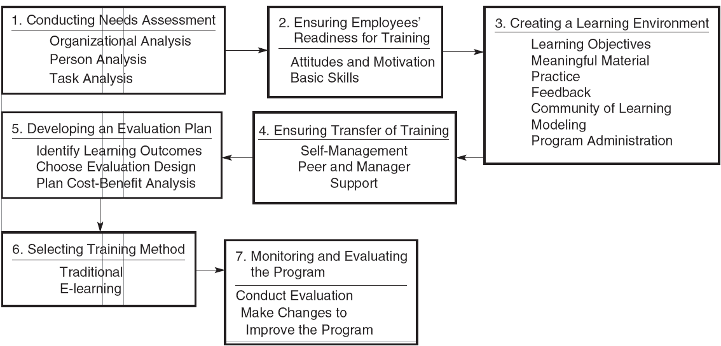
Systematic Training Design

Slide 12


Analysis
Evaluation
Design
ADDIE
Implementation
Development

Slide 13
Questions
O Why is it important to systemically design training?
O What are the limitations of the ISD and ADDIE models?
O What should you do in practice?

Slide 14
Forces Impacting Learning
O Economic cycles
O Globalization
O Value of intangible assets and human capital
O Focus on links to business strategy
O Changing demographics and diversity
O Generational differences
O Talent management
O Customer service and quality emphasis
O New technology
O High-performance models of work systems
Copyright © 2017 McGraw-Hill Education. All rights reserved. No reproduction or distribution without the prior written consent of McGraw-Hill Education.

Slide 15
Economic Cycles
O In difficult times, companies may be tempted to reduce training expenditures
O However, doing so may be detrimental
O For example, companies that used more selective staffing and training before the recession of 2009 performed better and recovered more quickly

Slide 16
Globalization
O Global companies must find talented employees
O Expatriates require training for success
O Individuals from different countries come to the U.S. for low-skill work and highly technical positions
O There are pros and cons of outsourcing

Slide 17
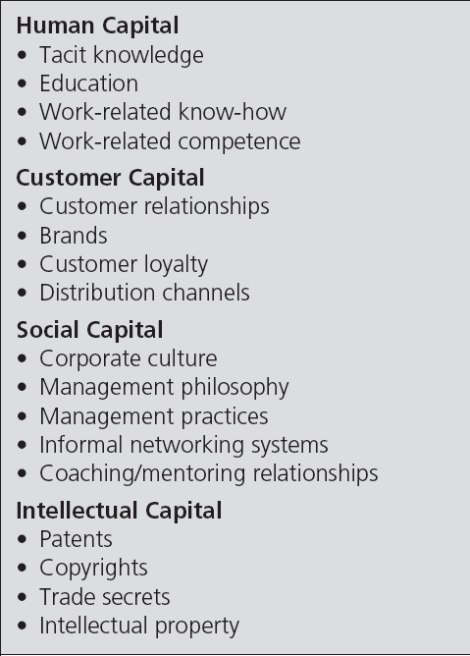
Intangible Assets

Slide 18
Implications
O Knowledge workers are becoming more important
O A greater focus on employee engagement is needed
O There is an increasing need for companies to become “learning organizations”

Slide 19
Links to Business Strategy
O Given the importance of intangible assets and human capital, training has greater strategic importance
O Training is no longer an isolated function, but rather an integral part of business success
O Different companies have different strategic training needs—one size does not fit all

Slide 20
Racial and Ethnic Diversity
O The U.S. labor force will continue to grow more racially and ethnically
O The projected annual growth rates are higher for Hispanics and “other groups” than for African Americans
O By 2022, the workforce is projected to by 78% Caucasian

Slide 21
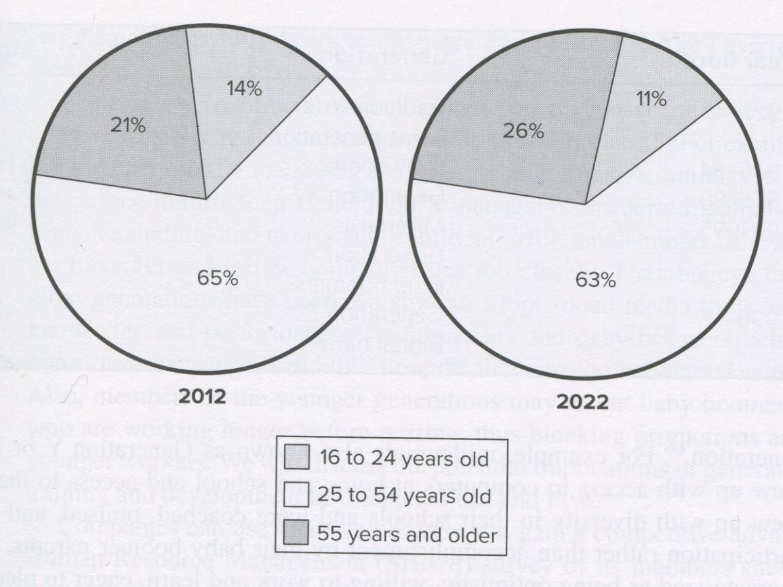
The Aging Workforce

Slide 22
Five Generations at Work in 2022
O Traditionalist O Baby Boomers O Generation X
O Generation Y—Millennials
O Generation Z—Digital Natives

Slide 23
Managing Diversity
O Communicating effectively
O Coaching, training, and developing
O Providing performance feedback that is free of stereotypes
O Recognizing and responding to generational differences
O Allowing employees of all backgrounds to be creative and innovative

Slide 24
Talent Management
O Systematic, planned, and strategic effort by a company to attract, retain, develop, and motivate highly skilled talent
O Key components
o acquiring and assessing employees
o learning and development
o performance management and compensation

Slide 25
Talent Management
O It’s important for a number of reasons:
o Changes in demand for certain occupations and jobs
o Cognitive and interpersonal skill requirements
o Anticipated retirement of baby boomers
o Developing managerial talent

Slide 26
Service & Quality Emphasis
O Total Quality Management (TQM)
o Companywide effort to continuously improve the ways people, machines, and systems accomplish work
O Quality Standards
o Malcolm Baldrige National Quality Award
o ISO 9000:2000

Slide 27
Baldrige Award Criteria
O Leadership
O Measurement, analysis, and knowledge management
O Strategic planning
O Workforce focus O Operational focus O Results
O Customer focus

Slide 28
Service & Quality Emphasis
O Six Sigma
o Measuring, analyzing, improving, and then controlling processes once they have been brought within the narrow six sigma quality tolerances or standards

Slide 29
New Technology
O Technology has changed how we train
O Training can occur at any time, anywhere
O Training is more consistent and more realistic
O More individuals can now be trained O Knowledge can be shared by readily O Trainers roles have evolved
O Many organizations used blended training methods

Slide 30
Challenges with New Technology
O Not all trainees may be comfortable with technology
O It may be difficult to engage trainees and ensure compliance with training
O Some trainees may desire greater “live” interaction with trainers

Slide 31
High Performance Systems
O Work teams
o Employees interact to assemble a product or provide a service
O Cross training
o Training employees in a range of skills to fill roles needed to be performed
O Virtual teams
o Teams separated by time, geographic, and organizational boundaries

Slide 32
Snapshot of Training Practices
O Direct expenditures have remained stable
O Increased demand for specialized learning that includes professional or industry- specific content
O Use of technology-based learning has increased
O Self-paced online learning is the most common technology-based learning

Slide 33
Snapshot of Training Practices
O Technology-based learning has helped improve learning efficiency
O Technology-based learning has resulted in a larger employee–learning staff member ratio
O The percentage of services distributed by external providers has remained the same since 2010

Slide 34
BEST Award Winners
O Training supports business strategy
O Visible support from top management
O Efficiency in training
O All employees with access to training on an as-needed basis
O Variety of learning opportunities
O Measurement of training effectiveness
O Use of non-training solutions

Slide 35
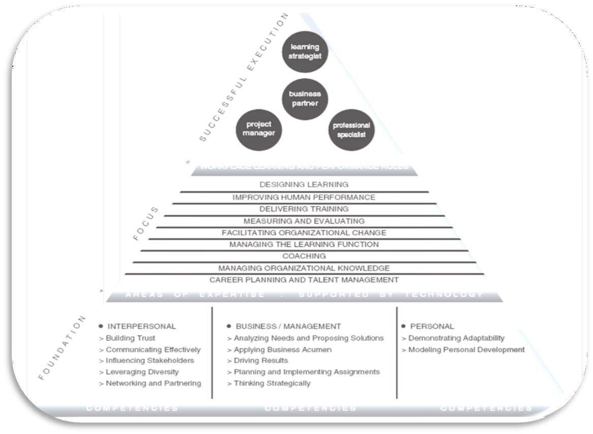
ATD Competency Model

Slide 36
Training Roles
O Learning Strategist
o Determines how learning can be used to align with business strategy
O Business Partner
o Uses business knowledge and industry expertise to create training that improves performance

Slide 37
Training Roles
O Project Manager
o Plans and monitors delivery of learning and performance solutions to support the business
O Professional Specialist
o Designs, develops, delivers, and evaluates learning and performance systems

Slide 38
Professional Associations
O Association for Talent Development (ATD)
O Academy of Human Resource Development (AHRD)
O Society for Human Resource Management (SHRM)
O Society for Industrial and Organizational Psychology (SIOP)
O Academy of Management (AOM)
O International Society for Performance Improvement (ISPI)

