Slide 1
ANTI-ARRYTHMIC DRUGS
Dr.Taseer Ahmad

Slide 2
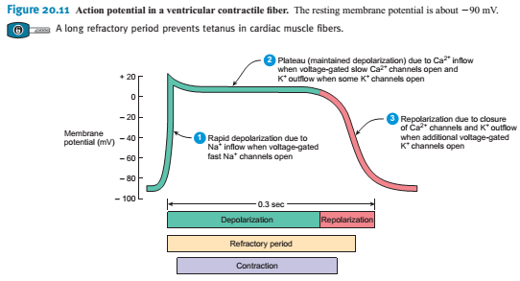

Slide 3
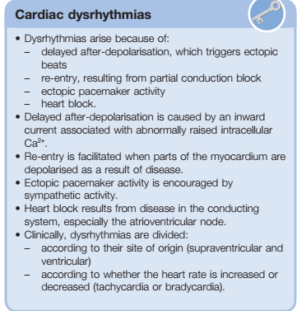

Slide 5
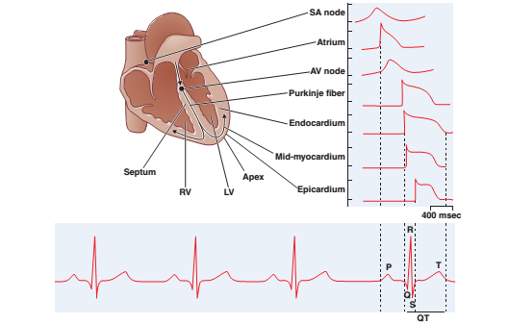

Slide 6
Notes:
Trevor and katzang

Slide 7
Notes:
Trevor and katzang

Slide 8
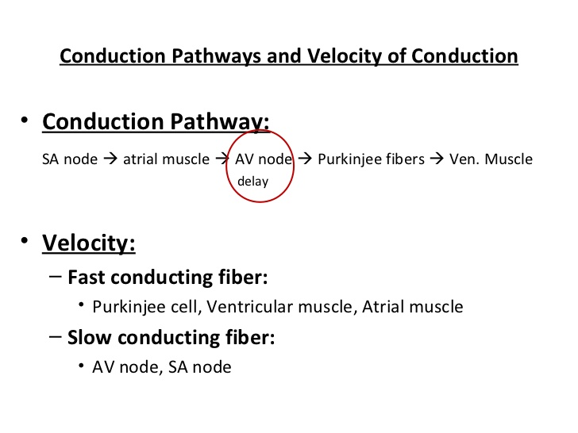

Slide 9
Refractory period
In physiology, refractory period is a period of time during which an organ or cell is incapable of repeating a particular action, or (more precisely) the amount of time it takes for an excitable membrane to be ready for a second stimulus once it returns to its resting state following an excitation.

Slide 10
Remember that in order to generate an action potential, the sodium channels need to open to depolarize the cell to the threshold for action potential firing.
Once the cell is depolarized, these Na⁺ channels are inactive, so no matter how much you stimulate the cell, you can't elicit another action potential. This is absolute refractory period.
Once the cell is repolarized, the cells go from inactive to closed, and an action potential can be generated.
During repolarization via K⁺ channels opening, the cell can hyperpolarize if too much K⁺ leaving the cell.
During this time, since the Na⁺ are closed, you can elicit an action potential if you give a big enough stimulus to open the Na⁺ channel.
However, since hyperpolarized means more negative potential relative to repolarized, a bigger stimulus is needed to elicit a action potential; this is the relative refractory period.

Slide 11
In electrocardiography, during a cardiac cycle, once an action potential is initiated, there is a period of time that a new action potential cannot be initiated.
This is termed the effective refractory period (ERP) of the tissue.
This period is approximately equal to the absolute refractory period (ARP), it occurs due to calcium ion influx During this period, depolarization on adjacent cardiac muscles does not produce a new depolarization in the current cell as it has to refract back to phase 4 of the action potential before a new action potential can activate it.
ERP acts as a protective mechanism and keeps the heart rate in check and prevents arrhythmias, and it helps coordinates muscle contraction. Anti-arrhythmic agents used for arrhythmias usually prolong the ERP.
For the treatment of atrial fibrillation, it is a problem that the prolongation of the ERP by these agents also affects the ventricles, which can induce other types of arrhythmias.

Slide 12
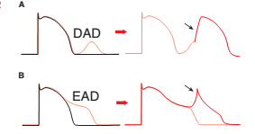
Afterdepolarizations and triggered activity
A. Delayed afterdepolarization (DAD) arising after full repolarization.
B. Early afterdepolarization (EAD) interrupting phase 3 repolarization.

Slide 13
RE-ENTRY
Re-entry occurs when a cardiac impulse travels in a path such as to return to its original site and reactivate the original site and self-perpetuate rapid activation independent of the normal sinus node conduction.
Anatomically Defined Re-entry. Re-entry can occur when impulses propagate by more than one pathway between two points in the heart, and those pathways have heterogeneous electrophysiologic properties.

Slide 14
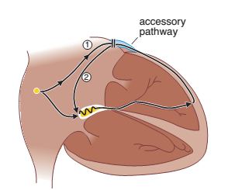
Wolff-Parkinson-White (WPW)
In Wolff-Parkinson-White (WPW) syndrome, an extra electrical pathway between your heart's upper chambers (atria) and lower chambers (ventricles) causes a rapid heartbeat (tachycardia).
Torsades de point: (French term means twist of the points),,a lethal form of ventricular arrythmia

Slide 15
Notes:
By katzan…

Slide 16
Notes:
Atlas of Pharmacology

Slide 18
Notes:
The five main classes in the Vaughan Williams classification of antiarrhythmic agents

Slide 19
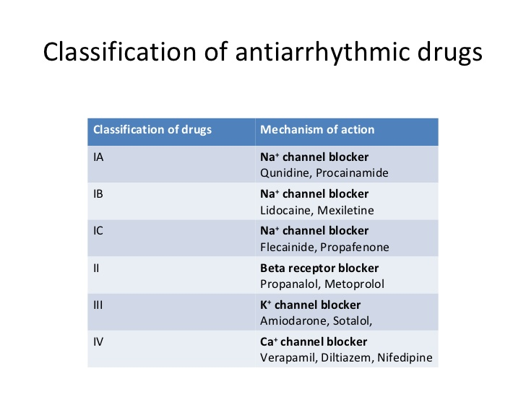

Slide 20
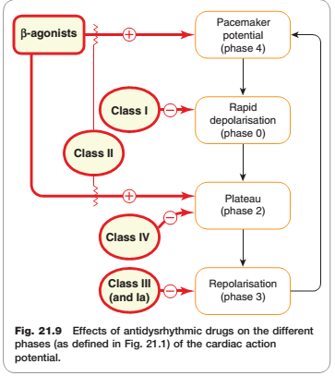

Slide 21
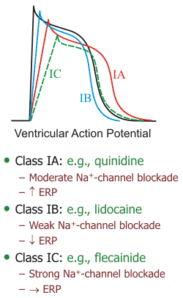
Sodium-channel blockade:
IC > IA > IB
Increasing the ERP:
IA > IC > IB (decreases)
Notes:
Besides affecting phase 0 of action potentials, sodium-channel blockers may also alter the action potential duration (APD) and effective refractory period (ERP). Because some sodium-channel blockers increase the ERP (Class IA), while others decrease the ERP (Class IB) or have no effect on ERP (Class IC), the Vaughan-Williams classification recognizes these differences as subclasses of Class I antiarrhythmic drugs. These effects on ERP are not directly related to sodium channel blockade, but instead are related to drug actions on potassium channels involved in phase 3 repolarization of action potentials. These channels regulate potassium efflux from the cell (K+ out), and therefore repolarization. The drugs in these subclasses also differ in their efficacy for reducing the slope of phase 0, with IC drugs having the greatest and IB drugs having the smallest effect on phase 0 (IA drugs are intermediate in their effect on phase 0).

Slide 22
Drugs may slow automatic rhythms by altering any of the four determinants of spontaneous pacemaker discharge
Decrease phase 4 slope
Increase threshold potential
Increase maximum diastolic potential
Increased action potential duration
Hyperpolarization

Slide 23
Notes:
LIPPENCOT

Slide 24
Notes:
Increasing or decreasing the APD and ERP can either increase or decrease arrhythmogenesis, depending on the underlying cause of the arrhythmia. Increasing the ERP, for example, can interrupt tachycardia caused by reentry mechanisms by prolonging the duration that normal tissue is unexcitable (its refractory period). This can prevent reentry currents from re-exciting the tissue. On the other hand, increasing the APD can precipitate torsades de pointes, a type of ventricular tachycardia caused by afterdepolarizations.

Slide 26
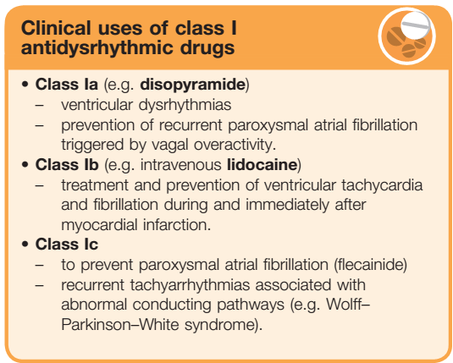
Notes:
Paroxysmal attacks or paroxysms (from Greek παροξυσμός) are a sudden recurrence or intensification of symptoms, such as a spasm or seizure

Slide 27
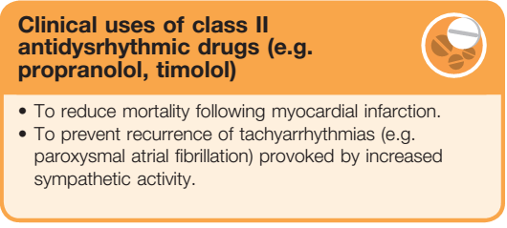
CLASS II ANTIARRHYTHMIC DRUGS
Class II agents are β-adrenergic antagonists, or β-blockers. These drugs;
Diminish phase 4 depolarization
Depress automaticity,
Prolong AV conduction
Decrease heart rate and contractility.
Notes:
Paroxysm..any sudden, violent outburst.. Pathology. a severe attack or a sudden increase in intensity of a disease,

Slide 29
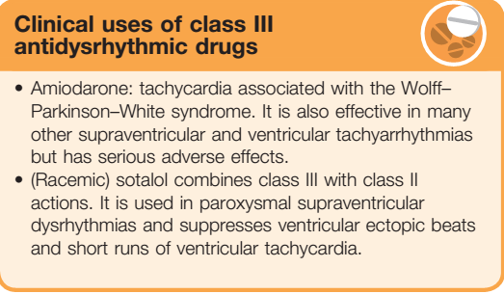

Slide 30
Pharmacokinetics:
Incompletely absorbed after oral administration.
Half-life of several weeks, and it distributes extensively in adipose
tissue.
Full clinical effects may not be achieved until months after
initiation of treatment, unless loading doses are employed.
Adverse effects: Amiodarone shows a variety of toxic effects,
including pulmonary fibrosis, neuropathy, hepatotoxicity, corneal
deposits, optic neuritis, blue-gray skin discoloration, and hypo- or
hyperthyroidism.
However, use of low doses and close monitoring reduce toxicity, while retaining clinical efficacy.
Drug interactions: Amiodarone is subject to numerous drug interactions, since it is metabolized by CYP3A4 and serves as an inhibitor of CYP1A2, CYP2C9, CYP2D6, and P-glycoprotein.

Slide 32
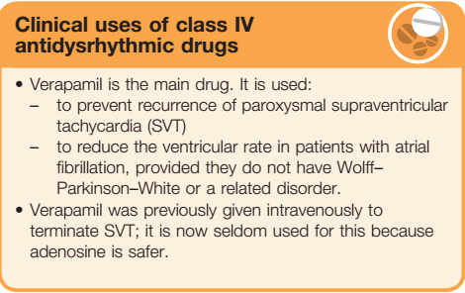

Slide 34
Notes:
Ectopic.. In an abnormal place or position.

Slide 36
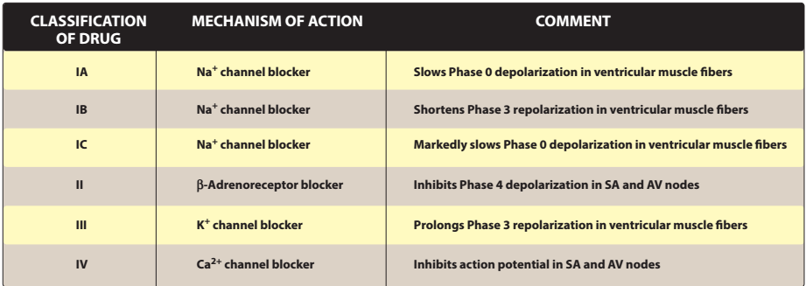

Slide 37
Adenosine
Adenosine is a naturally/ endogenously occurring nucleoside and is an important chemical mediator with effects on breathing, cardiac and smooth muscle, vagal afferent nerves and on platelets, in addition to the effects on cardiac conducting tissue that underlie its therapeutic use.
MOA: The A1 receptor is responsible for its effect on the AV node. These receptors are linked to the same cardiac potassium channel (KACh) that is activated by acetylcholine, and adenosine hyperpolarises cardiac conducting tissue and slows the rate of rise of the pacemaker potential accordingly. at high doses, the drug decreases conduction velocity, prolongs the refractory period, and decreases automaticity in the AV node

Slide 38
Indication:
Intravenous adenosine is the drug of choice for abolishing acute
supraventricular tachycardia. It has largely replaced verapamil for this purpose, because it is safer owing to its effect being short lived
Adverse Effects: It has low toxicity but causes flushing,
chest pain, and hypotension.
PK: It is administered intravenously to terminate SVT. Adenosine has an extremely short duration of action (approximately 10 to 15 seconds) due to rapid uptake by erythrocytes and endothelial cells.

Slide 39
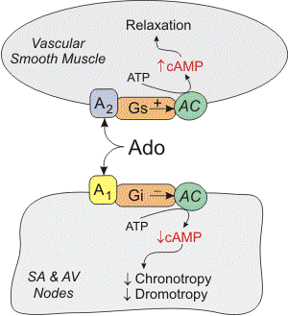
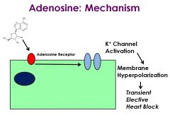

Slide 40

Digoxin
The mechanism whereby cardiac glycosides increase the force of cardiac contraction (positive inotropic effect) is inhibition of the Na+/K+ pump in the cardiac myocytes.
Cardiac glycosides bind to a site on the extracellular aspect of the α subunit of the Na⁺-K⁺-ATPase (which is an αβ heterodimer), and are useful experimental tools for studying this important transport system.
The molecular mechanism underlying increased vagal tone (negative chronotropic effect) is unknown, but could also be due to inhibition of the Na⁺/K⁺ pump.

Slide 41
Rate and rhythm
Cardiac glycosides slow AV conduction by increasing vagal outflow.
Their beneficial effect in established rapid atrial fibrillation results partly from this.
If ventricular rate is excessively rapid, the time available for diastolic filling is inadequate.
Increasing the refractory period of the AV node reduces ventricular rate.
The atrial dysrhythmia persists, but the pumping efficiency of the heart improves owing to improved ventricular filling.
SVT can be terminated by cardiac glycosides, which slow AV conduction, although other drugs are usually employed for this indication
Serum trough concentrations of 1.0 to 2.0 ng/mL are desirable for atrial fibrillation or flutter, whereas lower concentrations of 0.5 to 0.8 ng/mL are targeted for systolic heart failure….Tablet 0.125 mg or 125mcg
Notes:
Vagal tone decreases heart rate by inhibiting the firing rate of the sinoatrial node (S-A node, the usual natural pacemaker tissue of the heart).
By mechanisms that are not fully understood, digitalis compounds also increase vagal efferent activity to the heart. This parasympathomimetic action of digitalis reduces sinoatrial firing rate (decreases heart rate; negative chronotropy) and reduces conduction velocity of electrical impulses through the atrioventricular node (negative dromotropy).

Slide 42
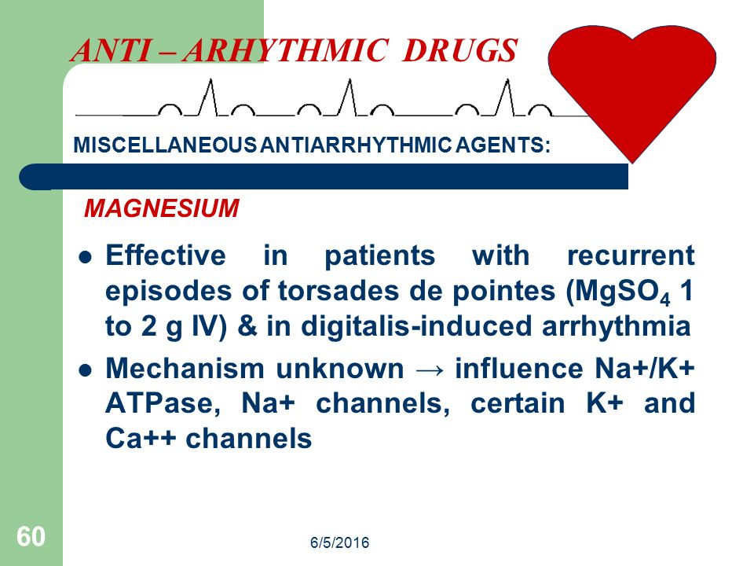

Slide 44
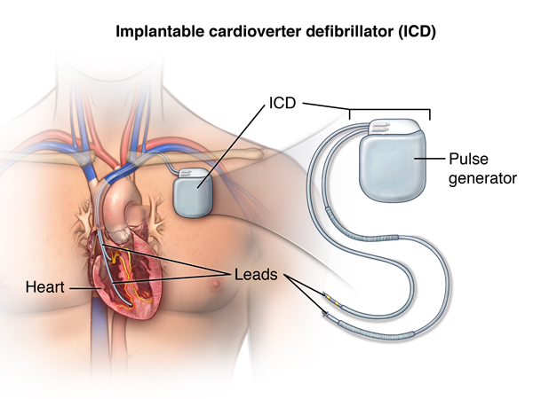
Non-Pharmacological Methods

