Slide 2
WELCOME

Slide 3
M.WAQAS MUNIR
ABU BAKAR
Department of Horticulture
University College of Agriculture, Sargodha
University of Sargodha
ROLE OF POLYAMINES

Slide 4
Contents
What are polyamines?
Types of polyamines in plants
Sources for commercial isolation of polyamines
Role of polyamines in PHM of fruits
Conclusion

Slide 5
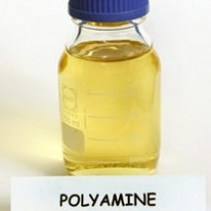

Slide 6
What are polyamines?
PAs are positively charged organic compounds derived from amino acids (Adam and Murthy, 2013).
PAs are a collective form of putrescine (PUT), spermidine (SPD) and spermine (SPM) (Malmber et al., 1998).
PAs are synthesized more or less in all types of living being and respond numerous post harvest processes (Malik and Singh, 2003a, 2004).

Slide 7
Conti……..
Exogenous applications of polyamines have frequently been shown to affect plant growth and as well as the response against various stress factors

Slide 8
Types of polyamine in plants
Putrescine (PUT),
Spermidine (SPD)
Spermine (SPM)
Cadaverine
Homospermidine
Caldopentamine

Slide 9
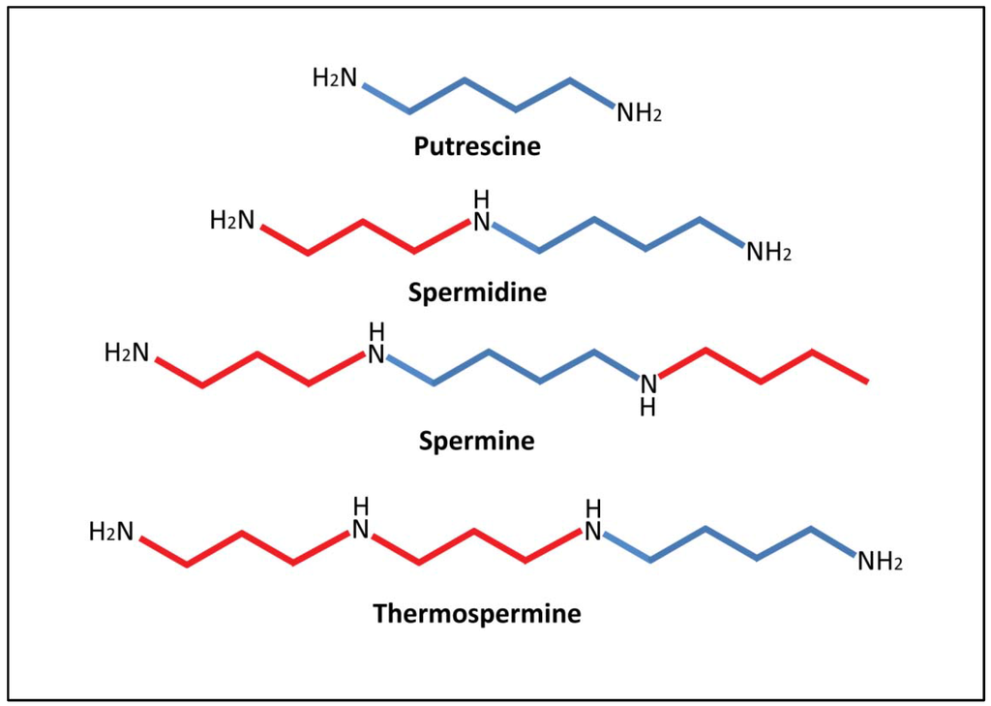

Slide 10
Sources for commercial isolation of polyamines
Plant sources
Leaves and stems of corn (Zea mays L.)
Cucumber (Cucumis sativus L.)
Oat (Avena sativa L.)
Radish (Raphanus sativus L.)
Microbial sources
Saccharomyces cerevisiae
Candida utilis

Slide 11
Role of polyamines in Post harvest of fruits
Inhibit biosynthesis of ethylene
Reduce respiration rate
Increase fruit firmness
Reduce chilling injury
Retard colour changes
Reduce mechanical damage
Maintain antioxidant enzyme activity
Reduce physiological weight loss (PWL)
Delay senescence

Slide 12
Reduce respiration rate
After harvest fruits are live and continue respiration
It converts stored sugars into energy
PAs reduced respiration also retards softening

Slide 13
Increase fruit firmness
PAs helps in reduction of fruit softening rate
Firmness always higher in putrescine-treated fruit
Firmness due to presence of pectic substances in the cell wall

Slide 14
Reduce chilling injury
Chilling injury (CI) are exposed to low but non-freezing temperatures either before or after harvest
CI shows skin browning, pitting, increased electrolyte leakage
PAs can enhance chilling tolerance of tissues

Slide 15
Retard colour changes
Accumulation of carotenoids and anthocyanins
PAs retarded chlorophyll breakdown and carotenoid biosynthesis.
Delay colour development during storage (Valero et al., 2002)

Slide 16
Reduce mechanical damage
Surface abrasion and packaging handling
Tissue anatomy, cell-to-cell adhesion, cell turgor and cell wall strength
Increase in fruit metabolism, leakage of juice, flesh browning and weight loss

Slide 17
Reduce physiological weight loss (PWL)
Lower rates of respiration in treated fruit
Cell wall and the permeability of tissues to water
Consolidation of cell integrity and permeability of the tissues
Moisture loss during storage

Slide 18
Maintain antioxidant enzyme activity
Antioxidant activity shows the nutritional and biological value of fruits
Secondary metabolite decline (flavonoids and phenolic acids and ascorbic acid )
Positive correlation between putrescine concentrations and antioxidant activity of fruit

Slide 19
Delay senescence
Activated oxygen free radicals cause per oxidative damage to all membranes and hasten senescence
Polyamines (PAs) are effective scavengers of these free radicals produced by lipoxygenase (LOX) and phosphor lipase-D (PL-D).

Slide 20
PAs maintained fruit quality
Increased TSS (due to insoluble starches being converted into soluble solids during storage)
Decreased titratable acidity, fruit firmness, ascorbic acid, total phenolics and antioxidant activity.

Slide 21
Conclusion
PAs are positively charged nitrogenous compounds derived from amino acids and commonly used PAs are putrescine (PUT), spermidine (SPD) and spermine (SPM).
PAs significantly inhibit ethylene biosynthesis, delay senescence, retard colour changes and reduce respiration rate, chilling injury, physiological weight loss (PWL), mechanical damage while, increase fruit firmness and maintain antioxidant enzyme activity.
PAs either endogenously or exogenously both helps in suppression of ethylene production during fruit ripening and significantly increase shelf life of the fruits for distant markets.

Slide 22
THANKS

