Slide 2
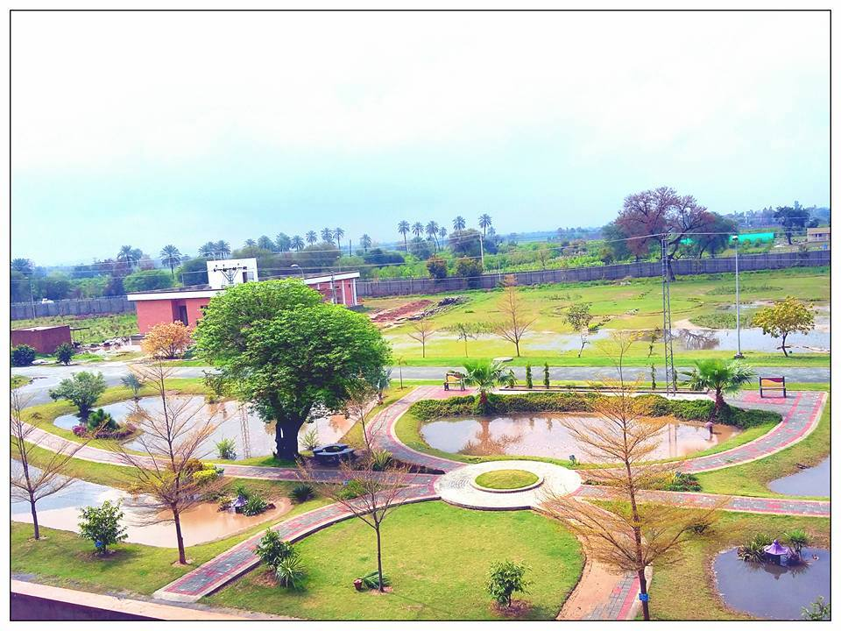
GIBBERELLINS
Presented to: DR. ZAHOOR HUSSAIN
Presented by:
MUHAMMAD ADNAN NAWAZ
SAEED-UR-RAHMAN
M.Sc(H) HORTICULTURE
Department of Horticulture
University College of Agriculture,
UNIVERSITY OF SARGODHA

Slide 3
Introduction
The gibberellins (GAs) are a family of compounds based on the ent gibberellin structure.
Over 136 members exist while the most widely available compound is GA3 or Gibberellic acid.

Slide 4
Variety of GA₃
This varies from GA₁ to GA₁₃₆
The most common active forms being GA1, GA3 and GA4

Slide 5
Sites of biosynthesis.
In general, the highest levels of bioactive GAs are found in actively growing organs.
GAs are synthesized from glyceraldehyde-3-phosphate.
It is synthesized in young tissues of the shoot and developing seed.
Their biosynthesis starts in the chloroplast and subsequently involves membrane and cytoplasmic steps.
In higher plants, GAs are formed primarily from the methyl erythritol phosphate pathway.

Slide 6
History
In 1930's, Ewiti Kurosawa and colleagues were studying plants suffering from bakanae, or "foolish seedling" disease in rice.
Disease caused by fungus called, Gibberella fujikuroi, which was stimulating cell elongation and division.
Compound secreted by fungus could cause bakanae disease in uninfected plants. Kurosawa named this compound gibberellin.
Gibberella fujikuroi also causes stalk rot in corn, sorghum and other plants.

Slide 7
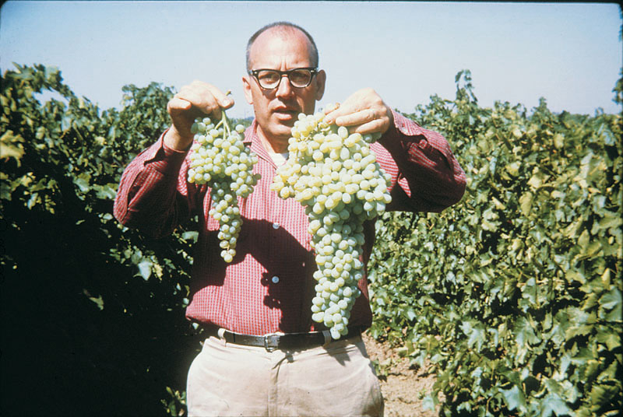
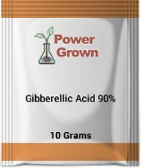

Slide 8
History
Kurosawa (1926) discovered a substance in fungus culture, that caused the elongation of rice seedling, called as ‘foolish seedling’ disease.
In 1938 Yabuta and Sumike isolated crystals from Gibberella culture named them Gibberellins.
In 1951 Brian and co-workers described it as unique ability to stimulate growth of plant.
In 1957 Anton Lang, found that gibberellins can induce flowering.

Slide 9
Gibberellins are named after the fungus Gibberella fujikuroi which causes rice plants to grow abnormally tall.
synthesized in apical portions of stems and roots
important effects on stem elongation
in some cases, hastens seed germination

Slide 10
Cell elongation.
GA induces cellular division and cellular elongation; auxin induces cellular elongation alone.
GA stimulated elongation does not involve the cell wall acidification characteristic of auxin-induced elongation
Breaking of dormancy in buds and seeds.
Seed Germination - Especially in cereal grasses, like barley. Not necessarily as critical in dicot seeds.
Promotion of flowering.
Transport is non-polar, bidirectional producing general responses.

Slide 11
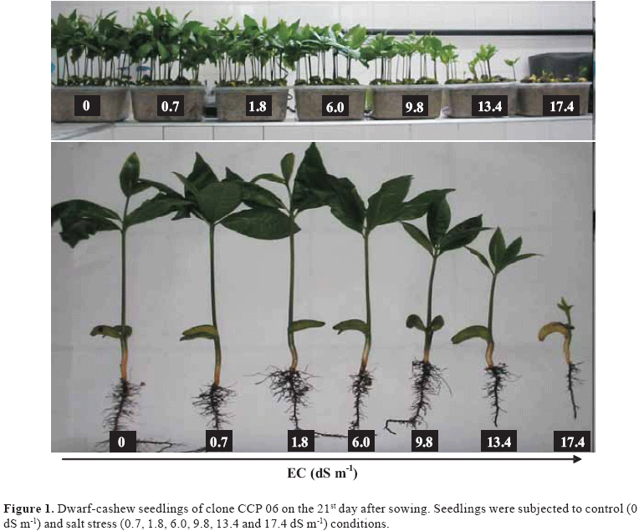

Slide 12
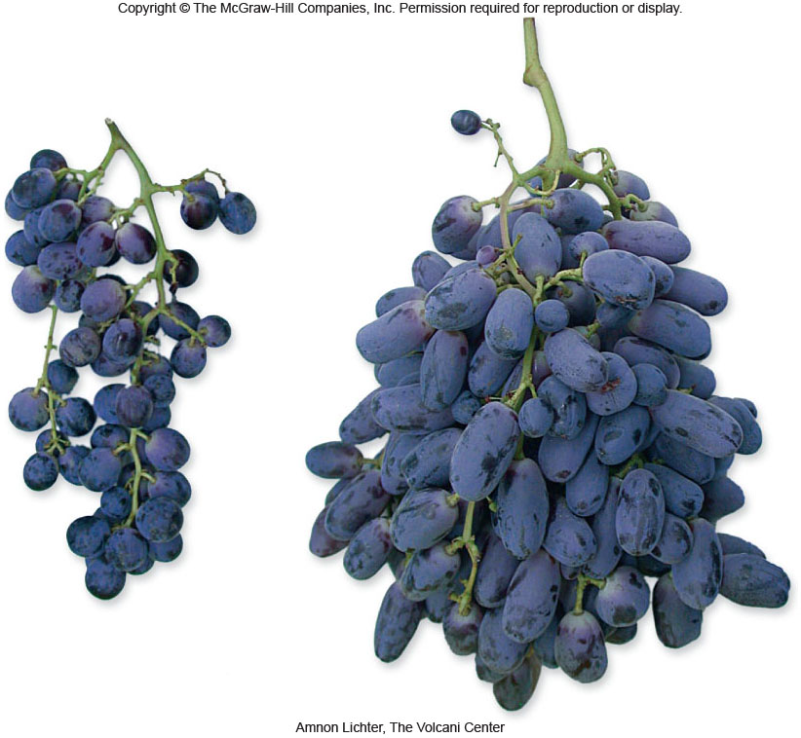
Gibberellins
Hasten seed germination
Used commercially to extend internode length in grapes
Which result is larger grapes.

Slide 13
Gibberellins
GA is used as a signal from the embryo that turns on transcription of genes encoding hydrolytic enzymes in the aleurone layer
When GA binds to its receptor, it frees GA-dependent transcription factors from a repressor
These transcription factors can now directly affect gene expression

Slide 14
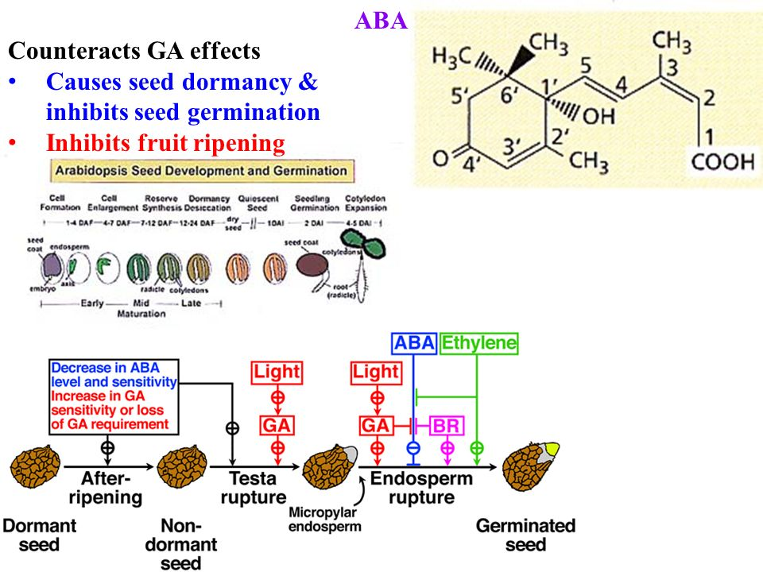

Slide 15
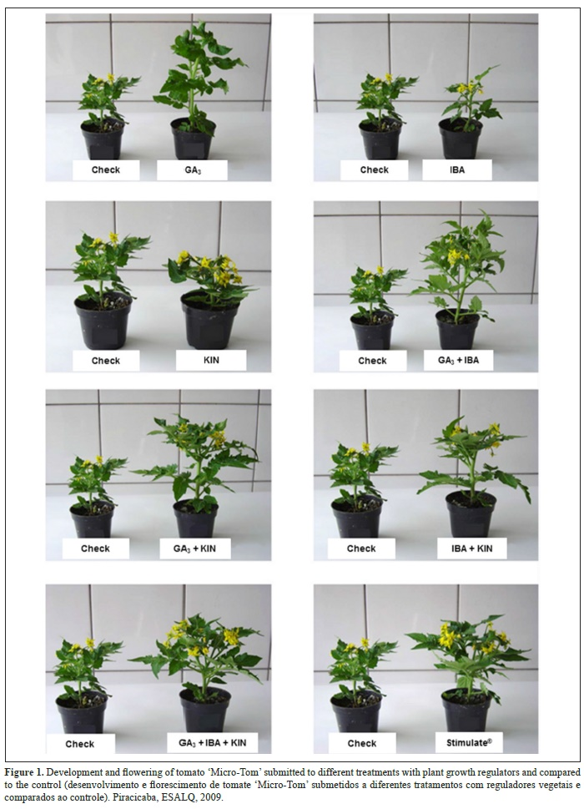

Slide 16
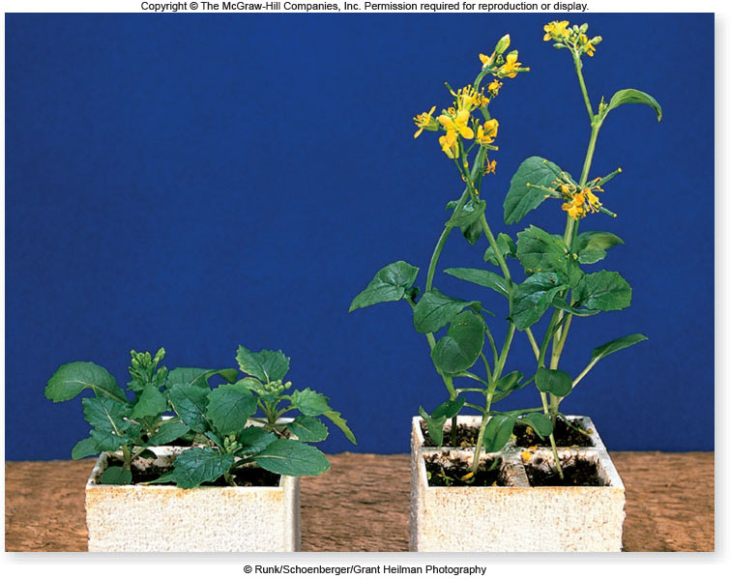
Adding gibberellins to certain dwarf mutants restores normal growth and development

Slide 17
GA₃ is very effective in terms of seed germination, uniform and increased flowering along with elongation in plant stem.
Exogenous application may enhance the vegetative as well reproductive growth.
It is responsible to decelerate the normal ripening process in persimmon.
Plant population, seed yield and height of plant in onion significantly increased by GA₃ application.

Slide 18
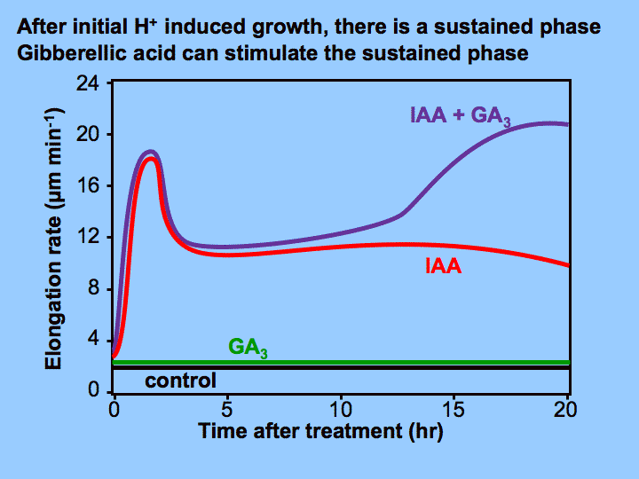

Slide 19
GAs cause evolutions from
meristem to shoot growth
juvenile to adult leaf stage
vegetative to flowering
determines sex expression
grain development
stimulate seed germination.

Slide 20
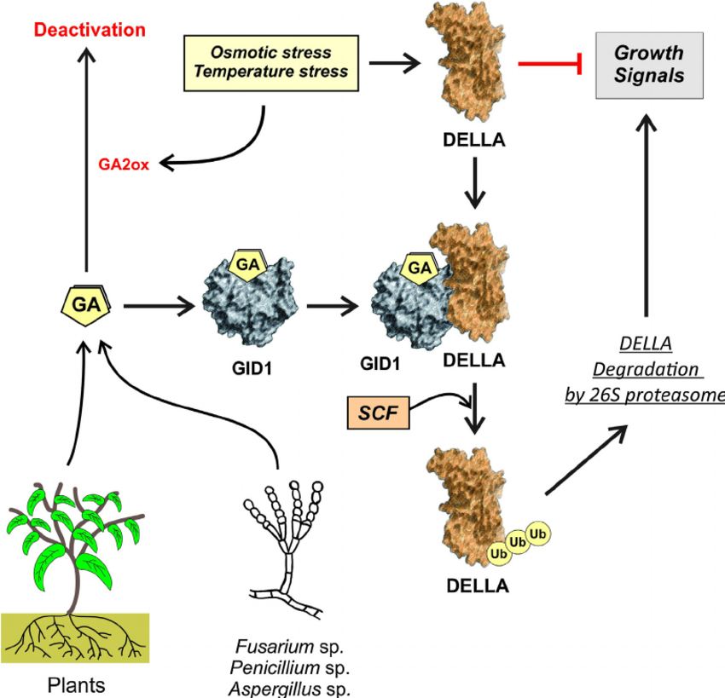

Slide 21
Experiments showed that 30 ppm GA₃ application expressively reduced the percent fruit drop, percent June drop and increased yield tree.
At blooming stage the foliar application of 30 ppm can improve fruit set, control fruit drop and to increase the yield of sweet orange.
The GA₃ pure indorses highest chlorosis rate than fermented extract. Fermented extract inhibits root formation at higher levels (1.0 mg.L⁻¹).

Slide 22
GA₃ works against stomatal resistance and remarkably increases water use efficiency in tomato plants.
Under saline stress it also normalizes number of fruit per plant
It stimulates the vernalization process.
It is best agent to break seed dormancy.

Slide 23
GA₃ (5, 10 and 20 mg/l) along with NAA and 2,4-D enhances following attributes when applied in Kinnow tree
Fruit Set %age
No. of fruits
Fruit weight
Total soluble solids
Acidity
Vitamin C
But
The application of 20 mg/l GA3 significantly reduced the number of seeds/fruit

Slide 24
GA3 at 400 ppm for their growth stimulation flower, number of flower, other quality physiognomy while chilling at 4°C.
To protract the sweet orange harvest and to control the disorders at different life stages of sweet orange 30 ppm GA₃ foliar spray considered the best.

