Slide 1
Topic
Techniques for estimating the nutritive value of feed stuff & their validity in vivo and lab techniques.

Slide 2
In vivo:
Color
Structure
Foreign Particles
Taste
Smell
In Vitro:
NIR (Nearly infrared Radiation)
Wet chemistry
Proximate Analysis
Moisture meter

Slide 3
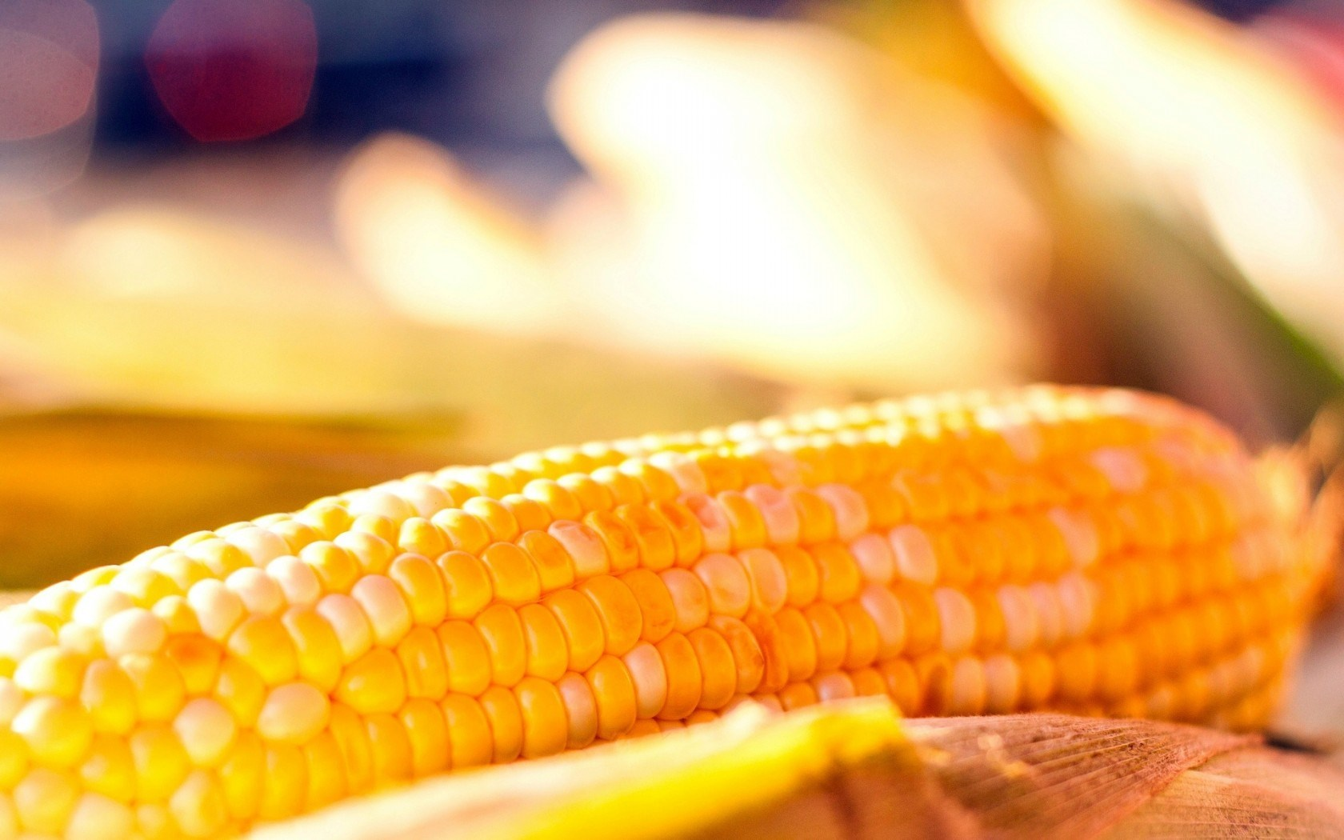
Maize

Slide 4
Dry matter: 85%
CP%: 8.5
ME/kcal: 3330
Fat%: 3.8
Fiber%: 2.5

Slide 5
In Vivo:
Moisture content 6 to 16%
Damage to the kernel
The lower the moisture content, the less the damage.
In Vitro:
NIR

Slide 6
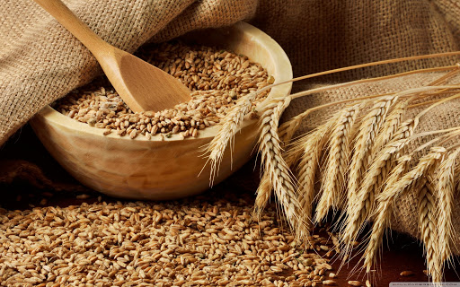
Wheat

Slide 7
Dry matter: 87%
CP%: 12-15
ME/kcal: 3150
Fat%: 1.5
Fiber%: 2.70

Slide 8
In Vivo:
Light yellow
Moisture 10%
In Vitro:
The farinograph and mixograph tests . The extensigraph test measures the resistance of dough to stretching. The alveograph test measures the resistance of a bubble of dough to expansion. The wet gluten test measures the amount of gluten protein in flour

Slide 9
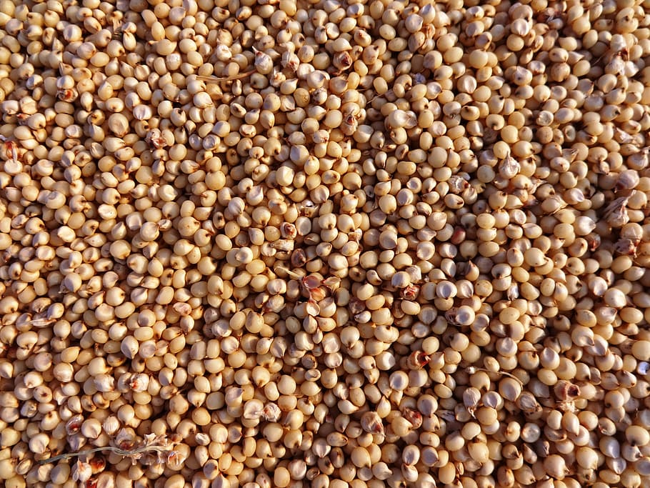
Sorghum

Slide 10
Dry matter%: 85
CP%: 9
ME/kcal: 3250
Fat%: 2.5
Fiber%: 2.70

Slide 11
In Vivo:
Light Red
10% Moisture
In Vitro:
1. Detection of Tannin in Sorghum Grain by the Bleach Test
2. Classification of Sorghum Grain according to Colour
3. Estimation of Sorghum Grain Endosperm Texture
4. Determination of Germinative Energy of Sorghum Grain
5. Determination of Total Defects in Sorghum Grain

Slide 12
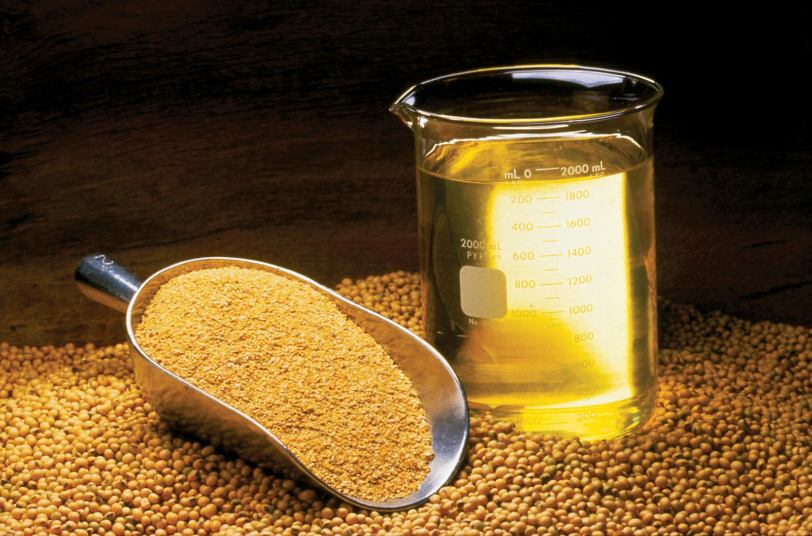
Soybean Meal

Slide 13
Dry matter%: 90
CP%: 48
ME/kcal: 2550
Fat%: 0.5
Fiber%: 3

Slide 14
In Vivo:
Slightly yellow to Black
10% Moisture
In Vitro:
The urease test has been used for some time as a measure of soybean meal processing. Urease is an enzyme in soybean meal that is of little interest in animal nutrition. It is, however, easier to measure than many of the antinutritional factors of interest.

Slide 15
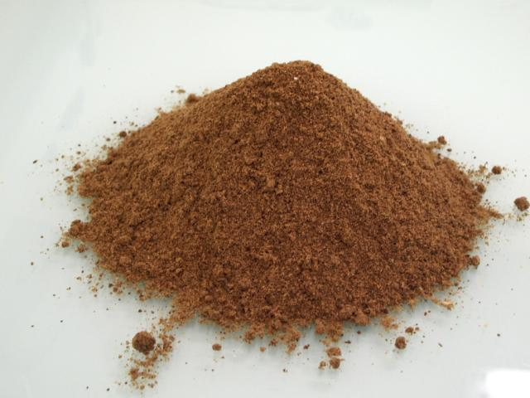
Fish Meal

Slide 16
Dry matter%: 90
CP%: 60
ME/kcal: 2750
Fat%: 2
Fiber%: 1

Slide 17
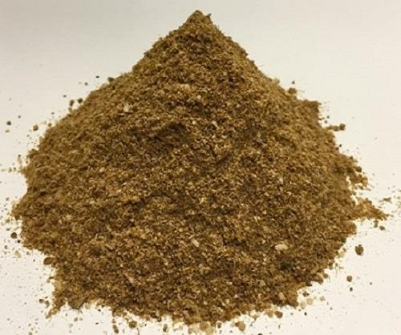
Poultry by product Meal

Slide 18
Dry matter%: 90
CP%: 60
ME/kcal: 2950
Fat%: 8.5
Fiber%: 1.9

Slide 19
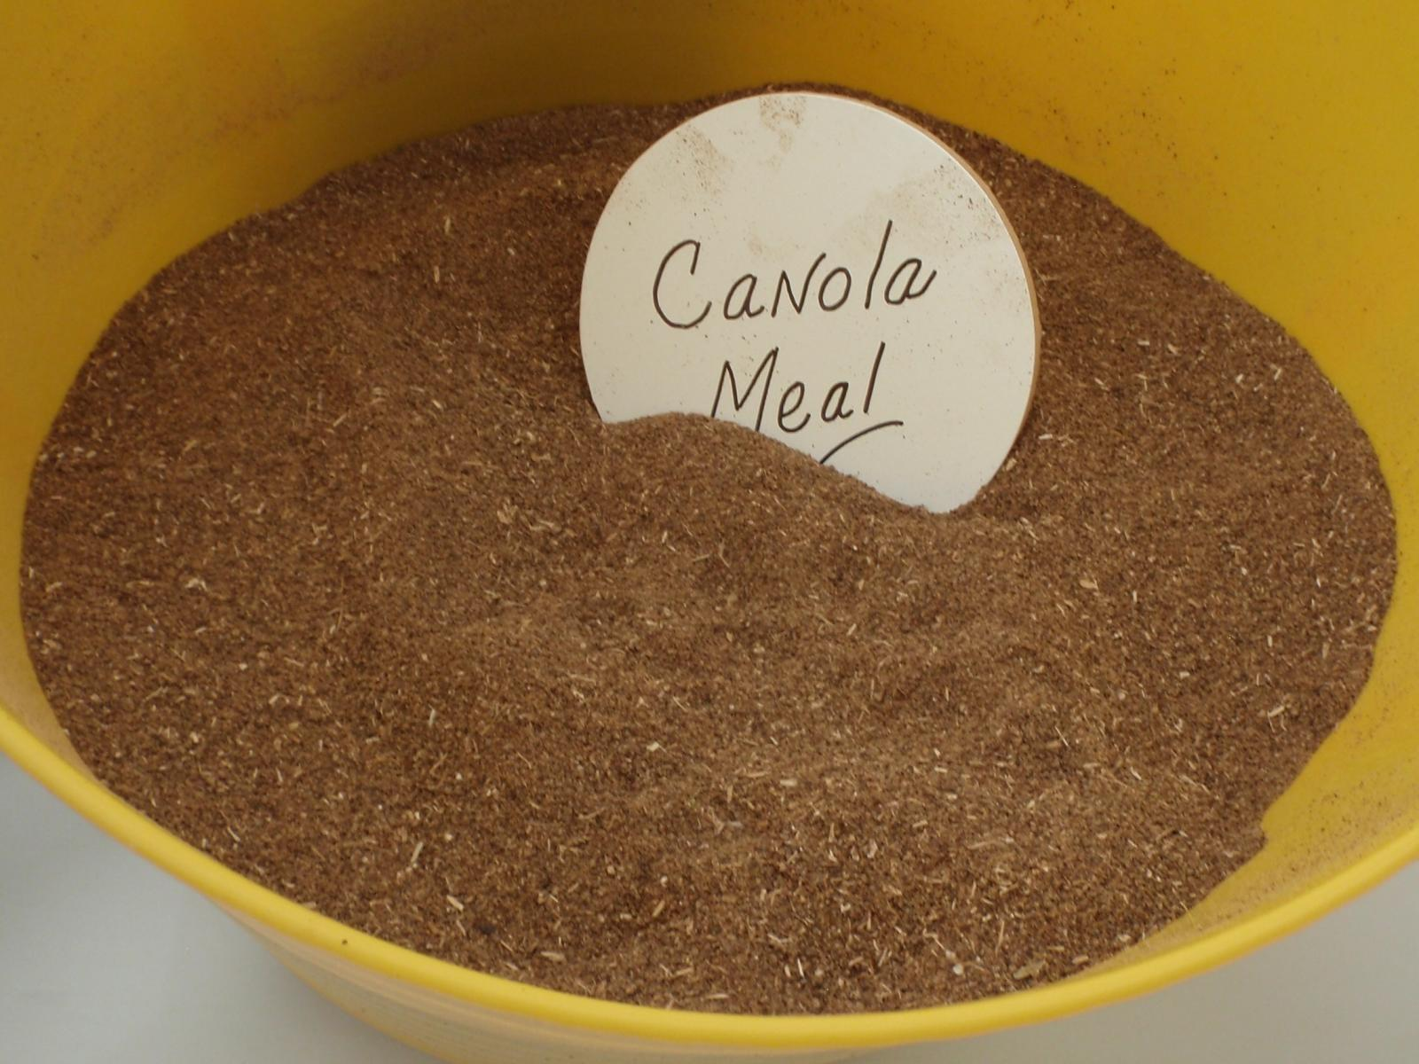

Slide 20
Dry matter%: 90
CP%: 37.5
ME/kcal: 2000
Fat%: 1.5
Fiber%: 12

Slide 21
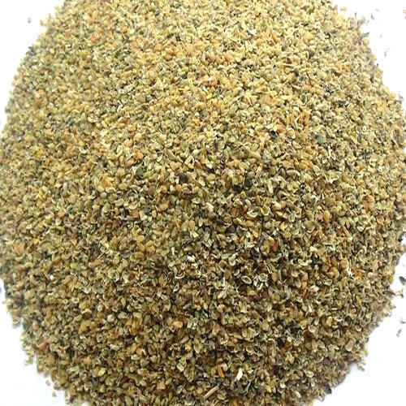
Guar Meal

Slide 22
Dry matter%: 90
CP%: 39
ME/kcal: 2050
Fat%: 1.5
Fiber%: 1

Slide 23
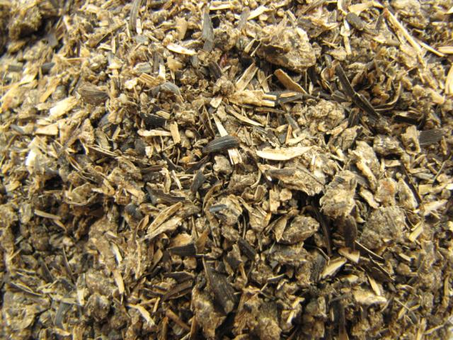
Sunflower Meal

Slide 24
Dry matter%: 90
CP%: 27
ME/kcal: 1440
Fat%: 1.5
Fiber%: 24

Slide 25
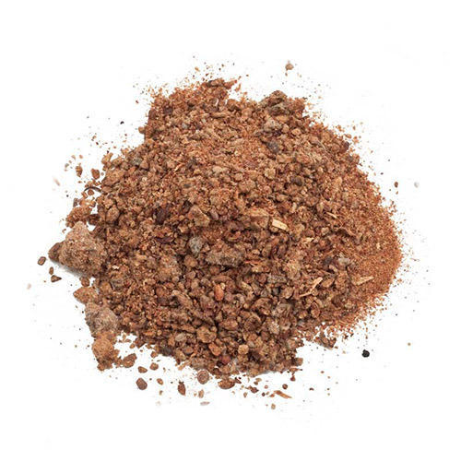
Cotton-seed Meal

Slide 26
Dry matter%: 90
CP%: 41
ME/kcal: 23500
Fat%: 0.5
Fiber%: 14.50

Slide 27
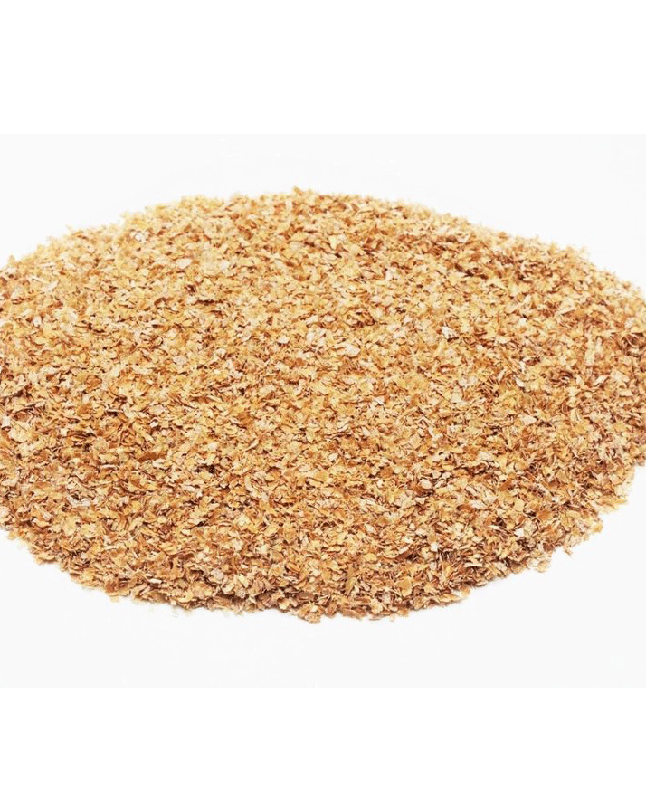
Wheat bran

Slide 28
Dry matter%: 90
CP%: 16
ME/kcal: 1580
Fat%: 4.5
Fiber%: 12

Slide 29
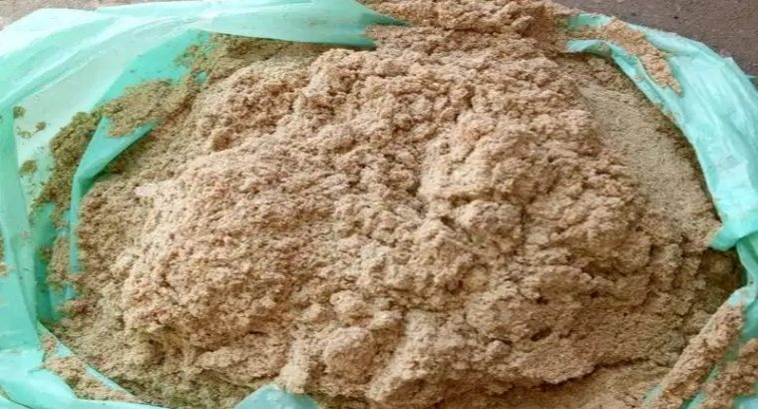
Rice Polishing

Slide 30
Dry matter%: 90
CP%: 11
ME/kcal: 2750
Fat%: 15
Fiber%: 2.5

