Slide 2
Forms of feed
Feed forms used in chicken feeding are
Mash
Pellet
Crumble
Wet mash.

Slide 3
Pellet Form
Birds normally consume about 6-8 percent more feed when fed pelleted feeds.
Pelleting is especially important with low density diet which reduces the feed intake to less than optimum due to less consumption.
Compressing the feed into pellets stops ingredient segregation.
Broilers fed pellets spend less time in eating and thus more net energy is available for body weight gain.
Size of pellet feed is 5mm

Slide 4
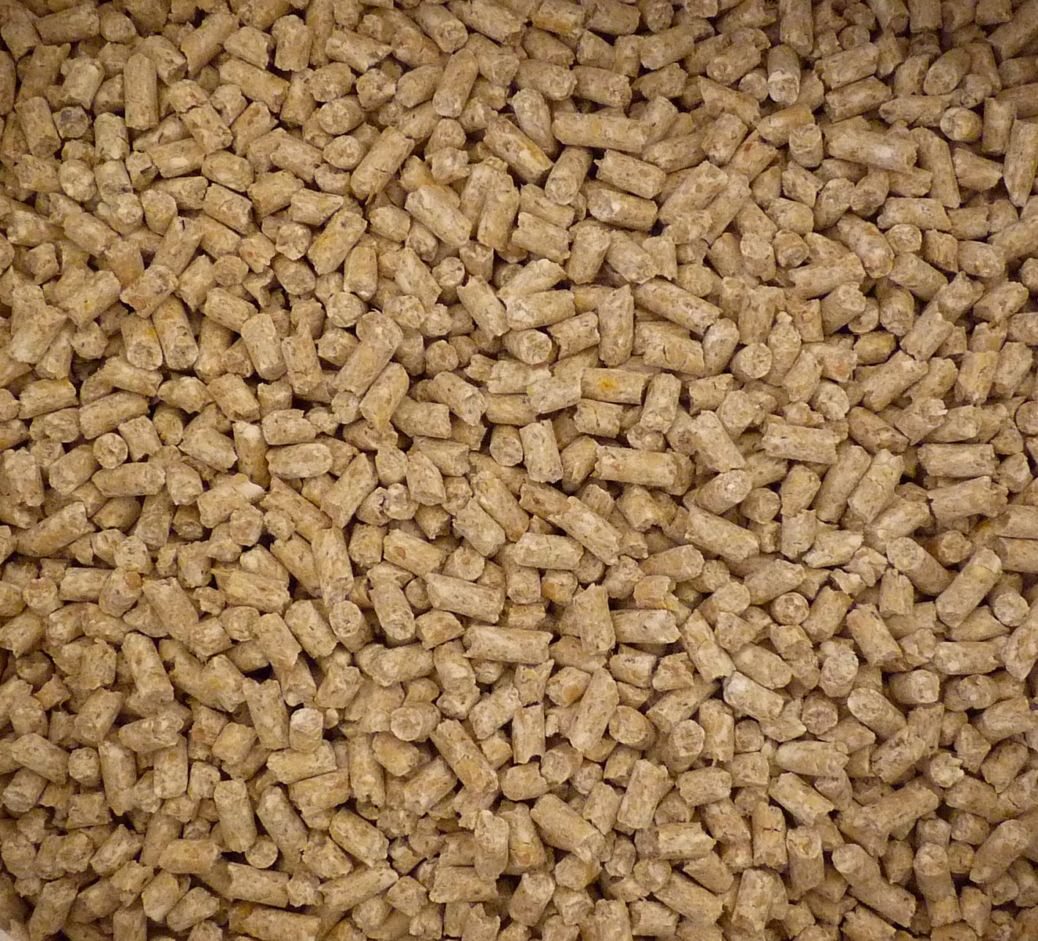

Slide 5
Pellet Binders
To improve hardness of pellets
These binders absorb water from processed pellet tend to reduce wet droppings and improves growth of young chicks
Common pellet binders are sodium bentonite (anhydrous silicate)
cellulose products (from wood pulp industry)
Occasionally molasses and guar gum meal is used as a pellet binder

Slide 6
Advantages of Pellets:
Pelleting results in a saving of 15-20% of feeding.
It is convenient, since it can be directly fed from bags.
It reduces labor, handling cost of feed and feed wastage.
Drinking water remains clean in troughs.
There is no wet feed to mold and to attract flies.

Slide 7
It is easier for a bird to eat a crumble or pellet than to eat mash.
Pelleted feed has a higher nutrient density.
Pelleting reduces bulkiness of feed by 18%.
It reduces selective eating by birds.
It destroys toxic organisms like Salmonella, E. Coli etc. during processing.
Molds are not formed in pelleted feed as propionic acid added during pelleting.
Trypsin inhibitors and gossypol are destroyed during pelleting process.
Metabolizable energy of some feed stuff is improved.
Availability of Vitamin E and B12 is increased.
Digestibility of certain nutrients is increased.

Slide 8
Disadvantages of Pellets
Pelleting involves additional cost.
Higher investment and machinery.
Specific know-how is needed for pelleting.
Considerable variation in the characteristics of different raw materials.
Pelleting destroys Vitamin A.
Increased water consumption.
Increased cannibalism.

Slide 9
Crumble Form
It is method of choice for feeding broilers and capons. Crumbles are usually made from 4.7 mm (3/10 inch) pellets. Crumbles are very easy to handle and convenient to use. It has been found that compressing a feed into pellets and crumbles dependents on fiber content of mash

Slide 10
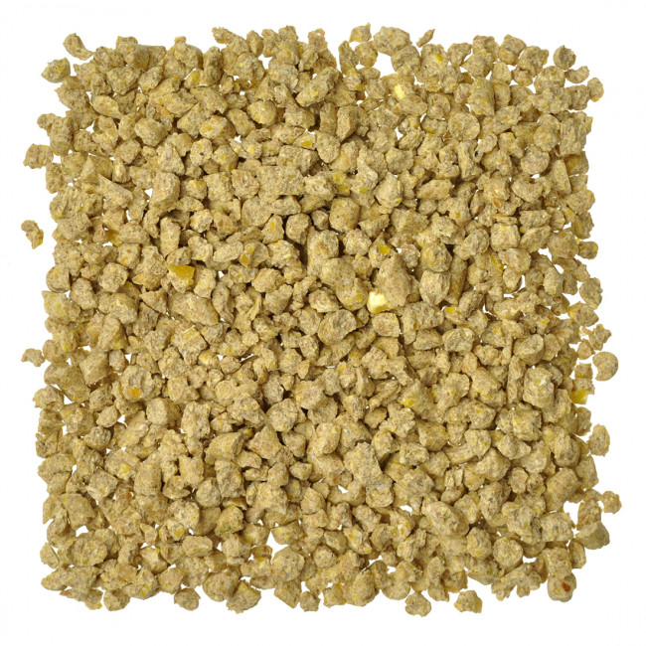

Slide 11
Mash Form
Dry mash is generally cheapest method of feeding compounded rations when considered in terms of cost of feed. Mash should be made available at all times, i.e. fed ad libitum. It is also essential for mash to be freshly mixed. Stale feed may result in reduced nutritional value and reduced intake which will be reflected in rate of growth or production. Stale feeds are prone to mold formation and rancidity.

Slide 12
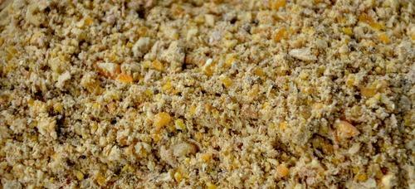

Slide 13
Wet Mash
Dryness of mash feed sometimes reduces feed intake below desired level, particularly if water intake is low. Constituents and some ingredients may be used specifically for this purpose. It is advisable to include a minimum of 20 percent of miller’s offal’s in the mixture. A ration containing 20 percent middlings and 20 percent bran can be made up into a very well textured wet mash. Feeding of wet mash may be true for one or two days but birds soon learn to adjust for the increased palatability and feed consumption reverts to its normal level. Wet mash feeding will not increase egg production, egg weight, growth and feed conversion.

