Slide 1
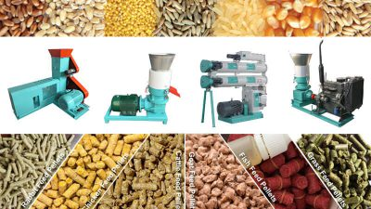
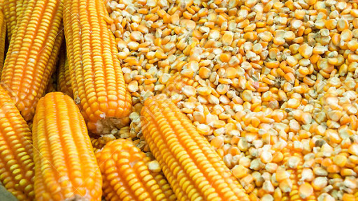
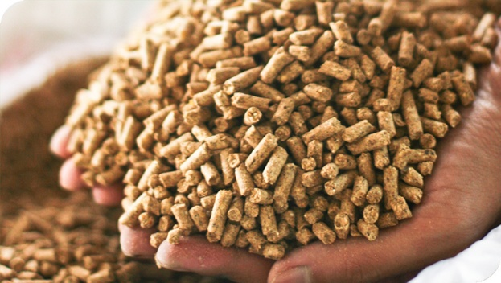
Mixing Processing & Storage of Finished Feed.
Sajid Ali
BASF16M29
Muhammad Awais
BASF16M20
B.Sc. ( Hons. ) Animal Sciences

Slide 2
Introduction
The process of manufacturing animal feed is a means whereby Raw materials of different physical, chemical and Nutritional composition can be converted into a homogenous mixture suitable for producing a desired nutritional response in Animals.
It should be remembered however that some raw materials will have undergone extensive processing prior to inclusion into feed,
For example extraction of oil from oilseeds by solvent or mechanical extraction, Heat treatment of Soybeans or other beans to denature some anti-nutritional factors.

Slide 3
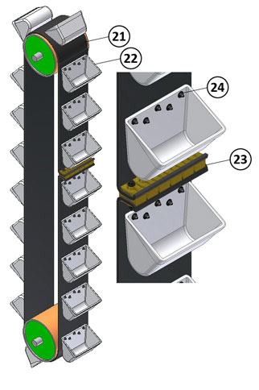
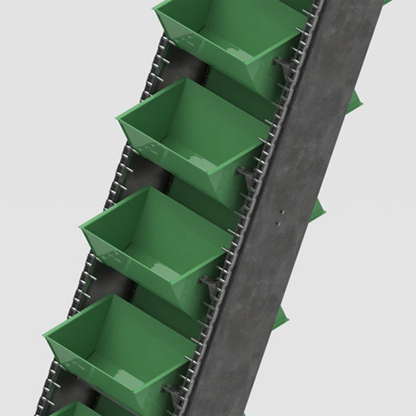
Equipments used for Transportation of Materials
Elevator:
Mostly the elevators which are used in the feed mill are bucket elevator. These are used to uplift the ingredients vertically

Slide 4
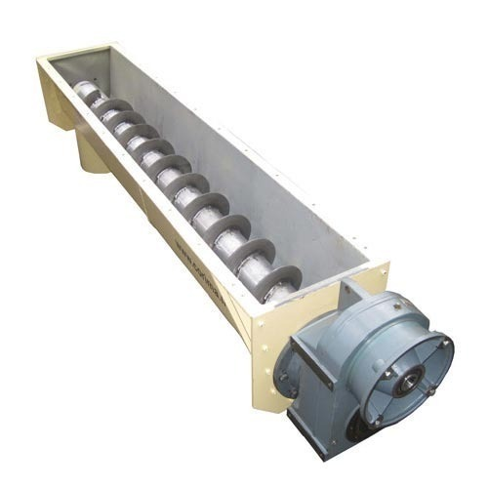
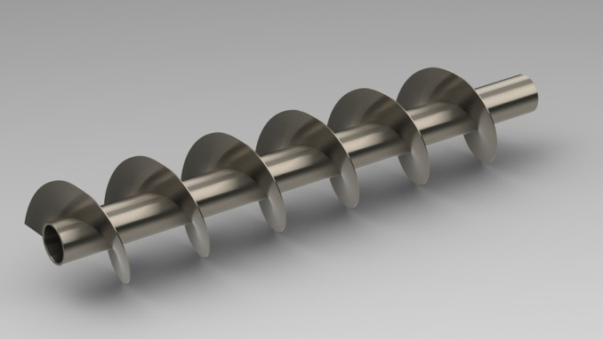
Screw Conveyer
These are used in the feed mill for short distance movement of material from one place to another place.

Slide 5
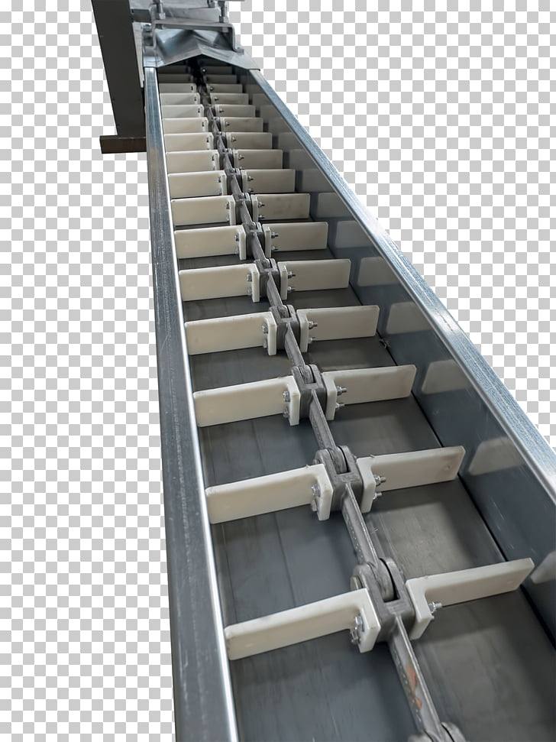
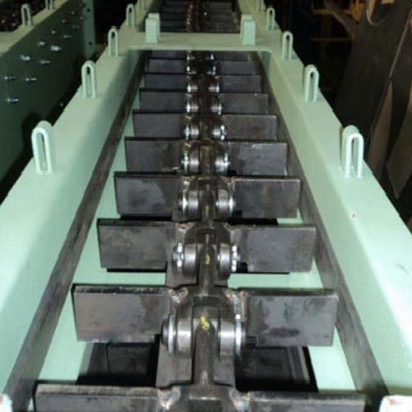
Chain Conveyer
These are used to transport material for long distance. It has high efficiency than screw conveyer.

Slide 6
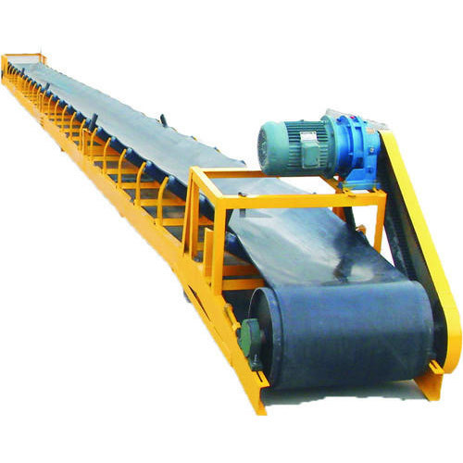
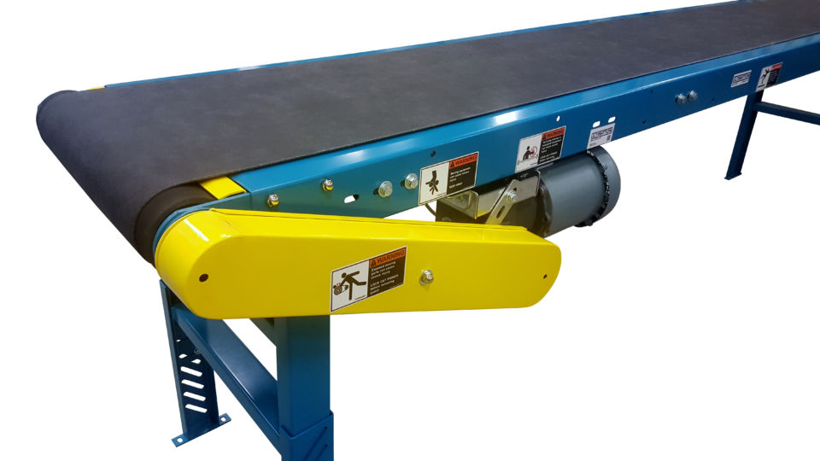
Belt Conveyer
These are used to transport material which has to protect from breaking. Such as finished feed.

Slide 7
Steps of Feed Processing
Raw material Selection & Storage
Raw material weighing
Raw material grinding
Raw material mixing & addition of Liquids
Pelleting (if required)
Packing, Storage & Dispatch of Finished Feed.

Slide 8
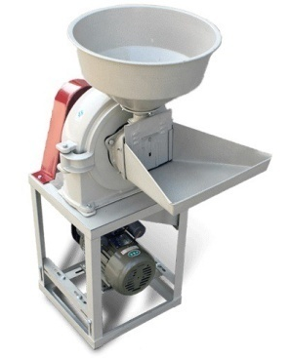
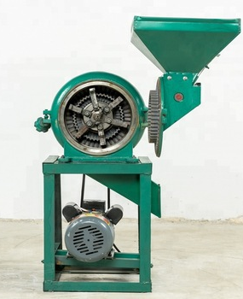
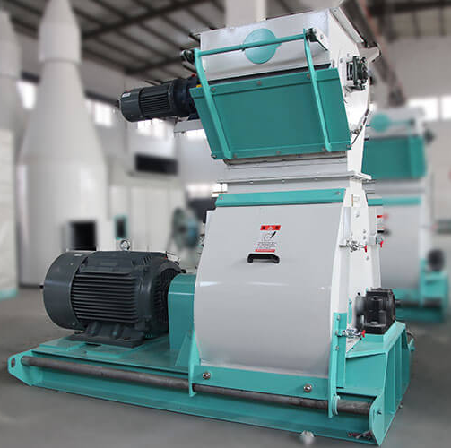
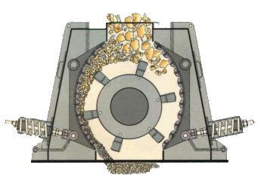
Grinding
Prior to utilization in feed formulations, whole grains must be ground to produce particle size.
Grinding before mixing more better than after batching.
Reasons:
Large fragments are reduced in size.
Some moisture is removed due to aeration.
Additives such as anti-oxidents may be blended.
Grinding will improve:
Feed digestibility.
Mixing Properties
Palatability
Increases bulk density of ingredients.

Slide 9
Batching Bins

Slide 10
Raw material Weighing & Batching System
The accurate weighing of raw material according to formulation for a given ration is perhaps is most important unit operation involved in feed manufacturig.
In order to produce particular feed mixtures, appropriate quantities of specific ingredients must be transferred out of the storage & transported to mixer. This is the function of Batching system.
The weighing of Raw materials require great care and inaccuracy must be kept to a minimum.
It should be noted that errors in the weighing of small quantities of raw material often have greater influence on the Growth performance of Animals than errors in the weighing of large quantities of material.

Slide 11
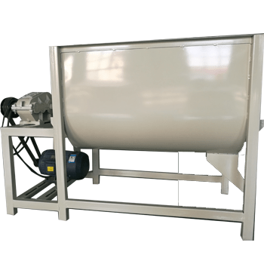
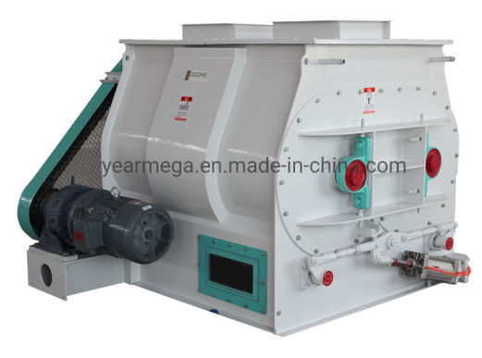
Mixing
It is the job of a mixer to produce a homogenous blend of all raw materials desired in a formulation so that at each feeding period each animal receives a balanced mixture of nutrients.

Slide 12
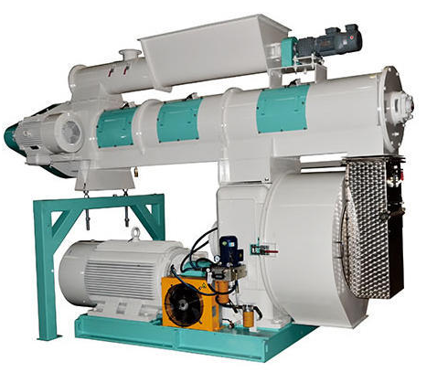
Pelleting
Pelleting involves the compression of a mixed feed through holes in a hardened steel ring or plate (a die) by means of hardened steel rollers. The die forms the feed into pencil-like extrusions which are cut by knives into pellets of desired length on leaving the die.
The pelleting process is very energy intensive, demanding up to 50% of the total power required for feed manufacture. The diameter of feed pellets is governed by the diameter of the holes in the die ring but the smaller the die holes the greater effort is required to force meal into these holes, hence the greater the power demand, that is, the smaller the pellet, the greater the cost of manufacture.

Slide 13
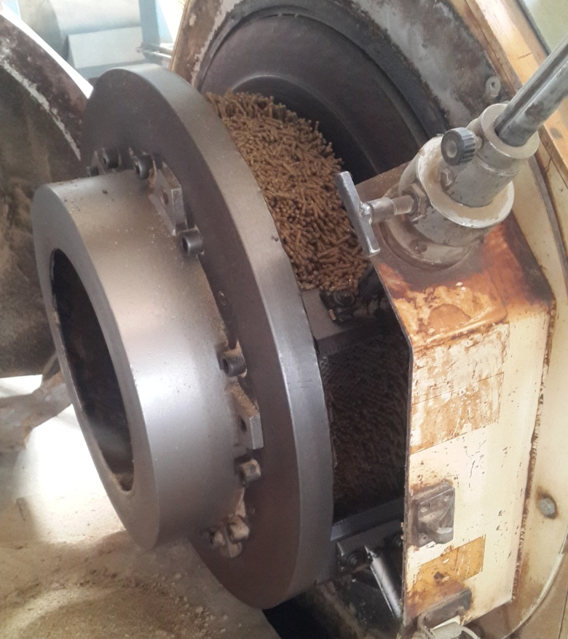

Slide 14
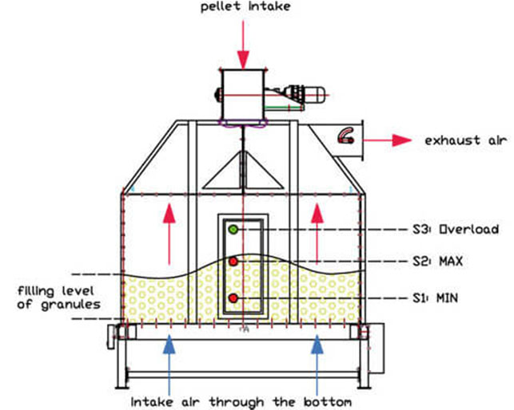
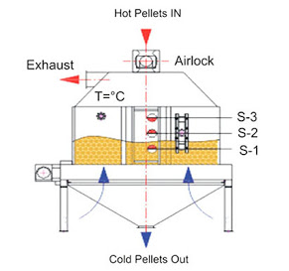
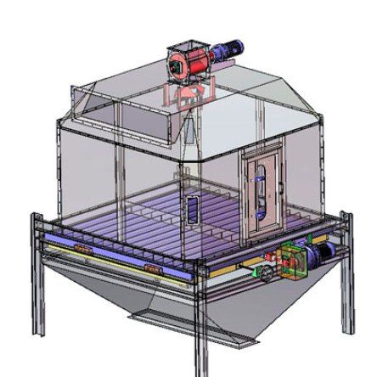
Cooling & Stabilizing
The pellet cooler is used for cooling hot feed pellet from 80 C to ambient temperature.

Slide 15
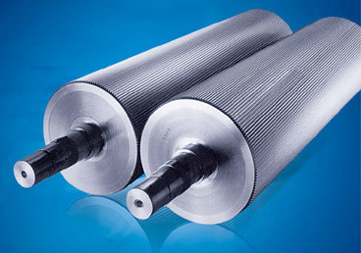
Crumbling
Pellet Crumblier is an essential equipment for the preparation of crumbled pellet feed.
The pellets then pass through the Crumblier if crumbles or granules are required.
Crumblier is used or breaking the pellets into crumbs required for Chicks which are 2 to 3 weeks old.
Pellets are broken into pieces of the required size between the two rolls of the crumblier situated below the cooler.
The gap between the rolls can be adjusted to regulate the size of crumbs.

Slide 16
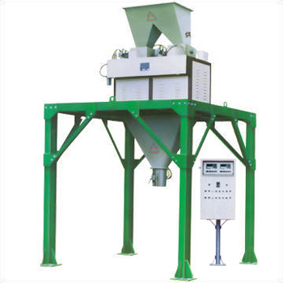
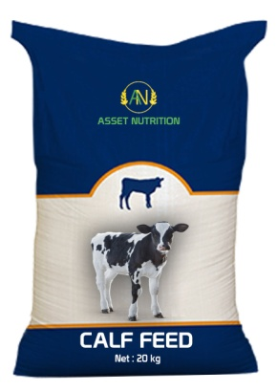
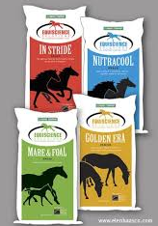
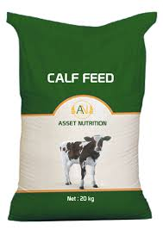
Packing
The load cell type bagging Machine or Bagging-Off-Weigher is an electronically controlled bagging machine.
It is a heavy duty machine for the repeated and accurate weighment.
It consists of a bin hopper, feeder with slow speed or high speed drives, a weighment chute supported on load cells and a pneumatically operated bag clump.
When bag put on the mouth of cell, Clump took message to sliding gate open for specific weight of feed dragging down in bag, as weight attained according to our input to load cell, Load cell will send message to pneumatically controlled cylinders to close the gate.
As gate closed , clumps are released and bag moves to sieving machine by belt conveyor.
Here packing process completes and feed bag either store in store house or directly load to vehicle.

Slide 17
Storage of Finished Feed
All types of materials are store in Godowns.
It mainly depends upon season, moisture contents and oil contents of Feed.
If moisture level is high then stacking is done 8 – 10 bags hight(for few days).
At lower moisture then stacking is done up to 20 bags hight.
If oil contents is high then stacking steps will be less because it will cause rancidity, heat up the material, cakes formation.

Slide 18
Storage of Finished Feed
Store all feed in closed bags at a cool and dry place
Keep feed dry to prevent fungal or bacterial growth
Prevent rodent or insect entry into feed
Provide a building for storage which is secure and can be adequately locked.
Ensure that its roof will protect the feed from rain and that surface water cannot enter the store.
Provide it with ventilation points (windows are not necessary or recommended).
Ventilation entry points should be low on the side facing the prevailing wind and high on the opposite side.
Orient the building so that one of the long sides faces the prevailing wind.
Ensure that all entry points are meshed to prevent entry by birds, rats etc.
Plan your purchases carefully so that you do not need to keep too great a quantity in stock.
Always keep the store clean. Floors and walls should be regularly swept. Spilled material must be removed and the contents of broken bags or containers used first.
Cleared areas of the store must always be cleaned before new materials are placed there.
Arrange your store so that new deliveries are not put in front of old stocks. The oldest materials must be used first.
Make small stacks. Large stacks of sacks lessen insect damage, which occurs mainly at the surface, but cause heat generation, with other consequential damage.
If possible, raise the sacks off the ground by stacking them on wooden pallets (platforms).
Ensure that products are clearly and indelibly labelled so that those drawing from the store are sure that they are drawing the correct products (some look very similar when ground) from the oldest batch.
Don’t walk on the stacks of compounded feeds unnecessarily. This will break the pellets on the surface and lead to the production of a lot of wasteful fines (dust).
Don’t allow sacks to rest against the outer walls of the store – leave a space between the stacks and the wall.
Don’t allow staff to sleep or eat in the feed store

