Slide 1
Nutritional disorders and their deficiencies

Slide 2
Introduction
Nutritional disorders associated with both forage and feed consumption
Can have a large impact on the profitability of beef cattle operations
Mineral imbalances and sudden shifts from high roughage to high concentrate diets are some of the factors associated with nutritional disorders in beef cattle

Slide 3
Ketosis
Occurs in gestating or lactating cattle
Most frequently happens in first 6 wks after calving
Very often affects first-calf heifers, or older cows
Excessive amounts of ketone bodies found in urine, blood, milk
Also called:
Acetonemia, hypoglycemia

Slide 4
Causes
Nutritional origin characterized by low blood sugar
Occurs when intake or the nutrition provided doesn’t meet requirements of the animal
Animal mobilizes its own fat reserves

Slide 5
Clinical Signs
Rapid weight loss
Loss of appetite
Acetone smell on the breath
Nervousness

Slide 6
Prevention
Avoid excessively fat cows at calving
Increase concentrate levels gradually after calving
Avoid abrupt forage changes
Feed high quality hay
Maintain proper CP, min/vit levels
Focus on cow comfort Temp

Slide 7
ACIDOSIS
commonly called grain poisoning
occurs when cattle are introduced to grain too rapidly or there is a sudden change from one grain to another
Acidosis sometimes causes founder and associated lameness due to overproduction of histamine compounds in the rumen

Slide 8
Stages of Acidosis
Feeding rapidly fermentable grain
Acidosis (low rumen pH)
Gut lesions
Bacterial proliferation (Fusobacterium necrophorum)
Rumen wall abscesses, inflammation and necrosis

Slide 9
bacteria travel to liver via blood
liver abscesses (F. necrophorum, Actinomyces pyogenes, Bacteriodes spp)

Slide 10
Effects of acidosis
Effects of acidosis on cell function
Cellular response to metabolic acidosis ≠ effect of lowering extracellular pH on cell function
Decrease of plasma pH during metabolic acidosis
impaired elimination of an extracellular acid load
overproduction of intracellular acid due to energy failure
Effects of extracellular acidotic pH on a normal cell

Slide 11
Prevention
Gradually increase the grain content of the diet over the first 14 days

Slide 12
BLOAT
Rumen gas production exceeds the rate of gas elimination
Gas accumulates causing distention of the rumen
Frothy Bloat
Legumes and some rapidly growing grasses cause a stable foam to form in the rumen
Gas is trapped in small bubbles in this foam in the rumen
may develop when high quality lucerne hay is being fed in the diet

Slide 13
Due to an insoluble slime in rumen
Free-Gas Bloat:
Many of the same factors causing acidosis are associated with free-gas bloat
Proper bunk management and other preventative measures should be practiced for prevention of bloat

Slide 14
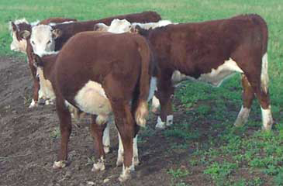
Signs of bloat
Distended left abdomen;
No longer grazing;
Reluctance to move
Appear distressed , eyes bulging;
Strain to urinate and defecate
Rapid breathing – mouth may be open with tongue protruding;
Staggering

Slide 15
Prevention
Poloxalene (Bloat Guard) saltmolasses blocks or feed additive to cattle at risk
Fill cattle up on hay before turning out onto lush pasture
Provide hay during initial grazing days
Do not place animals on lush forage just after a frost
Keep legume levels in pastures at <50% of the available dry matter
Check cattle on legume pasture frequently
Keep water and salt available at all times on legume pastures

Slide 16
Milk Fever
Associated with older, high producing dairy cattle
Occurs shortly after calving and the onset of milk production
Lactation generates a sudden, very high
demand on calcium homeostasis
Causing an imbalance between calcium output and influx of calcium
Failure of calcium homeostasis.

Slide 17
Between 5 and 20% of cows will develop milk fever
Initially hyper excitability followed by anorexia, listlessness and muscle weakness
Body temperature declines as condition worsens
Fever is not a clinical symptom.

Slide 18
Heart muscle contractile function is compromised
Sternal recumbency
Constipation due to a loss of smooth muscle contractile function causing bloat
Death can occur in a few to several hours, and is likely at a rate of 60-70% without treatment

Slide 19
Prevention
Feeding low calcium diets a month or two prior to calving
Negative DCAD will help prevent milk fever
Checking magnesium levels
Supplementing if necessary vitamin D3
Synthetic bovine parathyroid hormone

Slide 20
Displaced Abomasum
History and Signalment of DA
Age: older lactating dairy cattle
Timing: 80% occur during first month after parturition
Nutrition:
Dry cow rations: +DCAD / inadeq efv fiber
Fresh cow: excess NSC’s / inadeq efv fiber

Slide 21
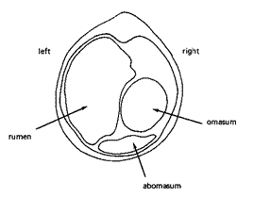
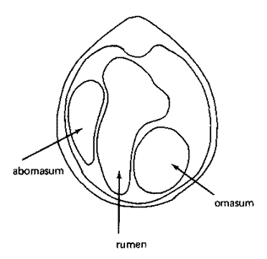
abomasum displace
(1) Abomasal atony
(2) Increased abomasal gas production
Normal position of abomasum
Left displacement

Slide 22
abomasal atony
Causes
Hypocalcaemia
7 times more likely to develop DA’s
Inadequate effective fiber
VFA’s reach abomasum causing abomasal hypomotility
HCl refluxes back into rumen and causes systemic metabolic alkalosis

Slide 23
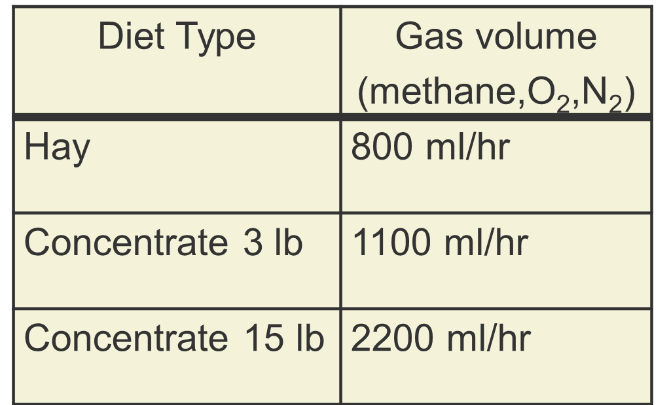
increased gas productn
NSC : effective fiber ratio

Slide 24
Clinical Signs of DA
Partial anorexia (“off feed”)
Hypogalactia (“down in milk” ~ 5-10 lb/day)
Depression
Secondary ketosis
mild to moderate
Scant stool
firm/loose
undigested particles

Slide 25
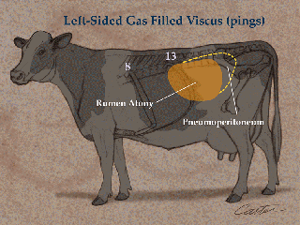
Paralumbar fossa
“slab-sided” abdomen
Mild colic
Mild hypocalcemia
Hypotonic rumen
Cold ears, widely dilated pupils

Slide 26
White Muscle Disease
Due to dietary deficiency
Calves being born to dams that consumed selenium deficient diets during gestation
Two forms
Cardiac form
Skeletal form
Cardiac form has rapid onset with the most common clinical sign being sudden death
Animals may exhibit an increased heart rate and respiratory distress

Slide 27
Death usually occurs within 24 hours
Skeletal form has a slower onset
Calves affected by the skeletal form exhibit stiffness and muscle weakness
Prevention
supplementation of vitamin E and selenium
Salt/mineral mixtures can be used to supplement the deficiencies.

Slide 28
Mineral supplement with an expected intake of 4 ounces/head/day should contain 27 ppm of selenium
In known selenium deficient area
Administer 25 mg of selenium and 340 IU of vitamin E intramuscularly four weeks before calving.

