Slide 2
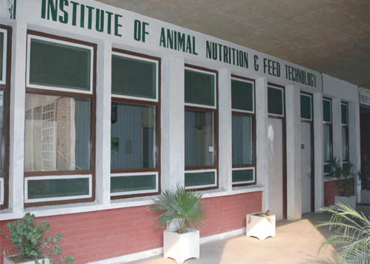
Bloat
Muhammad Asif
2011-ag-662
Institute of Animal Nutrition & Feed Technology
University of Agriculture Faisalabad

Slide 3
BLOAT
Bloat is defined as severe enlargement of abdomen due to an over accumulation of gases trapped within rumenoreticulum.

Slide 4
Types of bloat
Pasture bloat..
Plant protein
Feedlot bloat..
Microbial polysaccharides

Slide 5
GAS PRODUCTION
Healthy cattle peoduces 30-50 liters of gas every hour.
(Bowen, 1996).
Erructation phnomenon.
(Majak et al., 2003).

Slide 6
Cont…

Slide 7
Mechanism of bloat development
In frothy bloat erructation stops because gas becomes trapped in small bubbles.
As gas is not free receptors fail to recognize it.
(Howarth, 1975).

Slide 8
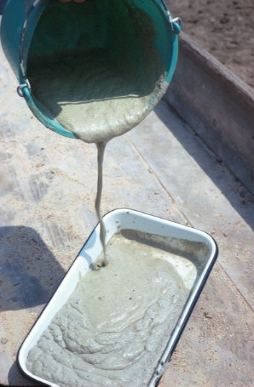
Froth…

Slide 9
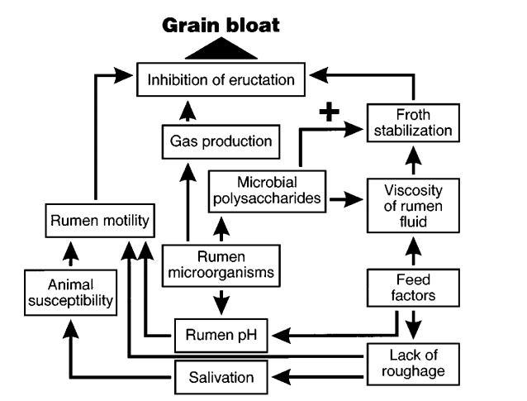
Cont …

Slide 10
Symptoms of bloat
Distension of the left side.
Labor breathing frequent urination and defecation.
In some cases profuse salivation protruding eyes.
Eructation slows and stops along with rumen motility.

Slide 11
CONTINUE…..
Mucus membranes become cyanotic.
Develop a staggering gait animal collapses and can not rise.
Death is due to suffocation.
(Majak et al., 2003).

Slide 12
Physical apperaence…

Slide 13
Pasture bloat
Three factors associated with frothy bloat.
A highly digestible high-protein forage (i.e., alfalfa, clover, wheat)
Presence of fine plant particles.
Conditions favourable for ruminal bacteria to produce an excessive amount of bacterial slime.
(Howarth et al., 1986).

Slide 14
Strategies to mitigate pasture bloat
Pasture management
Forages having low fiber and high protien are more succeptible to bloat e.g immature legume pastures as alfalfa and clover.
So avoid seeding pure stands of alfalfa.
May use bloat resistent legumes e.g sainfoin

Slide 15
Bloat-causing, moderate-risk and low-risk forages used as pastures.
Bloat-causing | Moderate-risk | Low-risk
Alfalfa (Medicago sativa) | Arrowleaf clover (Trifolium vesiculosum) | Sainfoin (Onobrychis viciifolia)
Sweetclover (Melilotus albus) | Berseen clover (Trifolium alexandrinum) | Birdsfoot trefoil (Lotus cornicula
Red clover (Trifolium pretense) | Persian clover (Trifolium resupinatum L) | Cicer milkvetch (Astragalus cicer
White clover (Trifolium repens) | Spring wheat (Triticum spp) | Crownvetch (Coronilla varia L.)
Winter wheat (Triticum spp.) | Perennial ryegrass (Lolium perenne) | Fall rye (Secale cereale L.)

Slide 16
Bloat-reduced forages
As indicated above bloat reduced forages be used.
Genetic modification of bloat-provoking forages.

Slide 17
Use of grass or silage–legume mixtures.
Inclusion of orchardgrass in the alfalfa reduced the incidence of bloat in cattle.
Orchardgrass when seeded in mixed pastures with alfalfa at proportions of 0.25 and 0.50.
Incidence of bloat reduced 70–90%.
(Thompson et al., 2000)

Slide 18
Stage Of Crop
Stage of growth of alfalfa is most impotant
Highest risk of bloat in vegetative stage as compared with bud stage.

Slide 19
Feeding schedules
Cattle consuming alfalfa either under grazing or confinement conditions bloated at least twice as frequently if the forage was made available earlier as compared to later in the day.
(Hall and Majak, 1995)

Slide 20
Feed additives
The additives included ionophores such as monensin and lasalocid as well as pluronic detergents and various mineral mixes.
monensin-containing Rumensin reduced the incidence of bloat 50% in steers.

Slide 21
Cont ..

Slide 22
Incorporating tannin-containing forages into alfalfa pasture.
Condensed tannins (CT) are phenolic compounds that exhibit a high affinity for bloat causing protiens.
CT can also directly inhibit rumen microorganisms and biofilm formation.
1.0 mg CT/g DM is needed to prevent pasture bloat.
Li et al. 1996.

Slide 23
Feedlot bloat
Feedlot bloat occurs most commonly when cattle are fed diets high in grain and low in roughage.
Certain feeding regimens in ruminants can lead to the proliferation of S. bovis in the rumen, resulting in the production of high levels of slime.
Herrera et al. 2009.

Slide 24
Strategies to mitigate feedlot bloat
Optimization of grain processing
Feedlot bloat is controlled most effectively by processing the grain to an optimal particle size.
Flaking of corn grains to a density of less than 0.31 kg/L may cause bloat in cattle.
Zinn et al. 2002.

Slide 25
Addition of physical fibre to high grain diets
Inclusion of increased levels of grass hay or cereal silage in feedlot diets can also reduce the risk of feedlot bloat

Slide 26
Adaptation
If bloat is to be avoided, sufficient time must be allowed (14–21 d) for the microbial populations to adjust and stabilize to the dramatic change.

Slide 27
Antibiotics
Antibiotics that are effective for bloat control such as ionophores, inhibit primarily Gram-positive bacteria including S. bovis and Lactobacillus spp.

Slide 28
Detergent-based bloat preventatives.
Inclusion of mineral oil at levels of 0.04 to 0.08 of the diet reduced the incidence of bloat in feedlot cattle.
Animal fat has no effect and soybean oil increased the incidence of bloat.

