Slide 1
Digestion and parts of digestive tract Efficient usage of Urea and NPN compound in dairy cow

Slide 2
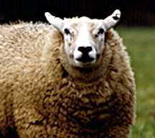
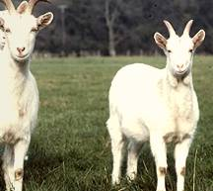
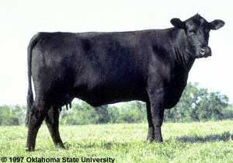

Complex Stomach
Sheep, cows, and goats are examples of animals with complex stomachs, which are also known as ruminant digestive systems

Slide 3
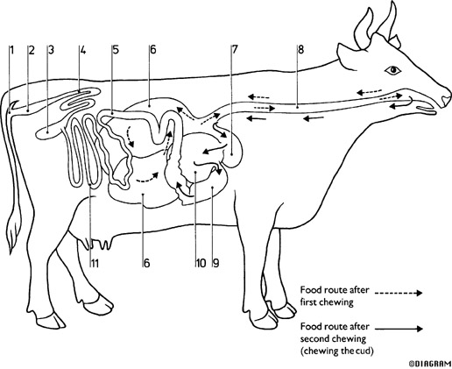
Parts and functions of the ruminant digestive system
Ruminants are characterized by having a stomach with four compartments
Rumination - the regurgitation,
rechewing and reswallowing of
ingested food
Cud - mass of regurgitated ingesta;
bolus
Process of rumination
1. regurgitate bolus from rumen
2. rechew and reinsalivate
3. reswallow
4. repeat with another bolus
Anus 7. Reticulum
Rectum 8. Esophagus
Cecum 9. Abomasum
Colon 10. Omasum
Duodenum 11. Small Intestine
Rumen

Slide 4
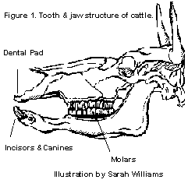
Parts and functions of the ruminant digestive system continued…
• Mouth
-contains dental pad, teeth, tongue and saliva
-saliva contains no salivary amylase
• Esophagus
-tube from mouth to stomach
-tube from stomach to mouth

Slide 5
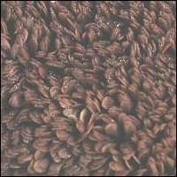
Rumen
Digestion and fermentation vat
  40-50 gallons
  No secretions
Contains anaerobic microbes (25-50 billion bacteria/mL fluid)
  Also protozoa, fungi
  Produce VFA, protein
Papillae lining
  Increase surface area
Absorption of VFA
  Passive diffusion

Slide 6
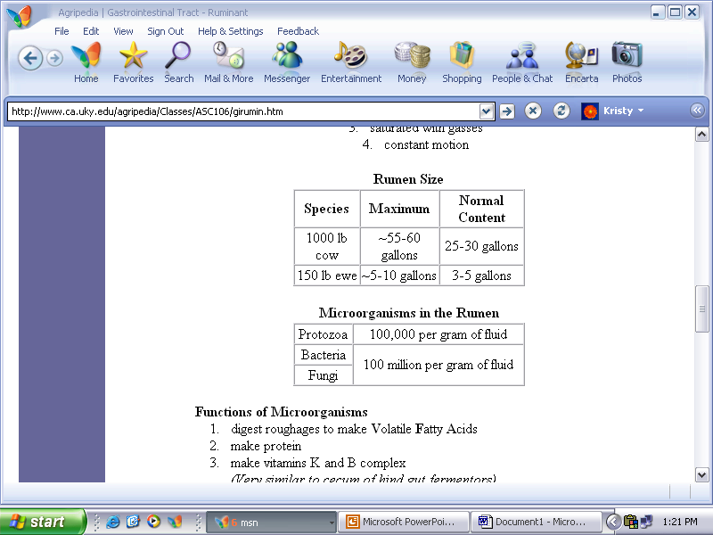
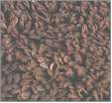
Parts and functions of the ruminant digestive system continued…
• Rumen - large fermentation vat; also called the "paunch"
-anaerobic
-Temperature = 39ºC (103ºF)
-saturated with gasses
-constant motion
Lining of the rumen

Slide 7
Parts and functions of the ruminant digestive system continued…
• Functions of Microorganisms
-digest roughages to make Volatile Fatty Acids
-make protein
-make vitamins K and B complex
(Very similar to cecum of rabbit and horse)
The function of the rumen is to house microorganisms.

Slide 8
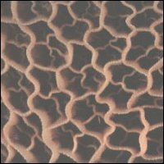
Reticulum
Honeycomb lining
  No secretions
Formation of food bolus
Regurgitation initiated here
Collects hardware (nails, wire)

Slide 9
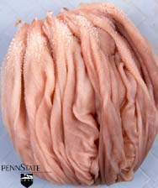
Omasum
Laminae/manyply lining
  Muscular folds
  No secretions
Reduces particle size
Absorption of water
  ~60% removed
Absorption of VFAs
  ~2/3 of VFAs entering or 10% of total produced
  Prevents buffering of the abomasum

Slide 10
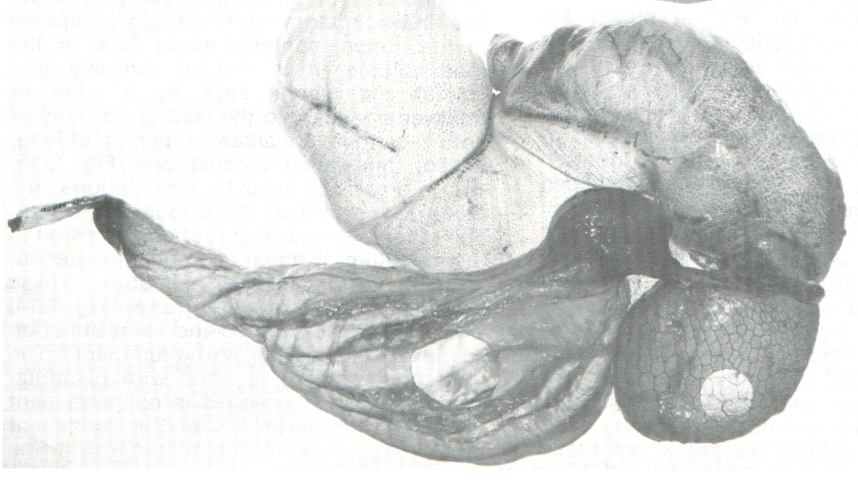
Abomasum
True gastric stomach - four gallons in a cow
  Three regions (cardiac, fundic, and pyloric)
  Digestive secretions
    Proteolytic enzymes and HCl
pH decreases
from 6 to 2.5
  Denatures proteins
  Kills bacteria
  and pathogens
  Dissolves minerals
  Gastric digestion

Slide 11
Food chewed a second time
1 Chewed grass + Urea
4
3
reticulum
2 rumen
Grass is ground up by chewing
It is swallowed and passes into the rumen

Slide 12
Food chewed a second time
4
=chewing the cud
Abomasum
‘true stomach’
5
6
duodenum

Slide 13
Food chewed a second time
1 Chewed grass
Food chewed a second time
4
4
Abomasum
‘true stomach’
5
6
3
duodenum
reticulum
2 rumen
The pathway the grass takes

Slide 14
How cattle can survive on a diet low in protein?
Nitrogen may be taken that is not part of protein e.g.urea
Some bacteria in the rumen use urea as a source of nitrogen to make protein
This protein is used for bacteria reproduction
Some bacteria are swallowed with the chewed cud

Slide 15
The bacterial protein is then digested in the abomasum and duodenum as in other mammals
Amino acids produced are absorbed in the small intestine and used to make cow protein
The bacteria have converted the waste urea into protein to supplement their diet

Slide 16
grass+saliva+urea
rumen
cellulase
urea+grass protein
cellulose
bacteria
glucose
bacteria grow
some protein
methane+CO₂+fatty acid
excess bacteria
abomasum+ duodenum
protein
fatty acids
peptides
absorbed
absorbed +made into protein
+respired
amino acids

Slide 17
Nitrogen metabolism in the ruminant
Some urea from deamination is recycled
Saliva + urea
Liver
rumen
urea
Deamination of amino acids
urine

Slide 18
NPN compound
Urea
Free amino acid
Amide
Amine
Ammonia
Nucleic acid
Uric acid
Nucleic acid is not readily available in the rumen

Slide 19
Urea and NPN compound
Usage is cost effective
Usage of rumen escape protein leads towards the rumen ammonia deficiency
Ammonia toxicity
NPN compound other then urea reduce the rumen pH and slow down ammonia absorption
NPN compound is costly than urea

Slide 20
Urea
Urea is a simple compound
It contains 46 % nitrogen
Found in many plants
End product of protein metabolism in mammal
Urea protein equivalent is 287%
13.5 pound of urea and 86.5 pound of corn has same protein and energy in ruminant.

Slide 21
Urea
Two source
Urea produce during metabolism
Feed grade urea
it contain 46% N and 287 % protein equivalent
Enzyme
Urea CO₂
Rumen bacteria hydrolyze 1g/hour

Slide 22
Usage of Urea
Urea is used to reduce the feed cost
The amount of urea is depend upon the total digestible energy of the ration.
No more than 0.1 to 0.25 pound urea per head per day should be fed in concentrate diet
Toxicity should not be used when urea use as recommendation
Vinegar is a helpful emergency treatment for urea poisoning if the animal is treated before tetany develops.

Slide 23
Factors Influencing Urea Utilization
Readily available carbohydrate
Total digestible energy
Constant and continuous intake
Level of urea
Supply of sulfur, phosphorus and trace minerals
Dehydrated alfalfa meal
( william, 1968)

Slide 24

Biuret
It is condensation of two molecule of urea by heating
slow down the degradation and reduce the ammonia toxicity
More palatable than urea
Biuret is costly than urea
Bacteria take six week for the adaptation.
Bacteria produce biurase enzyme for the breakdown

Slide 25
Recommendations for Urea Feeding
Feedlot Rations
up to 15 to 25 % of total CP in fattening rations.
0.1 to 0.25 pound urea per head per day to cattle.
0.28 to 0.70 pound CP/ head / day to cattle.
Up to 0.5 to 1.0 percent urea in total air dry beef ration (90 percent dry matter).
( Stanton and Whittier, 1995)

Slide 26
Dry cow ration
.05 pound actual urea per cow per day.
0.14 pound protein equivalent from urea per cow per day.
Lactating cow ration
0.05 to 0.10 pound actual urea.
0.14 to 0.28 pound protein equivalent from urea.
Do not feed urea to 300- to 450-pound calves
(Kwan et al., 1977)

Slide 27
Urea toxicity
It occur when fed at high level
Poor mixing in feed
Error in calculation
Symptoms
uneasiness, tremors, excessive salivation, rapid breathing, incoordination., bloat and tetany.
All symptoms show according to the same order

Slide 28


