Slide 1
TIME SERIES MODELLING AND DIAGNOSTIC CHECK
SUBMITTED TO:-DR. MUHAMMAD IQBAL
SUBMITTEDBY:_EYMAN IQBAL
PSTF18M0-09

Slide 2
What Are Time Series Models & ITS OBJECTIVE?
A time series is one or more measured output channels with no measured input.
A time series model, also called a signal model, is a dynamic system that is identified to fit a given signal or time series data
Time series model seeks to identify to historical trends and patterns and then extrapolate them into the future
The objective is not to build models which are a good representation of the economy with all its complex interconnections, but rather to build simple models which capture the time series behavior of the data and may be used to provide an adequate basis for forecasting alone

Slide 3
WHY THESE MODEL ARE USED?
To describe the important features of the time series pattern.
To explain how the past affects the future or how two time series can “interact”.
To forecast future values of the series.

Slide 4
Time series models
Purely random processes
A discrete-time process is called a purely random process if it consists of a sequence of random variables, {Zt}, which are mutually independent and identically distributed. We normally further assume that the random variables are normally distributed with mean zero and variance σ2z.
Purely random process is sometimes called white noise, particularly by engineers.

Slide 5
Random walk model
Suppose that {Zt} is a discrete-time, purely random process with mean µ and variance . A process {Xt} is said to be a random walk if
Xt=Xt-1+Zt
The process is customarily started at zero when t =0, so that
X1=Z1
And
Xt=$\sum_{i=1}^{t}{zi}$
Then we find that E(Xt) = tµ and that Var (Xt) = t$σ^{2}$z. As the mean and variance change with t, the process is non-stationary.
form a purely random process, which is therefore stationary.
The best-known examples of time series, which behave like random walks, are share prices on successive days.

Slide 6
AUTOREGREESIVE PROCESS
Suppose that {Zt} is a purely random process with mean zero and variance $σ^{2}$z . Then a process {Xt} is said to be an autoregressive process of order p (abbreviated to an AR (p) process) if
where:
at-1, at-2,..., at-q – past shocks (lags),
θ1, θ2,..., θq – lags’ coefficients,
at– a random shock (variable with mean zero, constant variances and zero covariance).
One of the simplest ARIMA type models is a model in which we use a linear model to predict the value at the present time using the value at the previous time. This is called an AR(1) model, standing for autoregressive model of order 1. The order of the model indicates how many previous times we use to predict the present time.

Slide 7
MOVING AVERAGE PROCESS
Suppose that {Zt} is a purely random process with mean zero and variance $σ^{2}$z. Then a process {Xt} is said to be a moving average process of order q (abbreviated to an MA (q) process) if
Xt=$β_{0} Zt+β_{1}Zt−1+ ………..+β_{q}$Zt-q
where { β i} are constants. The Z s are usually scaled so that β 0=1. We find immediately that
E(Xt)=0
Var(Xt)=$σ_{}^{2}$z $\sum_{i=0}^{q}{β}i^{2}$
since the Z s are independent.

Slide 8
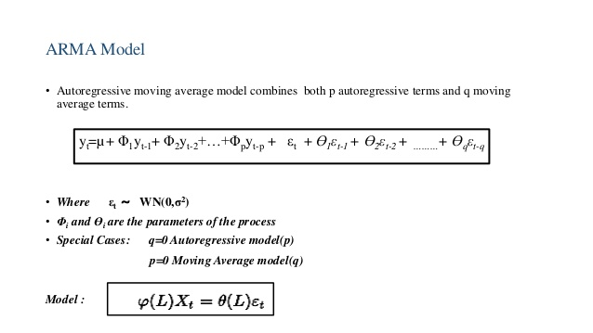
ARMA MODEL

Slide 9
Autoregressive Integrated Moving Average (ARIMA): –
A statistical technique that uses time series data to predict future. The parameters used in the ARIMA is (P, d, q) which refers to the autoregressive, integrated and moving average parts of the data set, respectively. ARIMA modeling will take care of trends, seasonality, cycles, errors and non-stationary aspects of a data set when making forecasts.
Example: measuring the level of unemployment each month of the year would comprise a time series.

Slide 10
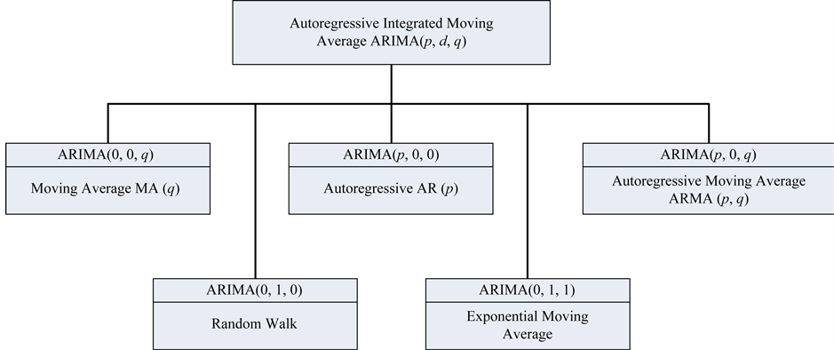

Slide 11
DIAGNOSTIC CHECK
ARMA (p, q)‐model has been fitted to a stationary time series. A diagnostic check for this model is suggested, using the estimated cross correlation function (CCF) between the observed series and the residuals.
For AR (p)‐processes the asymptotic covariance matrix of the estimated cross correlations is obtained.
Portmanteau statistic for testing the adequacy of the model for various choices of m where m is the number of autocorrelations. Some of the commonly applied diagnostic checks are discussed subsequently
For diagnostic use different tests ,ex, unit root test,Box Jenkins test. Make use of Box. Test() function to find p.
If p-value is non zero then no serial correlation is there & model is fit & can be used for forecasting purpose

