Slide 1
Mutation and DNA Repair
Chapter -16

Slide 2
Learning Objectives
To understand the phenomenon of mutations
Types of Mutations
How mutation affects DNA sequences
DNA Damage
DNA repair system

Slide 3
Mutation
A sudden change in the gene expression
OR
A change in DNA sequences
TYPES: ERRORS or Mutagen

Slide 4
Spontaneous mutations
Errors during cell division
Mismatches are readily targeted
DNA polymerase makes mistakes 1/100,0000
Making point mutation

Slide 5
Mutagen
Physical or chemicals factors inducing mutation
Chemicals reaction with DNA molecules
Heat, ultraviolet radiation, and other physical mutagens have similar effects.
Genetic factors can also mutate genes

Slide 6
Point Mutation
One nucleotide is replaced by another.
Simple mutations, or single-site mutations.
Transition or Transversion
Insertion , Deletion

Slide 9
Mutagens

Slide 10
Types | Examples
Base analogs Deaminating agents Alkylating agents Intercalating agents | 5-Bromouracil, 2-aminopurine Nitrous acid, sodium bisulfite Ethylmethane sulfonate, dimethylnitrosamine, Ethidium bromide

Slide 11
De-amination
Interclating agents

Slide 12
Dimer Formation: Photoproducts induced by UV O
irradiation. A segment of a polynucleotide
containing two adjacent thymine bases .

Slide 13
DNA repair
Cells possess efficient repair systems
Genomes suffer every day coupled with the errors
Without these repair systems it would be only a few hours before key genes became inactivated by DNA
damage.
Accumulation of replication errors leads to dysfunction after a few thousand cell divisions.

Slide 14
Repair system
Direct repair
Excision repair
mismatch repair
nonhomologous end joining (NHEJ)

Slide 15
Direct repair system
Directly without removal of the nucleotide
Products of alkylation
Enzymes that transfer the alkyl group from the nucleotide to their own polypeptide chains
Example: Ada enzyme of E. coli
Alkyl groups attached to the oxygen atoms at positions 4 and 6 of thymine and guanine
MGMT (O6-methylguanine-DNA methyltransferase)
Cyclobutyl dimers resulting from UV damage can also be repaired by DNA photolyase (photoreactivation)
Activated at wavelength between 300 and 500 nm this enzyme
binds to cyclobutyl dimers

Slide 16
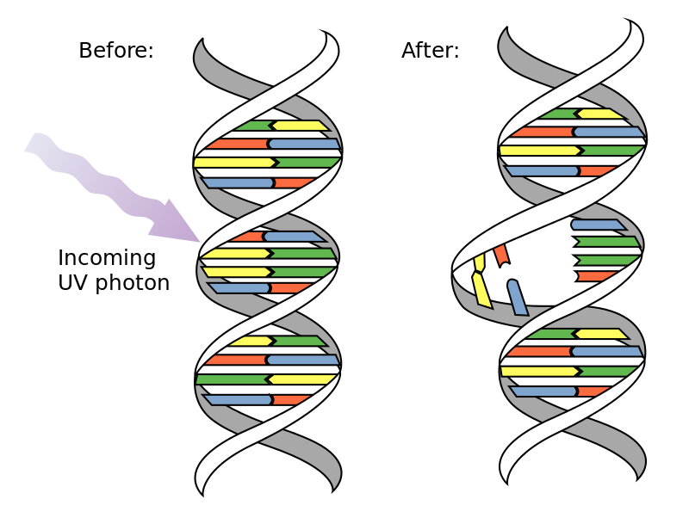
Photon causes two consecutive bases on one strand to bind together, destroying the normal base-pairing double-strand structure in that area.

Slide 17
Base Excision
Removal of one or more damaged nucleotides followed by resynthesis of DNA.
DNA glycosylase remove b-N-glycosidic bond between a damaged base and the sugar component of the nucleotide
Apurinic/apyrimidinic AP endonuclease, which cuts the phosphodiester bond on the 5’ side of the AP site

Slide 19
Nucleotide excision repair
Nucleotide excision repair is a second type of excision repair system, able to deal with more extreme forms of damage such as intrastrand crosslinks
a segment of single-stranded DNA containing the damaged nucleotide(s) is excised and replaced with new DNA
Short-patch repair is initiated by a multienzyme complex called the UvrABC endonuclease

Slide 20
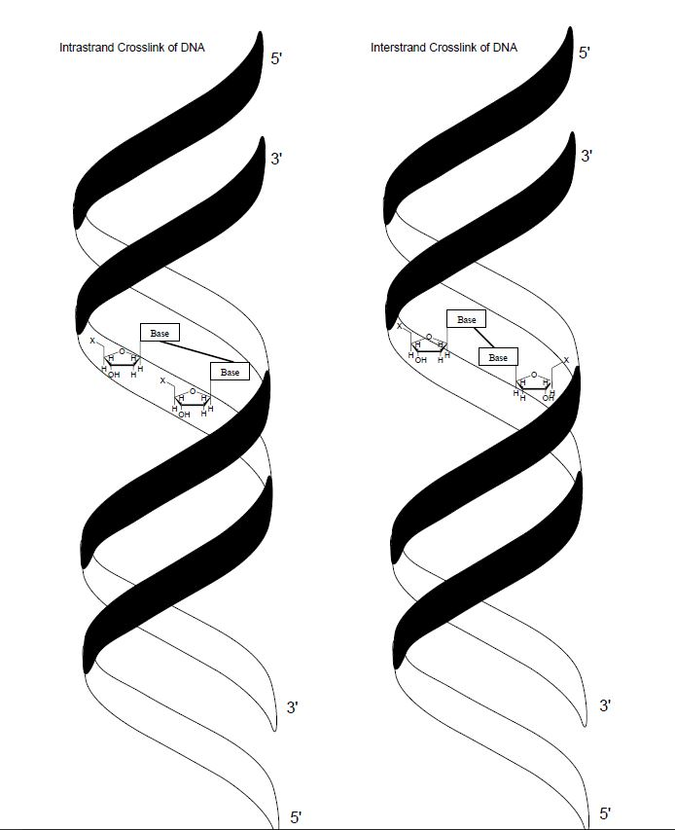

Slide 22
Mismatch repair system
It is simply removal of an A, C, G, or T that has been inserted at the wrong position.
Mismatch repair system detect the absence of base pairing between the parent and daughter strands.
Repair system excises part of the daughter polynucleotide and fills in the gap
Ecoli mismatch repair systems, called long-patch, short–patch, and very-short-patch

Slide 23
Mismatch repair system
The long-patch system replaces up to 1 kb or more of DNA and requires the MutH, MutL, and MutS proteins, as well as the DNA helicase II.
MutS recognizes the mismatch, and MutH distinguishes the two strands by binding to unmethylated 5’-GATC-3’ sequences

Slide 26
DNA breaks
A single stranded break in a double-stranded DNA molecule, such as is produced by some types of oxidative damage.
Double strand breaks can be repaired by the nonhomologous end joining process.
Ku proteins bind the DNA ends on either side of the break

