Slide 1
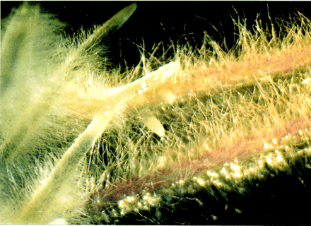
Agrobacterium - mediated Gene Transfer
Most common method of engineering dicots, but also used for monocots
Pioneered by J. Schell (Max-Planck Inst., Cologne)
Agrobacteria
  soil bacteria, gram-negative, related to Rhizobia
  species:
tumefaciens- causes crown galls on many dicots
rubi- causes small galls on a few dicots
rhizogenes- hairy root disease
radiobacter- avirulent

Slide 2
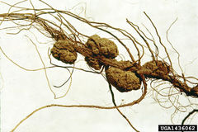
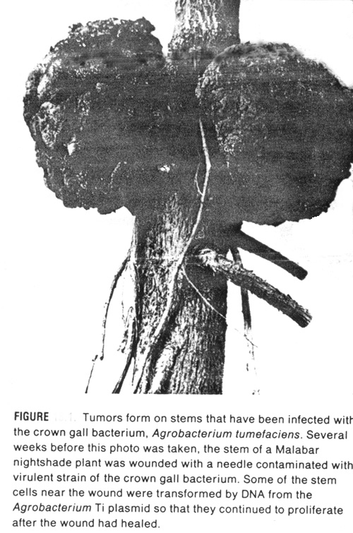
Crown galls caused by A. tumefaciens on nightshade.
More about Galls:
http://waynesword.palomar.edu/pljuly99.htm
http://kaweahoaks.com/html/galls_ofthe_voaks.html

Slide 3
Agrobacterium tumefaciens
the species of choice for engineering dicot plants; monocots are generally resistant
some dicots more resistant than others (a genetic basis for this)
complex bacterium – genome has been sequenced; 4 chromosomes; ~ 5500 genes

Slide 4
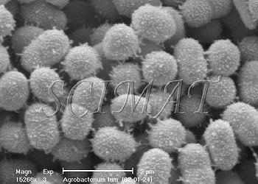
Agrobacterium tumefaciens
Notes:
Note: pili used for attachment to plant cells, and conjugation to other bacteria.

Slide 5
Ti Plasmid
Large (200-kb)
Conjugative
~10% of plasmid transferred to plant cell after infection
Transferred DNA (called T-DNA) integrates semi-randomly into nuclear DNA
Ti plasmid also encodes:
  enzymes involved in opine metabolism
  proteins involved in mobilizing T-DNA (Vir genes)

Slide 6
T-DNA
LB
auxA auxB cyt ocs
RB
LB, RB – left and right borders (direct repeat)
auxA + auxB – enzymes that produce auxin
cyt – enzyme that produces cytokinin
Ocs – octopine synthase, produces octopine
These genes have typical eukaryotic expression signals!

Slide 7
auxA auxB
Tryptophan→ indoleacetamide → indoleacetic acid (auxin)
cyt
AMP + isopentenylpyrophosphate → isopentyl-AMP (a cytokinin)
Increased levels of these hormones stimulate cell division.
Explains uncontrolled growth of tumor.

Slide 8
Vir (virulent) genes
On the Ti plasmid
Transfer the T-DNA to plant cell
Acetosyringone (AS) (a flavonoid) released by wounded plant cells activates vir genes.
virA,B,C,D,E,F,G (7 complementation groups, but some have multiple ORFs), span about 30 kb of Ti plasmid.

Slide 9
Vir gene functions (cont.)
virA - transports AS into bacterium, activates virG post-translationally (by phosphoryl.)
virG - promotes transcription of other vir genes
virD2 - endonuclease/integrase that cuts T- DNA at the borders but only on one strand; attaches to the 5' end of the SS
virE2 - binds SS of T-DNA & can form channels in artificial membranes
virE1 - chaperone for virE2
virD2 & virE2 also have NLSs, gets T-DNA to the nucleus of plant cell
virB - operon of 11 proteins, gets T-DNA through bacterial membranes

Slide 10
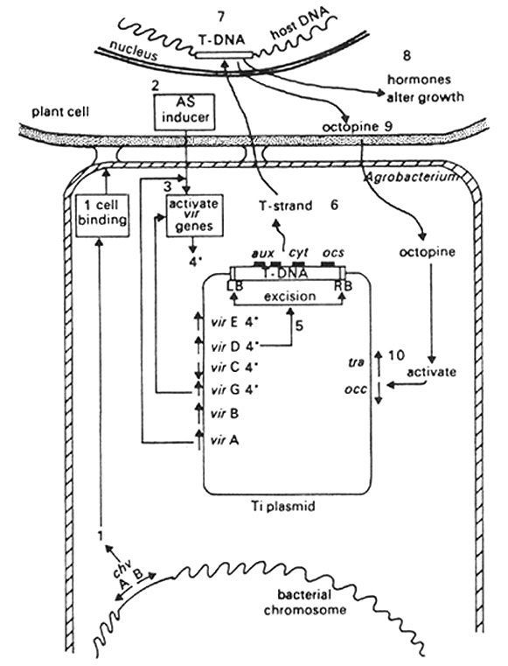
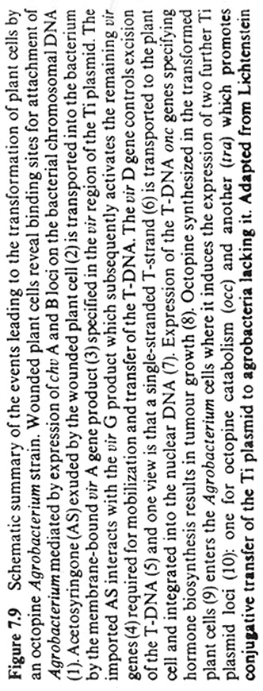
From Covey & Grierson

Slide 11
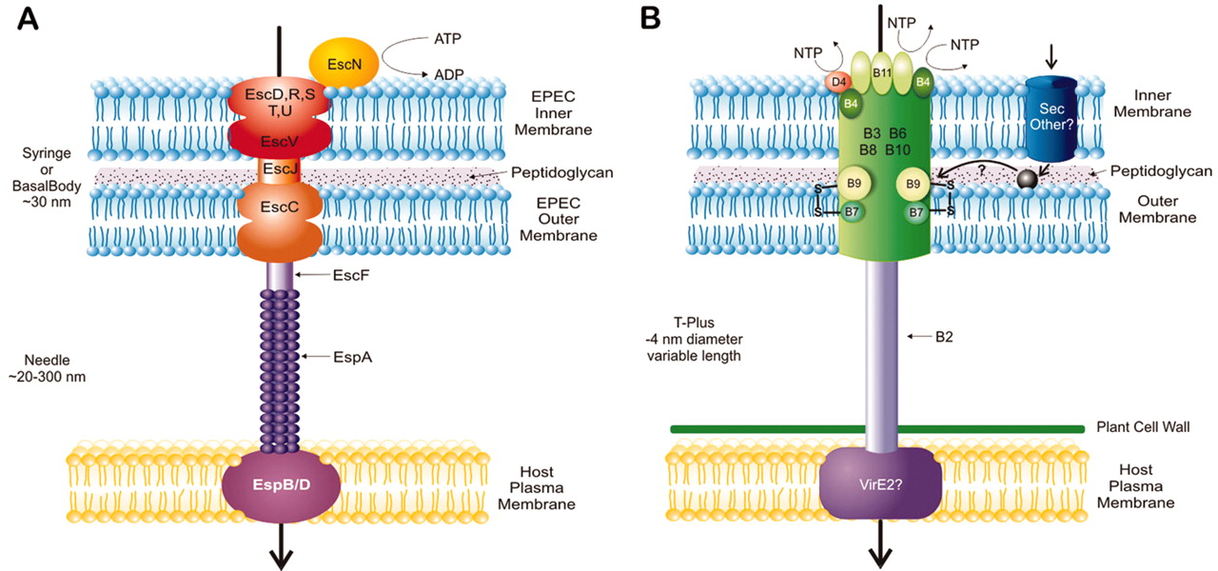
Type IV Secretion Sys.
many pathogens, also used in conjugation
promiscuous
forms T-Pilus
B7-B10 span OM & IM
B7-B9 in OM interacts w/B8 & B10 of IM to form channel
3 ATPases
D4 promotes specific transport
B2 can form filaments
Gauthier, A. et al. (2003) J. Biol. Chem. 278:25273-25276

Slide 12
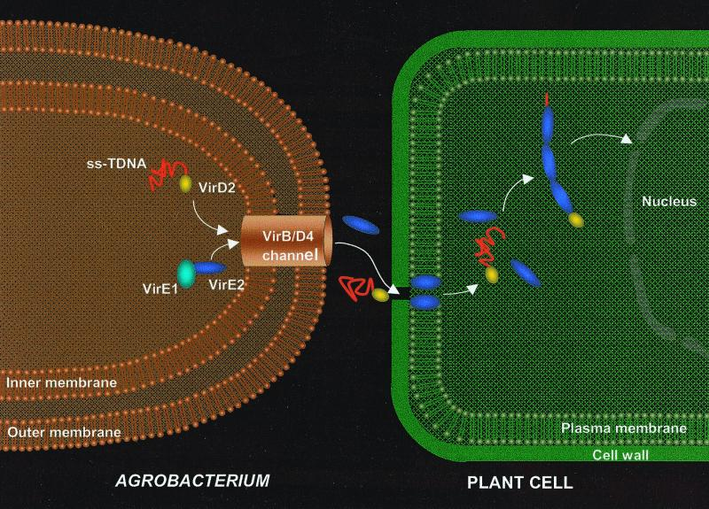
VirE2 may get DNA-protein complex across host PM
Dumas et al., (2001), Proc. Natl. Acad. Sci. USA, 98:485
Notes:
VirE1 chaperones VirE2 in Agro. Cytoplasm, but complex can also bind the SS T-DNA. VirE2 may help the T-DNA cross the plant cell PM, as it can form a channel in artificial bilayers by itself.

Slide 13
Monocots don't produce AS in response to wounding.
Important: Put any DNA between the LB and RB of T-DNA it will be transferred to plant cell!
Engineering plants with Agrobacterium:
Two problems had to be overcome:
(1) Ti plasmids large, difficult to manipulate
(2) couldn't regenerate plants from tumors

Slide 14
Binary vector system
Strategy:
1. Move T-DNA onto a separate, small plasmid.
2. Remove aux and cyt genes.
3. Insert selectable marker (kanamycin resistance) gene in T-DNA.
4. Vir genes are retained on a separate plasmid.
5. Put foreign gene between T-DNA borders.
6. Co-transform Agrobacterium with both plasmids.
7. Infect plant with the transformed bacteria.

Slide 15
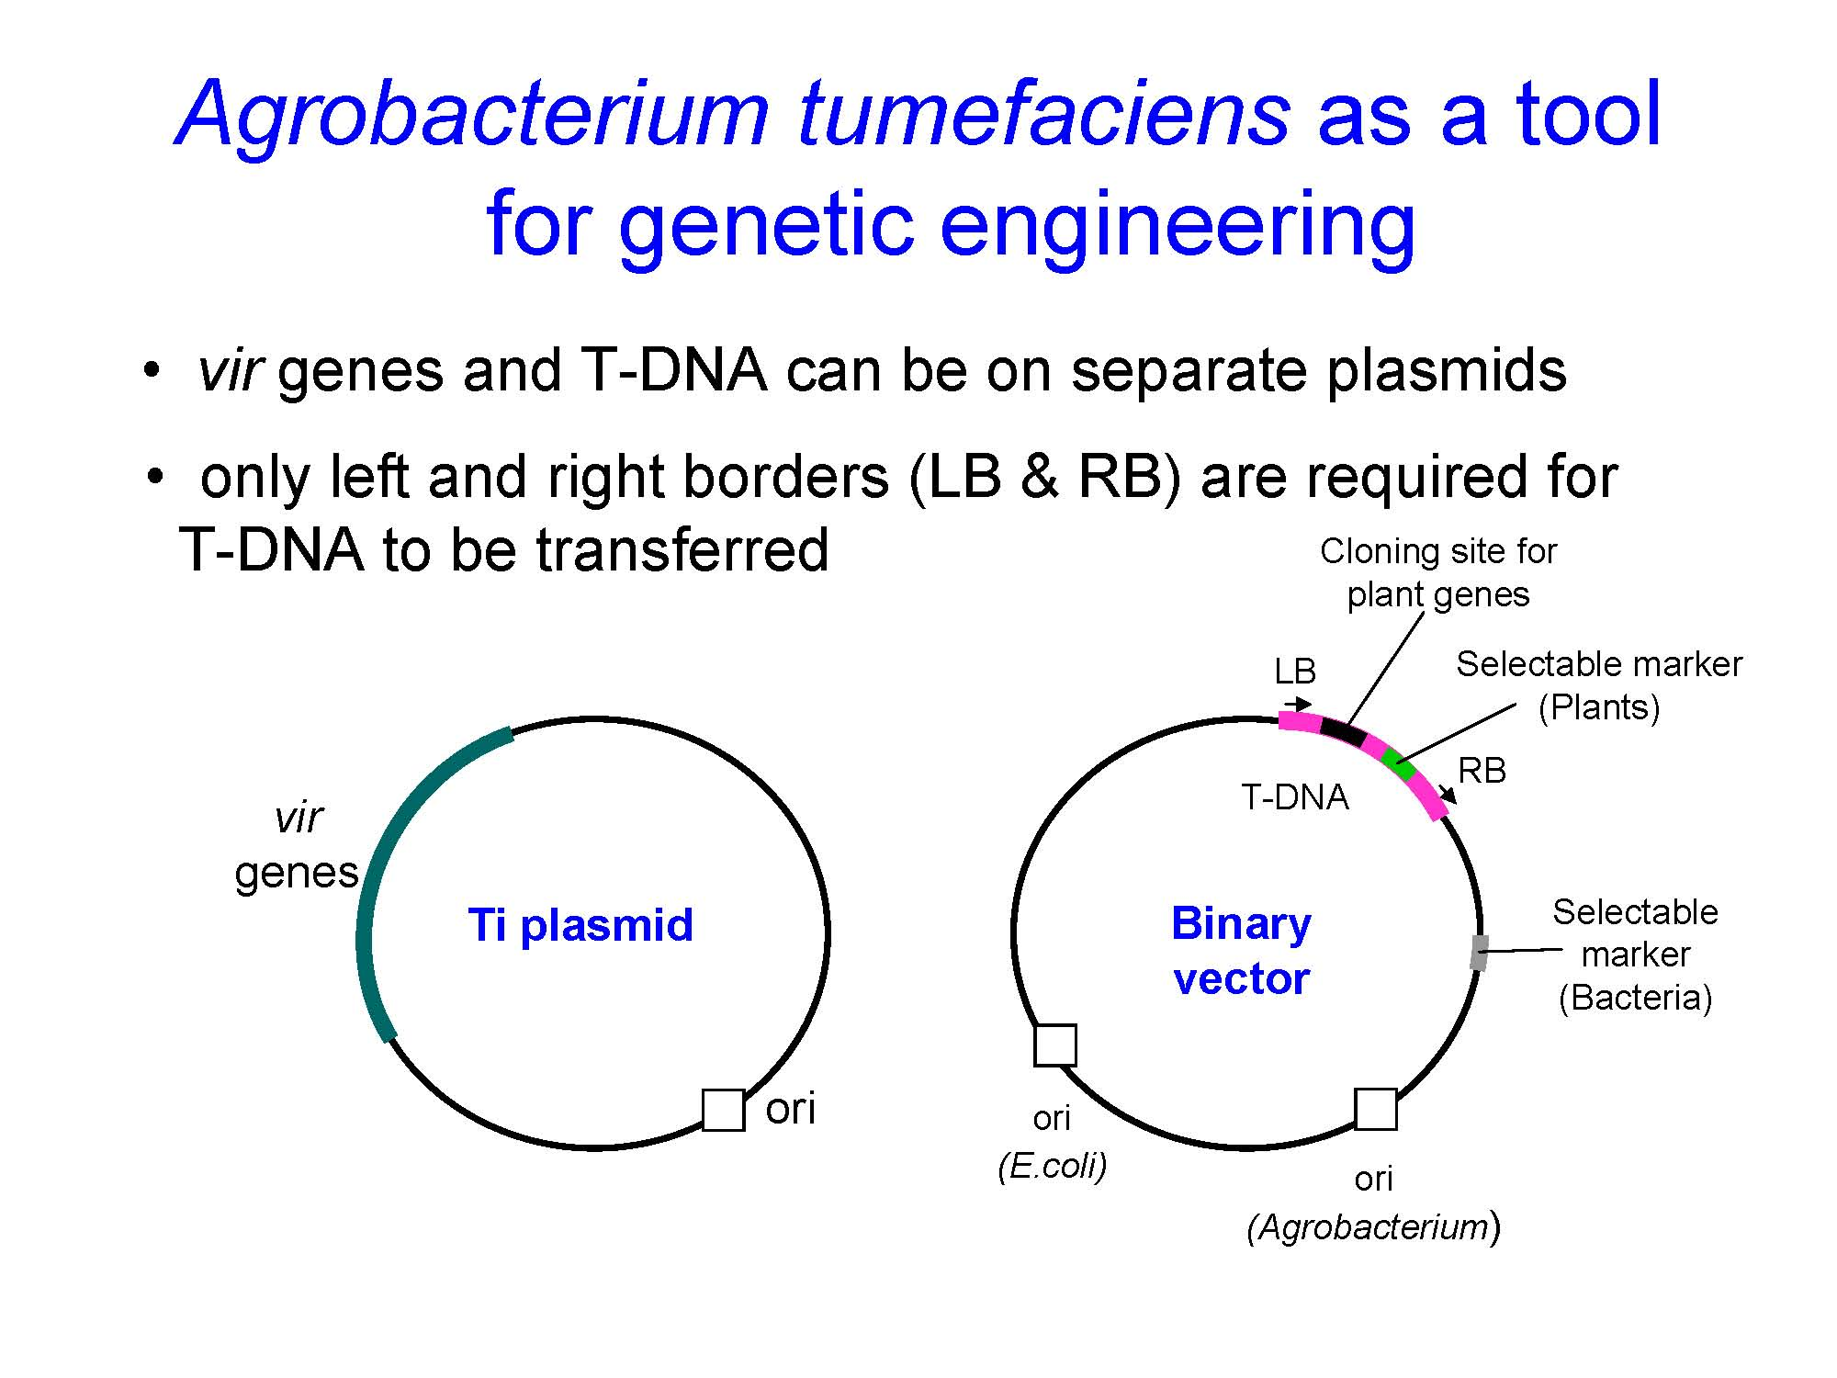
Binary vector system

Slide 16
2 Common Transformation Protocols
Leaf-disc transformation - after selection and regeneration with tissue culture, get plants with the introduced gene in every cell
Floral Dip – does not require tissue culture. Reproductive tissue is transformed and the resulting seeds are screened for drug-resistant growth. (Clough and Bent (1998) Floral dip: a simplified method for Agrobacterium-mediated transformation of Arabidopsis thaliana. Plant Journal 16, 735–743)

Slide 17
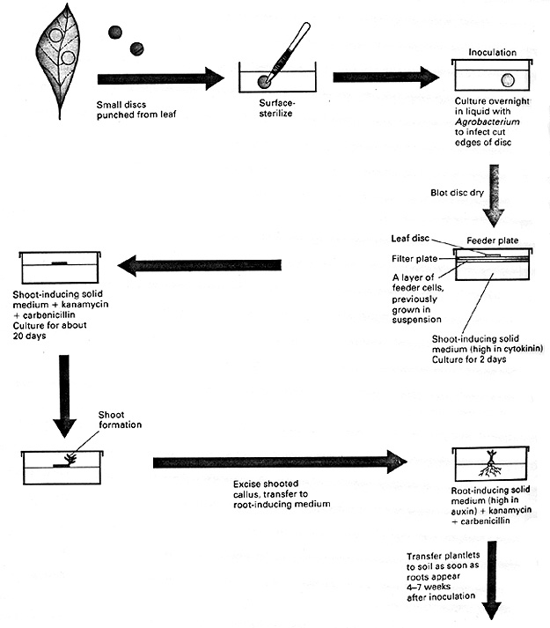
Making a transgenic plant by leaf disc transformation with Agrobacterium.
S.J. Clough, A.F. Bent (1998) Floral dip: a simplified method for Agrobacterium-mediated transformation of Arabidopsis thaliana. Plant Journal 16, 735–743.

Slide 18
Genetically engineered crops/foods allowed in the US food supply

Slide 19
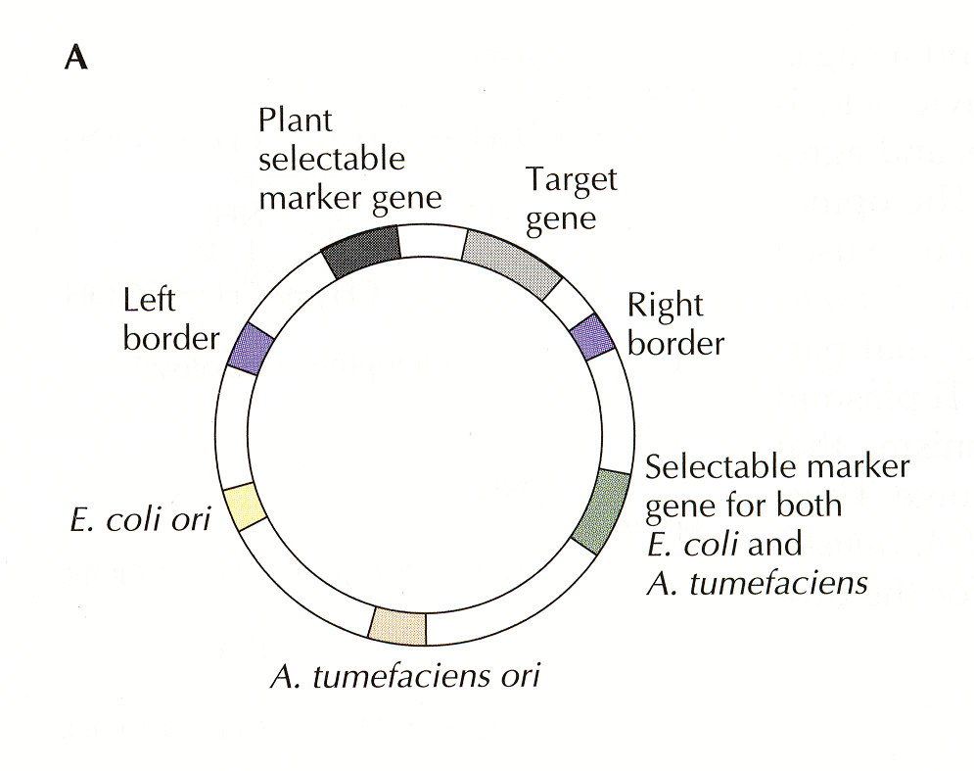
Fig. 18.7/19.3 A binary T-DNA plasmid for delivering the Bt gene to plants (not a cointegrate vector)
(NPT or kan^{r})
(35S-Bt gene-tNOS)
(Spc^{r})

Slide 20
Effectiveness of insecticide and Bt-tomato plants in resisting insect damage
% of plants or fruits damaged
Insect | wt tomato -insecticide | wt tomato +insecticide | Bt-tomato -insecticide | Bt-tomato +insecticide
Tobacco hornworm | 48 | 4 | 1 | 0
Tomato fruitworm | 20 | nd | 6 | nd
Tomato pinworm | 100 | 95 | 94 | 80
nd, not determined

Slide 21
Genetically engineered Bt-plants in the field
Product | Institution(s) | Engineered Trait(s) | Sources of New Genes | Name
Corn | Bayer | Resist glufosinate herbicide to control weeds/Bt toxin to control insect pests (European corn borer) | Bacteria, virus | StarLink-1998 (animals only)
Corn | Dow/Mycogen | Bt toxin to control insect pests (European corn borer) | Corn, bacteria, virus | NatureGard-1995
Corn | Dow/Mycogen | Resist glufosinate herbicide to control weeds/Bt toxin to control insect pests (Lepidopteran) | Corn, bacteria, virus | Herculex I-2001
 | DuPont/Pioneer
Corn | Monsanto/DeKalb | Bt toxin to control insect pests (European corn borer) | Bacteria | Bt-Xtra-1997
Corn | Monsanto | Bt toxin to control insect pests (European corn borer) | Bacteria | YieldGard-1996
Corn | Monsanto | Resist glyphosate herbicide to control weeds/Bt toxin to control insect pests (European corn borer) | Arabidopsis, bacteria, virus | ?-1998
Corn | Syngenta | Bt toxin to control insect pests (European corn borer) | Bacteria | Bt11-1996
Corn | Syngenta | Bt toxin to control insect pests (European corn borer) | Corn, bacteria, virus | Knock Out-1995
Corn (pop) | Syngenta | Bt toxin to control insect pests (European corn borer) | Corn, bacteria, virus | Knock Out-1998
Corn (sweet) | Syngenta | Bt toxin to control insect pests (European corn borer) | Bacteria | Bt11-1998
Cotton | Monsanto/Bayer | Resist bromoxynil herbicide to control weeds/Bt toxin to control insect pests (cotton bollworms | Bacteria | ?-1998
 |  | and tobacco budworm)
Cotton | Monsanto | Bt toxin to control insect pests (cotton bollworms and tobacco budworm) | Bacteria | Bollgard-1995
Potato | Monsanto | Bt toxin to control insect pests (Colorado potato beetle) | Bacteria | NewLeaf-1995
Potato | Monsanto | Bt toxin to control insect pests (Colorado potato beetle)/resist potato virus Y | Bacteria, virus | NewLeaf Y-1999
Potato | Monsanto | Bt toxin to control insect pests (Colorado potato beetle)/resist potato leafroll virus | Bacteria, virus | NewLeaf Plus-1998

Slide 22
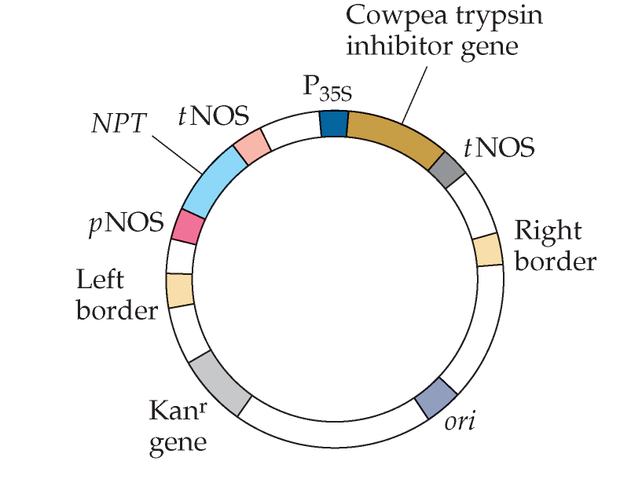
Figure 19.3
Binary cloning vector carrying a cowpea trypsin inhibitor gene

Slide 23
Herbicides and herbicide-resistant plants
Herbicides are generally non-selective (killing both weeds and crop plants) and must be applied before the crop plants germinate
Four potential ways to engineer herbicide resistant plants
    Inhibit uptake of the herbicide
    Overproduce the herbicide-sensitive target protein
    Reduce the ability of the herbicide-sensitive target to bind to the herbicide
    Give plants the ability to inactivate the herbicide

Slide 24
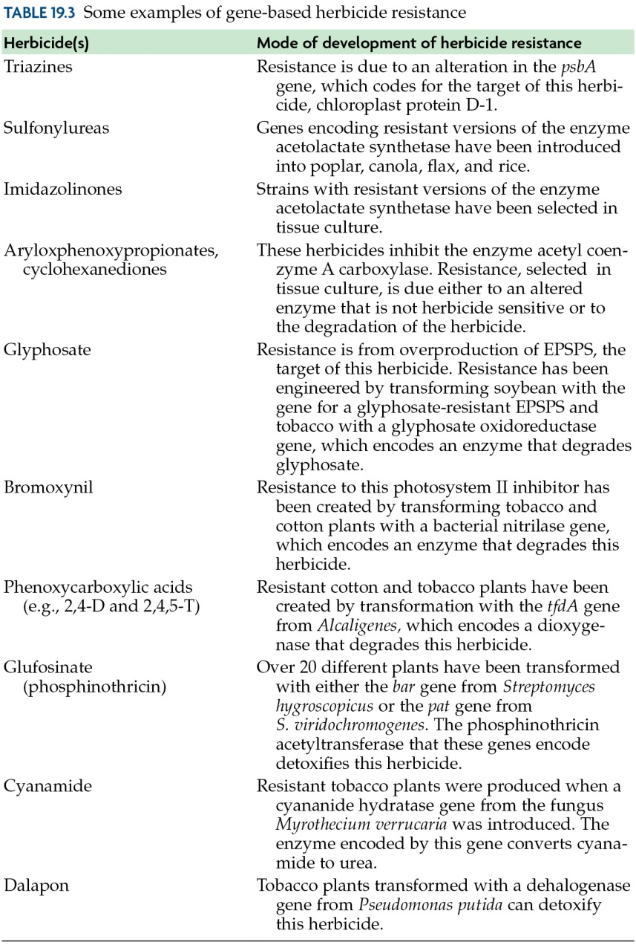
Table 19.3

Slide 25
Herbicide-resistant plants:
Giving plants the ability to inactivate the herbicide
Herbicide: Bromoxynil
Resistance to bromoxynil (a photosytem II inhibitor) was obtained by expressing a bacterial (Klebsiella ozaenae) nitrilase gene that encodes an enzyme that degrades this herbicide

Slide 26
Herbicide-resistant plants:
Reducing the ability of the herbicide-sensitive target to bind to the herbicide
Herbicide: Glyphosate (better known as Roundup)
Resistance to Roundup (an inhibitor of the enzyme EPSP involved in aromatic amino acid biosynthesis) was obtained by finding a mutant version of EPSP from E. coli that does not bind Roundup and expressing it in plants (soybean, tobacco, petunia, tomato, potato, and cotton)
5-enolpyruvylshikimate-3-phosphate synthase (EPSP) is a chloroplast enzyme in the shikimate pathway and plays a key role in the synthesis of aromatic amino acids such as tyrosine and phenylalanine
This is a big money maker for Monsanto!

Slide 27
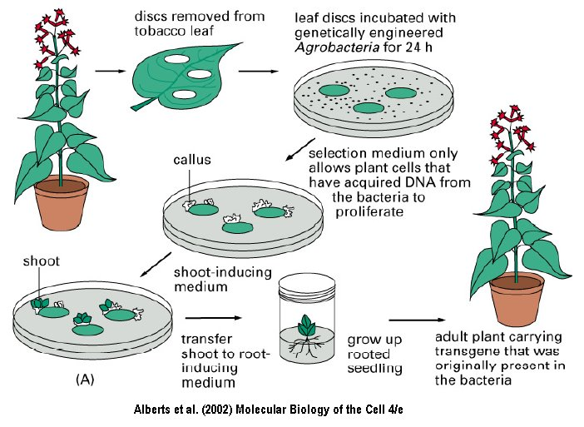
How to make a Roundup Ready Plant

Slide 28
Plants are also being genetically engineered for:
Biofuel production (e.g., lower lignin, lower recalcitrance)
Phytoremediation (i.e., bioremediation using plants)
Biopolymers (i.e., biodegradable plastics)

