Slide 1
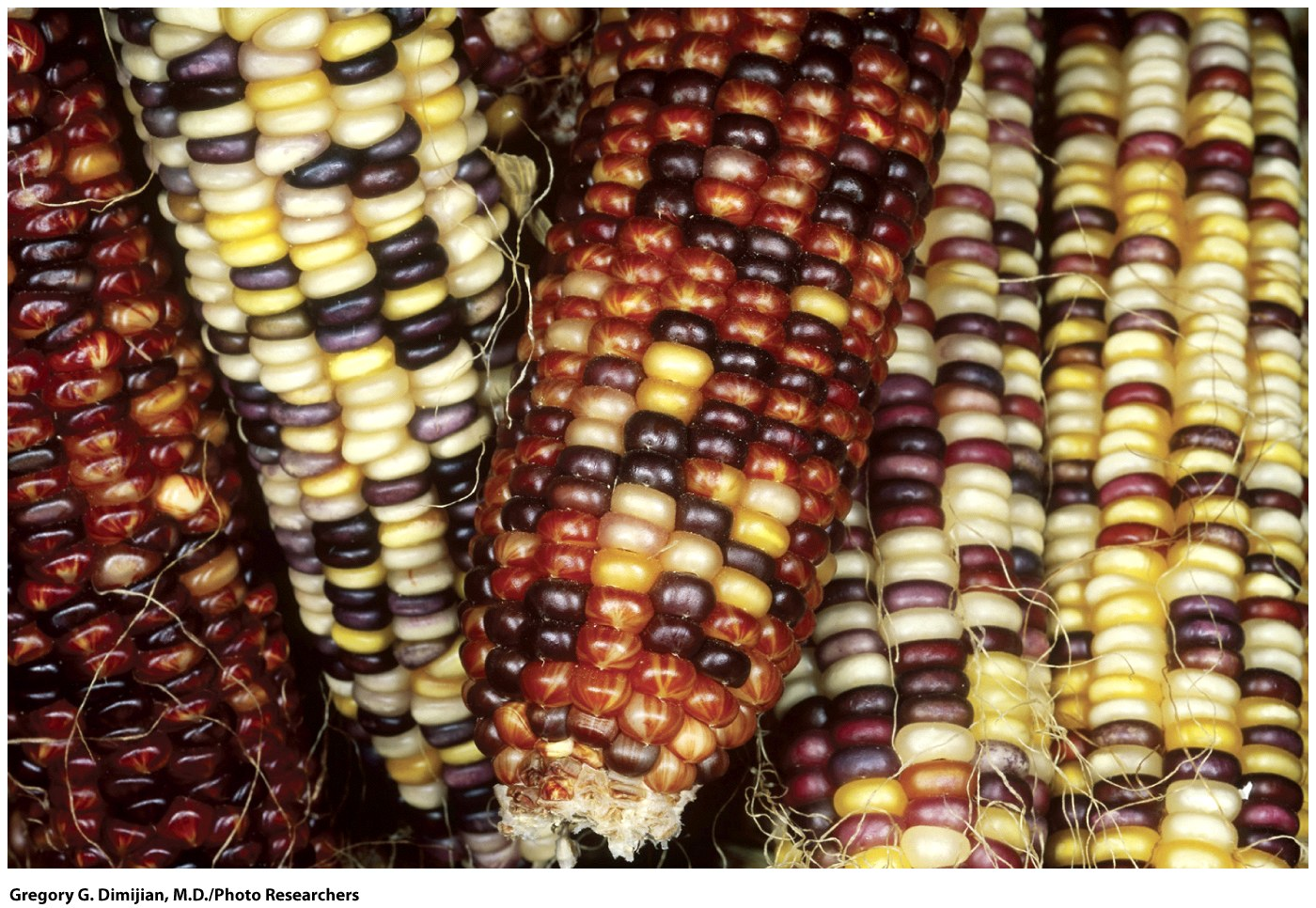
Chapter 17
Transposable Genetic Elements

Slide 2
Objectives
What are Transposable Elements:
An Overview
in Bacteria
in Eukaryotes
Retroviruses and Retrotransposons
Transposable Elements in Humans
The Genetic and Evolutionary Significance of Transposable Elements

Slide 3
Transposable Elements:
An Overview
Transposable elements: -transposons- (~40% of the genomic DNA)
They are “specific” sequence of DNA.
They are found in the genomes of many kinds of organisms.
They are structurally and functionally diverse.

Slide 4
Types of Transposition
In cut-and-paste transposition, an element is cut out of one site in a chromosome and pasted into a new site.
In replicative transposition, an element is replicated, and one copy is inserted at a new site; one copy also remains at the original site.
In retrotransposition, an element’s RNA is used as a template to synthesize DNA molecules, which are inserted into new chromosomal sites.

Slide 5
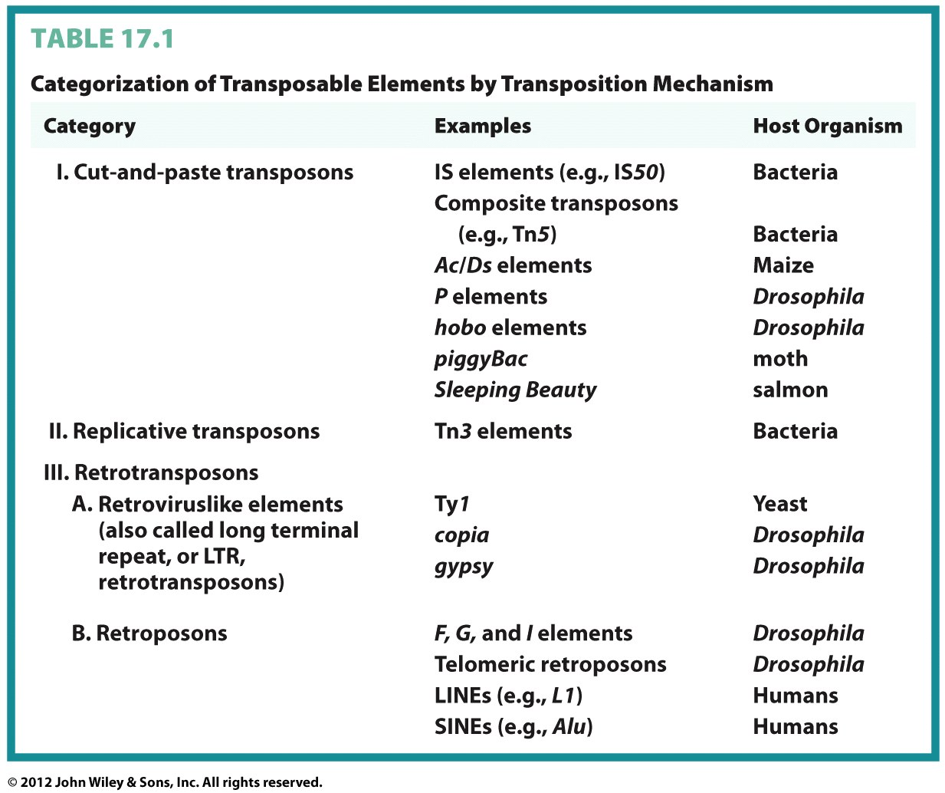

Slide 6
A cut-and-paste transposon is excised from one genomic position and inserted into another by an enzyme, the transposase, which is usually encoded by the transposon itself.
A replicative transposon is copied during the process of transposition.
A retrotransposon produces RNA molecules that are reverse-transcribed (by an enzyme-reverse transcriptase-) into DNA molecules; these DNA molecules are subsequently inserted into new genomic positions.

Slide 7
Transposable Elements in Bacteria
Bacterial transposons move within and between chromosomes and plasmids.
Are the extra circular chromosomal structures which are present in the bacterial cell
Contain and spread of antibiotic resistance genes

Slide 8
Bacterial Transposons
Insertion Sequences (IS Elements)
Composite Transposons
Tn3 Elements

Slide 9
IS Elements
Insertion Sequences (IS elements) are the simplest bacterial transposons (small DNA fragment).
IS elements were first detected in certain lac⁽⁻⁾ gene mutations of E. coli (it reverses the wild type phenotype).
IS elements are compactly organized (~2500 bp) and contain only genes whose products are involved in transposition.
Inverted terminal repeats are found at the ends.
Some IS elements encode transposase, an enzyme.

Slide 10
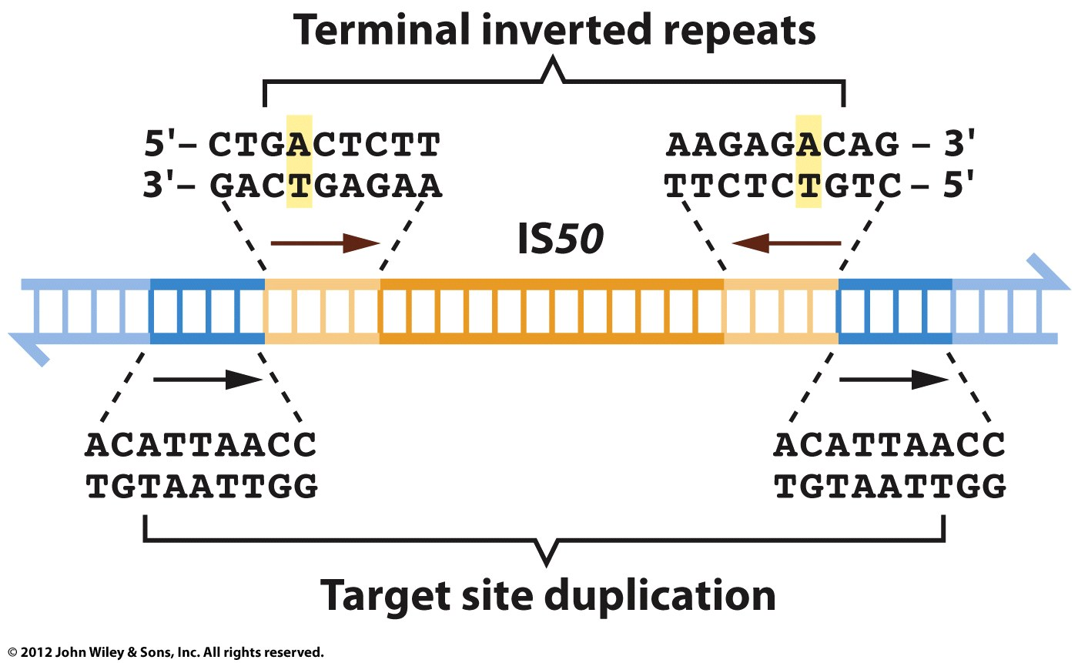
The IS50 Element
transposase

Slide 11
Bacterial transposons are demarcated by
inverted terminal repeats;
When they insert into a DNA molecule, they
create a duplication of sequences at the
insertion site (a target site duplication).

Slide 12
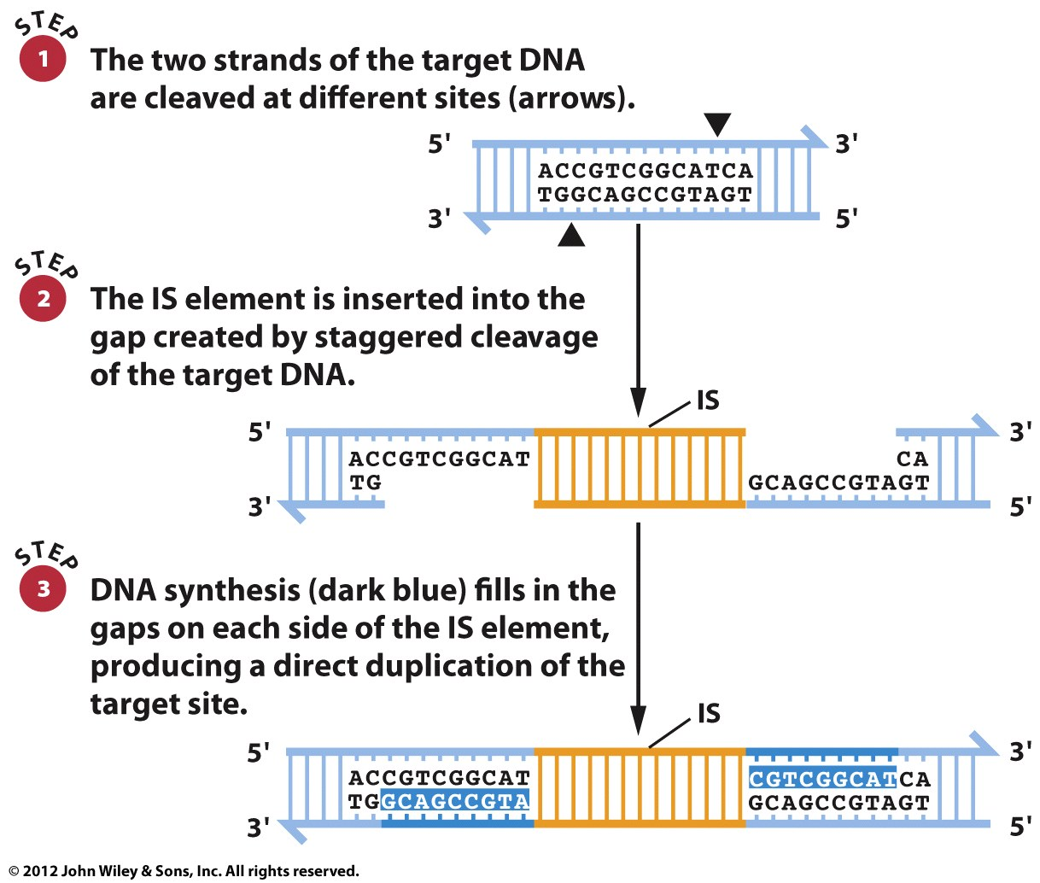
Insertion of an IS Element Causes Target Site Duplication
Two different way to cut DNA by
restriction enzymes:
-blunt ends
-over hanging ends -(sticky ends)

Slide 13
Multiple IS Elements
The bacterial chromosome may contain several copies of an IS element.
Plasmids may also contain IS elements.
When a particular IS element is found on both a plasmid and a chromosome, homologous recombination may occur.

Slide 14
Conjugative R Plasmids
Bacteria mating A non-chromosomal circular DNA
Resistance
Conjugative R plasmids have spread multiple drug resistance in bacterial populations.
These plasmids have two components.
  The resistance transfer factor (RTF) contains genes required for conjugative transfer between cells.
  The R-determinant contains the genes for antibiotic resistance.

Slide 15
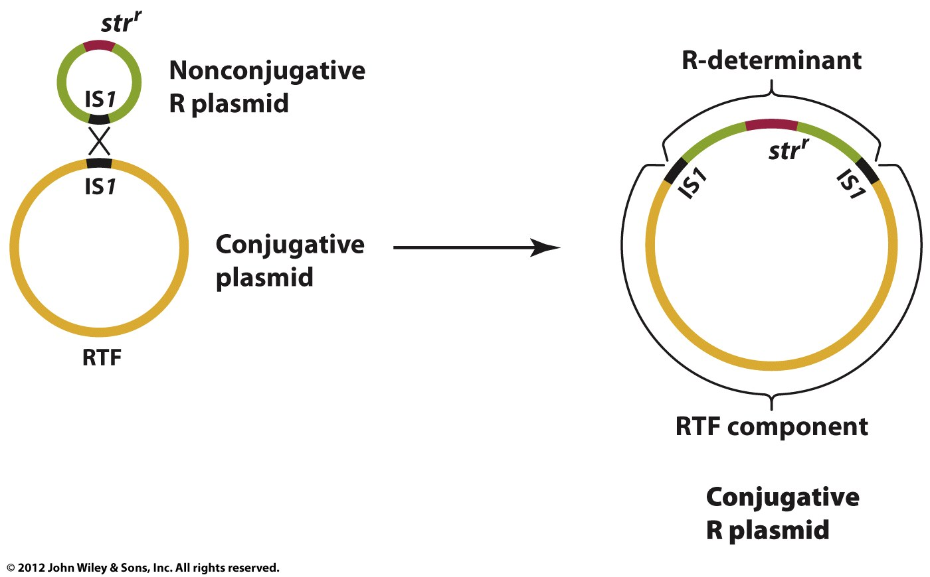
Formation of Conjugative R Plasmid by Recombination of IS Elements
F-plasmid-tra gene
R-plasmid- ?tra and other genes?
Col-plasmid
Virulence-plasmid
Degradative-plasmid
Satphylococcus
Enterptococcus
Neisseria
Shigella
Salmonella
Pseudomonas

Slide 16
Bacterial Transposons
© John Wiley & Sons, Inc.
Insertion Sequences (IS Elements)
Composite Transposons
Tn3 Elements
Notes:
16

Slide 17
Composite Transposons
Composite transposons are
--bacterial cut-and-paste transposons
--denoted by the symbol Tn.
--are created when two IS elements insert near each other.

Slide 18
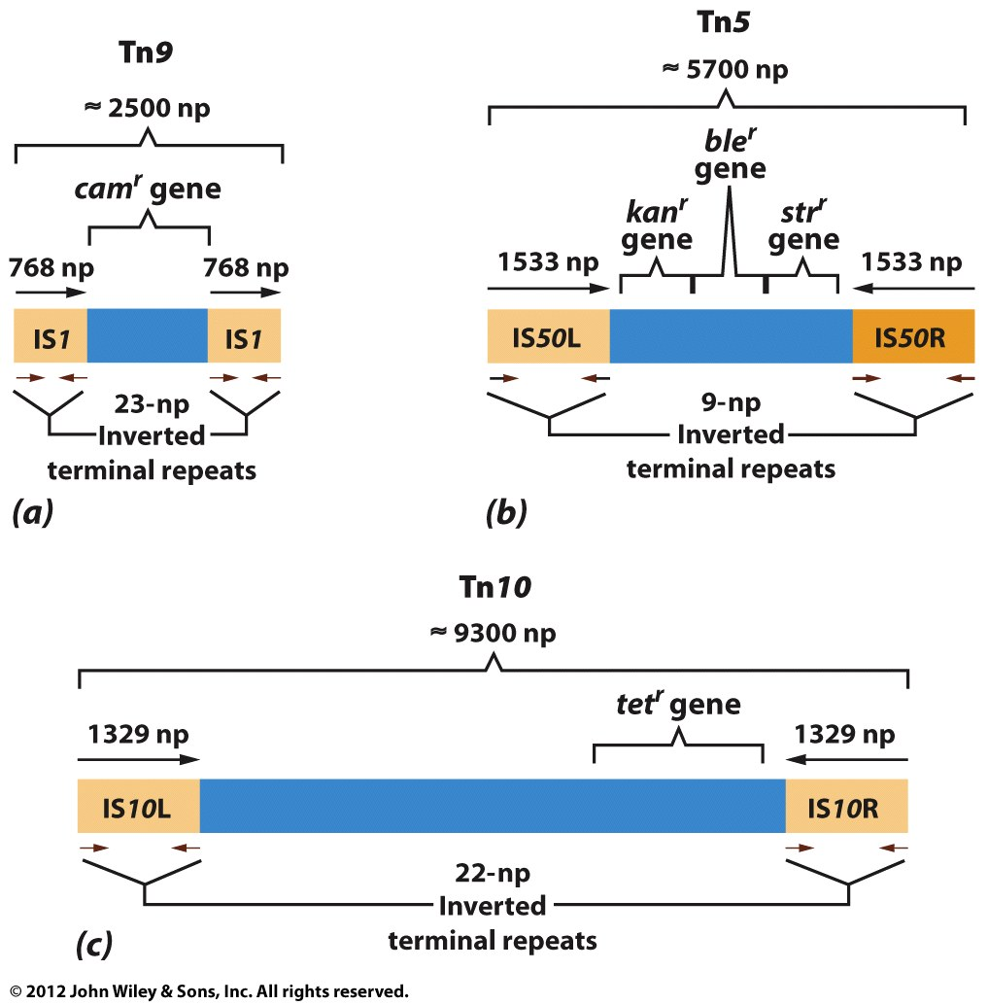
Genetic Organization of Composite Transposons
Cam: Chloramphenicol
Kan: Kanamycin
Str: Streptmycin
Tet: tetracycline
Ble: bleomycin
protein synthesis inhibitors (affecting the binding of
aminoacyl-tRNA to the mRNA-ribosome complex)

Slide 19
Composite transposons consist of two IS elements flanking a region that contains one or more genes for antibiotic resistance.

Slide 20
Bacterial Transposons
© John Wiley & Sons, Inc.
Insertion Sequences (IS Elements)
Composite Transposons
Tn3 Elements
Notes:
20

Slide 21
Tn3 Elements
Tn3 elements are larger than the IS elements.
Tn3 elements (like composite transposons) contain genes that are not required for transposition.
Tn3 elements have simple inverted repeats at each end (not IS elements).
Tn3 elements produce target site duplication when they transpose.

Slide 22
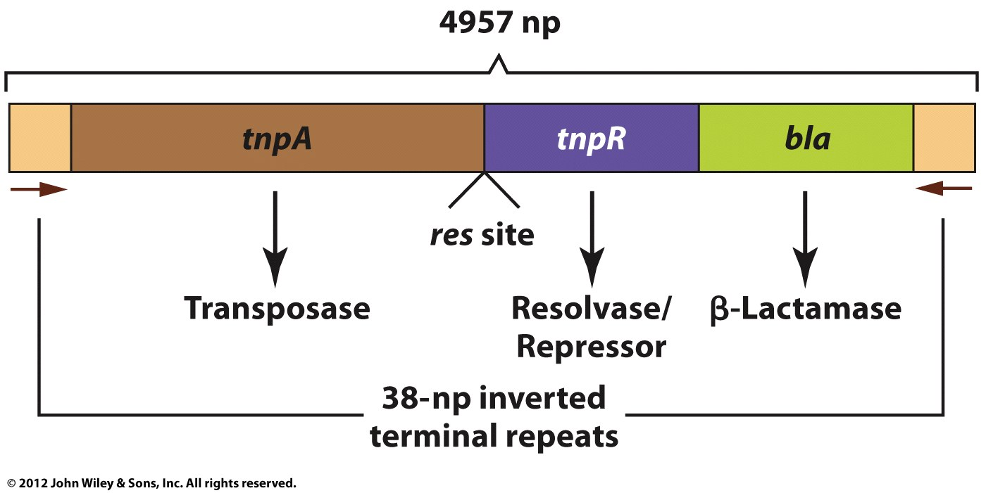
Genetic Organization of Tn3
Resistance to Amp
(ampicillin)

Slide 23
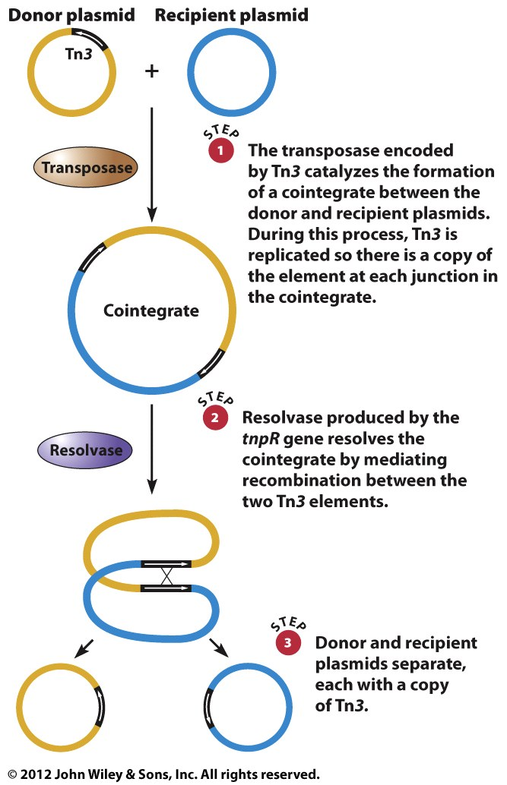
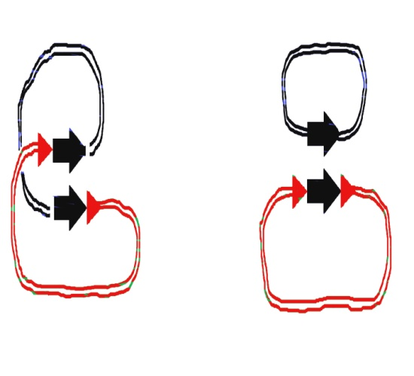
Transposition of Tn3
--Association, Replication, Integration
----transposase (integrase)
--Resolution
?

Slide 24
Tn3 is a replicative transposon that transposes by temporarily fusing DNA molecules into a cointegrate; when the cointegrate is resolved, each of the constituent DNA molecules emerges with a copy of Tn3.
© John Wiley & Sons, Inc.
Notes:
24

Slide 25
Insertion sequences (IS elements) are cut-and-paste transposons that reside in bacterial chromosomes and plasmids.
IS elements can mediate recombination between different DNA molecules.
Conjugative plasmids can move transposons that contain genes for antibiotic resistance from one bacterial cell to another.

Slide 26
Cut-and-Paste Transposons in Eukaryotes
Transposable elements were discovered by analyzing genetic instabilities in maize; genetic analyses have also revealed transposable elements in Drosophila.
Chromosome breakage

Slide 27
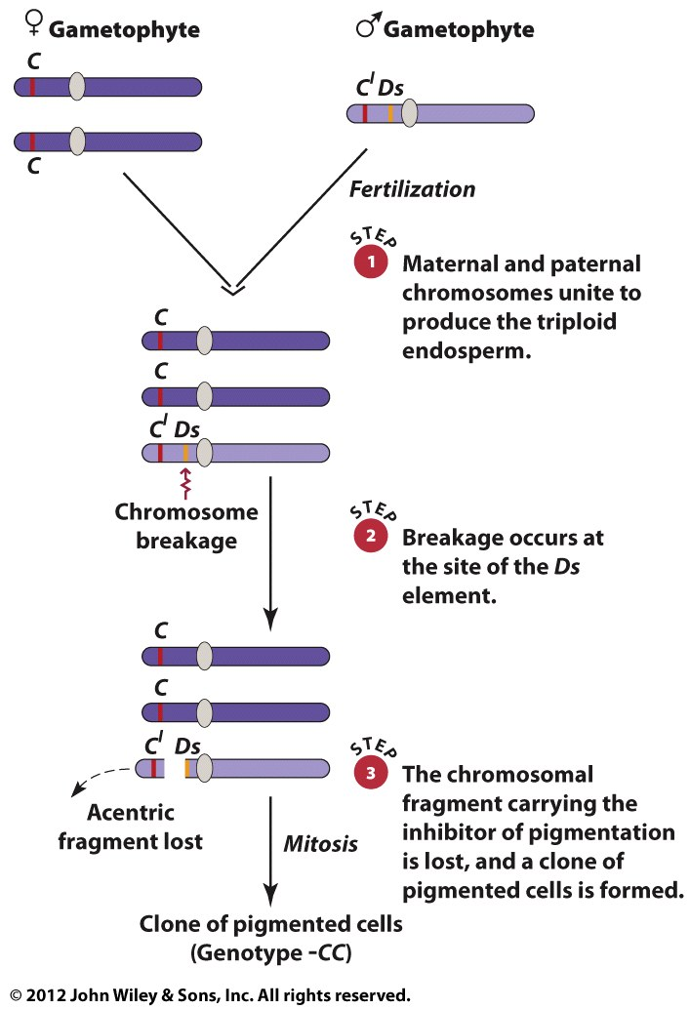
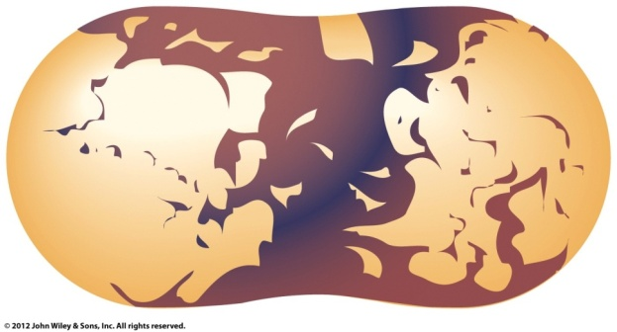
Ac and Ds Elements in Maize
(Triploid endosperm nucleus in maize)
Aleurone color is affected by
the C^{l} allele, which encodes dominant
inhibitor of aleurone coloration.
Mosaics with pigmented patches were
caused by loss of the C^{l} allele.

Slide 28
The Ac/Ds System
The Dissociation Factor (Ds) is located at a site on chromosome 9 in mosaic kernels where chromosome breakage occurs.
Ds cannot induce chromosome breakage by itself.
The Activator Factor (Ac) stimulates chromosome breakage at the site of Ds.

Slide 29
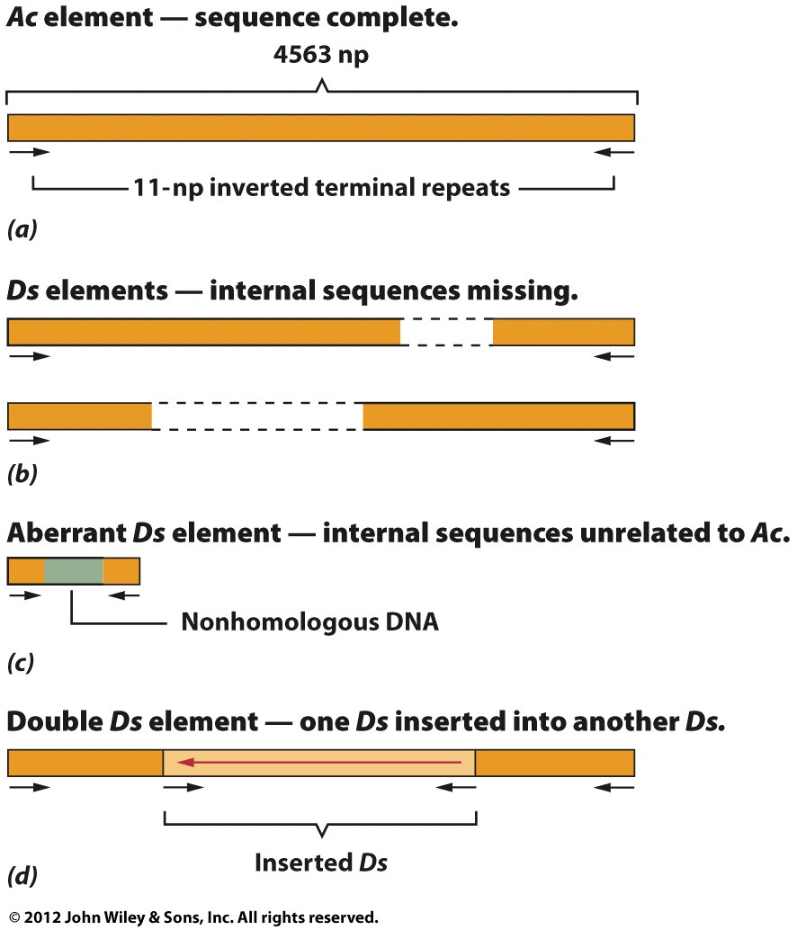
Essential for
transposition
Variations

Slide 30
Activities of the Ac/Ds Elements
The Ac element encodes a transposase that is responsible for excision, transposition, mutation, and chromosome breakage.
The Ac transposase interacts with sequences at the ends of Ac and Ds elements and catalyzes their movement.
Deletions or mutations in the Ac gene abolish its catalytic function.

Slide 31
P elements and Hybrid Dysgenesis in Drosophila
Drosophila crossing produced assorted aberrant traits…
Deletions,
Insertions,
Mutations,
Chromosome breakage
Chromosome abnormalities (dysgenesis)
Chromosome Instability
Sterility
Two types of strains: M and P strains
The chromosomes of P strains carry genetic factors that are activated in the
eggs of M females; these factors cause mutations and chromosome breakage

Slide 32
P Elements
The chromosomal element in P strains is called a P element ( DNA sequence).
P elements are transposons that are present in multiple copies and at different locations in the genomes of P strains but are absent from the genomes of M strains.

Slide 33
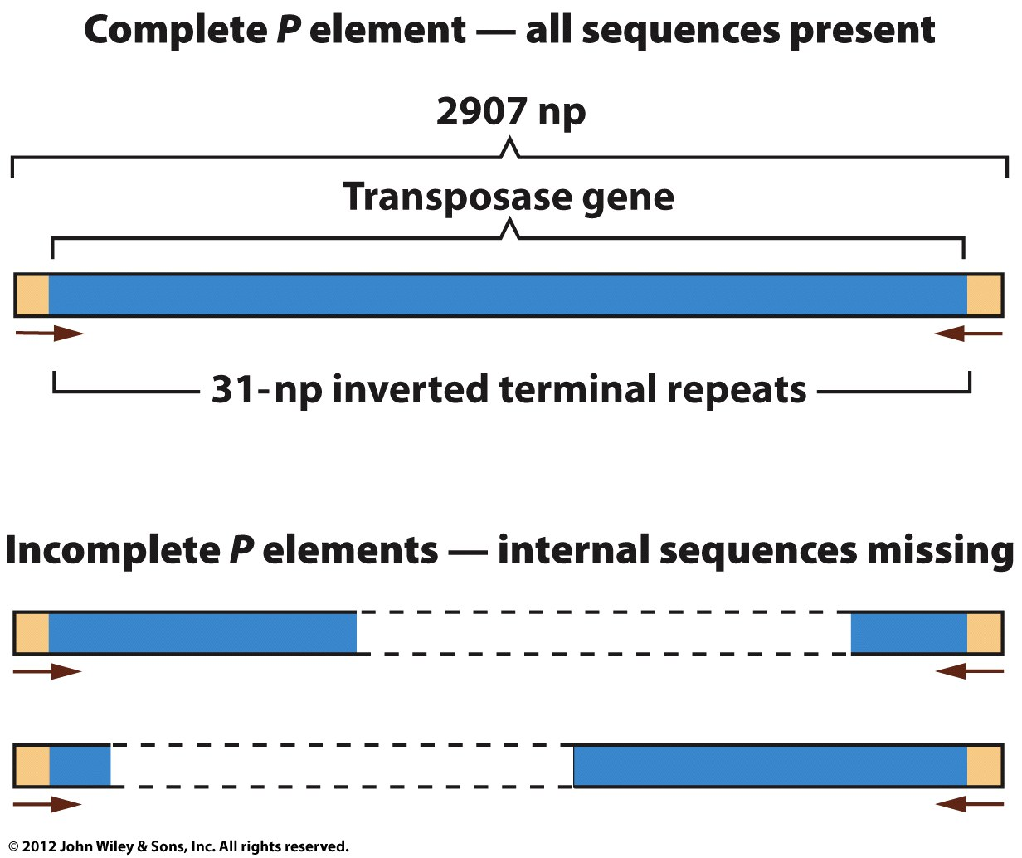
The Structure of P Elements
No transposase gene

Slide 34
© John Wiley & Sons, Inc.
Notes:
34

Slide 35
Retroviruses and Retrotransposons
Retroviruses and related transposable elements utilize the enzyme reverse transcriptase to copy RNA into DNA. The DNA copies of these entities are subsequently inserted at different positions in genomic DNA.

Slide 36
Retroviruses
Retroviruses possess an RNA-dependent DNA polymerase (reverse transcriptase), which allows them to synthesize DNA from an RNA transcript.
The human immunodeficiency virus (HIV), which causes acquired immune deficiency syndrome (AIDS), is a retrovirus.

Slide 37
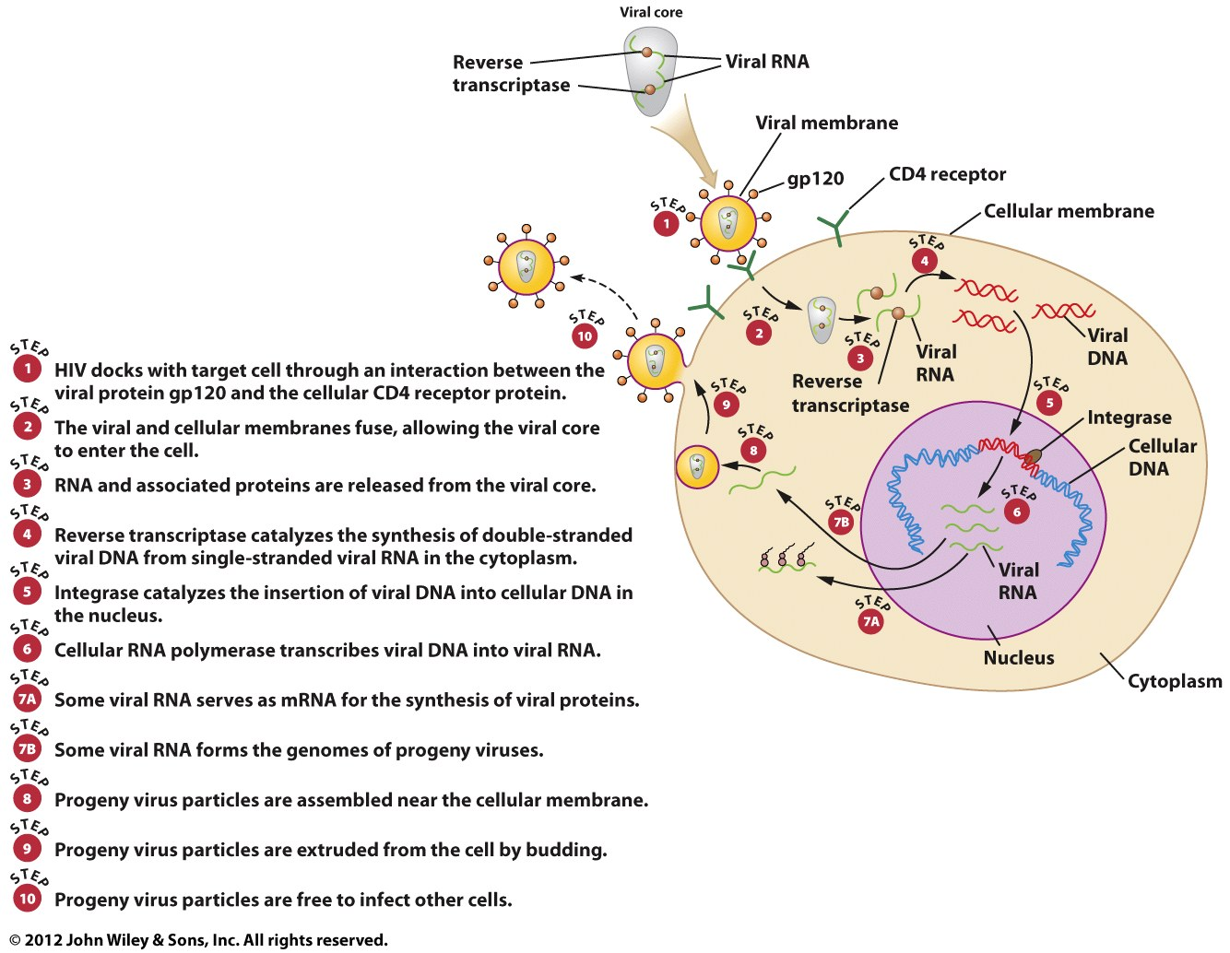
The Life Cycle of HIV
endocytosis
1
1 x 10¹²

Slide 38
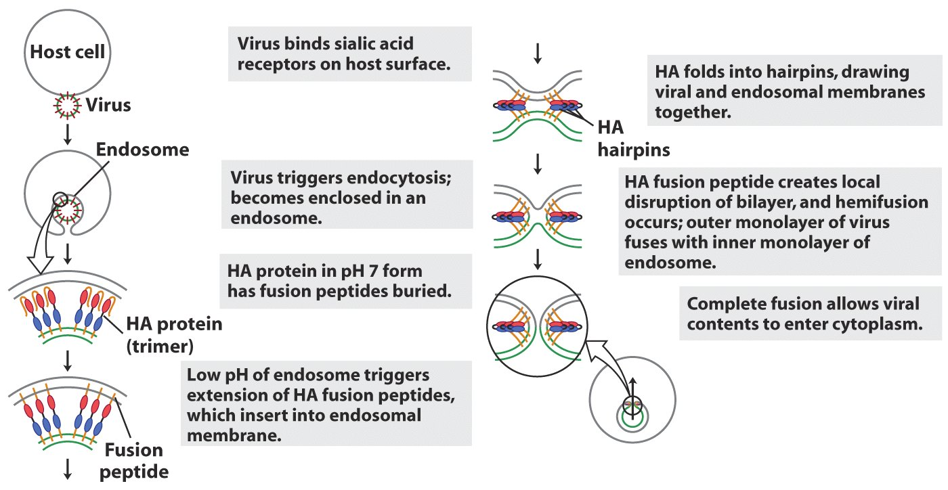
Influenza Virus Must “Uncoat” in Cytoplasm
H5N1 hemagglutinin (HA) type 5 and neuraminidase type 1

Slide 39
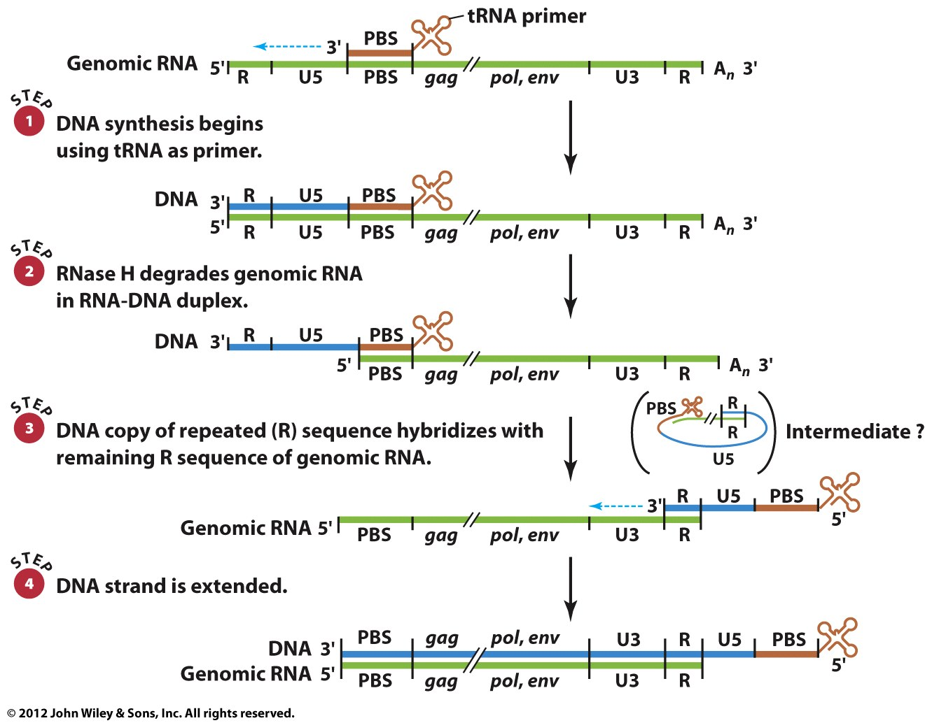
Replication of the HIV Genome
Jump #1

Slide 40
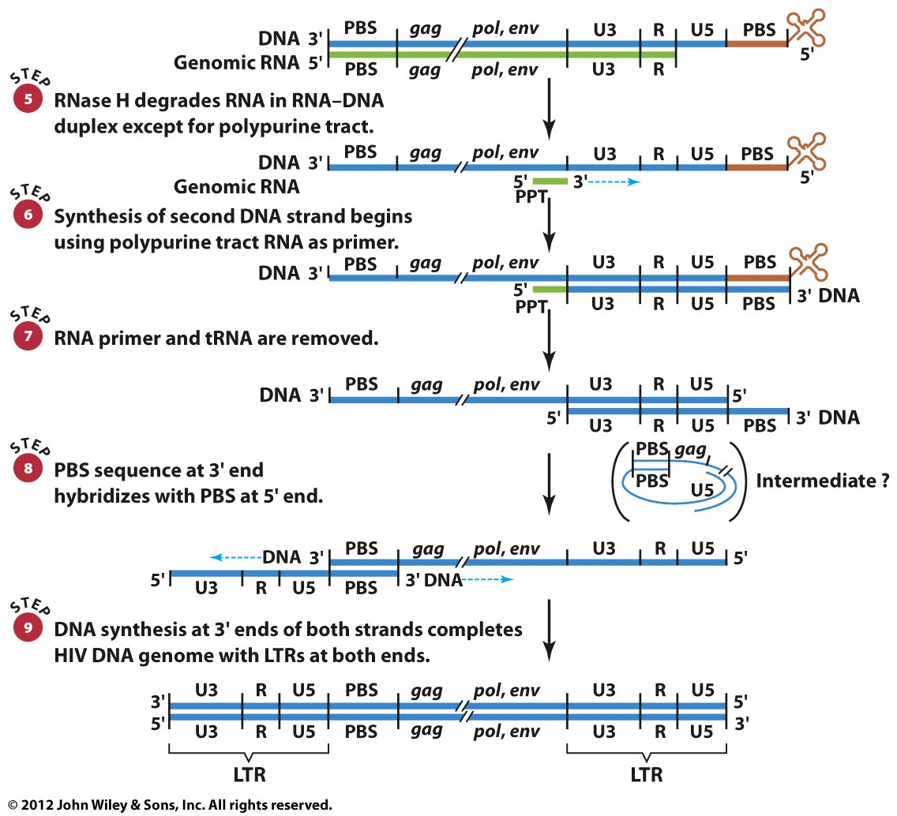
Jump #2

Slide 41
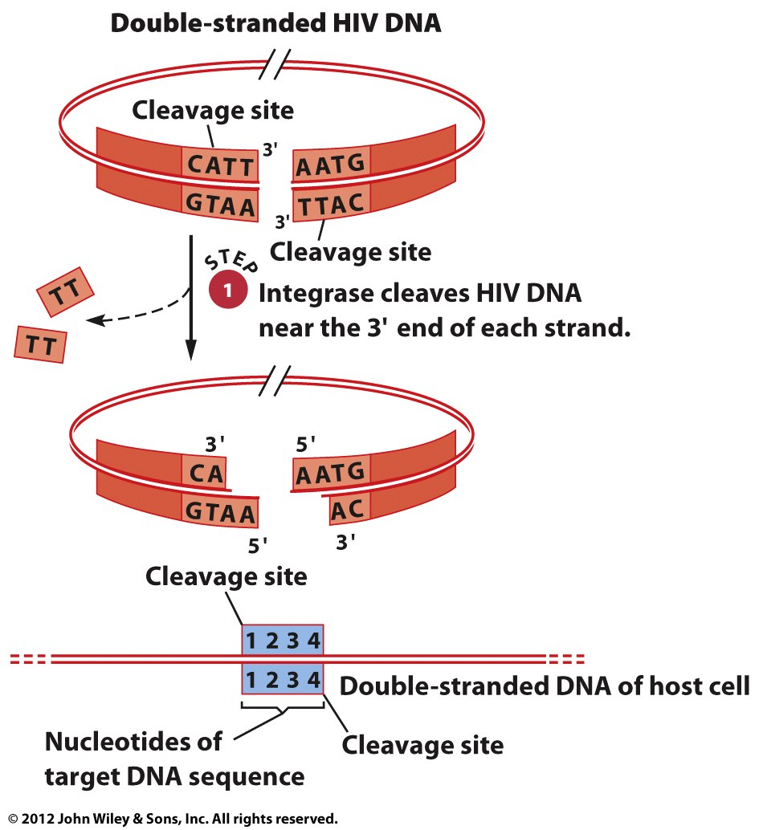
Integration of the HIV Double-Stranded DNA into Chromosomal DNA

Slide 42
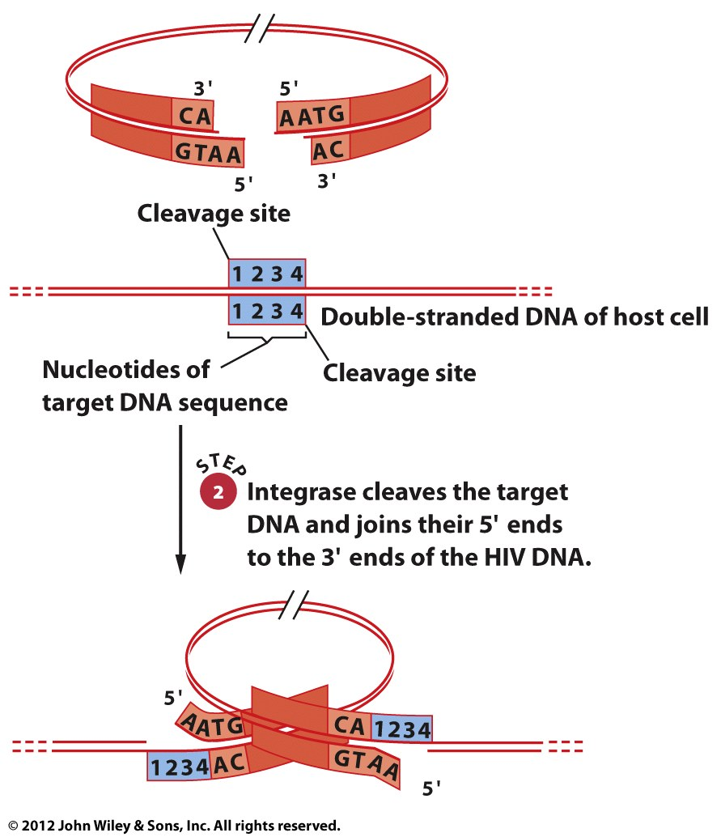

Slide 43
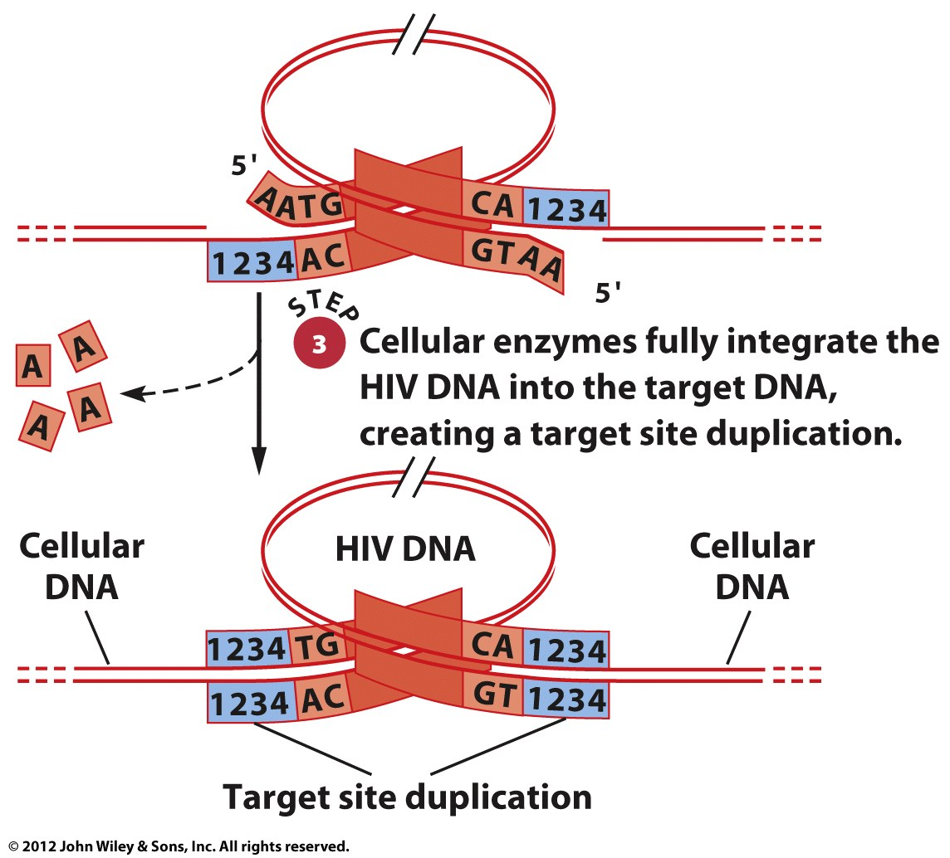

Slide 44
Retrovirus genomes are composed of single-stranded RNA
comprising at least three genes:
gag (coding for structural proteins of the viral particle- structural
proteins in matrix, capsid, and nucleocapsid.),
pol (coding for a reverse transcriptase/integrase protein- protease,
reverse transcriptase, and integrase.),
env (coding for a protein imbedded in the virus’ lipid envelope-
surface protein, transmembrane protein for recognition and fusion).
Reverse Transcriptase:
-RT converts RNA to DNA
-RT shows DNA polymerase activity
-RT has RNAase H activity

Slide 45
1-A retrovirus has two copies of its genome of single-stranded RNA.
2-An integrated provirus is a double-stranded DNA sequence.
3-Polyproteins are initially produced and then processed (proteases) to give all the viral protein products necessary for retrovirus reproduction.
4- U3 region of each LTR carries a promoter and enhancer (initiates transcription)

Slide 46
Retrotransposons
Retroviruslike elements (LTR retrotransposons) resemble integrated retroviruses.
Retroposons are DNA copies of polyadenylated RNA.

Slide 47
Retroviruslike Elements
Found in yeast, plants, and animals.
Structure: central coding region flanked by long terminal repeats (LTRs) oriented in the same direction.
The coding region contains homologues of the gag and pol genes of retroviruses.

Slide 48
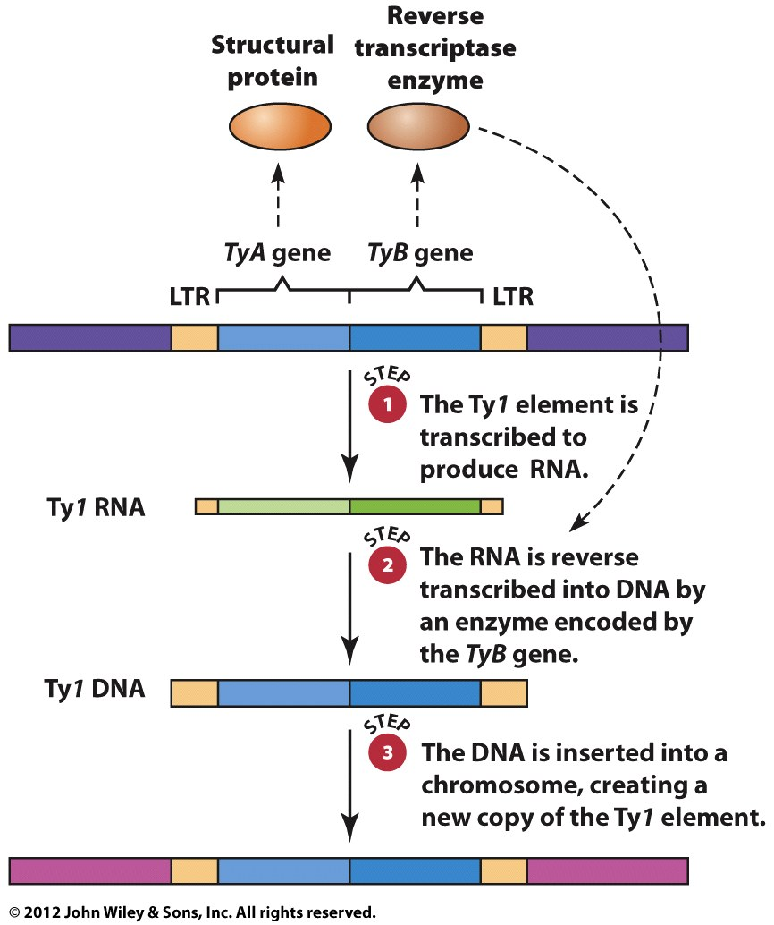
Transposition of the Yeast Ty1 Element
--Homologous to the gag and pol genes
Drosophila
--Copia ~ to Ty1 element
--Gypsy~ to retrovirus (env gene)

Slide 49
Retroposons (non-LTR Retrotransposons)
Retrotransposons are a large and widely distributed class of retrotransposons.
Retroposons move through an RNA molecule that is reverse transcribed into DNA.
Retroposons have a homologous sequence of A:T base pairs at one end that is derived from the poly(A) tail of retroposon RNA.
In Drosophila, the retroposons HeT-A and TART ( for telomere) are found at the telomeres of chromosomes and replenish DNA that is lost by incomplete chromosome replication.

Slide 50
Transposable Elements in Humans
The human genome is populated by a diverse array of transposable elements that collectively account for 44 % of all human DNA.

Slide 51
The L1 Element
The L1 element is a retroposon belonging to a class of sequences known as the long interspersed nuclear elements (LINEs).
The human genome contains 3000-5000 complete L1 elements and more than 500,000 truncated L1 elements.
Complete L1 elements are about 6 kb long, have an internal promoter, and have two open reading frames that encode a nucleic-acid binding protein and a protein with endonuclease and reverse transcriptase activities.

Slide 52
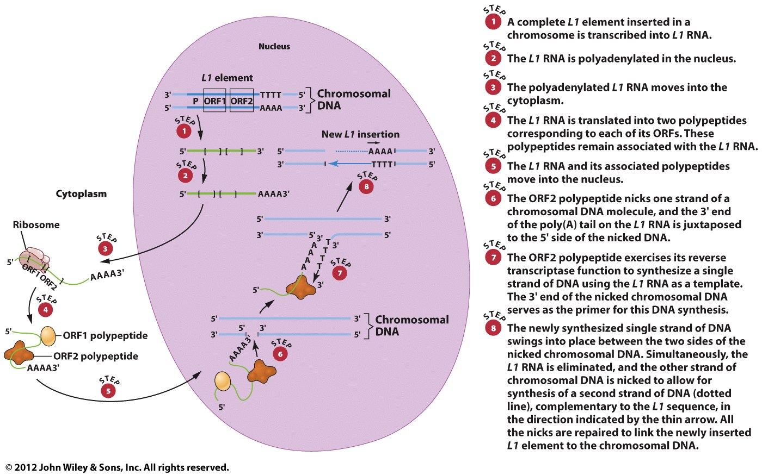

Slide 53
Short Interspersed Nuclear Elements (SINEs)
SINEs retroposons are the second most abundant class of transposable elements in the human genome. SINE families are the Alu, MIR, and Ther2/MIR3 elements.
SINEs are usually less than 400 base pairs long and do not encode proteins.
The reverse transcriptase required for SINE transposition is provided by a LINE-type element.

Slide 54
The human genome contains four basic types of transposable elements: LINEs, SINEs, retroviruslike elements, and cut-and-paste transposons ( and retrovirus).
The L1 LINE and the Alu SINE are transpositionally active; other human transposons appear to be inactive.

Slide 55
The Genetic and Evolutionary Significance of Transposable Elements
Transposable elements are used to study spontaneous mutations and chromosome-breaking activity

Slide 56
Transposons and Chromosome Structure
Transposable elements have been implicated in the formation of chromosome rearrangements.
Crossing over may occur between homologous transposons located at different positions on the same chromosome or on different chromosomes.
These events are referred to as intrachromosomal exchanges or interchromosomal exchanges, respectively.

Slide 57
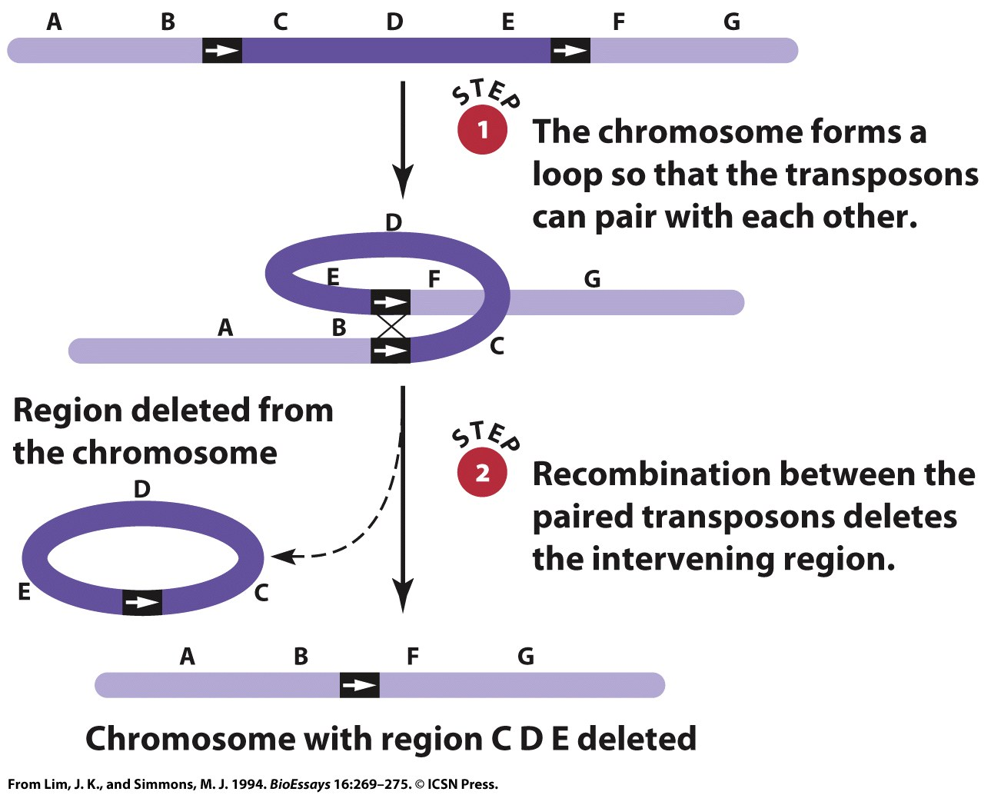
Intrachromosomal Recombination Between Transposons in the Same Orientation Produces a Deletion

Slide 58
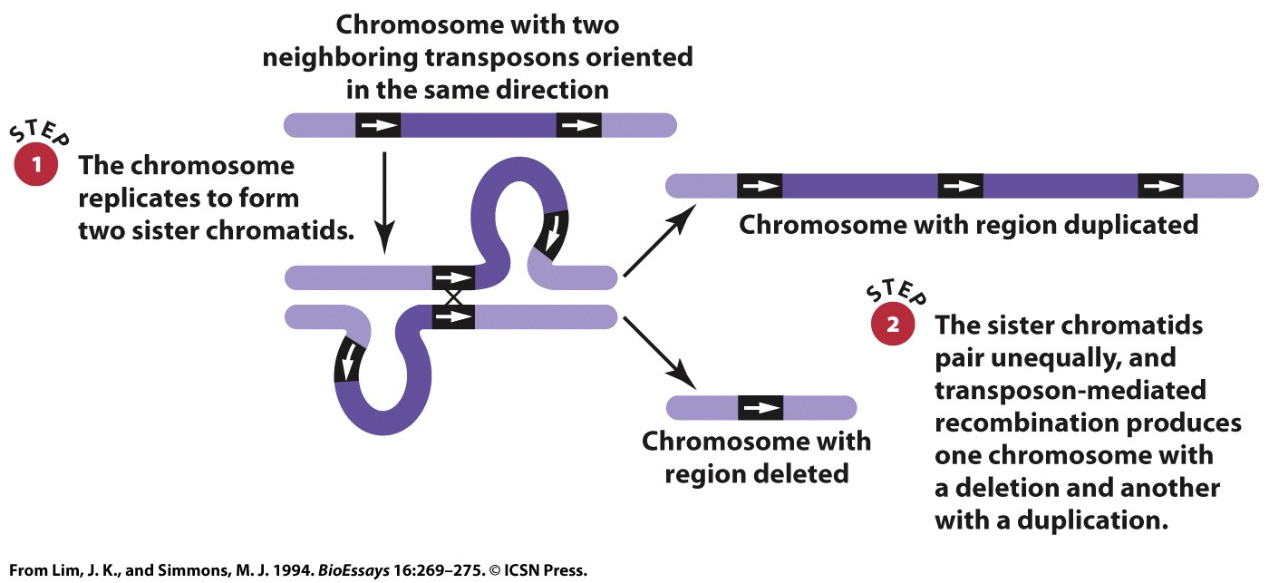
Unequal Crossing Over Between Transposons on Sister Chromatids Produces a Gene Duplication

Slide 59
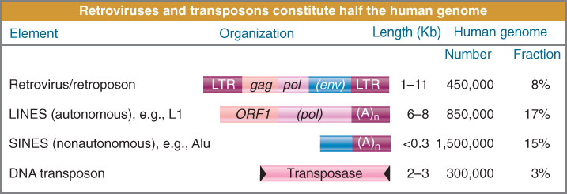
Transposons
-move DNA within and between chromosomes
-reorganize and create chromosome rearrangements

