Slide 2
Splicing site
5’ splice site: 5’-AG GUAAGU-3’
3’ splice site: 5’-PyPyPyPyPyPyNCAG -3’

Slide 3
The importance of precision when making a cut at an exon–intron
boundary. The cut must be made at precisely the position shown. An error in either direction would result in a change in the sequence of the mature mRNA. An mRNA that has been incorrectly spliced in this way would no longer be able to direct synthesisof its protein product.

Slide 6
The Genetic Code
The sequence of codons in the mRNA defines the primary structure of the final protein.
Three nucleotides in mRNA (a codon)specify one amino acid in a protein.

Slide 7
The Genetic Code

Slide 8
The Genetic Code
The triplet sequence of mRNA that specify certain amino acid.
64 different combination of bases; 61 of them code for 20 amino acids (AA); the last three codon (UAG,UGA,UAA) don not code for amino acids; they are termination codons.
Degenerate
More than on triplet codon specify the same amino acid.

Slide 9
The Genetic Code
Unambiguous
Each codon specifies a particular amino acid, the codon ACG codes for the amino acid threonine, and only threonine.
Non overlapping
This means that successive triplets are read in order. Each nucleotide is part of only one triplet codon.

Slide 10
DNA Codon
RNA Codon

Slide 11
Translation

Slide 12
Translation
Translation is the process by which ribosomes read the genetic message in the mRNA and produce a protein product according to the message's instruction.

Slide 13
Requirement for Translation
Ribosomes
tRNA
mRNA
Amino acids
Initiation factors
Elongation factors
Termination factors
Aminoacyl tRNA synthetase enzymes:
Energy source:

Slide 14
Ribosomes
Eukaryotic ribosomes are larger. They consist of two subunits, which come together to form an 80S particle;
60S subunit holds (three rRNAs 5S, 5.8S, 28S and about 40 proteins).
40S subunit contains (an18S rRNA and about 30 proteins).

Slide 15
The large ribosomal subunit contains three tRNA binding sites, designated A, P, and E.
The A site binds an aminoacyl-tRNA (a tRNA bound to an amino acid);
P site binds a peptidyl-tRNA (a tRNA bound to the peptide being synthesized).
The E site binds a free tRNA before it exits the ribosome.

Slide 16
Preparatory Steps for Protein Synthesis
First, aminoacyl tRNA synthetase joins amino acid to their specific tRNA.
Second, ribosomes must dissociate into subunits at the end of each round of translation.

Slide 17
The protein synthesis occur in 3 phases
Accurate and efficient initiation occurs; the ribosomes binds to the mRNA, and the first amino acid attached to its tRNA.
Chain elongation, the ribosomes adds one amino acid at a time to the growing polypeptide chain.
Accurate and efficient termination, the ribosomes releases the mRNA and the polypeptide.

Slide 18
Initiation
The initiation phase of protein synthesis requires over 10 eukaryotic Initiation Factors (eIFs): Factors are needed to recognize the cap at the 5'end of an mRNA and binding to the 40s ribosomal subunit.
Binding the initiator Met-tRNAiMet (methionyl- tRNA) to the 40S small subunit of the ribosome.

Slide 19
Initiation
Scanning to find the start codon by binding to the 5'cap of the mRNA and scanning downstream until they find the first AUG (initiation codon).
The start codon must be located and positioned correctly in the P site of the ribosome, and the initiator tRNA must be positioned correctly in the same site.
Once the mRNA and initiator tRNA are correctly bound, the 60S large subunit binds to form 80s initiation complex with a release of the eIF factors.

Slide 20
Elongation
Transfer of proper aminoacyl-tRNA from cytoplasm to A-site of ribosome;
Peptide bond formation; Peptidyl transferase forms a peptide bond between the amino acid in the P site, and the newly arrived aminoacyl tRNA in the A site. This lengthens the peptide by one amino acids.

Slide 21
Elongation
Translocation; translocation of the new peptidyl t-RNA with its mRNA codon in the A site into the free P site occurs. Now the A site is free for another cycle of aminoacyl t-RNA codon recognition and elongation. Each translocation event moves mRNA, one codon length through the ribosomes.

Slide 22
Termination
Translation termination requires specific protein factors identified as releasing factors, RFs in E. coli and eRFs in eukaryotes.
The signals for termination are the same in both prokaryotes and eukaryotes. These signals are termination codons present in the mRNA. There are 3 termination codons, UAG, UAA and UGA.

Slide 23
Termination
After multiple cycles of elongation and polymerization of specific amino acids into protein molecules, a nonsense codon = termination codon of mRNA appears in the A site. The is recognized as a terminal signal by eukaryotic releasing factors (eRF) which cause the release of the newly synthesized protein from the ribosomal complex.

Slide 24
Polysomes
Most mRNA are translated by more than one ribosome at a time; the result, a structure in which many ribosomes translate a mRNA in tandem, is called a polysomes.

Slide 25
Control of Gene Expression
Transcriptional
Posttranscriptional
Translational
Posttranslational

Slide 26
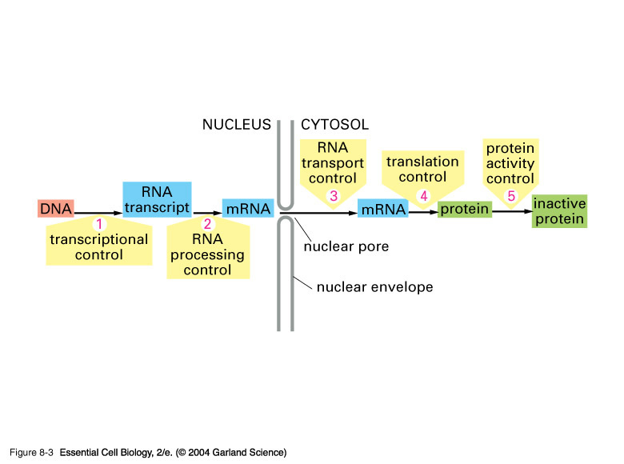
Control of Gene Expression

Slide 27
Control of gene expression depends various factors including:
Chromosomal activation or deactivation.
Control of initiation of transcription.
Processing of RNA (e.g. splicing).
Control of RNA transport.
Control of mRNA degradation.
Control of initiation of translation (only in eukaryotes).
Post-translational modifications.

Slide 29
Gene Expression Analysis
Polymerase Chain Reaction
Quantitative PCR
Microarray
…….
……

Slide 30
Eukaryotic Gene Expression
Essentially all humans' genes contain introns. A notable exception is the histone genes which are intronless.
Eukaryote genes are not grouped in operons. Each eukaryote gene is transcribed separately, with separate transcriptional controls on each gene.
Eukaryotic mRNA is modified through RNA splicing.
Eukaryotic mRNA is generally monogenic (monocistronic); code for only one polypeptide.

Slide 31
Eukaryotic Gene Expression
Eukaryotic mRNA contain no Shine-Dalgarno sequence to show the ribosomes where to start translating. Instead, most eukaryotic mRNA have caps at their 5` end which directs initiation factors to bind and begin searching for an initiation codon.
Eukaryotes have a separate RNA polymerase for each type of RNA.
In eukaryotes, polysomes are found in the cytoplasm.
Eukaryotic protein synthesis initiation begins with methionine not N formyl- methionine.

Slide 32
Prokaryotic vs. Eukaryotic
Bacterial genetics are different.
Prokaryote genes are grouped in operons.
Prokaryotes have one type of RNA polymerase for all types of RNA,
mRNA is not modified
The existence of introns in prokaryotes is extremely rare.

Slide 33
Prokaryotic vs. Eukaryotic
To initiate transcription in bacteria, sigma factors bind to RNA polymerases. RNA polymerases/ sigma factors complex can then bind to promoter about 40 deoxyribonucleotide bases prior to the coding region of the gene.
In prokaryotes, the newly synthesized mRNA is polycistronic (polygenic) (code for more than one polypeptide chain).
In prokaryotes, transcription of a gene and translation of the resulting mRNA occur simultaneously. So many polysomes are found associated with an active gene.

Slide 34
Glossary
Alleles are forms of the same gene with small differences in their sequence of DNA bases.
Alternative splicing: is a very common phenomenon in higher eukaryotes. It is a way to get more than one protein product out of the same gene and a way to control gene expression in cells.
Exon: a segment of a gene that is represented in the mature RNA product. Individual exons may contain coding DNAand/or noncoding DNA (untranslated sequences).
Bioinformatics I is the application of computer science and information technology to the field of biology and medicine
Introns (intervening sequence) (A noncoding DNA sequence ): Intervening stretches of DNA that separate exons.
Primary transcript: The initial production of gene transcription in the nucleus; an RNA containing copies of all exons and introns.
RNA gene or non-coding RNA gene: RNA molecule that is not translated into a protein. Noncoding RNA genes produce transcripts that exert their function without ever producing proteins. Non-coding RNA genes include transfer RNA (tRNA) and ribosomal RNA (rRNA), small RNAs such as snoRNAs, microRNAs, siRNAsand piRNAs and lastly long ncRNAs.
Enhancers and silencers: are DNA elements that stimulate or depress the transcription of associated genes; they rely on tissue specific binding proteins for their activities; sometimes a DNA elements can act either as an enhancer or silencer depending on what is bound to it.
Activators: Additional gene-specific transcription factors that can bind to enhancer and help in transcription activation.
Open reading frame (ORF): A reading frame that is uninterrupted by translation stop codon (reading frame that contains a start codon and the subsequent translated region, but no stop codon).
Directionality: in molecular biology, refers to the end-to-end chemical orientation of a single strand of nucleic acid. The chemical convention of naming carbon atoms in the nucleotide sugar-ring numerically gives rise to a 5' end and a 3' end ( "five prime end" and "three prime end"). The relative positions of structures along a strand of nucleic acid, including genes, transcription factors, and polymerases are usually noted as being either upstream (towards the 5' end) or downstream (towards the 3' end).
Reverse Transcription: Some viruses (such as HIV, the cause of AIDS), have the ability to transcribe RNA into DNA.
Pseudogenes. DNA sequences that closely resemble known genes but are nonfunctional.
More:http://www.ncbi.nlm.nih.gov/books/NBK7584/

Slide 35
References and Further Reading
Ali Khalifa. Applied molecular biology; eds: ( Fathi Tash and Sanna Eissa). 109 pages. Egypt. University Book Center. 2002. Available in paper copy from the publisher
Daniel H. Farkas. DNA Simplified: The Hitchhiker's Guide to DNA. 110 pages. Washington, DC: AACC Press, 1996, ISBN 0-915274-84-1. Available in paper copy from the publisher
Daniel P. Stites, Abba T. Terr. Basic Human Immunology: 336 Pages. Appleton & Lange (November 1990). ISBN. 0838505430. Available in paper copy from the publisher
Innis, David H. Gelfand, John J. Sninsky. PCR Applications: Protocols for Functional Genomics: 566 pages. Academic Press; 1 edition (May 17, 1999). ISBN:0123721865. Available in paper copy from the publisher
Bruce Alberts, Alexander Johnson, Julian Lewis, Martin Raff, Keith Roberts, and Peter Walter. Molecular Biology of the cell. 1392 pages.Garland Science; 5 edition (November 16, 2007).ISBN. 9780815341055. Available in paper copy from the publisher
Robert F. Mueller, Ian D. Young. Emery's Elements of Medical Genetics: Publisher: Churchill Livingstone. 1995 ISBN. 044307125X. Available in paper copy from the publisher.
Robert F. Weaver. Molecular Biology. 600 Pages. Fourth Edition. McGraw-Hill International Edition. ISBN 978-0-07-110216-2. Available in paper copy from the publisher
William B. Coleman, Gregory J. Tsongalis. Molecular Diagnostics. For the Clinical Laboratorian: 592 pages.Humana Press; 4th Printing. edition (August 15, 2005). ISBN 1588293564... Available in paper copy from the publisher.
Eukaryotic promoter . Internet. Available from;http://www.patentlens.net/daisy/promoters/242/g1/250/1346.html
Transcription factor. Available from. Fred Hutchinson Cancer Research Center
Transcription factor . Internet. Table. Avalable from; http://oregonstate.edu/instruction/bb492/lectures/EuTranscriptionI.htm

Slide 36
Image Citation
Structure of a typical eukaryotic gene. http://biocadmin.otago.ac.nz/fmi/xsl/bioc2/learnbitslecture.xsl?-db=BIOC2web.fp7&-lay=Lectures&-recid=4546&-find=LadyofHats.
Ribosome mRNA translation.29 September 2008. http://en.wikipedia.org/wiki/File:Ribosome_mRNA_translation_en.svg
Forluvoft. Simple transcription elongation. 9 October 2007. http://en.wikipedia.org/wiki/File:Simple_transcription_elongation1.svg
TransControl. RNA-codons. 22 May 2007 http://en.wikipedia.org/wiki/File:RNA-codons.png

