Slide 1
Contents
Gene Expression
The Gene Structure
Transcription
Genetic Code and Protein Synthesis
Regulation of Gene Expression
Prokaryotes Vs Eukaryotes
Gene Expression Analysis

Slide 2
Gene Expression
The process by which a gene's information is converted into a biologically functional molecule of either protein or RNA (gene product).
Gene expression is assumed to be controlled at various points in the sequence leading to protein synthesis.

Slide 3
Gene Structure
Eukaryotic gene structure: Most eukaryotic genes in contrast to typical bacterial genes, the coding sequences (exons) are interrupted by noncoding DNA (introns). The gene must have (Exon; start signals; stop signals; regulatory control elements).
The average gene 7-10 exons spread over 10-16kb of DNA.

Slide 4
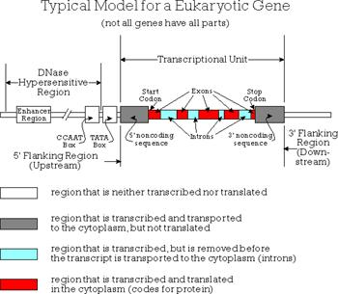

Slide 5
Protein Synthesis: Four stages
Transcription
RNA processing
Translation
Post-translation processing

Slide 7
Gene Expression
Transcription
Synthesis of an RNA that is complementary to one of the strands of DNA.
Translation
Ribosomes read a messenger RNA and make protein according to its instruction.

Slide 8
Protein Synthesis

Slide 9
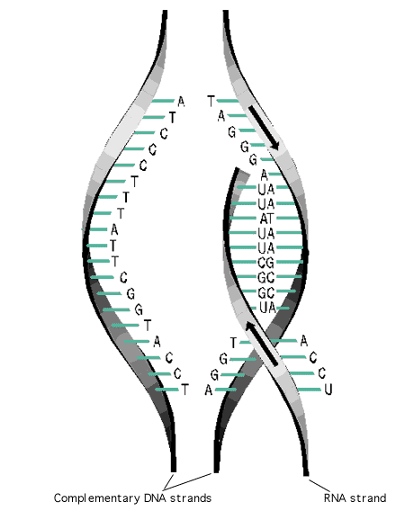
Transcription

Slide 10
Transcription Enzymes
RNA polymerase: The enzyme that controls transcription and is characterized by:
Search DNA for initiation site,
It unwinds a short stretch of double helical DNA to produce a single-stranded DNA template,
It selects the correct ribonucleotide and catalyzes the formation of a phosphodiester bond,
It detects termination signals where transcript ends.

Slide 11
Eukaryotic RNA polymerases have different roles in transcription
Polymerase I | nucleolus | Makes a large precursor to the major rRNA (5.8S,18S and 28S rRNA in vertebrates
Polymerase II | nucleoplasm | Synthesizes hnRNAs, which are precursors to mRNAs. It also make most small nuclear RNAs (snRNAs
Polymerase III | Nucleoplasm | Makes the precursor to 5SrRNA, the tRNAs and several other small cellular and viral RNAs.

Slide 12
Eukaryotic Promoter
Eukaryotic Promoter lies upstream of the gene. There are several different types of promoter found in human genome, with different structure and different regulatory properties class/I/II/III.
Conserved eukaryotic promoter elements | Consensus sequence
CAAT box | GGCCAATCT
TATA box | TATAA
GC box | GGGCGG
CAP site | TAC

Slide 13
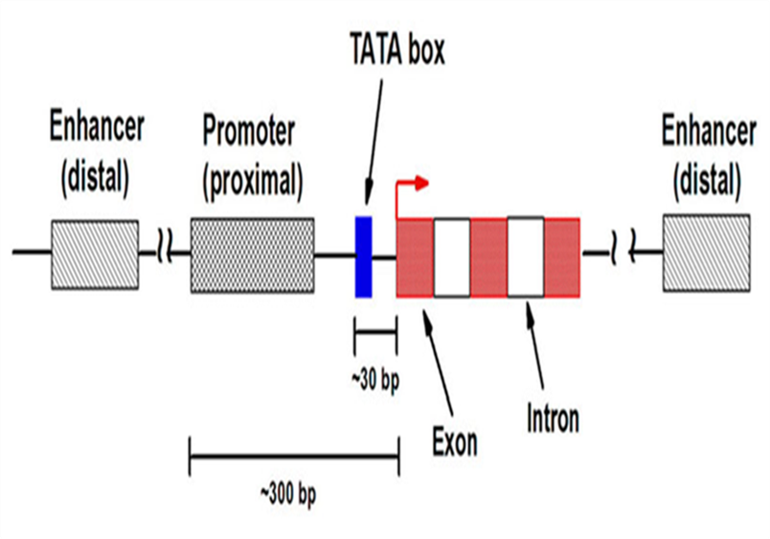
Enhancers
Enhancers are stretches of bases within DNA, about 50 to 150 base pairs in length; the activities of many promoters are greatly increased by enhancers which can exert their stimulatory actions over distances of several thousands base pairs.

Slide 14
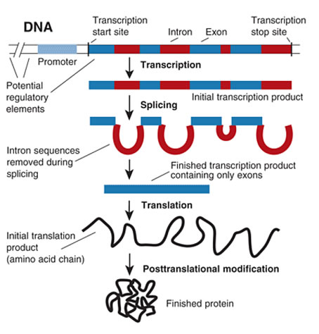
Source: http://www.news-medical.net/health/What-is-Gene-Expression.aspx

Slide 15
Transcription Factors
Transcription factors are proteins that bind to
DNA near the start of transcription of a gene.
Transcription factors either inhibit or assist RNA polymerase in initiation and maintenance of transcription.

Slide 16
Structure of prokaryotic RNA polymerase

Slide 17
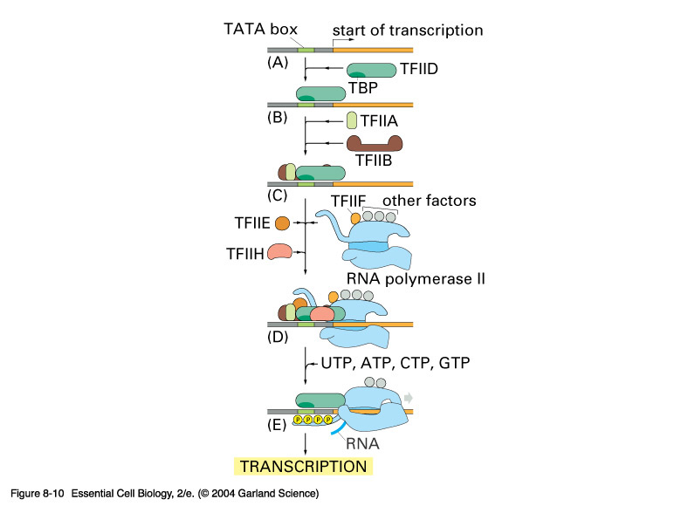
Transcription Factors

Slide 18
Functions of Transcriptional Factors
TATA-binding protein (TBP) and TAFs saddle like shape that wraps partially around the double helix, forming a platform onto which the remainder of the initiation complex assembles.
TFIIB, which attaches to the DNA-bound TBP and forms the structure that RNA polymerase II recognizes,
TFIIF, which binds to the RNA polymerase and prevents it from attaching to the DNA at the wrong place

Slide 19
Functions of Transcriptional Factors
TFIIH is a helicase, a type of enzyme that is able to break the base pairs that hold the two strands of the double helix together.

Slide 22
Initiation
The polymerase binding causes the unwinding of the DNA double helix which expose at least 12 bases on the template.
This is followed by initiation of RNA synthesis at this starting point.

Slide 23
Initiation
The RNA polymerase starts building the RNA chain; it assembles ribonucleotides triphosphates: ATP; GTP; CTP and UTP into a strand of RNA.
After the first nucleotide is in place, the polymerase joins a second nucleotide to the first, forming the initial phosphodiester bond in the RNA chain.

Slide 24
Elongation
RNA polymerase directs the sequential binding of riboncleotides to the growing RNA chain in the 5' - 3' direction.
Each ribonucleotide is inserted into the growing RNA strand following the rules of base pairing. This process is repeated utill the desired RNA length is synthesized……………………..

Slide 25
RNA polymerase working during elongation

Slide 26
Speed of RNA polymerase
Generally can go up to maximum speed 2000 nucleotides per minute
Transcription of prokaryotic gene is completed in Few minutes
Human dystrophin gene is 2400 kb in length and takes about 20 hours to synthesize.

Slide 27
Termination
Terminators at the end of genes; signal termination. These work in conjunction with RNA polymerase to loosen the association between RNA product and DNA template.
It is stimulated by inverted repeats in Bacteria

Slide 28
An inverted repeat in a double stranded molecule can give rise to
a hairpin loop in a single-stranded RNA molecule.

Slide 30
The primary product of RNA transcription; the hnRNAs contain both intronic and exonic sequences.
These hnRNAs are processed in the nucleus to give mature mRNAs that are transported to the cytoplasm where to participate in protein synthesis.

Slide 31
Overall Capping model

Slide 33
Whether the weather what ever the weather its hot or cold, whether you like it or not.. You have to

Slide 34
RNA Processing (Pre-mRNA → mRNA)
Capping
Splicing
Addition of poly A tail

Slide 35
RNA Processing
Capping
The cap structure is added to the 5' of the newly transcribed mRNA precursor in the nucleus prior to processing and subsequent transport of the mRNA molecule to the cytoplasm.
Splicing:
Step by step removal of pre mRNA and joining of remaining exons; it takes place on a special structure called spliceosomes.

Slide 36
RNA Processing
Addition of poly A tail:
Synthesis of the poly (A) tail involves cleavage of its 3' end and then the addition of about 40- 200 adenine residues to form a poly (A) tail.

Slide 38
Alternative Splicing
Alternative splicing: is a very common phenomenon in higher eukaryotes. It is a way to get more than one protein product out of the same gene and a way to control gene expression in cells.

Slide 39
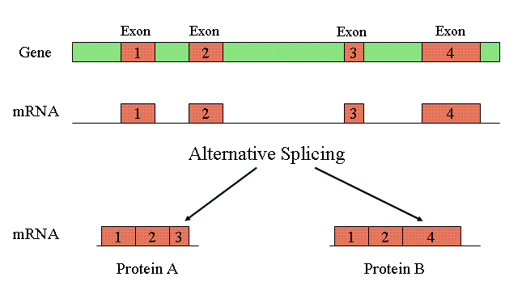
Source: http://www.ncbi.nlm.nih.gov/Class/MLACourse/Modules/MolBioReview/alternative_splicing.html

