Slide 1

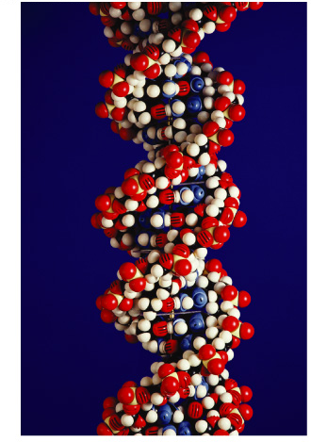
DNA Replication

Slide 2
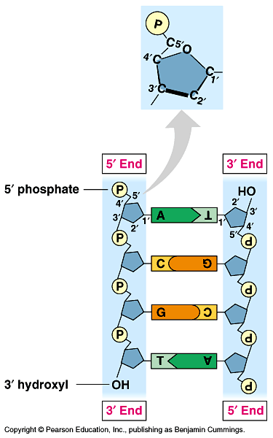
Anti-parallel strands
Nucleotides in DNA backbone are bonded from phosphate to sugar between 3′ & 5′ carbons
  DNA molecule has “direction”
  complementary strand runs in opposite direction
5′
3′
3′
5′

Slide 3
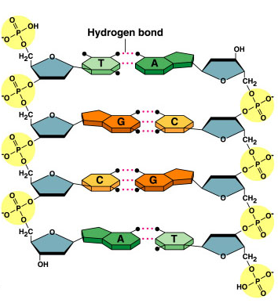
Bonding in DNA
hydrogen
bonds
5′
3′
covalent
phosphodiester
bonds
3′
5′
….strong or weak bonds?
How do the bonds fit the mechanism for copying DNA?

Slide 4
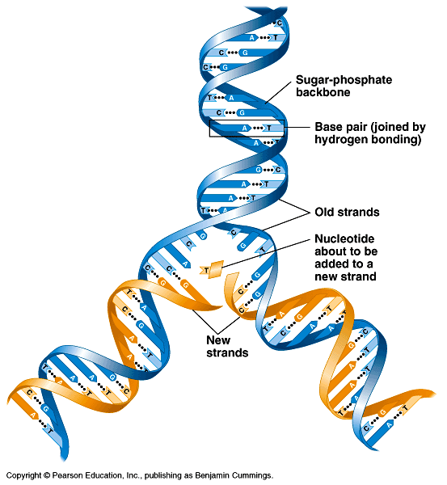
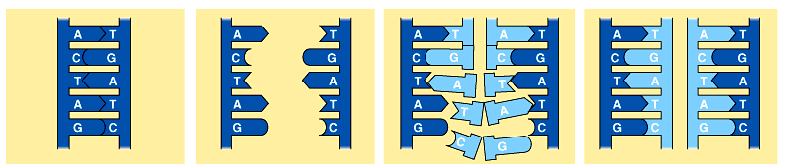
Copying DNA
Replication of DNA
  base pairing allows each strand to serve as a template for a new strand
  new strand is 1/2 parent template &
  1/2 new DNA

Slide 5
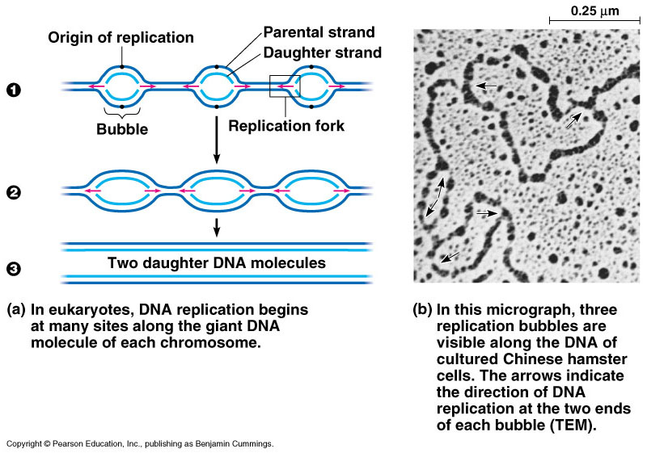
DNA Replication
Let’s meet
the team…
Large team of enzymes coordinates replication
Notes:
Enzymes
more than a dozen enzymes & other proteins participate in DNA replication

Slide 6
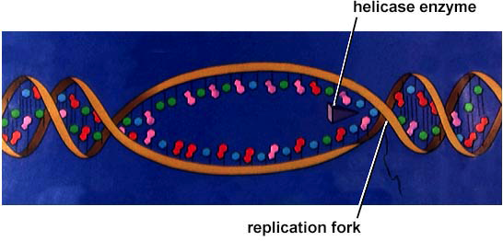
Replication: 1st step
Unwind DNA
  helicase enzyme
    unwinds part of DNA helix
    stabilized by single-stranded binding proteins
helicase
single-stranded binding proteins
replication fork

Slide 7
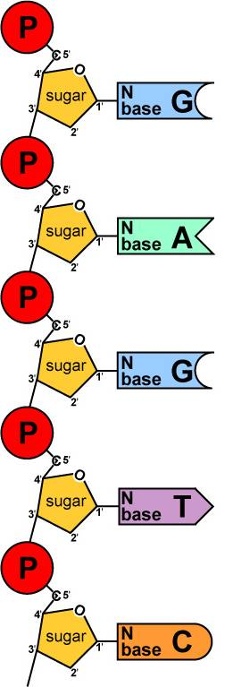
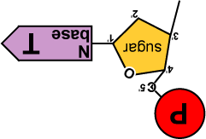
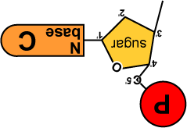
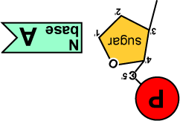
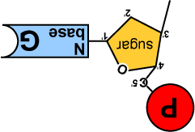
Replication: 2nd step
Build daughter DNA strand
  add new complementary bases
  DNA polymerase III
But…
We’re missing
something!
What?
Where’s the
ENERGY
for the bonding!
DNA
Polymerase III

Slide 8


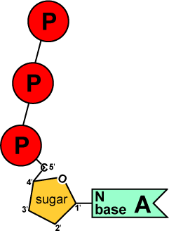
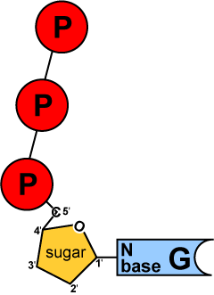
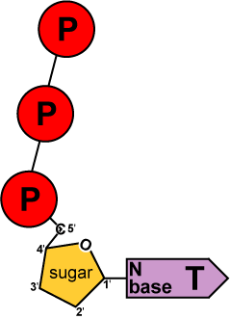
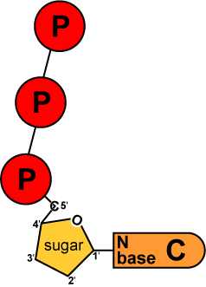
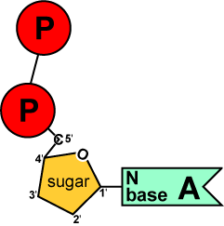
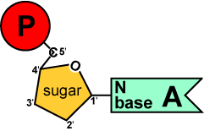
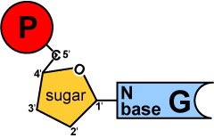
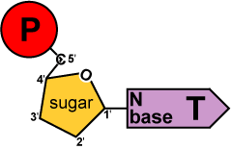
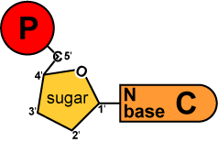
Energy of Replication
Where does energy for bonding usually come from?
We come
with our own
energy!
energy
You
remember
ATP!
Are there
other ways
to get energy
out of it?
energy
Are there
other energy
nucleotides?
You bet!
And we
leave behind a
nucleotide!
ATP
GTP
TTP
CTP
ADP
AMP
GMP
TMP
CMP
modified nucleotide

Slide 9
Energy of Replication
The nucleotides arrive as nucleosides
  DNA bases with P–P–P
    P-P-P = energy for bonding
  DNA bases arrive with their own energy source for bonding
  bonded by enzyme: DNA polymerase III
ATP
GTP
TTP
CTP

Slide 10
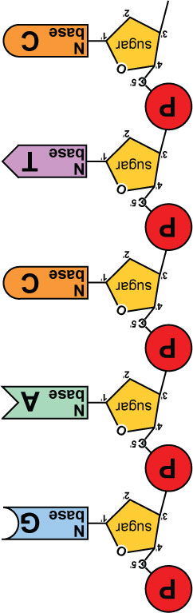
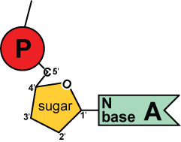
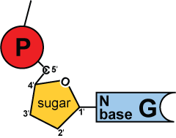
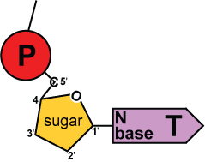
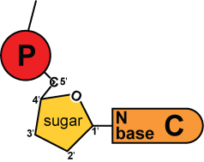
Replication
5′
3′
energy
DNA
Polymerase III
Adding bases
  can only add nucleotides to
  3′ end of a growing DNA strand
    need a “starter” nucleotide to
    bond to
  strand only grows
  5′→3′
DNA
Polymerase III
energy
DNA
Polymerase III
energy
DNA
Polymerase III
energy
B.Y.O. ENERGY!
The energy rules
the process
3′
5′
Notes:
The energy rules the process.

Slide 11
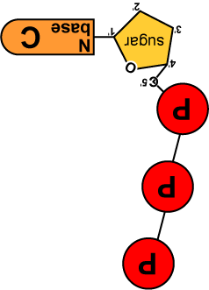
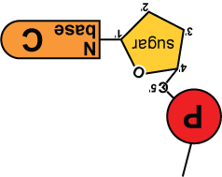
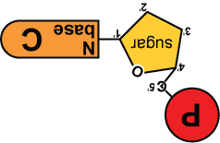

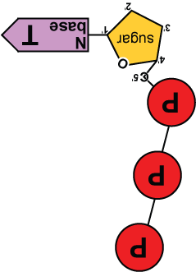
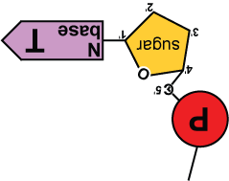
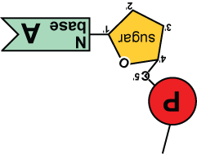
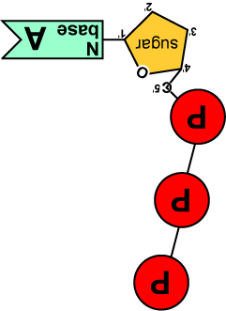
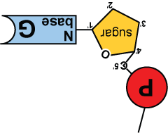
5′
3′
5′
need “primer” bases to add on to
3′
energy
no energy to bond
✗
energy
energy
energy
energy
ligase
energy
energy
3′
5′
3′
5′

Slide 12
Leading & Lagging strands
Okazaki
Limits of DNA polymerase III
  can only build onto 3′ end of an existing DNA strand
5′
✗
Okazaki fragments
5′
3′
3′
5′
3′
5′
5′
Lagging strand
3′
ligase
growing
replication fork
3′
5′
✓
Leading strand
3′
5′
Lagging strand
  Okazaki fragments
  joined by ligase
    “spot welder” enzyme
3′
DNA polymerase III
Leading strand
  continuous synthesis

Slide 13
Replication fork / Replication bubble
3′
5′
5′
3′
DNA polymerase III
leading strand
3′
5′
3′
5′
5′
5′
5′
3′
3′
lagging strand
3′
5′
5′
3′
5′
lagging strand
leading strand
growing
replication fork
3′
5′
5′
growing
replication fork
leading strand
5′
3′
3′
lagging strand
5′
5′
5′

Slide 14
Starting DNA synthesis: RNA primers
Limits of DNA polymerase III
  can only build onto 3′ end of an existing DNA strand
5′
3′
5′
3′
3′
5′
3′
5′
growing
replication fork
3′
primase
5′
DNA polymerase III
RNA
5′
RNA primer
  built by primase
  serves as starter sequence for DNA polymerase III
3′

Slide 15
Replacing RNA primers with DNA
DNA polymerase I
  removes sections of RNA primer and replaces with DNA nucleotides
DNA polymerase I
5′
3′
3′
ligase
5′
growing
replication fork
3′
5′
RNA
5′
3′
But DNA polymerase I still can only build onto 3′ end of an existing DNA strand

Slide 16
Chromosome erosion
Houston, we
have a problem!
All DNA polymerases can only add to 3′ end of an existing DNA strand
DNA polymerase I
5′
3′
3′
5′
growing
replication fork
3′
5′
DNA polymerase III
RNA
5′
Loss of bases at 5′ ends
in every replication
  chromosomes get shorter with each replication
  limit to number of cell divisions?
3′

Slide 17
Telomeres
Repeating, non-coding sequences at the end of chromosomes = protective cap
  limit to ~50 cell divisions
5′
3′
3′
5′
growing
replication fork
3′
telomerase
5′
Telomerase
  enzyme extends telomeres
  can add DNA bases at 5′ end
  different level of activity in different cells
    high in stem cells & cancers -- Why?
5′
TTAAGGG
TTAAGGG
TTAAGGG
3′

Slide 18
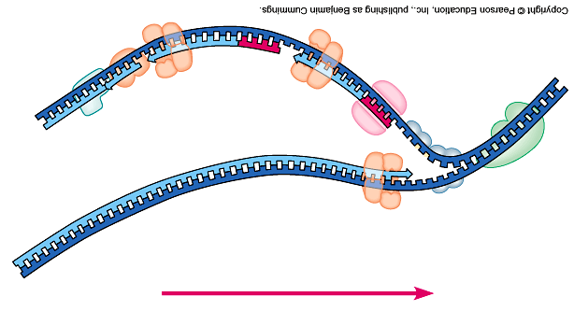
Replication fork
DNA
polymerase III
lagging strand
DNA
polymerase I
3’
Okazaki
fragments
primase
5’
5’
ligase
3’
5’
SSB
3’
helicase
DNA
polymerase III
5’
leading strand
3’
direction of replication
SSB = single-stranded binding proteins

Slide 19
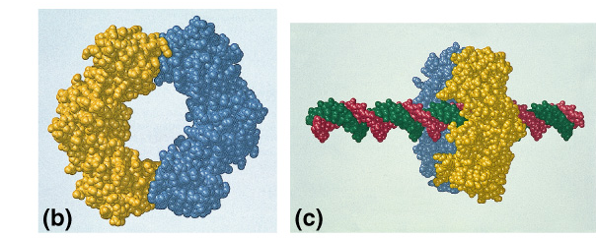
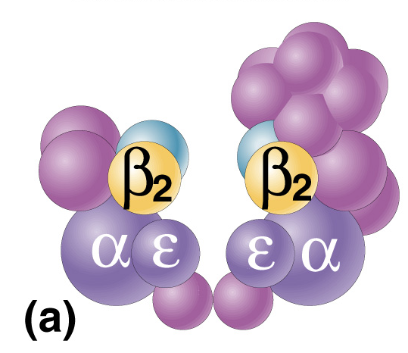
DNA polymerases
DNA polymerase III
  1000 bases/second!
  main DNA builder
DNA polymerase I
  20 bases/second
  editing, repair & primer removal
Roger Kornberg
2006
DNA polymerase III
enzyme
Arthur Kornberg
1959
Notes:
In 1953, Kornberg was appointed head of the Department of Microbiology in the Washington University School of Medicine in St. Louis. It was here that he isolated DNA polymerase I and showed that life (DNA) can be made in a test tube. In 1959, Kornberg shared the Nobel Prize for Physiology or Medicine with Severo Ochoa — Kornberg for the enzymatic synthesis of DNA, Ochoa for the enzymatic synthesis of RNA.

Slide 20
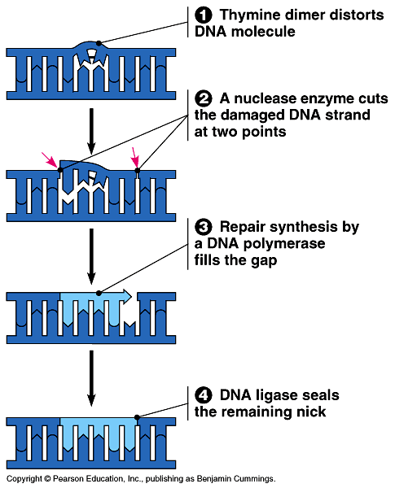
Editing & proofreading DNA
1000 bases/second =
lots of typos!
DNA polymerase I
  proofreads & corrects typos
  repairs mismatched bases
  removes abnormal bases
    repairs damage
    throughout life
  reduces error rate from
  1 in 10,000 to
  1 in 100 million bases

Slide 21
Fast & accurate!
It takes E. coli <1 hour to copy
5 million base pairs in its single chromosome
  divide to form 2 identical daughter cells
Human cell copies its 6 billion bases & divide into daughter cells in only few hours
  remarkably accurate
  only ~1 error per 100 million bases
  ~30 errors per cell cycle

Slide 22
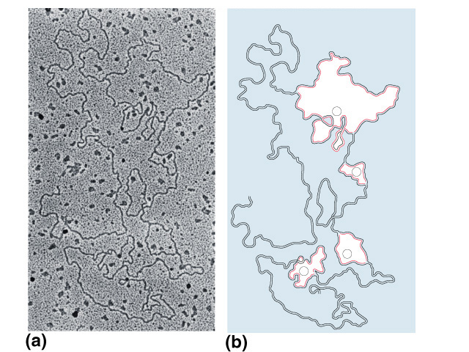
What does it really look like?
1
2
3
4

Slide 23
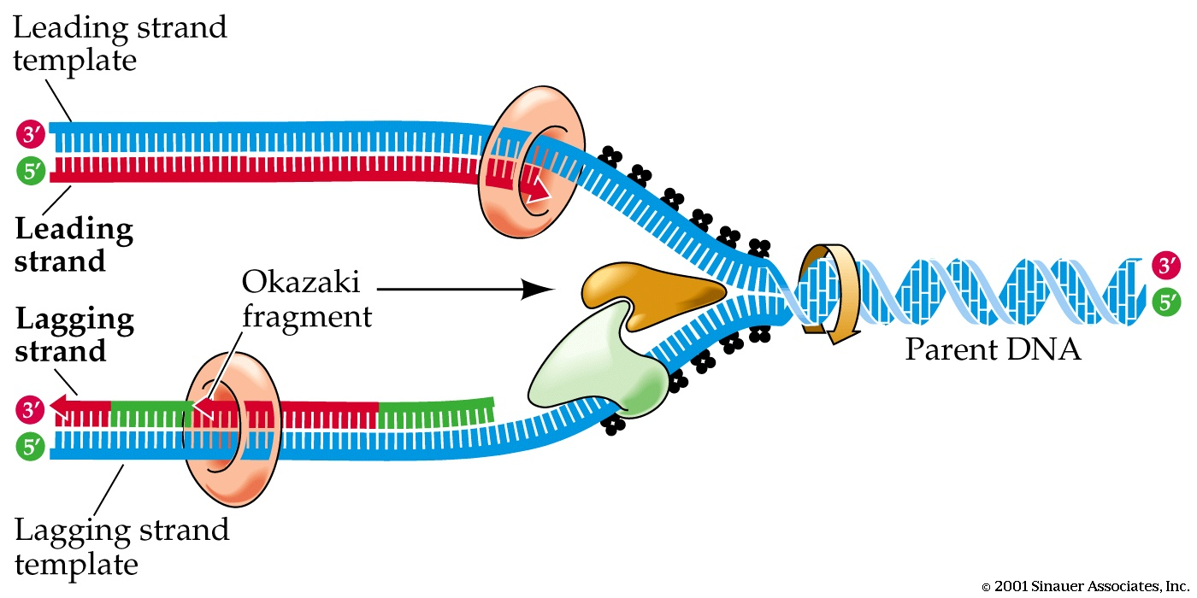
Any Questions??

