Slide 1
Genetic codon
Set of three nucleotide which specify an amino acid.

Slide 2
Features of genetic codon
Genetic code is a triplet code (to be grouped in 3nt);
The triplet codons are adjacent (non-overlapping);
They are not separated by punctuation (comma-less).
Because many of the 64 codons specify the same amino acid, the genetic code is degenerate;
So that the genetic codons have redundancy.
Genetic code is very nearly, but not quite, universal. This supports the hypothesis that all life has evolved from a single common origin.

Slide 4
Deciphering
In the 1960s, Marshall Nirenberg developed a “cell-free protein synthesizing system” from E. coli (细胞外蛋白合成体系).
To determine which amino acids were being polymerized into polypeptides, it was nucleotide phosphorylase was used to make synthetic mRNAs that were composed of only one nucleotide, that is poly (U), poly (C), poly (A) and poly (G).
In this way, it was found that:
Poly (U) caused the synthesis of poly-phonylalanine,
Poly (C) coded for poly-proline
Poly (A) for poly-lysine
Poly (G) did not work because it formed a complex secondary structure.

Slide 5
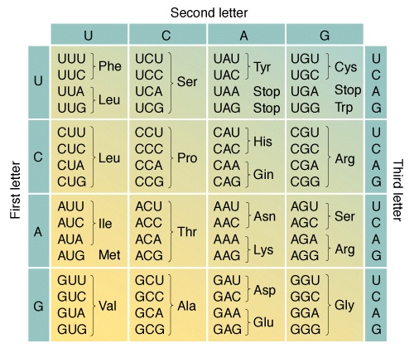
Deciphering

Slide 6
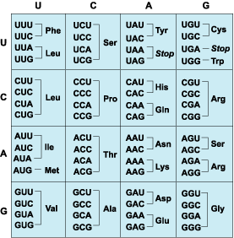
Feature
The genetic code is degenerate (or it shows redundancy). This is because 18 out of 20 amino acids have more than one codon to specify them, called synonymous codons .
Only methionine and tryptophan have single codons.
The synonymous codons are not positioned randomly, but are grouped in the table. Generally they differ only in their third position.
In all cases, if the third position is a pyrimidine, then the codons specify the same amino acid (are synonymous).
In most cases, if the third position is a purine the codons are also synonymous.

Slide 7
Universality
P254, P1.2
Modifications of the genetic code
Codon Usual Alternative Organelle/organism
AGA Some Animal
AGG Mitochondria
AUA Ile Met Mitochondria
CGG Arg Trp Plant Mitochondria
CUN Leu Thr Yeast Mitochondria
AUU Ile
GUG Val Start Some Prokaryotes
UUG Leu
UAA
UAG
UGA Stop Trp Mit. Mycoplasma
For a long time after the genetic code was deciphered, it was thought to be universal, that is the same in all organisms.
However, since 1980, it has been discovered that mitochondria, which have their own small genomes, use a genetic code that differs slightly from the standard, or ‘universal’ code. Indeed, it is now known that some other unicellular organisms also have a variant genetic code.
Arg Stop, Ser
Stop Glu Some Protozoans

Slide 8
Overlapping Genes
Generally overlapping genes occur where the genome size is small and there is a need for greater information storage density.
In viruses, for example, the phage ΦΧ174 makes 11 proteins of combined molecular mass 262 kDa from a 5386 bp genome. Without overlapping genes, this genome could encode at most 200 kDa of protein. Three proteins are encoded within the coding regions for longer proteins.
In prokaryotes, the ribosomes simply have to find the second start codon to be able to translate the overlapping gene and they may achieve this without detaching from the template.
Eukaryotes have a different way of initiating protein synthesis and tend to make use of alternative RNA processing to generate variant proteins from one gene.

Slide 9
tRNA Primary Structure
tRNAs are the adaptor molecules that deliver ammo acids to the ribosome and decode the information in mRNA. Their primary structure (i.e. the linear sequence of nucleotides) is 60-95 nt long, but most commonly 76 nt.
They have many modified bases sometimes accounting for 20% of the total bases in any one tRNA molecule. Indeed, over 50 different types of modified base have been observed in the several hundred tRNA molecules characterized to date, and all of them are created post-transcriptionally.
Seven of the most common types are shown in Fig. 1 as nucleosides.

Slide 10
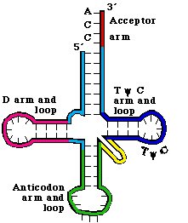
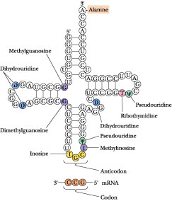
tRNA Secondary Structure
All tRNAs have a common secondary structure (i.e. base pairing of different regions to form stems and loops), the cloverleaf structure.

Slide 11
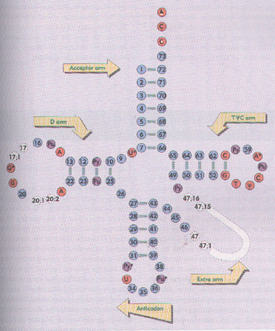
---aa accept arm
loading aa at 3’ end
---TΨC loop:
contact with 5s rRNA
---DHU loop:
contact with AARS
---anti-codon loop:
34th is wobble base
34
---extra loop: (Variable arm) classification marker ?

Slide 12
tRNA Function
tRNAs are joined to amino adds to become aminoacyl-tRNAs (charged tRNAs) in a reaction called aminoacylation.
It is these charged tRNAs that are the adaptor molecules in protein synthesis.
Special enzymes called aminoacyl-tRNA synthetases carry out the joining reaction which is extremely specific (i.e. a specific amino acid is joined to a specific tRNA).
These pairs of specific amino acids and tRNAs, or tRNAs and aminoacyl-tRNA synthetases are called cognate pairs, and the nomenclature used is shown in Table 1 (page 258).

Slide 13
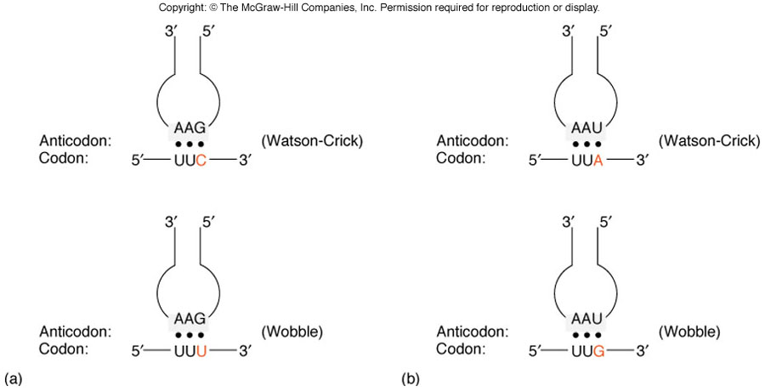

Slide 14
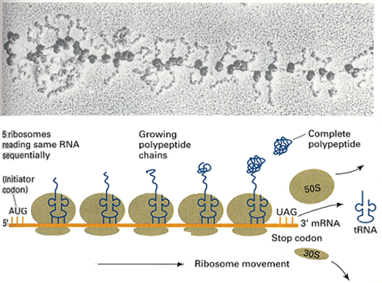

Slide 15
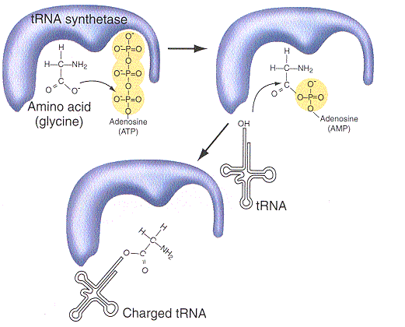
Aminoacyl-tRNA
Step 1
Setp 2

Slide 16
