Slide 1
Gene cloning in Agriculture

Slide 2
Gene Cloning
Gene cloning provided a new dimension to crop breeding for improvement
Two general strategies have been used:
Gene addition
Gene subtraction

Slide 3
Gene Addition
Insect and disease resistant crop plants
Improving nutritional value of crop plant
Abiotic stress tolerance i.e. drought, cold, heat stresses

Slide 4
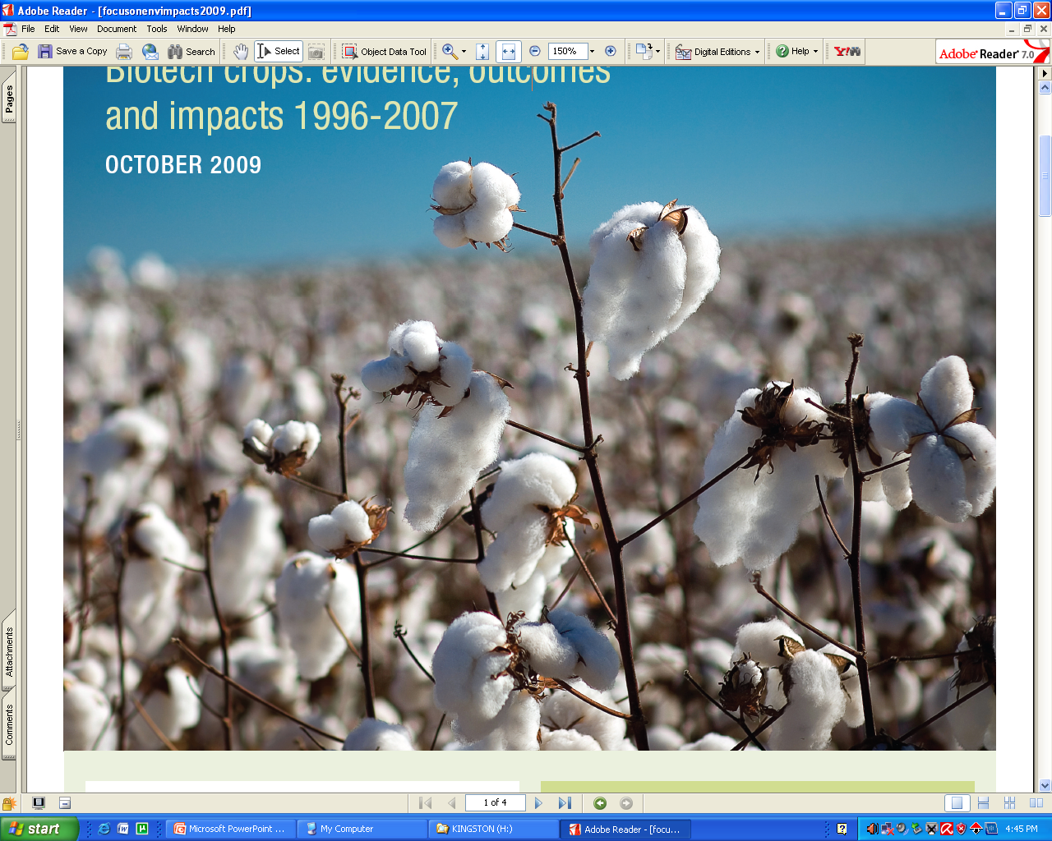
BT Cotton

Slide 5
The δ-endotoxins of Bacillus thuringiensis
Bacteria have evolved defense mechanisms against insect
Sporulation intracellular crystalline bodies that contain an insecticidal protein called the δ-endotoxin.
The activated protein 80,000 times more toxic than organophosphate insecticides.

Slide 6
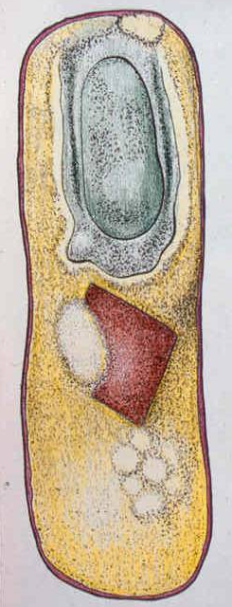
Bacillus thuringiensis (Bt), Use as exogenous Insecticide
Bt was first time used as a pesticide in 1920
Spore based formulations were commercialized in 1938 in France .
Bt was registered as a pesticide in USA in 1961.
The -endotoxin protein that accumulates in the bacterium is an inactive precursor.
Protoxin is cleaved by proteases in insect’s gut and damaging the surface epithelium

Slide 7
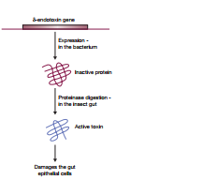

Slide 8
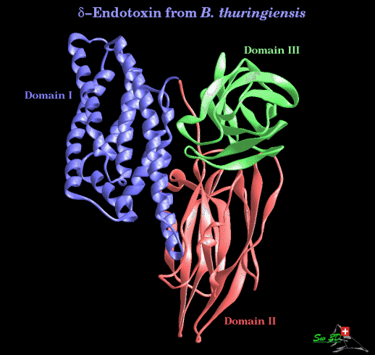
Crystalline proteins: Properties
Cry proteins are classified according to structure & have a specific nomenclature
Grouped in 16 distinct groups
Solubilized in alkaline environment
Cry1 toxic to lepidoptran insects
Cry2 toxic to lepidoptran and Diptera where as Cry2B specific to Diptera
Cry3 toxic to Coleoptra insect
Cry4 toxin specific to Diptera insect

Slide 9
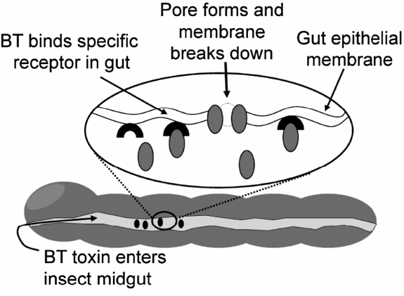
Crystalline protein:
How does it work

Slide 10
Transformation of Cry coding genes (Bt) in crops
Advances in genetic engineering lead to insertion of foreign genes to crop plants
Development of the Bt crops is perhaps the most successful application of biotechnology in agriculture
First genetically modified (GM) plant for Bt, corn, was registered in 1995.
Subsequently Bt version for cotton potato and tomato were commercialized.

Slide 11
Cloning a δ -endotoxin gene in maize
European corn borer (Ostrinia nubilialis)
Maize plants to synthesize δ –endotoxin CryIA(b) in 1993,
.The CryIA(b) protein 155 amino acids in length, with the toxic activity residing in the segment from amino acids 29–607.
A shortened version containing the first 648 codons was made by artificial gene synthesis.
The codons that were used in the artificial gene were those known to be preferred by maize
Overall GC content of the gene was set at 65%, compared with the 38% GC
content of the native bacterial version of the gene.
The artificial gene was ligated into a cassette vector (p. 232) between a promoter and polyadenylation signal from cauliflower mosaic virus,

Slide 12
Gene Expression
Immunological test
Artificial gene activity 250–1750 ng of toxin per mg of total protein.
Field trials
Transformed plants gave better results than the wild ones.

Slide 13
Cloning δ -endotoxin genes in chloroplasts
The CryIIA(a2 had broader toxicity spectrum than the CryIA toxins
Gene expression machinery of chloroplasts related bacteria
Biolistics (p. 85) was used to introduce the CryIIA(a2) operon into tobacco leaf cells.
Insertion into the chloroplast genome was ensured by attaching chloroplast DNA sequences to the
Transgenic shoots growing out of the leaf segments were then placed on a medium thatinduced root formation, and plants grown.

Slide 14
Gene Expression
Toxin making up over 45% of the total soluble protein, more than previously achieved in any plant cloning experiment.
high copy number per cell
Two helper proteins coded by the other genes in the CryIIA(a2) operon.
Five days after being placed on the GM plants, all cotton bollworm and beet armyworm larvae were dead,

Slide 15
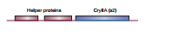

Slide 16
Environmental release of Bt Corn
Company | Events | Gene (s)
Bayer crop Sci. | 2 | cry9C cry1Ab
DeKalb Genetics | 1 | cry1Ac
Dow Agro Sci. | 7 | cry1F cry34Ab1+ cry34Ab1 cry34Ab1+ cry34Ab1+cry1F
Monsanto | 16 | cry1Ab cry1Ab+cry3Bb1 Cry genes
Syngenta seeds | 7 | cry1Ab cry3A mcry3A mcry3A+cry1Ab

Slide 17
Environmental release of Bt Cotton
Company | Events | Gene (s)
Bayer crop Sci. | 1 | cry1Ac+ cry2Ab
Calgene Inc | 1 | cry1Ac
Dow Agro Sci. | 5 | cry1F cry1Ac cry1Ac+ cry1F
Monsanto | 5 | cry1Ac cry2Ab cry1Ac+ cry2Ab cry1Ac+ cry2Ab+vip3A(a)
Syngenta seeds | 1 | vip3A(a)

Slide 18
Growth in Global Area under Bt Crops

Slide 19
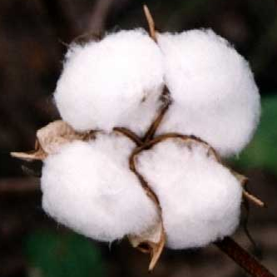
Development of Bt Cotton
Bt gene is inserted to DNA of regeneration responsive cotton variety through gene gun or agrobactarium mediated transformation
The gene is transferred to desirable genetic back ground through conventional back crossing of transgenic plants with commercial lines
Coker 312
Recurrent back-crossing

Slide 20
Bt Cottons
Monsanto was pioneer to launch first generation Bt cotton Bollgard ® containing cry1Ac gene in 1995 in USA
Bollgard ® was commercialized in six cotton growing countries within eight years
Later, Monsanto (Bollgard II®) and DOW AgroScienes (WideStrike™) introduced double and three gene Bt cottons

Slide 21
Commercial versions of Bt cotton containing single or double gene
Product/Company | Event | Protein | Country | Year approved
Bollgard® and Ingard® /Monsanto | MON531, MON757 | Cry1Ac | Argentina Australia China India Indonesia Mexico South Africa USA | 1998 1996 1997 2002 2001 1997 1997 1995
Bollgard® II /Monsanto | Stacked MON15985 MON531 | Stacked Cry2Ab, Cry1Ac | Australia USA India | 2002 2002 2006
Bt Cotton/CAAS | GK | Fused Cry1Ab, Cry1Ac | China | 1998
Bt Cotton/CAAS | GK | Fused Cry1Ab, Cry1Ac Stacked CpTi | China | 1999

Slide 22
Why Bt Cotton?
Increased productivity
Suitable in Integrated pest management
Favourable impact on:
  Farmer health
  Environment
Food safety

Slide 23
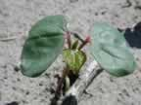



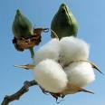

Increased productivity
Increased Yield
Indian and Chinese Bt cotton growers are getting 50 and 10% more yield than non-Bt respectively.
Lower cost of production through:
Less number of sprays e.g. In china and India, use of insecticides is reduced up to 50%.
Reduced number of sprays helps to minimize fuel, machinery and labor cost
Suitable in Integrated pest management
Favourable impact on:
  Farmer health
  Environment
Food safety

Slide 24
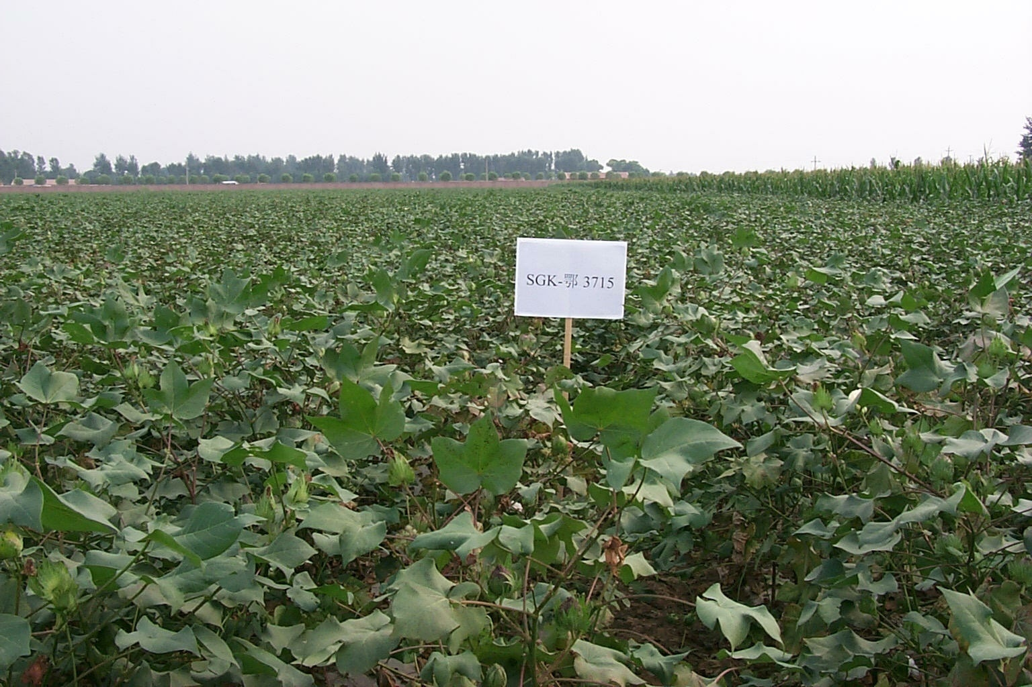
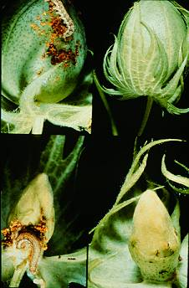
Non-Bt Cotton
Bt cotton

Slide 25

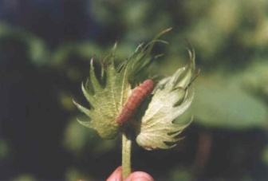
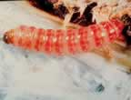
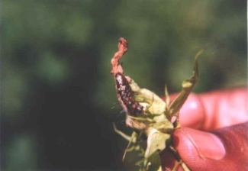
Cry1Ac induced insect control
Excellent
No
Army Worm
ABW
Beneficial insects
Sucking Insect
PBW
SBW

Slide 26

Cry1Ac+Cry2Ab Induced Insect Control
Excellent
No
ABW
Beneficial insects
Sucking Insect
PBW
SBW
Army Worm

Slide 27

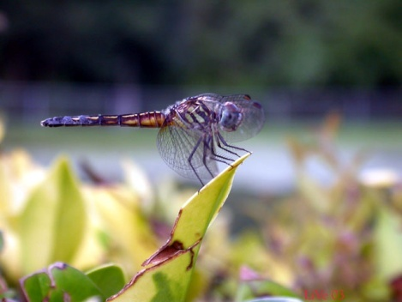

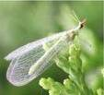
Impact on health and Environment
(Continued)
Environmental Benefits
Conserve natural resources, habitat and indigenous animal life
Friendly to beneficial insects

Slide 28
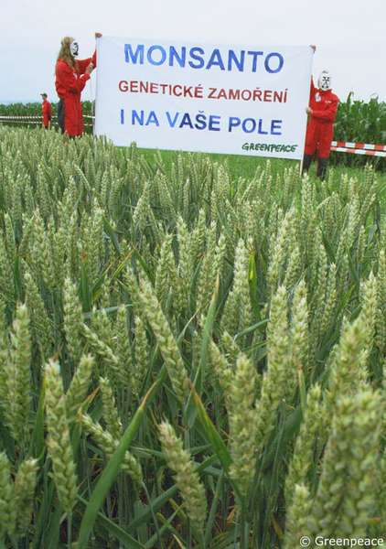
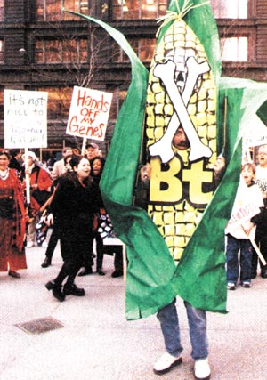
Concerns about Bt

Slide 29
GMOs Detection

Slide 30
Herbicide resistant crops
“Roundup Ready” crops
glyphosate resistant crops were called by Monsanto Co. and called “Roundup Ready”
Plants contained modified genes for the enzyme enolpyruvylshikimate-3-phosphate synthase (EPSPS)
Inhibit synthesis of enolpyruvylshikimate-3-phosphate and preventing the plant from making the three amino acids.

Slide 31
Glyphosate resistant ESPS gene
the EPSPS gene from Agrobacterium strain CP4 .
EPSPS is located in the plant chloroplasts, so the
Agrobacterium EPSPS gene was cloned in a Ti vector
Biolistics was used to introduce the recombinant vector into soybean callus culture.
GM plants were found to have a threefold increase in herbicide resistance.

Slide 32
Antisense DNA technolgy
Using antisense RNA to inactivate the polygalacturonase gene
Number of genes involved in the ripening are switched on in Tomato, including one coding for the polygalacturonase enzyme.
Enzyme slowly breaks down the polygalacturonic acid component of the cell walls in the fruit pericarp

Slide 33
Gene Inactivation
Partial inactivation of the polygalacturonase gene increasde the time between flavor development and spoilage of the fruit.
a 730 bp restriction fragment was obtained from the 5′ region of the normal polygalacturonase gene,
The orientation of the fragment was reversed, a cauliflower mosaic virus promoter was ligated to the start of the sequence, and a plant polyadenylation signal attached to the end.
The construction was then inserted into the Ti plasmid vector pBIN19

Slide 34
Northern hybridization with a single stranded DNA probe specific for the sense mRNA.
Transformed plants contained less polygalacturonase mRNA than the fruits from normal plants.
The amounts of polygalacturonase enzyme produced in the ripening fruits of transformed plants were less enzyme was synthesized in transformed fruits.
The transformed fruits under going a gradual softening, could be stored for a prolonged period before beginning to spoil.
Antisense RNA had not completely inactivated the polygalacturonase gene, but had nonetheless produced a sufficient reduction in gene expression to delay the ripening process as desired. The

