Slide 1
Transcriptome
and analysis of gene transcription

Slide 2
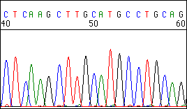
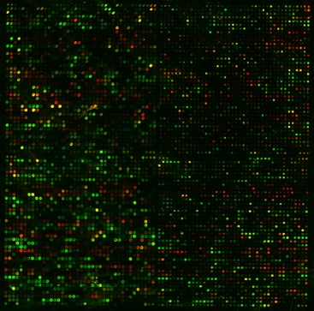
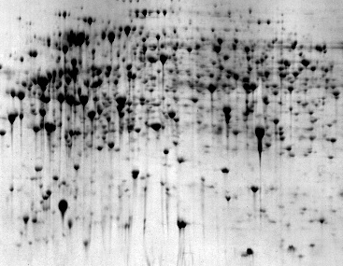
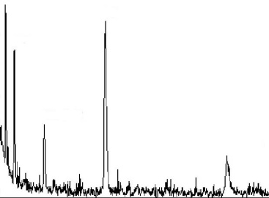
Gene expression
Genome maping
Genome sequencing
Genome annotations
Structural
genomics
Nucleus
DNA (Genome)
DNA arrays and chips
(semi) qRT-PCR
Northern blot + hybrid.
Transkriptional fusions
pre-mRNA
Cytoplasm
mRNA
Regulation
2D electrophoresis
Mass spectrometry
Protein sequencing
Translational fusional
Immunodetection
Enzyme activities
mRNA (Transcriptome)
Functional
genomics
Proteins (Proteome)
Metabolites
(Metabolome)
Chromatography
Mass spectrometry
NMR

Slide 3
Transcriptome
set of all mRNAs present in certain cell, tissue, organ, …
mRNA level results from intensity of transcription and mRNA stability
Transcriptomics
– expression analysis of populations of genes
→ detection of differentially expressed genes
(under different conditions, treatments, developmental stages)

Slide 4
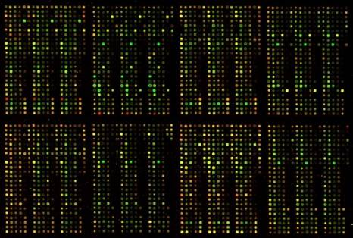
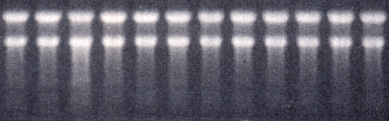
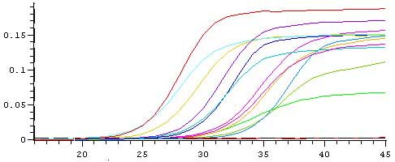
Analysis of gene transcription (mRNA level)
Methods based
on hybridization
Hybridization on
Northern blots
Macroarrays
Chips / microarrays
Methods based on PCR
mRNAs
(Transcriptome)
Real time PCR
qRT-PCR;
Semiquant.
RT-PCR
DNA (Genome)
Proteins
(Proteome)
Reporter gene
P gene T
RNA-seq
parallel NG sequencing
of cDNAs
Transcriptional fusion of gene
promotor with reporter gene

Slide 5
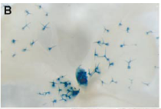
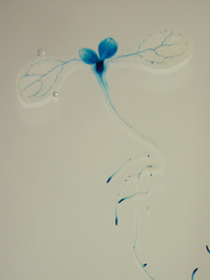
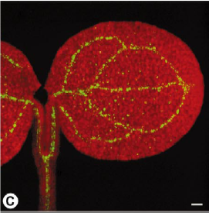
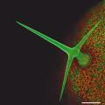
1. Transcriptional fusion of promoter with reporter gene encoding glucuronidase or GFP
easy analysis of the sites of certain gene expression in planta
Reporter gene
P gen T
Arabidopsis
thaliana

Slide 6
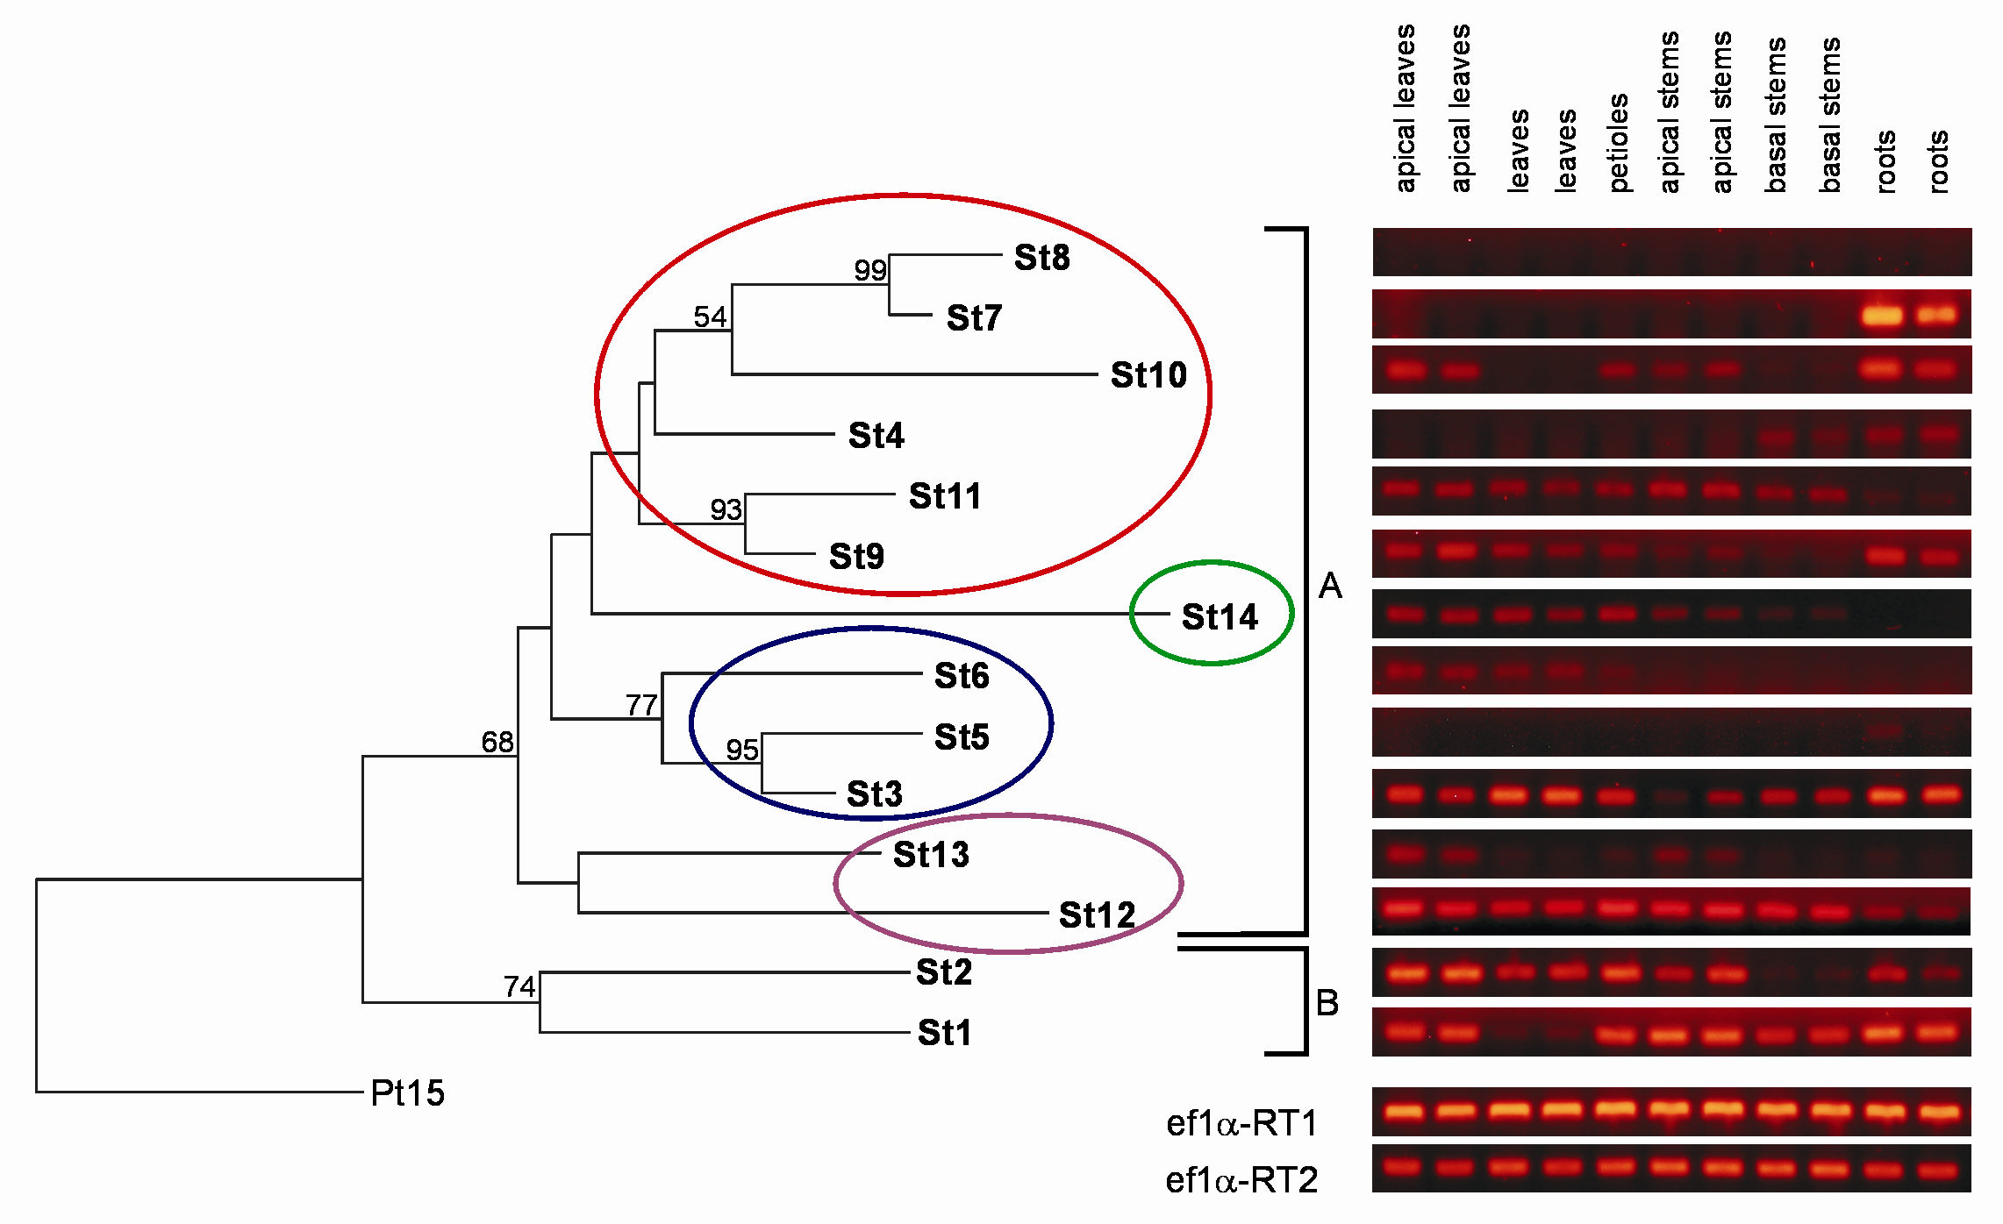
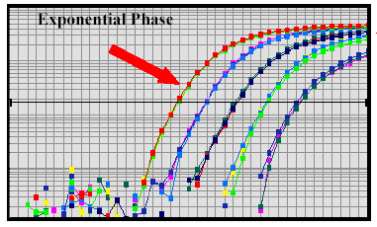
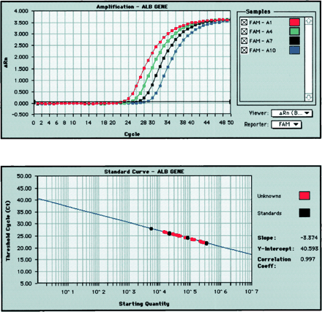
qRT-PCR a Semiquantitative RT-PCR
original level of template measured as:
- PCR product level after certain number of cycles
- number of PCR cycles necessary to reach certain product level
mRNA isolation
Semiquantitative RT-PCR
Proper number of cycles has to be determined
Reverze transcription
(oligo T-primer, specific reverze primer)
cDNA
qRT(real time)-PCR
Electrophoretic detection limit

Slide 7
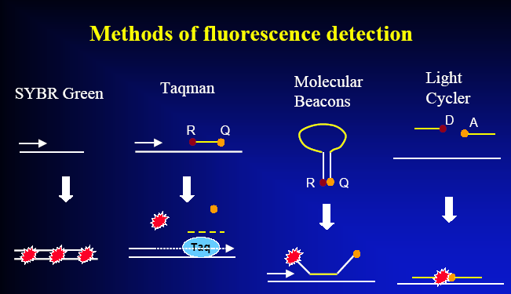
qReal Time - PCR
Detection of product level – fluorescent probes improve specificity
Fluorescent labels:
R …reporter
Q …quencher
D … donor
A … acceptor

Slide 8
Detection of nucleic acids
by hybridization – basic principles
Probe - strand of NA with known sequence used for detection
of complementary strands in a mixture of NAs
(e.g. transcripts, cDNAs, genomic fragments)
Two phases system (↑):
hybridization of complementary single-stranded NA:
immobilized phase (bound on membrane, glass, in tissue)
mobile phase (NA in solution)

Slide 9
immobilized probes
(on known positions)
Arrangement I:
mobile, labeled mixture of NA
immobilized mixtures
Arrangement II:
mobile labeled probe

Slide 10
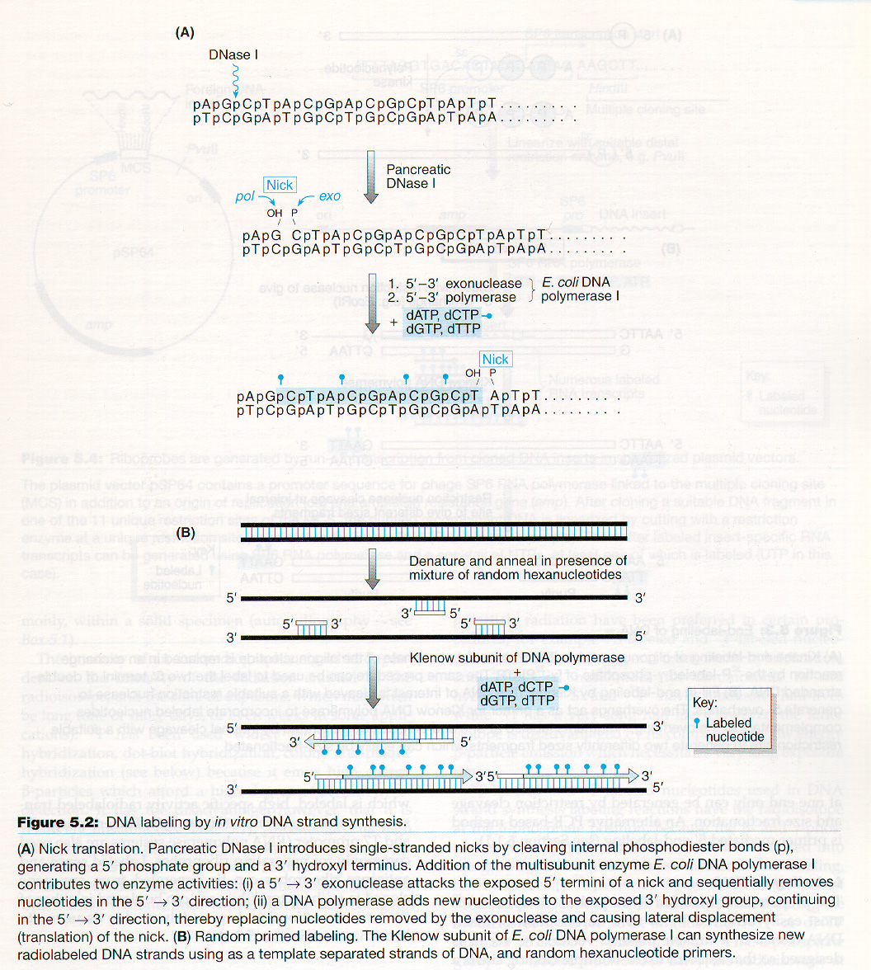
Labelling of probes for hybridization
- labelling usually by incorporation of labelled nucleotide
during NA synthesis
Types of labelling – radioactive (most frequently ³²P)
- fluorescent
- digoxygenin, biotin etc. + (followed by detection with a specific antibody)

Slide 11
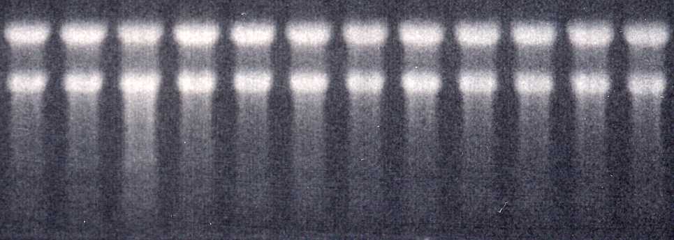
Hybridization on Northern blots
RNA isolation
Electrophoretic separation
Macroarrays
Microarrays
Blotting = transfer of mRNA from gel onto a membrane
Hybridization with labelled probe, detection

Slide 12
DNA arrays and DNA chips - principle
Fluorescently (RI)
labelled analyzed NAs
(mobile phase)
Hybridization
Fluorescent (RI) signal
Pozition
Intensity
Array, chip
(imobilized probe)
Identity
Amount

Slide 13
Hybridization on Northern blots
Immobilized phase – analyzed mixture of mRNAs
Mobile phase = labeled probe of certain gene
(signal intensity + position = transcript level + transcript size)
immobilized mixtures:
x Hybridization on DNA arrays or chips
Immobilized phase – multiple probes with known sequences bound on certain places of the solid support
Mobile phase = labeled mixture of analyzed NAs
(simultaneous detection of presence and quantity of many sequences)
immobilized probes:
(on known positions)

Slide 14
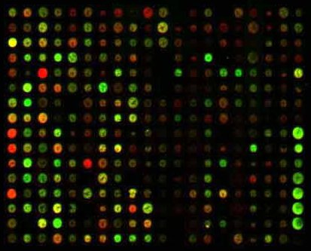
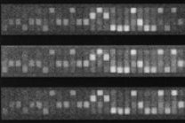
Terminology: arrays, chips
Preparation
Support
Density
[probes/cm²]
Printing of oligo-nucleotids or
PCR fragments
Membrane
max. 64
Macroarray (High Density
Array)
e.g. glass
Printing of oligo-nucleotids or
PCR fragments
up to 10⁴
Microarray
Direct synthesis on the support
e.g. glass
up to 2.5 *10⁵
Chip

Slide 15
Arrays
Probes
Mobile phase
(usually labelled cDNA)
Imobilized phase (array)
cDNA (ESTs)
Imobilized probes
Genome sequences
Oligonucleotides, …

Slide 16
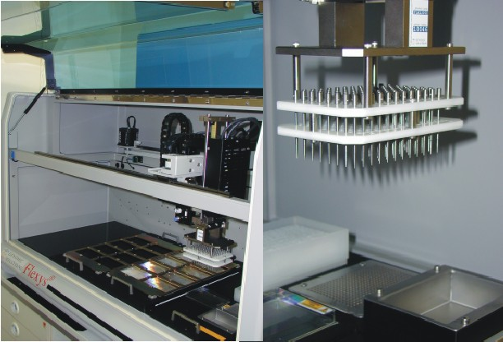
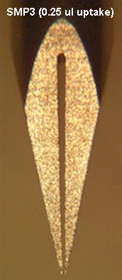
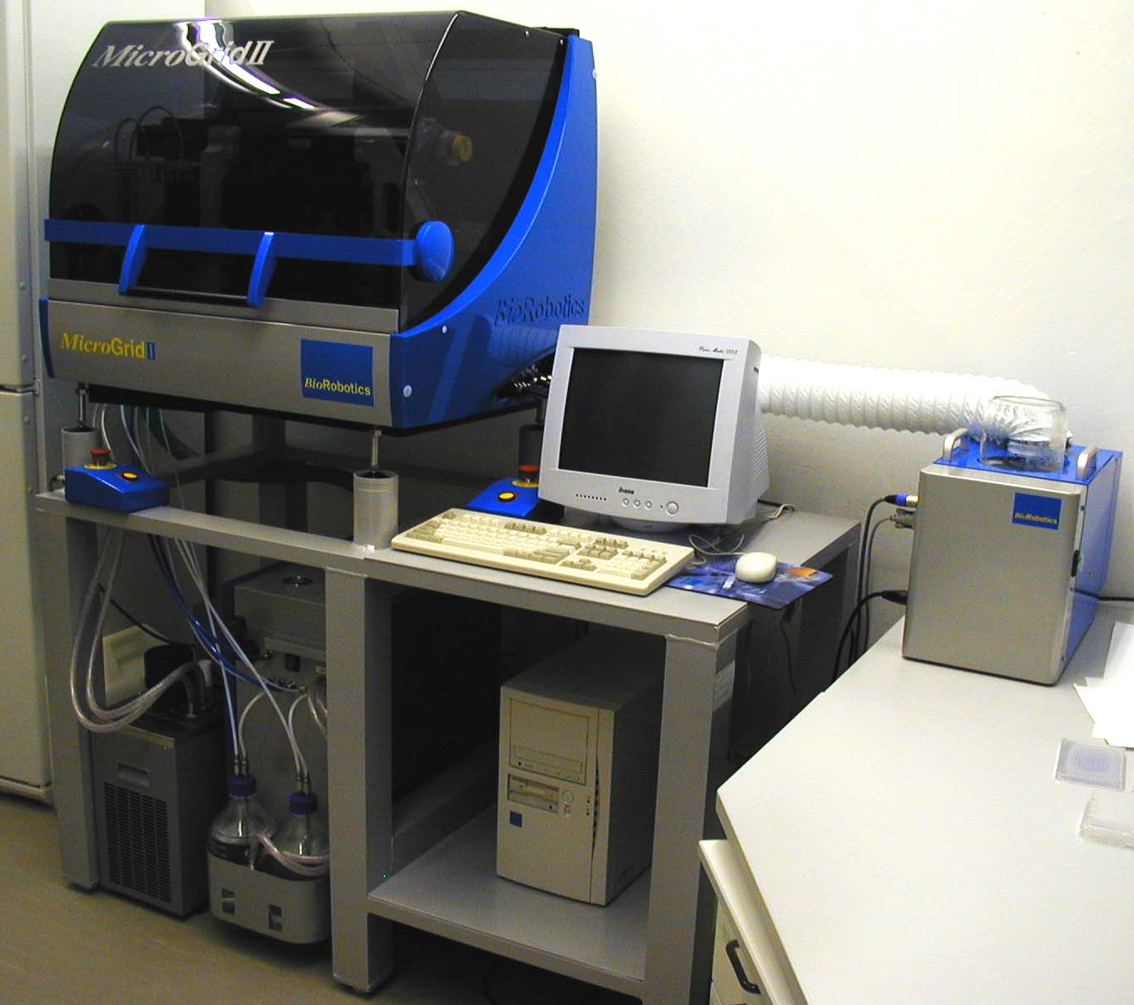
Automated preparation of macroarrays - contact printing
4.5 mm

Slide 17
Comparison of gene expression using differential labelling on arrays
Situation I
Hybridization
RNA isolation
Labelling
Situation II
Alternative approach:
independent hybridization and comparison of the results

Slide 18
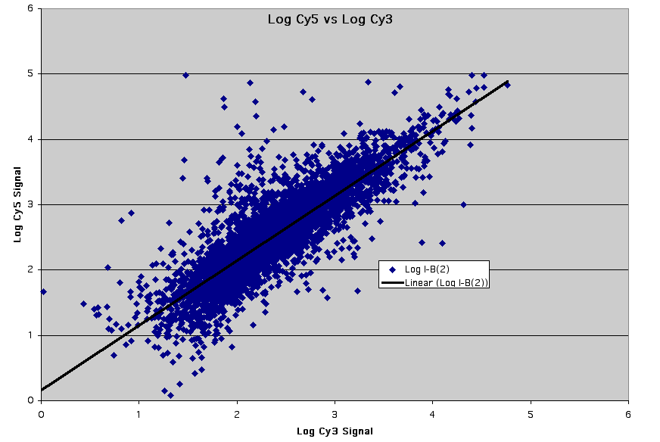
Identification of differentially expressed genes

Slide 19
Oligonucleotide chips from Affymetrix
- mutiple probes for every gene (20 pairs), direct synthesis on the chip
- probes from 3' end of mRNA (for Eukaryotic genes)
- every oligonucleotide in two versions: perfectly matching + with one missmatch
mRNA sequence
5‘
3‘
Pairs of oligonuceotide probes
Gene sequence
Perfect match
Single NT missmatch
Perfect match
Fluorescens intensity
Single NT missmatch
Differences in fluorescence intensity between perfect and missmatched oligonucleotide are averaged for all probe pairs

Slide 20
Sample labelling for hybridization on Affimetrix chips
mRNA
reverse transcription
cDNA with T7 promoter
AAAAAAAAA
AAAAAAAAA
AAAAAAAAA
TTTTTTTTTT- T7 promoter
AAAAAAAAA
ligation of an adaptor
with T7 promoter
AAAAAAAAA
in vitro transcription
with biotinylated NTP
Sample ready for hybridization
with the chip
Biotin-labelled cRNA
fragmentation
B
B
B
B
B
B
B
B
B
UUUUUUUUU
B
B
B
B
UUUUUUUUU
B
B
B
B
B
B
B
B
UUUUUUUUU
B
B
B
B
B
B
B
B
UUUUUUUUU
B
B
B
B
B
B

Slide 21
Affymetrix chips - hybridization and result analysis
B
B
B
B
B
B
B
B
B
B
streptavidin- phycoerythrin binds to biotin
B
B
B
B
B
B
B
B
B
B
Image analysis
detector
Emission at 570 nm
B
B
B
B
B
B
B
B
B
B
excitation
at 488 nm

Slide 22
Genevestigator
https://www.genevestigator.com
partially free approach to chip results
https://genevestigator.com/gv/
Selection of:
phycoerythrin
species
genes
chips
(experiments)

Slide 24
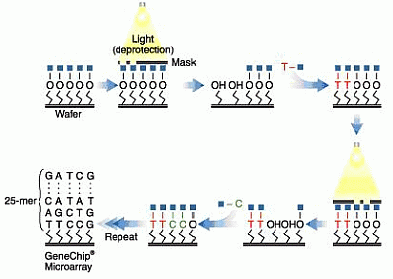
Affymetrix chip preparation
Photolithography

Slide 25
Troubles with hybridization on arrays
Non-specific (cross-) hybridizations, background
Signal intensity depends also on sequence
(differences in efficiency of hybridization)
3. Reproducibility
Solutions:
every probe on different positions on the array
several different probes for every gene
Affimetrix chips

