Slide 1
The genome of prokaryotes and eukaryotes- nuclear and extranuclear genetic organization

Slide 2
Genomes and Genomics
The word “genome,” coined by German botanist Hans Winkler in 1920, was derived simply by combining gene and chromos-ome.
If not specified, “genome” usually refers to the nuclear genome!
An organism’s genome is defined as the complete haploid genetic complement of a typical cell.
The genetic content of the organelles in the cell, is not considered part of the nuclear genome.
In diploid organisms, sequence variations exist between the two copies of each chromosome present in a cell.
The genome is the ultimate source of information about an organism.

Slide 3
Continue…
The number of genomes sequenced in their entirety is now in the thousands and includes organisms ranging from bacteria to mammals.
The first complete genome to be sequenced was that of the bacterium Haemophilus influenzae, in 1995.
The first eukaryotic genome sequence, that of the yeast Saccharomyces cerevisiae, followed in 1996.
The genome sequence for the bacterium Escherichia coli became available in 1997 .
The much larger effort directed at the human genome was also accelerating.

Slide 4
Prokaryotes and Eukaryotes genome
Prokaryotes | Eukaryotes
Single cell | Single or multi cell
No nucleus | Nucleus
One piece of circular DNA | Chromosomes
No mRNA post transcriptional modification | Exons/Introns splicing

Slide 5
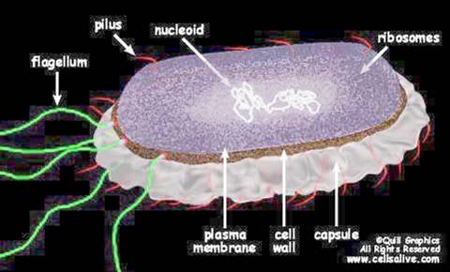
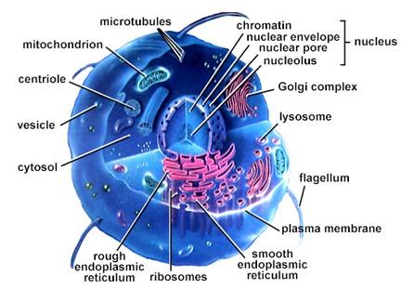
Prokaryotic and Eukaryotic Cells Chromosomal differences
Prokaryotes
The genome of E.coli contains amount of 4X10⁶ base pairs
> 90% of DNA encode protein
Lacks a membrane-bound nucleus.
Circular DNA and supercoiled domain
Histones not present

Slide 6
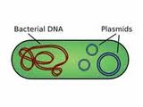
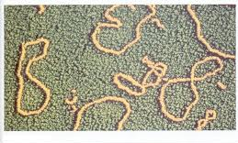
Continue…
Prokaryotic genomes generally contain one large circular piece of DNA referred to as a "chromosome" (not a true chromosome in the eukaryotic sense).
Some bacteria have linear "chromosomes".
Many bacteria have small circular DNA structures called plasmids which can be swapped between neighbors and across bacterial species.

Slide 7
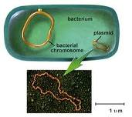
Plasmid
The term plasmid was first introduced by the American molecular biologist Joshua Lederberg in 1952.
A plasmid is separate from, and can replicate independently of, the chromosomal DNA.
Plasmid size varies from 1 to over 1,000 (kbp).

Slide 8
Continue…
Eukaryotes
The genome of yeast cells contains
1.35x10⁷ base pairs
A small fraction of the total DNA encodes protein.
Many repeats of non-coding sequences
All chromosomes are contained in a membrane bound nucleus
DNA is divided between two or more chromosomes
A set of five histones
DNA packaging and gene expression regulation

Slide 9
Karyotype
The study of chromosomes, their structure and their inheritance is known as Cytogenetics.
Each species has a characteristic number of chromosomes and this is known as karyotype.
Bacteria 1
Fruit fly 8
Garden Pea 14
Yeast 16
Frog 26
Cat 38
Fox 34
Mouse 40
Rat 42
Rabbit 44
Human 46
Chicken 78

Slide 10
Continue…
Prior to 1950's it was believed that humans had 48 chromosomes but in 1956 it was confirmed that each human cell has 46 chromosomes (Tjio and Levan, 1956).
On the chromosomes the genes are situated in a linear order.
Each gene has a precise position or locus.
The size of bacterial chromosomes ranges from 0.6 -10 Mbp, and the size of Archael range from 0.5 - 5.8 Mbp, whereas Eukaryotic chromosomes range from 2.9 - 4,000 Mbp.

Slide 11
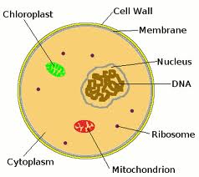
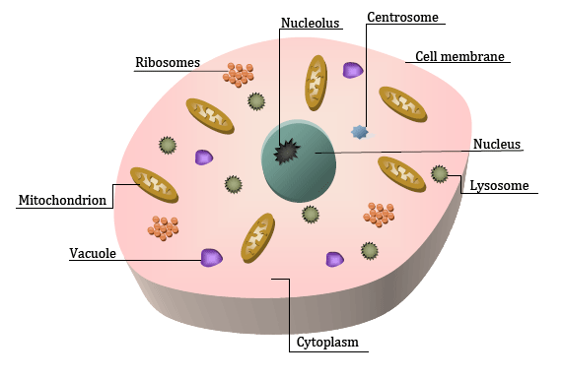
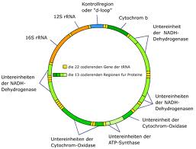
Eukaryotic Genome
Nuclear
Mitochondrial
Plasmids (in yeast and plant chloroplasts)

Slide 12
Mitochondrial DNA
Mitochondrial DNA is a single double stranded circular molecule.
There are several copies in each mitochondrion and there are many mitochondria in each of your cells.
Mitochondrial DNA is similar to prokaryotic DNA. There are no histones or any other protein associated with mt DNA.
The genes contain no introns. Maternal inheritance.
Because it is in a highly oxidizing environment it has a much higher rate of mutations than nuclear DNA.
The genes in mt DNA code for mitochondrial ribosomes and transfer RNAs.
Some genes code for polypeptide subunits of the electron transport chain common to all mitochondria.

Slide 13
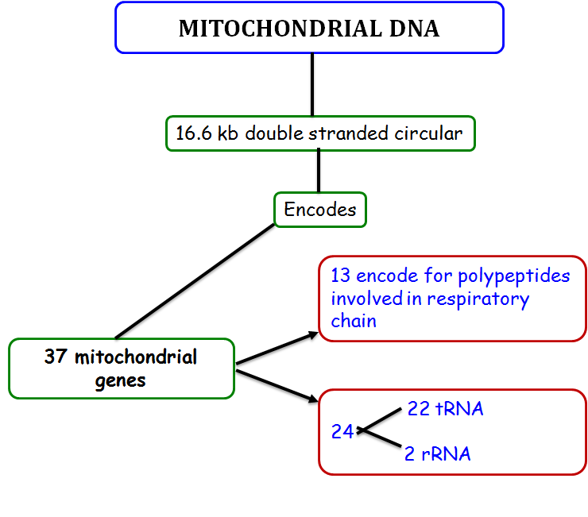
Notes:
10

Slide 14
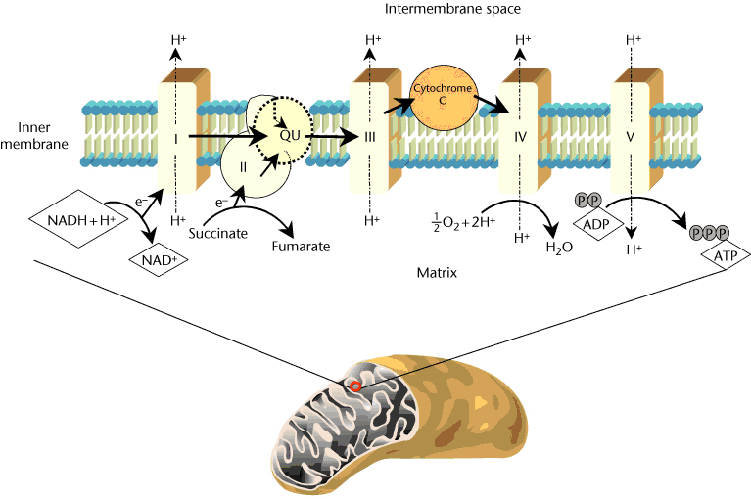
Mitochondria
Notes:
Schematic representation of the mitochondrion with details of the inner membrane and its respiratory complexes (I–IV). Mitochondria are formed by two membranes, an outer membrane having mainly permeability properties and an inner membrane where electron transport and oxidative phosphorylation occur. The inner space, called matrix, contains metabolic enzymes, the mitochondrial deoxyribonucleic aci ...

Slide 15
Human Mitochondrial DNA
Multicopy (466-806 nucleoids /cell)
16,569 bp length and 0.68μM diameter
Genes lack introns
Maternally inherited
Sequenced in 1981 (Nature,1981, 290:457-65)
Mutation rate ~1/33 generations
Heteroplasmy (original and mutated forms co-exist)
Notes:
~2-10 genomes / nucleoid)

Slide 16
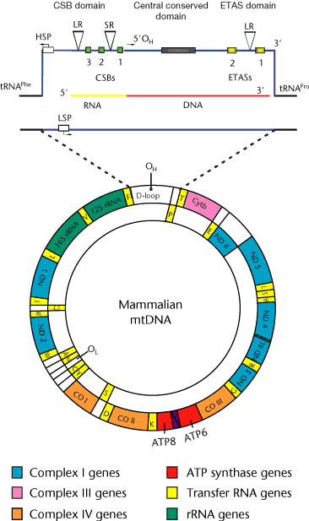
Organization of human mitochondrial DNA.
44% GC
heavy (H) – G-rich and
light (L) strand – C rich
37 genes distributed, of which
28 genes have H as sense strand
9 genes have L as sense strand
24 genes encode mature RNA
13 encode enzymes involved in oxidative phosphorylation
Notes:
Figure 2 Organization of human mitochondrial DNA. The two strands are called heavy (H) and light (L) according to their isopycnic sedimentation in a cesium chloride gradient. Gene distribution between the two strands and the main regulatory regions is indicated. The protein-coding genes are: ATP6, ATP8: ATPase subunits; CO I, II, III: cytochrome c oxidase subunits; Cytb: cytochrome b; 1, 2, 3, 4, 4L, 5, 6: NADH dehydrogenase subunits; 12S, 16S rRNAs: small and large ribosomal subunits RNA; A: alanine; C: cysteine; D: aspartic acid; E: glutamic acid; F: phenylalanine; G: glycine; H: histidine; I: isoleucine; K: lysine; L: leucine; M: methionine; N: asparagine; P: proline; Q: glutamine; R: arginine; S: serine; T: threonine; V: valine; W: tryptophan; Y: tyrosine transfer RNA genes; OL: L strand replication origin; OH: H strand replication origin. In the expanded D-loop region – HSP: H strand promoter; LSP: L strand promoter; CSB: conserved sequence box; ETAS: extended termination associated sequences; LR and SR: short and long repeats; the conserved central domain (black bar), the RNA primer (gray) and the RNA/DNA transition are indicated.

Slide 17
Mitochondrial genetic code
vertebrates Codon Mitochondrial Universal UGA Tryptophan Stop
AUA Methionine Isoleucine
AGA Stop Arginine
AGG Stop Arginine

Slide 18
sequential development of ageing mechanisms
Notes:
The sequential development of ageing mechanisms. Modelling can reveal how the mechanisms responsible for cellular ageing can develop sequentially as the process advances6. In simulations, it is found that a long period of gradual accumulation of mitochondrial (mt)DNA mutations results in a progressive increase in intracellular stress and a decline in energy production that eventually precipitates a more pronounced breakdown of cellular homeostasis.

Slide 19
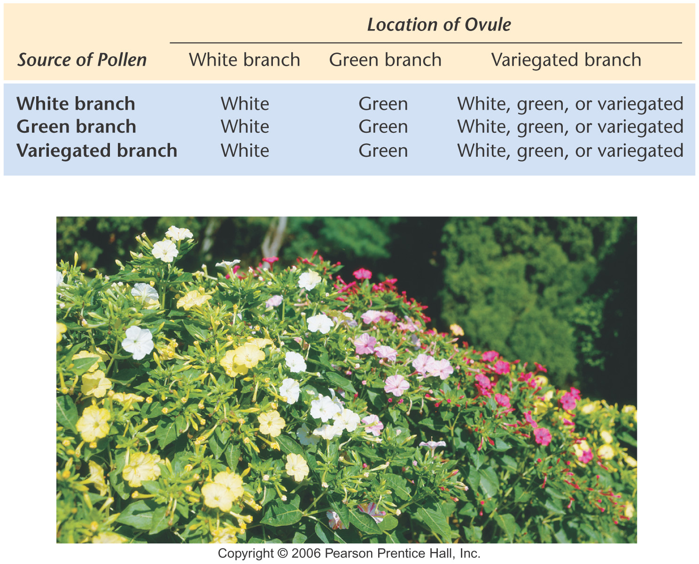
Four O‘Clocks

Slide 20
Mitochondrial/Chloroplast Evolution
Endosymbiont theory
Mitochondria and chloroplasts arose independently about 2 billion years ago as free-living prokaryotes
Primitive eukaryotes without these abilities engulfed the prokaryotes as endosymbionts
Relationship ultimately changed to that of an organelle
Organelles have circular DNA
Most genes moved to “nucleus” (<10% remain)
Targeting peptides added
Organelle genes/expression still “prokaryotic”

Slide 21
Chloroplast Genes/Expression
Chloroplasts have circular DNA and a complete gene expression system
Components derived from cpDNA and nuclear DNA encoded genes
cpDNA commonly 100-225 kbp in size
No nucleosomes, but has introns and large intergenic regions
Multiple copies/organelle (75 in Chlamydomonas) and recombination can occur
Encode rRNAs, tRNAs, rproteins (~70S ribosome) and other proteins/enzymes (92 encode thylakoid proteins in the liverwort)

Slide 28
Mitochondrial Genes/Expression
mtDNA is circular, generally relatively small
16-18 kbp in mammals, 75 kbp in yeast, but 367 kbp in Arabidopsis (a mustard plant)
5-10 copies/organelle in vertebrates, 20-40 in plants
Introns generally absent, small intergenic spaces in small mtDNAs, reverse in larger ones such as yeast
Genetic code similar but modified
Encodes rRNAs, tRNAs and 13 polypeptides in humans (portions of electron transport chain)

Slide 29
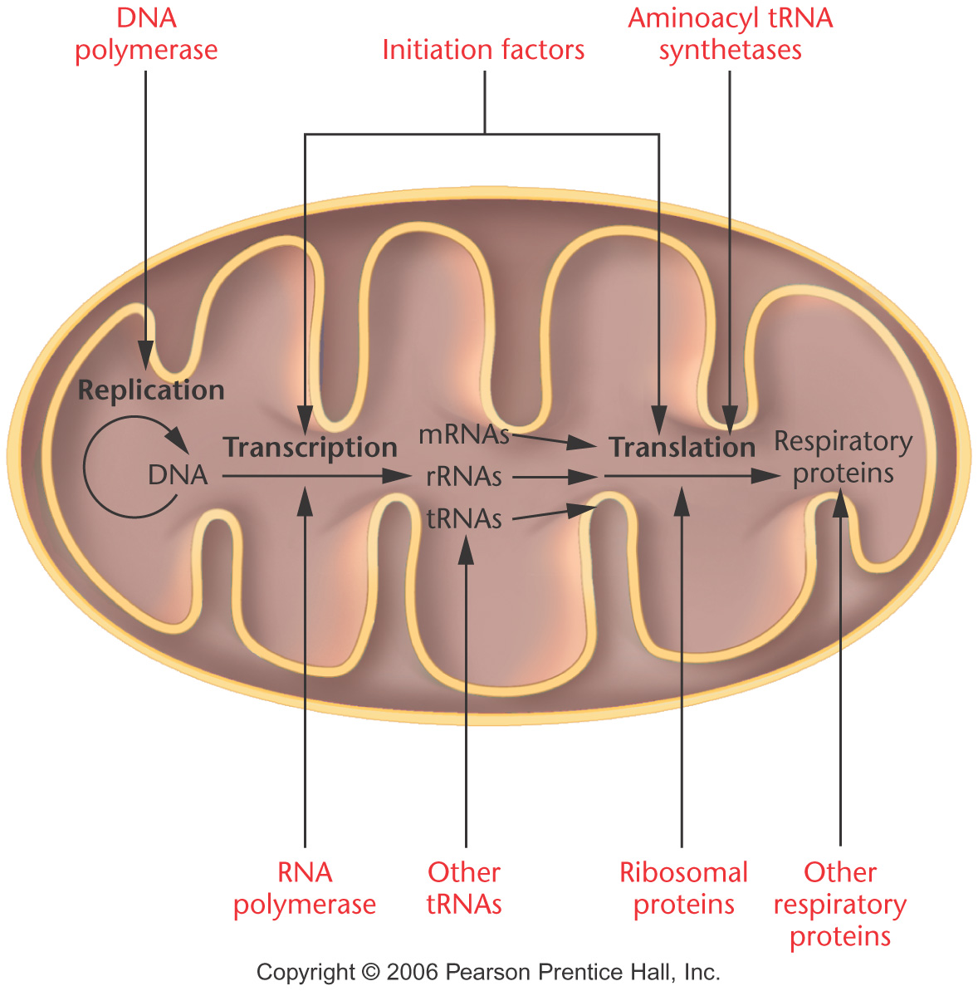
Many proteins
encoded by nuclear
genes have products
transported to
mitochondria
and RNAs ….

Slide 30
Maternal Effect/Maternal Influence
Offspring phenotype under control of nuclear gene product present in the egg
Genetic information of mother used to produce products present in the egg cytoplasm
Snail Limnaea peregra shell coiling is an example

Slide 31
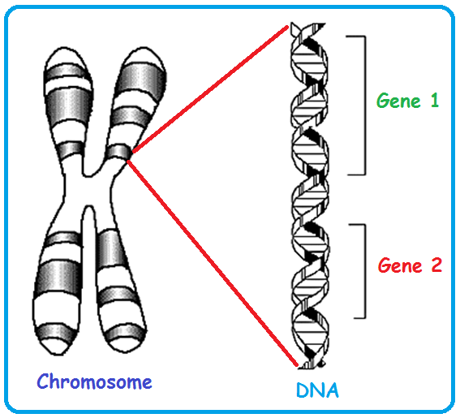
Genes: Genetic Information on Chromosomes
One gene : one enzyme hypothesis: summarizes that a gene is a stretch of DNA coding for one or more isoforms of a single enzyme.
One gene : one polypeptide hypothesis: a gene is responsible for the production of a single polypeptide.
Many genes: one protein:
e.g. Hemoglobin requires different globin genes.

