Slide 1
The genome of prokaryotes and eukaryotes- nuclear and extranuclear genetic organization

Slide 2
Genomics, Genetics and Biochemistry
Genetics: study of inherited phenotypes.
Genomics: study of genomes.
Biochemistry: study of the chemistry of living organisms and/or cells.

Slide 3
Genomes and Genomics
The word “genome,” coined by German botanist Hans Winkler in 1920, was derived simply by combining gene and chromos-ome.
If not specified, “genome” usually refers to the nuclear genome!
An organism’s genome is defined as the complete haploid genetic complement of a typical cell.
The genetic content of the organelles in the cell, is not considered part of the nuclear genome.
In diploid organisms, sequence variations exist between the two copies of each chromosome present in a cell.
The genome is the ultimate source of information about an organism.

Slide 4
"Genes" are units of genetic information present on the DNA in the chromosomes and chromatin.
" Genome" is all the DNA contained in an organism or a cell, which includes the chromosomes plus the DNA in mitochondria (and DNA in the chloroplasts of plant cells).

Slide 5
Continue…
The number of genomes sequenced in their entirety is now in the thousands and includes organisms ranging from bacteria to mammals.
The first complete genome to be sequenced was that of the bacterium Haemophilus influenzae, in 1995.
The first eukaryotic genome sequence, that of the yeast Saccharomyces cerevisiae, followed in 1996.
The genome sequence for the bacterium Escherichia coli became available in 1997 .
The much larger effort directed at the human genome was also accelerating.

Slide 6
Prokaryotes and Eukaryotes genome
Prokaryotes | Eukaryotes
Single cell | Single or multi cell
No nucleus | Nucleus
One piece of circular DNA | Chromosomes
No mRNA post transcriptional modification | Exons/Introns splicing

Slide 7
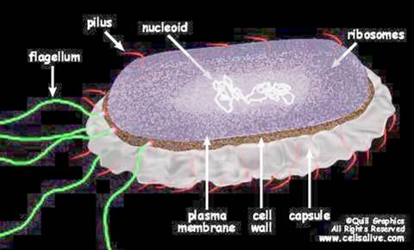
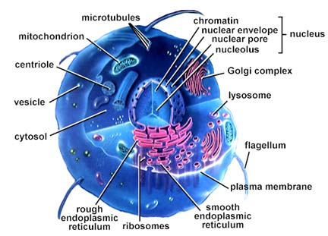
Prokaryotic and Eukaryotic Cells Chromosomal differences
Prokaryotes
The genome of E.coli contains amount of 4X10⁶ base pairs
> 90% of DNA encode protein
Lacks a membrane-bound nucleus.
Circular DNA and supercoiled domain
Histones not present

Slide 8
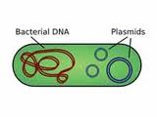
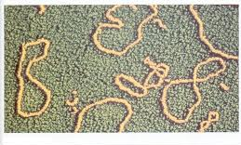
Continue…
Prokaryotic genomes generally contain one large circular piece of DNA referred to as a "chromosome" (not a true chromosome in the eukaryotic sense).
Some bacteria have linear "chromosomes".
Many bacteria have small circular DNA structures called plasmids which can be swapped between neighbors and across bacterial species.

Slide 9
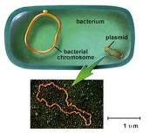
Plasmid
The term plasmid was first introduced by the American molecular biologist Joshua Lederberg in 1952.
A plasmid is separate from, and can replicate independently of, the chromosomal DNA.
Plasmid size varies from 1 to over 1,000 (kbp).

Slide 10
Continue…
Eukaryotes
The genome of yeast cells contains
1.35x10⁷ base pairs
A small fraction of the total DNA encodes protein.
Many repeats of non-coding sequences
All chromosomes are contained in a membrane bound nucleus
DNA is divided between two or more chromosomes
A set of five histones
DNA packaging and gene expression regulation

Slide 11
Karyotype
The study of chromosomes, their structure and their inheritance is known as Cytogenetics.
Each species has a characteristic number of chromosomes and this is known as karyotype.
Bacteria 1
Fruit fly 8
Garden Pea 14
Yeast 16
Frog 26
Cat 38
Fox 34
Mouse 40
Rat 42
Rabbit 44
Human 46
Chicken 78

Slide 12
Continue…
Prior to 1950's it was believed that humans had 48 chromosomes but in 1956 it was confirmed that each human cell has 46 chromosomes (Tjio and Levan, 1956).
On the chromosomes the genes are situated in a linear order.
Each gene has a precise position or locus.
The size of bacterial chromosomes ranges from 0.6 -10 Mbp, and the size of Archael range from 0.5 - 5.8 Mbp, whereas Eukaryotic chromosomes range from 2.9 - 4,000 Mbp.

Slide 13
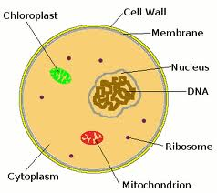
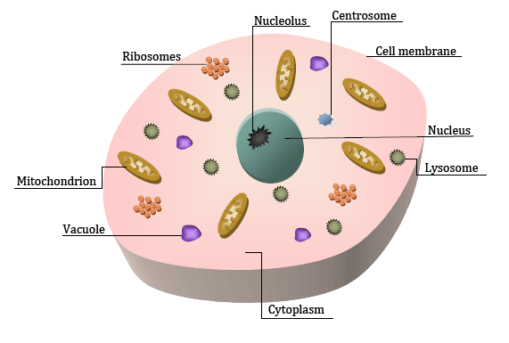
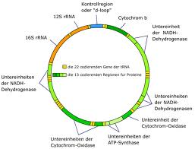
Eukaryotic Genome
Nuclear
Mitochondrial
Plasmids (in yeast and plant chloroplasts)

Slide 14
Mitochondrial DNA
Mitochondrial DNA is a single double stranded circular molecule.
There are several copies in each mitochondrion and there are many mitochondria in each of your cells.
Mitochondrial DNA is similar to prokaryotic DNA. There are no histones or any other protein associated with mt DNA.
The genes contain no introns. Maternal inheritance.
Because it is in a highly oxidizing environment it has a much higher rate of mutations than nuclear DNA.
The genes in mt DNA code for mitochondrial ribosomes and transfer RNAs.
Some genes code for polypeptide subunits of the electron transport chain common to all mitochondria.

Slide 15
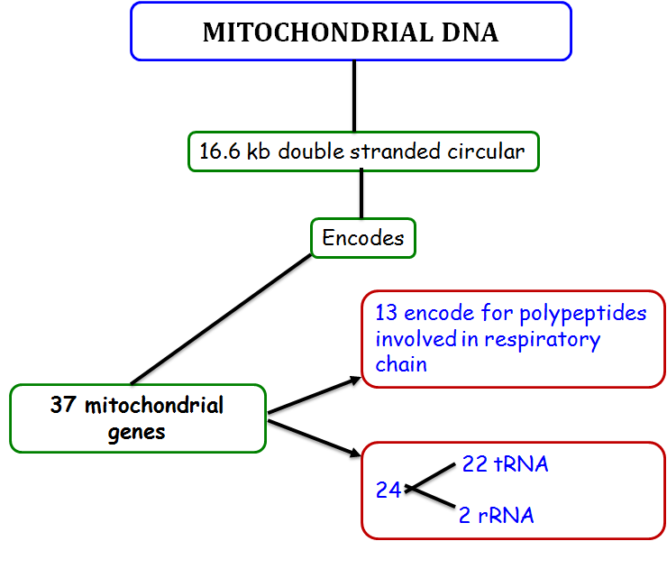
Notes:
10

Slide 16
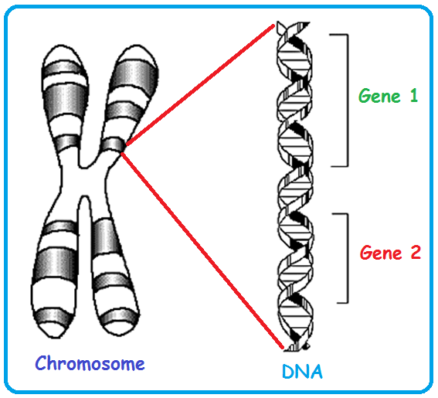
Genes: Genetic Information on Chromosomes
One gene : one enzyme hypothesis: summarizes that a gene is a stretch of DNA coding for one or more isoforms of a single enzyme.
One gene : one polypeptide hypothesis: a gene is responsible for the production of a single polypeptide.
Many genes: one protein:
e.g. Hemoglobin requires different globin genes.

