Slide 1
What is Gender?

Slide 2
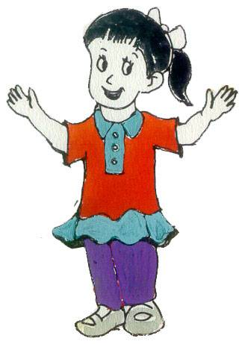
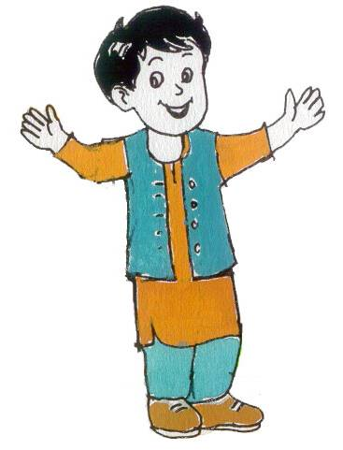
Definition ………..
Culturally and socially constructed roles, responsibilities , privileges, relation, and expectations of women and men , boys and girls.

Slide 3
Difference between Sex and Gender
Sex :sex refers to the biological characteristics distinguished male and female. Biological differences emphasizes on difference in chromosomes,hormones,reproductive system and other physiological components.
Gender:
It refers to social, cultural and psychological traits linked to males and females through particular social contexts.

Slide 4
Related concepts
Sexism
Patriarchy
Androcentrism
Gender attributes
Sex Roles
Gender roles

Slide 5
Continue………………….
Gender Role Stereotyping
Gender Bias
Gender Blind
Gender Neutral
Gender issues
Gender Discrimination
Gender Gap

Slide 6
Continue…..
Sexism: The belief that the status of one gender is inferior from the other gender.
Patriarchy: Male-dominated social structure.
Androcentrism: Male-centered norms operating throughout all the social institutions that become the standard to which all persons adhere.

Slide 7
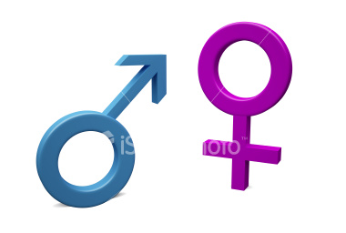
Gender Attributes
What features we
would like to see in males?
What features we
would like to see in females?

Slide 8
Sex Roles
Sex Roles refer to an qualification is to belong to one particular sex category.
For Example:
Pregnancy is a female sex role because only members of the female sex may bear children.

Slide 9
Gender Role
The different task and responsibilities and expectations that society defines and allocates to men and women , boys and girls.
These are not necessarily determined by biological make-up and therefore can change with time and in different situation.

Slide 10
Gender Role Stereotyping
Is the constant portrayal , such as in the media or in the books, of women and men occupying social roles according to the traditional gender division of labour in a particular society.
The assignment of roles, tasks and responsibilities to a particular Gender on the basis of preconceived prejudice.

Slide 11
Gender Bias:
An approach that impacts more positively on male than female, or on Female than male.

Slide 12
Gender Blind
An Approach that doesn’t recognize that there may be difference in situation, needs, feelings, interest etc etc. of women, men , girls, boys.

Slide 13
Gender Neutral
An approach to planning that treats women, men, girls, boys, as if they are part of one homogeneous group.

Slide 14
Gender Issues
Arise where an instance of Gender inequality is recognized as undesirable or unjust.
Three aspects of Gender issues
1 – Gender Gap
2 - Gender Discrimination
3- Gender’s Oppression

Slide 15
Gender Gap
Unfair differences in the situation or access to services of men and women.
These may result from customary practice , religious biases, social assumption, Myths or Taboos, among others.

Slide 16
Gender Discrimination
Means to give differential treatment to individuals on the grounds of their Gender.

Slide 17
Gender Oppression
Where one Gender dominates the other.

Slide 18
Sociological perspectives on Gender
Symbolic Interactionism
Structural functionalism
Conflict theory
Feminist sociological theory

Slide 19
Symbolic Interactionism
Social construction of reality
Doing gender
Dramaturgy
Doing differences.
Critique

