Slide 1
Exogenous Landforming Processes
Weathering and Erosion

Slide 2
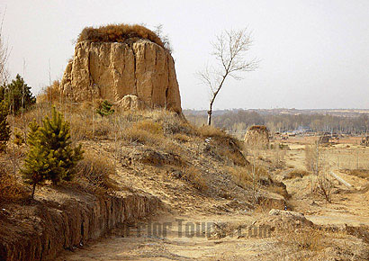
Weathering and Erosion

Slide 3
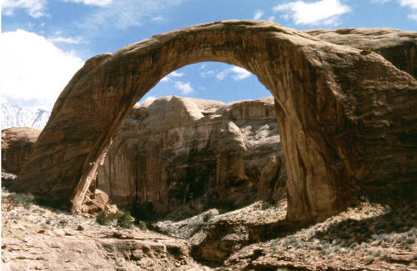
Weathering
The breakdown do the materials of Earth’s crust into smaller pieces.

Slide 4
Physical Weathering
Process by which rocks are broken down into smaller pieces by external conditions.
Types of Physical weathering
Frost heaving and Frost wedging
Plant roots
Friction and impact
Burrowing of animals
Temperature changes

Slide 5
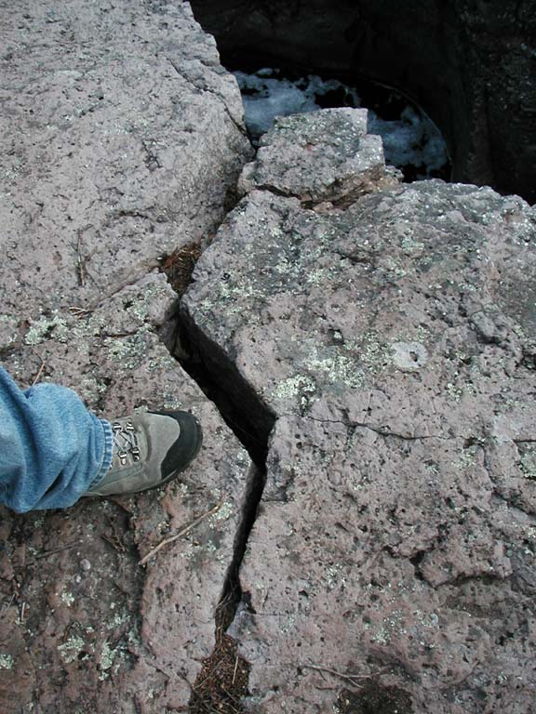
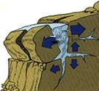
Frost Wedging

Slide 6
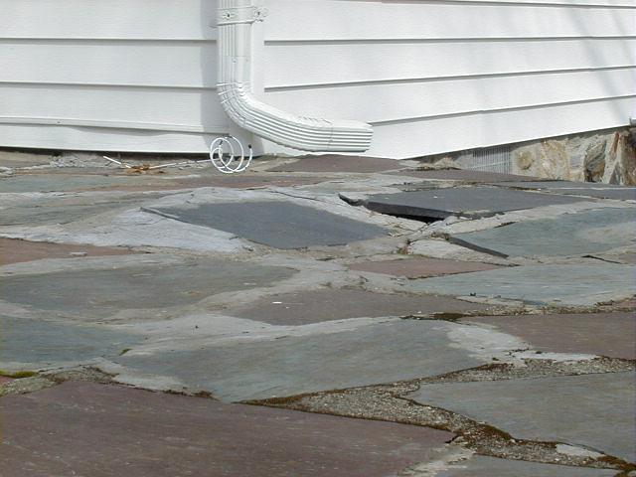
Frost Heaving

Slide 7
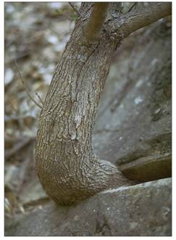
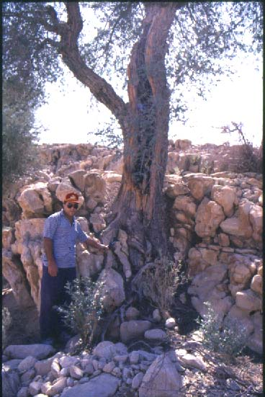
Plant Roots

Slide 8
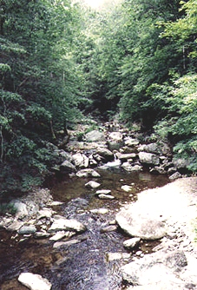
Friction and Repeated Impact

Slide 9
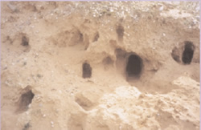
Burrowing of Animals

Slide 10
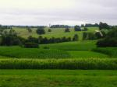
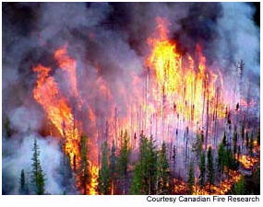
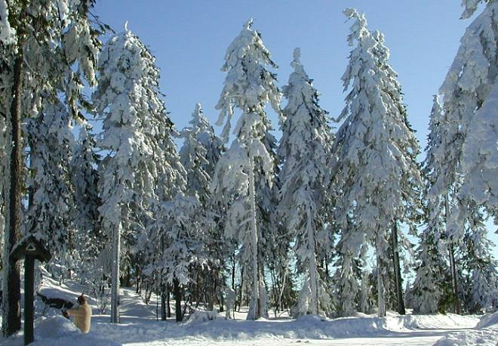
Temperature Changes

Slide 11
Chemical Weathering
The process that breaks down rock through chemical changes.
The agents of chemical weathering
Water
Oxygen
Carbon dioxide
Living organisms
Acid rain

Slide 12
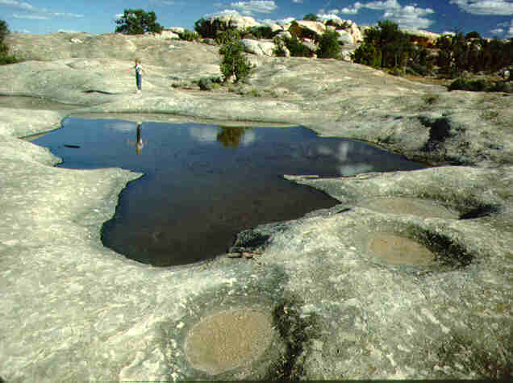
Water
Water weathers rock by dissolving it

Slide 13
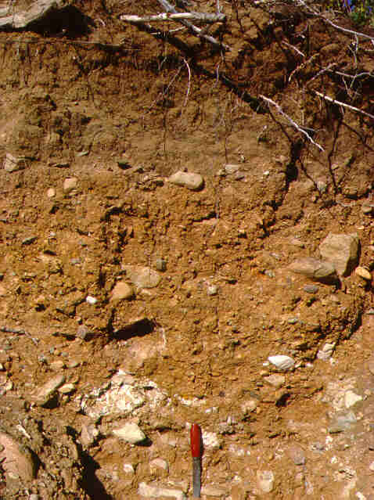
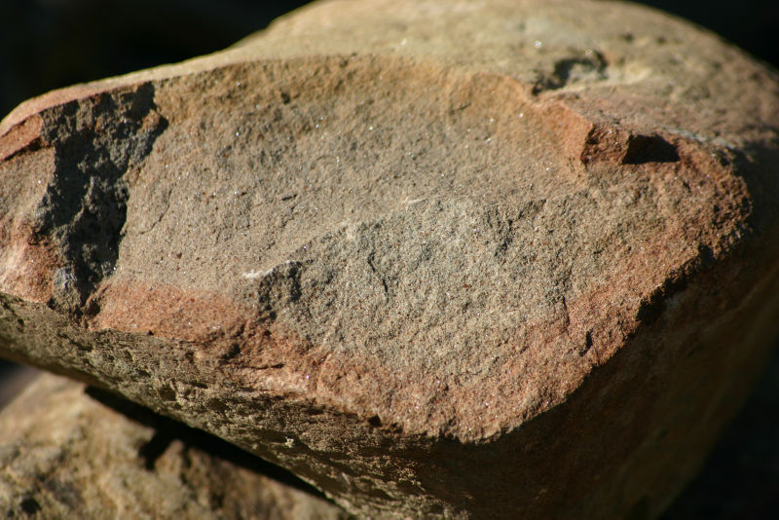
Oxygen
Iron combines with oxygen in the presence of water in a processes called oxidation
The product of oxidation is rust

Slide 14
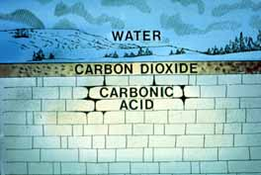
Carbon Dioxide
CO₂ dissolves in rain water and creates carbonic acid
Carbonic acid easily weathers limestone and marble

Slide 15
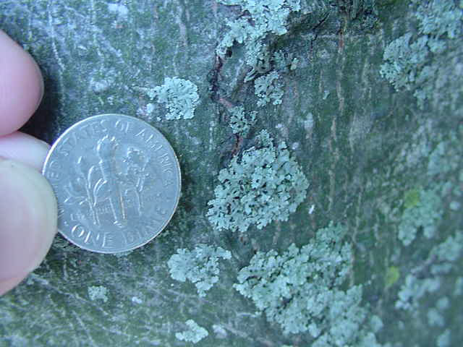
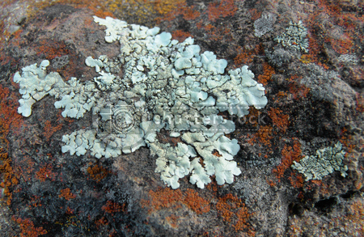
Living Organisms
Lichens that grow on rocks produce weak acids that chemically weather rock

Slide 16
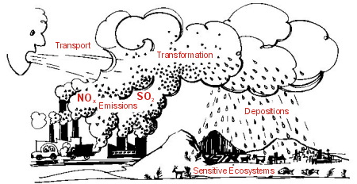
Acid Rain
Compounds from burning coal, oil and gas react chemically with water forming acids.
Acid rain causes very rapid chemical weathering

Slide 17
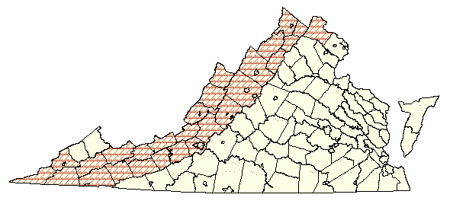
Karst Topography
A type of landscape in rainy regions where there is limestone near the surface, characterized by caves, sinkholes, and disappearing streams.
Created by chemical weathering of limestone

Slide 18
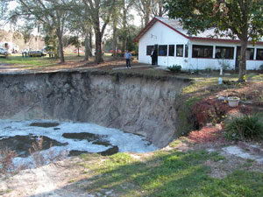
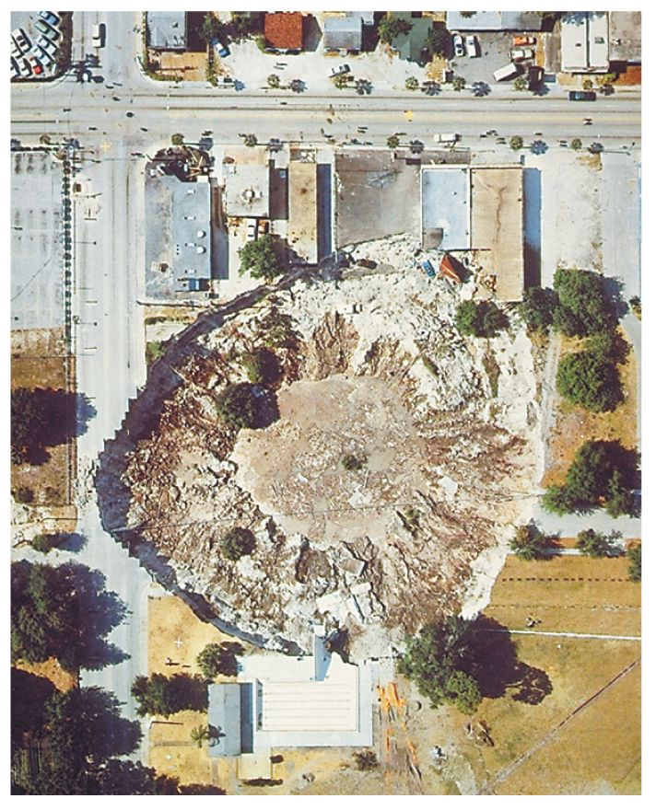
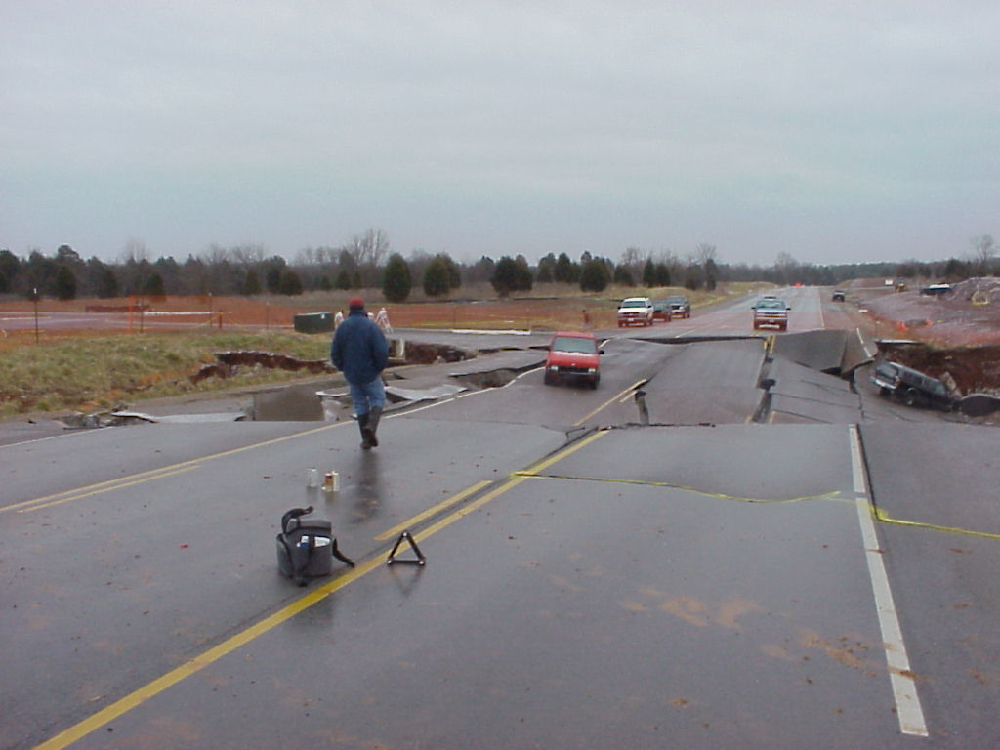
Features of Karst: Sinkholes

Slide 19
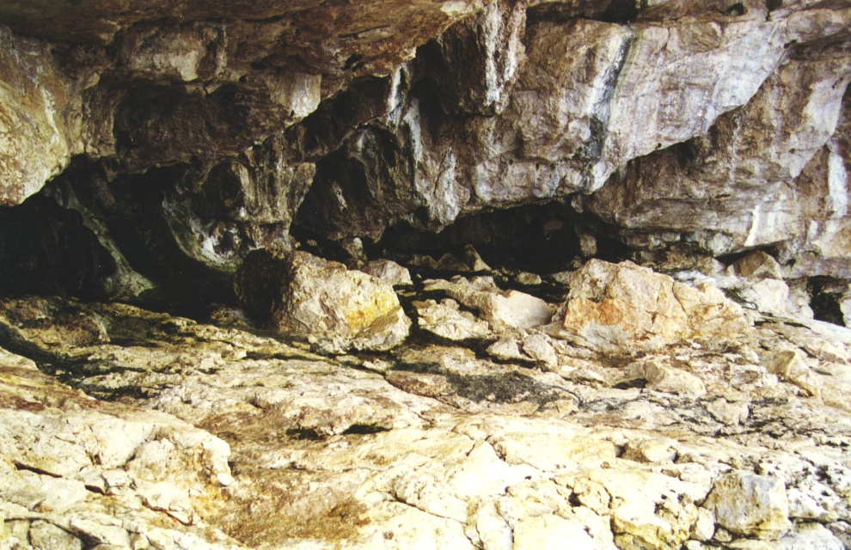
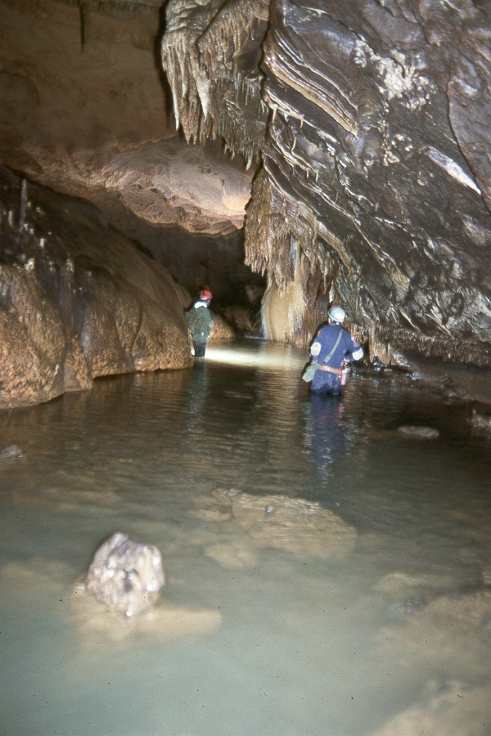
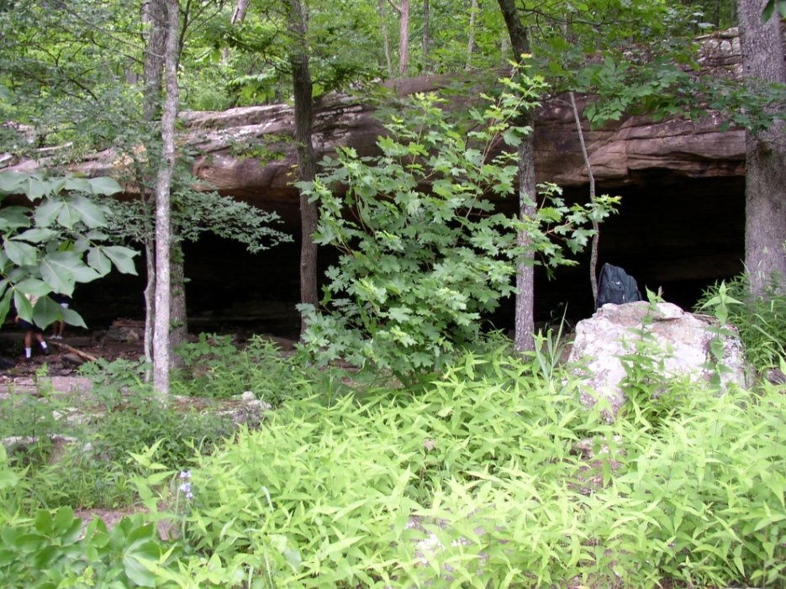
Features of Karst: Caves

Slide 20
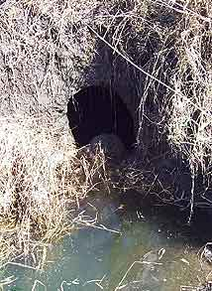
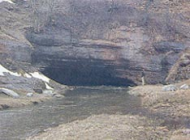
Features of Karst: Disappearing Streams

Slide 21
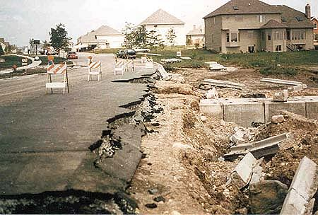
Erosion
The process by which water, ice, wind or gravity moves fragments of rock and soil.

Slide 22
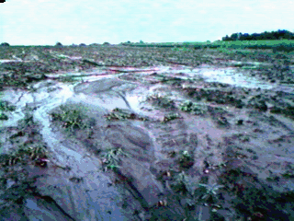
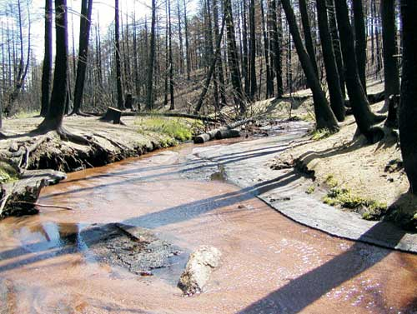
Water Erosion
Rivers, streams, and runoff

Slide 23
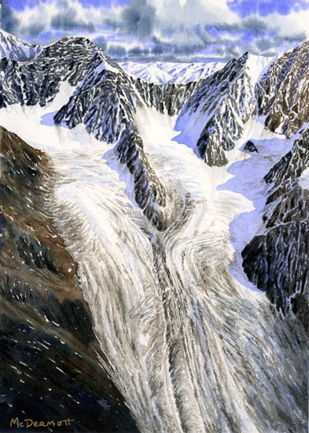
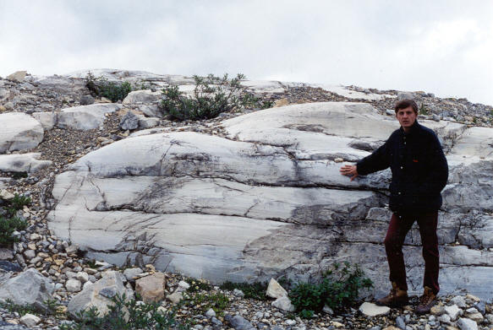
Ice Erosion
Glaciers

Slide 24
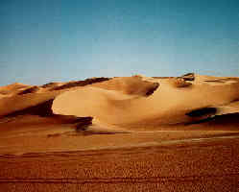
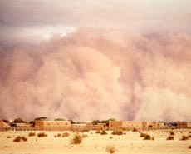
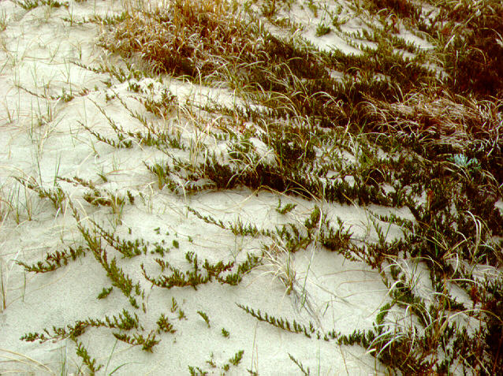
Wind Erosion

Slide 25
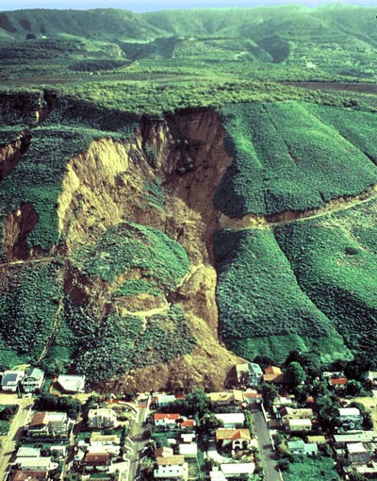
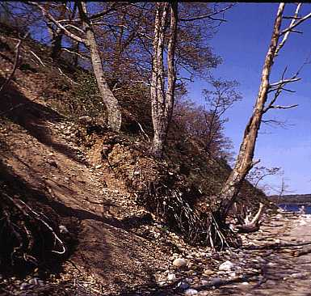
Mass Movements
Landslides, mudslides, slump and creep

