Slide 1
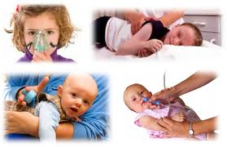
Pediatric Chest Physical Therapy

Slide 2
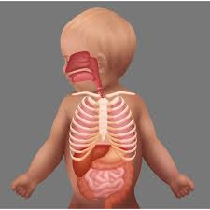
Post – Natal development

Slide 3
Chest shape
Ribs of newborn = horizontally placed
Transverse diameter = AP diameter
As the infant grows and develops upright posture:
Ribs = develop more oblique angle
Transverse diameter increases
The adult chest shape is achieved by 3 years of age.

Slide 4
Airways
No increase in no. of airways formed
Only growth and development in their size
In first few years of life: significant increase in diameter of large, more proximal airways
Smaller, more distal airways, no increase in diameter until nearer 5 years of age.

Slide 5
Alveoli
Post – natally, there is both
Increase in size
Increase in no.
At birth: 150 million alveoli
Much growth of alveoli during first 12 months
By age 4, 300-400 million may exist
Their growth continues until 7 years of age

Slide 6
Collateral ventilation
Is the means by which a distal lung unit can be ventilated despite blockage of the main airway.
Network of interconnecting pathways:
Channels of Martin: connect respiratory bronchioles
Canals of Lambert: connect respiratory and terminal bronchioles with alveoli and their ducts
Pores of Kohn: connects adjacent alveoli by openings in the alveolar wall

Slide 7
Differences in respiratory anatomy and physiology

Slide 8
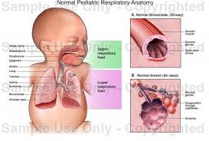
Anatomy
Larynx
Lymphatic tissue
Airways
Bronchial walls
Cillia
Alveoli
Internal organs
Ribcage
Diaphragm

Slide 9
Physiology
Compliance
Closing volumes
Collateral ventilation
Ventilation and perfusion
Oxygen consumption
Response to hypoxia
Muscle fatigue
REM sleep
Breathing pattern

Slide 10
Assessment
History
Investigations
Inspection
Palpation
Auscultation

Slide 11
Physiotherapy techniques
Positioning
Postural drainage
Percussions and vibrations
Breathing exercises and coughing
Airway suction

Slide 12
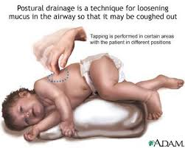
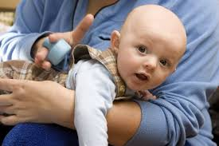

Slide 13
ICU management
History
Ventilation
Drugs
Vital signs
Chest xrays
ABGs

Slide 14
Indications for physiotherapy
Retained secretions unable to be cleared from suctions alone
Acute lobar or lung collapse with mucous plugging

Slide 15
Physiotherapy techniques
MPD
Suction
Manual hyperinflation
Saline instillation
Broncho-alveolar lavage
Breathing exercises
Pronged CPAP
Treatment timing

