Slide 1
CYSTIC FIBROSIS

Slide 2
Cystic fibrosis is an inherited disease of the mucus glands that affects many body systems. In particular, this disorder causes progressive damage to the respiratory system and chronic digestive system problems.

Slide 3
CYSTIC FIBROSIS
Cystic fibrosis is a hereditary disorder of the exocrine glands, with a high sodium chloride content in sweat and pancreatic insufficiency resulting in mal-absorption. There is hypertrophy and hyperplasia of mucus secreting glands resulting in excessive mucus production in the lining of the bronchi, which predisposes the patient to chronic bronchopulmonary infection.

Slide 4
Cystic fibrosis (CF)
Most common hereditary multisystemic disease
Autosomal recessive disorder
Cause: mutations in the single gene on the long arm of chromosome 7 that encodes cystic fibrosis transmembrane conductance regulator (CFTR)
Notes:
Many functions still under investigation----CFTR

Slide 5
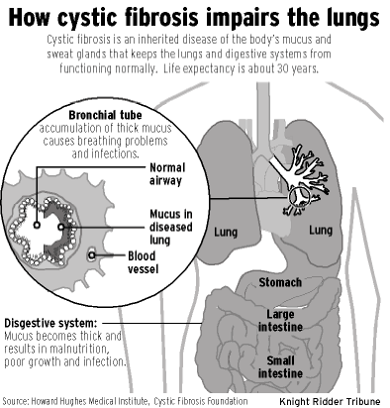

Slide 6
CF is a disease of exocrine gland function, involving multiple organ systems and chiefly resulting in chronic respiratory infections, pancreatic enzyme insufficiency, and associated complications in untreated patients. Pulmonary involvement occurs in 90% of patients surviving the neonatal period. End-stage lung disease is the principal cause of death.

Slide 7
Mucus is a slippery substance that lubricates and protects the linings of the airways, digestive system, reproductive system, and other organs and tissues. In people with cystic fibrosis, the body produces mucus that is abnormally thick and sticky

Slide 8
This abnormal mucus can obstruct the airways, leading to severe problems with breathing and bacterial infections in the lungs.

Slide 9
These infections cause chronic coughing, wheezing, and inflammation. Over time, mucus buildup and infections result in permanent lung damage, including the formation of scar tissue (fibrosis) and cysts in the lungs.

Slide 10
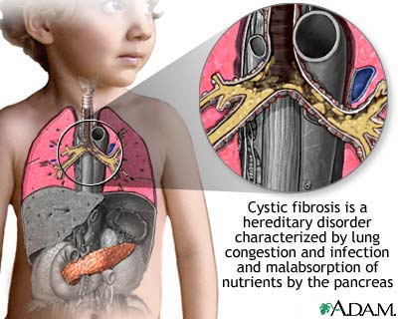

Slide 11
Clinical features of Cystic Fibrosis
Chronic Sino-Pulmonary Disease
Nutritional deficiency
Electrolyte abnormality – high level of sodium in blood
Nasal polyps – benign lesions in nasal airways
Frequent fowl- smelling stools
Intestinal abnormality
Hepatobiliary disease
Pancreatic endocrine dysfunction
Infertility
Notes:
Chronic sp disease---chronic cough, recurrent sp infection, bronchiolitis/asthma, nasal polyps
Nutr---ftt, vit def
Gi---mec ileus, DIOS, rectal prolapse, liver disease---biliary cirrhosis

Slide 12
Chronic Sino-Pulmonary Disease
Chronic infection with CF pathogens
Endobronchial disease
Cough producing copius, often purulent sputum production
Air obstruction--- dyspnoea, wheezing; evidence of obstruction on PFTs
Digital clubbing - Bulbous swelling at end of fingers
Chest x-ray anomalies
Sinus disease
CT or x-ray findings of sinus disease

Slide 13
Diagnosis of cystic fibrosis
One or more clinical features of CF
PLUS
Two CF mutations
OR
Two positive quantative pilocarpine iontophoresis sweat chloride values

Slide 14
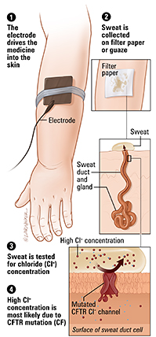

Slide 15
Cystic fibrosis---Treatment Multidisciplinary
Airway Clearance
Infection
Nutrition
Gastrointestinal
Inflammation
Infertility
Social Issues

Slide 16
Medical Management (Respiratory)
Antibiotics
Bronchodilators
Oxygen therapy
Mucolytic agents

Slide 17
Physical therapy Management
Aims:
To reduce bronchospasm and to clear the lung fields
To encourage activities for maintaining physical fitness/increase exercise tolerance
To train postural awareness and relaxation
To educate the patient in self-management.

Slide 18
Physical therapy Management
Clearing lung fields:
Nebulization
Positioning
Postural drainage
Percussion, shaking and vibration

Slide 19
Physical therapy Management
Increasing exercise tolerance
Aerobic exercise training
Physical activities
Participation in home and school activities

Slide 20
Physical therapy Management
Postural awareness
Relaxation techniques
- Diaphragmatic breathing and breathing control
- Generalised relaxation techniques

