Slide 1
Asthma
Chronic inflammatory disease of the airways – increase responsiveness of the Tracheobronchial tree to a variety of stimuli
Narrowing of the airways with cough, dyspnea, wheezing, inability to expel air completely
Episodic in nature – symptoms free time periods
Allergens, exercise, infections, occupational stress, environmental stress, pharmacologic stress, emotional stress
PCO2- initially-30-35 mmHg, later-above 45 mmHg
1 kilopascal =
7.50061683 mmhg

Slide 2
Asthma
Reversible inflammation & obstruction
Intermittent attacks
Sudden onset
Varies from person to person
Severity can vary from shortness of breath to death

Slide 3
What Causes Asthma Attacks?
AN ASTHMA TRIGGER IS…
anything that sets off asthma symptoms
Notes:
Triggers causes the airways to react and the muscles around it to swell and squeeze shut. In addition, the body produces a lot of mucus to get rid of the triggers and the airway gets even narrower.

Slide 4
TRIGGERS
Notes:
Asthma attacks can be caused by something that bothers or irritates your lungs, which are called asthma triggers. Not all the asthma triggers affect every person with asthma. Not all asthma triggers are listed here.
There are many asthma triggers.

Slide 5
Asthma
Triggers:
Allergens
Exercise
Respiratory infections
Drugs and food additives
Nose and sinus problems
GERD
Emotional stress

Slide 6
Asthma: Pathophysiology
Two phases of response occur:
1 . The sensitization stage, which occurs in atopic people: exposure to allergens, especially in foetal or early life, stimulates production of excess immunoglobulin-E antibodies (IgE) in the serum.
IgE becomes fixed to mast cells, which then react to antigens by releasing bronchoconstrictor mediators such as histamine.
Serum IgE levels are five-times higher in asthma patients than in controls.
An atopic person is one who is prone to allergy and who may develop asthma if exposed to allergens, e.g. certain foods, or the faeces of house-dust mite

Slide 7
Asthma: Pathophysiology
2. The hyperreactive stage: continued exposure to allergens, or response to other stimuli, leads to mast cell degranulation and release of inflammatory cytokines such as interleukins and eosinophils .
Chronic low-grade inflammation damages the surface epithelial layer, causing bronchial hyperreactivity.

Slide 8
Degranulation is a cellular process that releases antimicrobial cytotoxic molecules from secretory vesicles called granules found inside some cells. It is used by several different cells involved in the immune system, including granulocytes (neutrophils, basophils and eosinophils) and mast cells.

Slide 9
Development of asthma
Allergen exposure Other causes
IgE increase and
sensitization
Inflammation and hyperreactivity, i.e. chronic asthma
(Trigger)
Asthma attack

Slide 10
Asthma: Pathophysiology
Once asthma is established, hyperreactive airways develop bronchospasm intermittently in response to a variety of stimuli, which increases the work of breathing.
Over time, structural changes stiffen the airway walls and parenchyma, contributing further to airway narrowing.

Slide 11
Asthma: Pathophysiology
Swelling of mucus membranes (edema)
Spasm of smooth muscle in bronchioles
Increased airway resistance
Increased mucus gland secretion

Slide 12
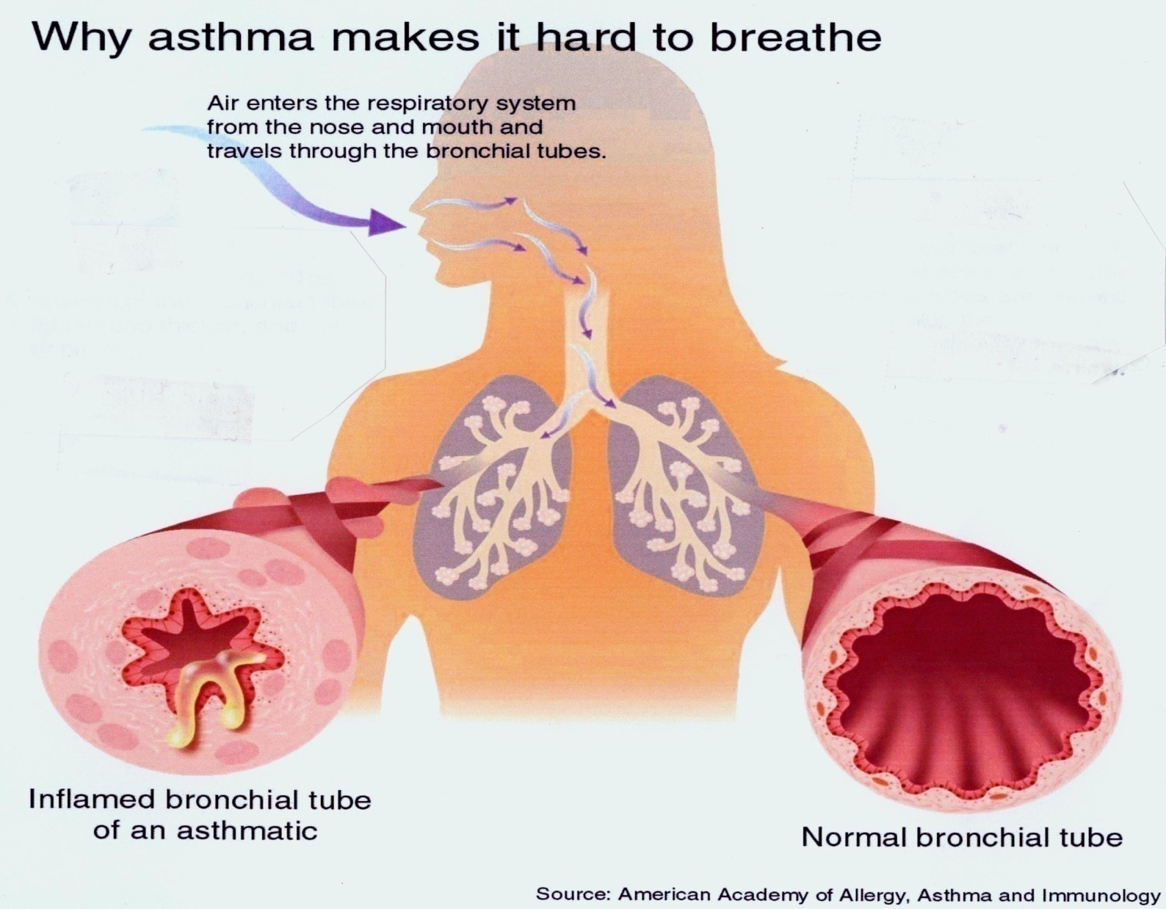
What Is Happening During an Asthma Attack in the Lungs?

Slide 13
Asthma: Pathophysiology
Early phase response: 30 – 60 minutes
Allergen or irritant activates mast cells
Inflammatory mediators are released
histamine, bradykinin, leukotrienes, prostaglandins, platelet-activating-factor, chemotactic factors, cytokines
Intense inflammation occurs
Bronchial smooth muscle constricts
Increased vasodilation and permeability
Epithelial damage
Bronchospasm
Increased mucus secretion
Edema

Slide 14
Asthma: Pathophysiology
Late phase response: 5 – 6 hours
Characterized by inflammation
Eosinophils and neutrophils infiltrate
Mediators are released , mast cells release histamine and additional mediators
Lymphocytes and monocytes invade as well
Future attacks may be worse because of increased airway reactivity that results from late phase response
Individual becomes hyperresponsive to specific allergens and non-specific irritants such as cold air and dust
Specific triggers can be difficult to identify and less stimulation is required to produce a reaction

Slide 15
Asthma: Early Clinical Manifestations
Wheezing
Chest tightness
Dyspnea
Cough
Prolonged expiratory phase
Anxious &Agitated
Increased respiratory & heart rate

Slide 16
Asthma: Severe Clinical Manifestations
Hypoxia
Confusion
Increased heart rate & blood pressure
Respiratory rate up to 40/minute
Use of accessory muscles
Diaphoresis & pallor
Cyanotic nail beds

Slide 17
Classification of Asthma
Mild intermittent
Mild persistent
Moderate persistent
Severe persistent

Slide 18
Asthma
Status asthmaticus
This term is sometimes used interchangeably with severe acute asthma, but specifically describes an asthma attack prolonged over 24 hours, leading to dehydration and exhaustion.

Slide 19
Asthma: Diagnostic Tests
Pulmonary Function Tests
FEV1 decreased
PEFR decreased
Symptomatic patient
eosinophils > 5% of total WBC
Increased serum IgE
Chest x-ray shows hyperinflation
ABGs
Early: respiratory alkalosis, PaO2 normal or near-normal
severe: respiratory acidosis, increased PaCO2,

Slide 20
Types of Medications
Long-term “controller” medicine
Quick-relief “rescue” medicine

Slide 21
Long-Term Medications
Long-term “controller” medicine prevents swelling and inflammation of the airway and should be used every day, even when feeling well.
Notes:
*Long term medication should not be used as a quick relief.

Slide 22
Quick-Relief Medications
Quick-relief “rescue” medicine works quickly to open the tightened airway.
Quick-relief medicine is usually used on an as-needed basis.
Notes:
The quick relief medication should not be used in place of long term medicine

Slide 23
Asthma: Collaborative Care
Mild intermittent
Avoid triggers
Premedicate before exercising
May not need daily medication
Mild persistent asthma
Avoid triggers
Premedicate before exercising
Low-dose inhaled corticosteroids

Slide 24
Asthma: Collaborative Care
Moderate persistent asthma
Low-medium dose inhaled corticosteroids
Long-acting beta2-agonists
Can increase doses or use theophylline or leukotriene-modifier [singulair, accolate, zyflo]
Severe persistent asthma
High-dose inhaled corticosteroids
Long-acting inhaled beta2-agonists
Corticosteroids if needed

Slide 25
Asthma Medications: Anti-inflammatory
Corticosteroids
Not useful for acute attack
Beclomethasone: vanceril, beclovent, qvar
Cromolyn & nedocromil
Inhibits immediate response from exercise and allergens
Prevents late-phase response
Useful for premedication for exercise, seasonal asthma
Leukotriene modifiers
Interfere with synthesis or block action of leukotrienes
Have both bronchodilation and anti-inflammatory properties
Not recommended for acute asthma attacks
Should not be used as only therapy for persistent asthma
Accolate, Singulair, Zyflo

Slide 26
Asthma Medications: Bronchodilators
β2-adrenergic agonists
Rapid onset: quick relief of bronchoconstriction
Treatment of choice for acute attacks
If used too much causes tremors, anxiety, tachycardia, palpitations, nausea
Too-frequent use indicates poor control of asthma
Short-acting
Albuterol[proventil]; metaproterenol [alupent]; bitolterol [tornalate]; pirbuterol [maxair]
Long-acting
Useful for nocturnal asthma
Not useful for quick relief during an acute attack
Salmeterol [serevent]

Slide 27
Asthma: Client Teaching
Correct use of medications
Signs & symptoms of an attack
Dyspnea, anxiety, tight chest, wheezing, cough
Relaxation techniques
When to call for help, seek treatment
Environmental control
Cough & postural drainage techniques

