Slide 1
Cardiovascular Diagnostic Tests and procedures

Slide 2
Diagnostic tests for heart diseases:
Test Name | Lower/normal risk | High risk | Cost $US (approx)
Total Cholesterol | <200 mg/dL | >240 mg/dL
LDL | <100 mg/dL | >160 mg/dL | $150*
HDL | >60 mg/dL | <40 mg/dL
Triglyceride | <150 mg/dL | >200 mg/dL
Blood Pressure | <120/80 mmHg | >140/90 mmHg
C-reactive protein | <1 mg/L | >3 mg/L | $20
Fibrinogen | <300 mg/dL | >460 mg/dL | $100
Homocysteine | <10 µmol/L | >14 µmol/L | $200
Fasting Insulin | <15 µIU/mL | >25 µIU/mL | $75
Ferritin | male 12–300 ng/mL female 12–150 ng/mL |  | $85
Lipoprotein(a) - Lp(a) | <14mg/dL | >19mg/dL | $75

Slide 3
DIAGNOSTIC TESTS
Cardiac catheterization
Cardiac Enzymes Test
(CAT) Computed Axial Tomography
Echocardiography
Electrocardiogram (EKG, ECG)
Exercise stress testing
Holter monitoring
Event monitoring
Magnetic Resonance Imaging (MRI)
Positron Emission Tomography (PET)
Intravascular ultrasound
Serum lipid
Thalium scan
Computed tomography angiography (CTA),

Slide 4
Cardiac catheterization
Diagnostic procedure in which a catheter is introduced into a large vein or artery, usually of an arm or a leg, and is then threaded through the circulatory system to the heart
Used to obtain detailed information about the structure and function of the heart chambers, valves, and the great vessels

Slide 5
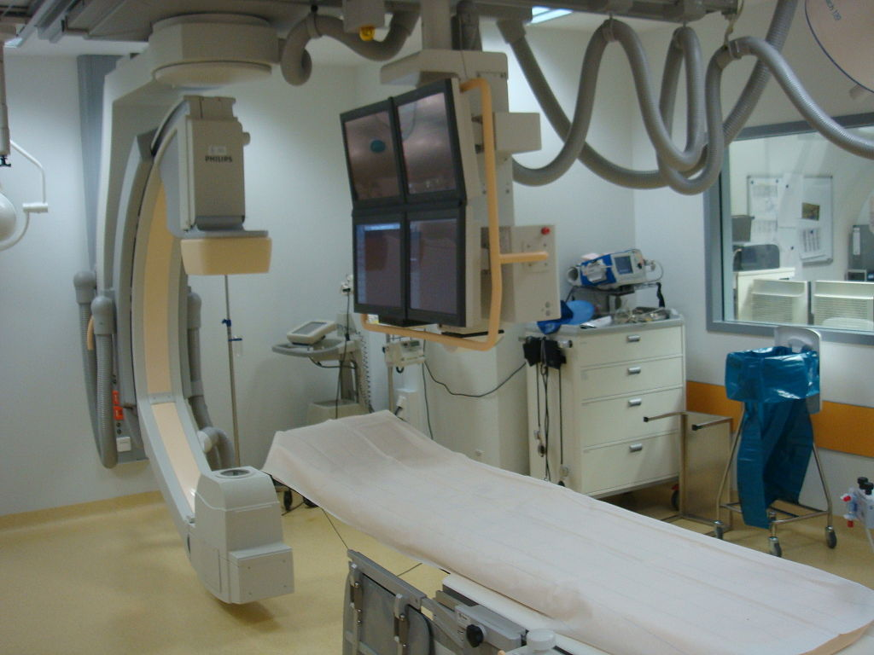

Slide 6
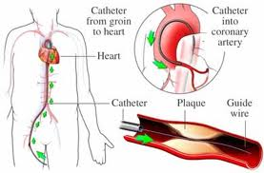

Slide 7
Cardiac Enzyme Studies
Cardiac enzyme studies measure the levels of enzymes and proteins that are linked with injury of the heart muscle. These include the enzyme creatine kinase (CK), and the proteins troponin I (TnI) and troponin T (TnT). Low levels of these enzymes and proteins are normally found in your blood, but if your heart muscle is injured, such as from a heart attack, the enzymes and proteins leak out of damaged heart muscle cells, and their levels in the bloodstream rise.
Because some of these enzymes and proteins are also found in other body tissues, their levels in the blood may rise when those other tissues are damaged. Cardiac enzyme studies must always be compared with your symptoms, your physical examination findings, andelectrocardiogram (EKG, ECG) results.

Slide 8
Cardiac Enzymes Test
Tests performed on samples of blood obtained by venipuncture to determine the presence of damage to the myocardial muscle
(CAT) Computed Axial Tomography
Diagnostic X-ray technique that uses ionizing radiation to produce a cross-sectional image of the body
Often used to detect aneurysms of the aorta

Slide 9
Echocardiography
Diagnostic procedure for studying the structure and motion of the heart
Useful in evaluating structural and functional changes in a variety of heart disorders
Electrocardiogram (EKG, ECG)
Graphic record of the electrical action of the heart as reflected from various angles to the surface of the skin

Slide 10
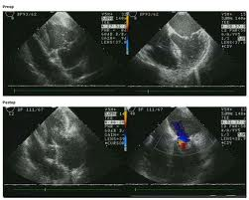

Slide 11
Exercise stress testing
Means of assessing cardiac function, by subjecting the patient to carefully controlled amounts of physical stress, for example, using the treadmill

Slide 12
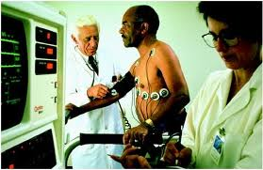

Slide 13
Holter monitoring
Small, portable monitoring device that makes prolonged electrocardiograph recordings on a portable tape recorder
Continuous EKG (ambulatory EKG) is recorded on a magnetic tape recording while the patient conducts normal daily activities

Slide 14
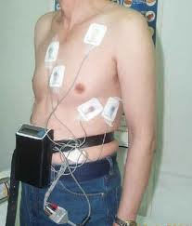

Slide 15
Event monitor
Similar to the Holter monitor in that it also records the electrical activity of the heart while patient goes about usual daily activities
Can be used for a longer period of time than a Holter monitor
Usually a month

Slide 16
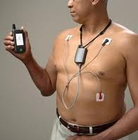

Slide 17
Magnetic Resonance Imaging (MRI)
Use of strong magnetic field and radiofrequency waves to produce imaging that is valuable in providing images of the heart, large blood vessels, brain, and soft tissue
Used to examine the aorta, to detect masses or possible tumors, and pericardial disease
Can also show the flowing of blood and the beating of the heart

Slide 18
Positron Emission Tomography (PET)
Computerized x-ray technique that uses radioactive substances to examine the blood flow and the metabolic activity of various body structures, such as the heart and blood vessels
Patient is given doses of strong radioactive tracers by injection or inhalation
Radiation emitted is measured by the PET camera

Slide 19
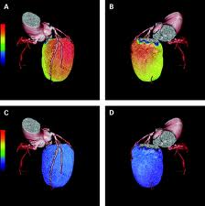

Slide 20
Intra vascular ultrasound
also known as a percutaneous echocardiogram is an imaging methodology using specially designed, long, thin, complex manufactured catheters attached to computerized ultrasound equipment to visualize the lumen and the interior wall of blood vessels.

Slide 21
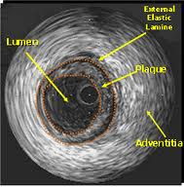

Slide 22
Serum Lipid
Test that measures the amount of fatty substances (cholesterol, triglycerides, and lipoproteins) in a sample of blood obtained by venipuncture
Thallium Stress
Combination of exercise stress testing with thallium imaging to assess changes in coronary blood flow during exercise

Slide 23
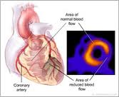

Slide 24
Computed tomography angiography (CTA), an imaging methodology using a ring-shaped machine with an X-Ray source spinning around the circular path so as to bathe the inner circle with a uniform and known X-Ray density.
Currently, multidetector CT, specially the 64 detector-CT are allowing to make cardiac studies in just a few seconds (less than 10 seconds, depending on the equipment and protocol used). These images are reconstructed using algorithms and software.
Great development and growth seen in the short term, allowing radiologists to diagnose cardiac artery disease without anesthesia and in a non-invasive way.

Slide 25
