Slide 1
ASSESSMENT OF CARDIOVASCULAR SYSTEM
BY
MUHAMMAD RAMZAN
ASSISTANT PROFESSOR

Slide 2
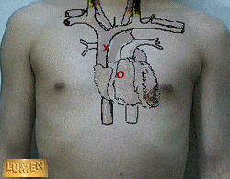
Topographical Landmarks of the Heart
Precordium- area on anterior chest that covers heart and great vessels

Slide 3
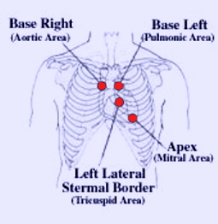
Topographical Landmarks
Each area corresponds to one of the hearts 4 valves.
Aortic area - 2nd ICS to right of sternum (closure of the aortic valve loudest here).
Pulmonary area - 2nd ICS to left of sternum (closure of the pulmonary valve loudest here).
Tricuspid - 5th ICS left of sternal border (closure of tricuspid valve).
Mitral - 5th ICS left of the sternum just medial to MCL (closure of mitral valve).

Slide 4
Physical Examination
Steps:
Subjective data.
Objective data.
Inspection: general appearance, precordium.
Palpation: peripheral pulses, apical impulse.
Percussion.
Auscultation: heart sounds, murmurs.
Summary checklist.

Slide 5
Assessment: Subjective data

Slide 6
Assessment: Subjective
Personal and family history
Diet history: 24 hr. sample diet Opportunity for teaching food selection and preparation
Socioeconomic status – ability to purchase proper foods, medicines. Employment and its effects on health?
Cigarette smoking : # packs /day and also # years smoked PACK YEARS

Slide 7
History taking.
Past cardiac history:
! Last ECG, stress ECG, serum chilesterol measurements, other heart tests?
Family cardiac history:
Family history of hypertension, diabetes, heart problems, coronary artery disease (CAD), sudden death at younger age?
Personal habits (cardiac risk factors): nutrition, smoking, alcohol, exercise, drugs.

Slide 8
Assessment: Subjective
Physical Activity/Inactivity – 30 minutes daily of moderate exercise recommended on most days ( Healthy People 2010 )
Obesity – associated with HTN, hyperlipidemia, and diabetes and all contribute to CV disease.
Current Health Problems – describe health concerns.

Slide 9
Assessment: Subjective
Chest pain: or discomfort, a symptom of cardiac disease, can result from ischemic heart disease, pericarditis and aortic dissection.
Chest pain: can also be due to non- cardiac causes; pleurisy, pulmonary embolus, hiatal hernia and anxiety musculoskeletal strain, GERD

Slide 10
Assessment- Chest Pain
Onset
Duration
Frequency
Precipitating factors / Relieving factors
Location
Radiation
Quality
Intensity

Slide 11
Chest pain:
Angina – an important cardiac symptom.
“Clenched fist” sign is characteristic of angina.
Onset, location, character, aggravating and/or relieving factors
Character: crashing, stabbing, burning, vise-like.
Associated symptoms: sweating, ashen gray or pale skin, shortness of breath, nausea or vomiting, racing of heart, heart skips beat.

Slide 12
Assessment: Subjective
Paroxysmal Nocturnal Dyspnea – client has been recumbent for several hours, increase in venous return leads to pulmonary congestion.
Fatigue- resulting from decreased cardiac output is usually worse in evening. Ask pt. if can they perform same activities as a year ago

Slide 13
Assessment: Subjective
Palpitations- fluttering or unpleasant awareness of heartbeat. Non- cardiac- causes- fatigue, caffeine, nicotine, alcohol
Weight gain- a sudden increase in wt. of 2.2 pounds (1 kg) can be result of accumulation of fluid (1L) in interstitial spaces, known as edema.
Syncope- transient loss of consciousness, decrease in perfusion to brain.

Slide 14
Subjective data
Edema:
Swelling of legs or dependent body part due to increased interstitial fluid.
Onset, recent change, relation to time of day, relieving factors, associated symptoms.
Nocturia:
Occurs with heart failure in the person who is ambulatory during the day.

Slide 15
Subjective data
Hemoptysis is often a
pulmonary problem,
but also occurs with
mitral stenosis
Cough: duration, frequency, type, coughing up sputum (color, odor, blood tinged, aggravating and/or relieving factors.
Fatigue: onset, relation to time of day?
Cyanosis or pallor: occurs with myocardial infarction or low cardiac output.

Slide 16
Subjective data
Paroxysmal nocturnal dyspnea (PND) occurs with heart failure.
Classically, the person awakens after 2 hrs. of sleep, arises, and flings open the window with the perception of needing fresh air.
Dyspnea:
Cause, onset, duration, affection by position,
Does shortness of breath interfere with activities of daily living?
Orthopnea:
Is the need to assume a more upright position to breathe.
Note the exact number of pillows used.

Slide 17
Assessment:Objective Beginning Inspection
General appearance: Build, skin color, presence of SOB, DOE
Older age
Skin- color and temperature – look for symmetry in color, temp, any cyanosis
Extremities – assess skin changes, vascular changes, clubbing, capillary filling and edema.
Neck vein distention

Slide 18
Assessment:Objective
BP: supine – change position 1-2 minutes, check again.
Normally, systolic drops slightly or remains unchanged and diastolic increases slightly.
Carotid & Peripheral pulses are assessed for:
Presence
Amplitude
Rhythm
Rate
Equality

Slide 19
Assessment:Objective
Precordium Assessment- area over heart, done by:
Inspection
Palpation
Percussion
Auscultation

Slide 20
Physical Assessment
Inspection-
General Inspection:
Inspect the patient status whether he or she is comfortable at rest or obviously short of breath.
Inspect the neck for increased jugular venous pressure (JVP)or abnormal waves.
There are specific signs associated with cardiac illness and abnormality however, during inspection any noticed cutaneous sign should be noted.

Slide 21
INSPECTION
Inspect the hands for:
Temperature - described as warm or cool, sweaty or dry
Skin turgor for hydration
Janeway lesion
Osler's node
At the nails Splinter hemorrhage

Slide 22
INSPECTION
Then inspect the precordium for:
visible pulsations
apex beat
masses
scars
lesions
signs of trauma and previous surgery (e.g. median sternotomy)
permanent Pace Maker

Slide 23
Palpation
Palpation of pulses
The pulses should be palpated for rate, rhythm (regular, irregular) and character (rapid, slow, bounding)
Palpation of the precordium
The valve areas are palpated for abnormal pulsations
Palpation of the apex beat
The apex beat is found approximately in the 5th intercostal space in the mid-clavicular line. It can be impalpable for a variety of reasons including obesity, emphysema, effusion and rarely dextrocardia

Slide 24
Palpation

Slide 25
Percussion
Is used to estimate approximately heart borders and configuration.
Recently is displaced by the chest x-ray or EchoCG.
Helps to detect heart enlargement
Heart (cardiac) enlargement is due to increased ventricular volume or thickening of heart wall.
Occurs with HTN, CAD, heart failure, cardiomyopathy

Slide 26
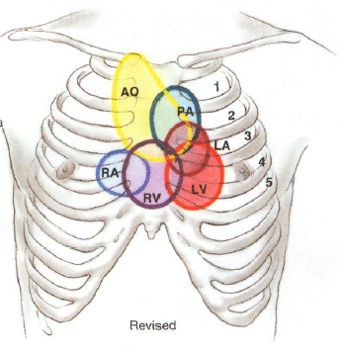
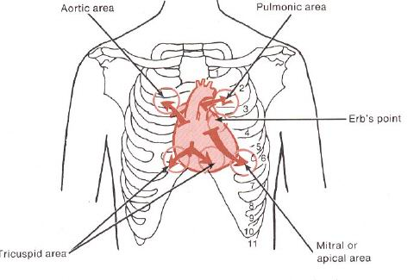
Auscultation

Slide 27
Auscultation
A Z-pattern is recommended.
Before beginning alert the person for long duration of procedure.
use the following pattern:
Note the rate
the rhythm
Identify S1 and S2
Listen for extra heart sounds
Listen for murmurs

Slide 28
Cardiovascular: Cardiac Cycle
2 phases
DIASTOLE: AV valves open – passive flow (75% of volume) into relaxed ventricles, then atria contract – active flow of remaining 25% into ventricles
SYSTOLE : AV valves close, ventricle pressure increases, ventricle contracts, Seminular valves open, blood pumped into pulmonary and systemic arteries

Slide 29
Heart sounds
Heart sounds are the noises generated by the beating heart and the resultant flow of blood through it (specifically, the turbulence created when the heart valves snap shut).
Stethoscope is used to listen to these sounds using the bell and diaphragm portion.
Diaphragm of stethoscope – 1st and 2nd heart sounds and high frequency murmurs. lub-dub
Use bell of stethoscope – low frequency gallops and murmurs.

Slide 30
In healthy adults, there are two normal heart sounds often described as a lub and a dub (or dup), that occur in sequence with each heartbeat. These are the first heart sound (S₁) and second heart sound (S₂), produced by the closing of the AV valves and semilunar valves respectively. In addition to these normal sounds, a variety of other sounds may be present including heart murmurs, adventitious sounds, and gallop rhythms S₃ and S₄.

Slide 31
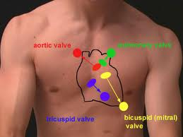

Slide 32
S1
The first heart sound - systolic S1:
forms the "lub" of "lub-dub"
Signals the closure of AV valves and the beginning of ventricular systole.
Consists of mitral M1 and tricuspid T1 components.
Normally M₁ precedes T₁ slightly.
It is caused by the sudden block of reverse blood flow due to closure of the atrioventricular valves, i.e. tricuspid and mitral (bicuspid), at the beginning of ventricular contraction, or systole
loudest at the apex

Slide 33
Intensity of S1
Loud S1
Stiff valve
MITRAL STENOSIS
Rapid rise in LV pressure
Exercise, hyperdynamic state
Short PR interval
MV wide open when LV pressure starts rising
Soft S1
Very stiff valve
Severe MITRAL STENOSIS
Decreased energy
Failing left ventricle
Long PR interval
MV has drifted closed and so doesn’t move much with LV systol

Slide 34
S2
The second heart sound - diastolic S2:
forms the "dub" of "lub-dub"
Consists of aortic A2 and pulmonic P2 components.
Signals the closure of semilunar valves and the end of systole.
Normally A₂ precedes P₂ especially during inspiration when a split of S₂ (lub d/dub) can be heard.
It is caused by the sudden block of reversing blood flow due to closure of the semilunar valves (the aortic valve and pulmonary valve) at the end of ventricular systole, i.e. beginning of ventricular diastole
loudest at the base.

Slide 35
Effect of respiration:
MoRe to the Right heart
Less to the Left
A split S2 – when the aortic valve closes significantly earlier than the pulmonic valve, you can hear the two components separately.

Slide 36
S3
Rarely, there may be a third heart sound also called a protodiastolic gallop, ventricular gallop
"lub-dub-ta" If new indicates heart failure or volume overload.
It occurs at the beginning of diastole after S2 and is lower in pitch than S1 or S2 as it is not of valvular origin.
The third heart sound is a normal finding in youth, some trained athletes, and sometimes in pregnancy but if it re-emerges later in life it may signal cardiac problems like a failing left ventricle as in dilated congestive heart failure (CHF).

Slide 37
S4
The rare fourth heart sound when audible in an adult is called a presystolic gallop or atrial gallop. This gallop is produced by the sound of blood being forced into a stiff/hypertrophic ventricle.
It occurs just before the first sound "ta-lub-dub" (a-stiff-wall)
It is a sign of a pathologic state, usually a failing left ventricle, but can also be heard in other conditions such as restrictive cardiomyopathy. The sound occurs just after atrial contraction ("atrial kick") at the end of diastole and immediately before S1.

Slide 38
Murmurs
Heart murmurs are produced by turbulent flow of blood across an abnormal valve, septal defect or outflow obstruction, or by increased volume or velocity of flow through a normal valve.
Murmurs may occur in healthy heart. These murmurs occur when stroke volume is increased, e.g. during pregnancy, and in athletes with resting bradycardia or children with fever.

Slide 39
Murmurs are classified according to their timing within the cardiac cycle.
Systolic Between S1and S2.
Diastolic Between S2 and S1).
Systolic ejection Begin after the first heart sound, attain a peak during midsystole, and terminate before the second heart sound.
Pansystolic or holosystolic During all of systole.
Pandiastolic or holodiastolic During all of diastole.
Prodiastolic Early diastolic.
Presystolic Late diastolic.
Continuous Continue through all of systole and all or part of diastole.

Slide 40
Auscultation ADVENTITIOUS SOUNDS
Pericardial Friction Rubs- results from inflammation of pericardial membrane.
Ejection Click- Early systole, stiff deformed valve, high pitch, apex, diaphragm.
Opening snap – Immediately after S2 stenotic mitral or tricuspid valve leaflets recoil abruptly during diastole.
Notes:
.

