Slide 1
Anatomy and Physiology of Cardiovascular and Respiratory System
By
MUHAMMAD RAMZAN
ASSISTANT PROFESSOR

Slide 2
Cardiovascular System
3 components:
Heart
Blood vessels
Blood

Slide 3
Anatomy of the Heart

Slide 5
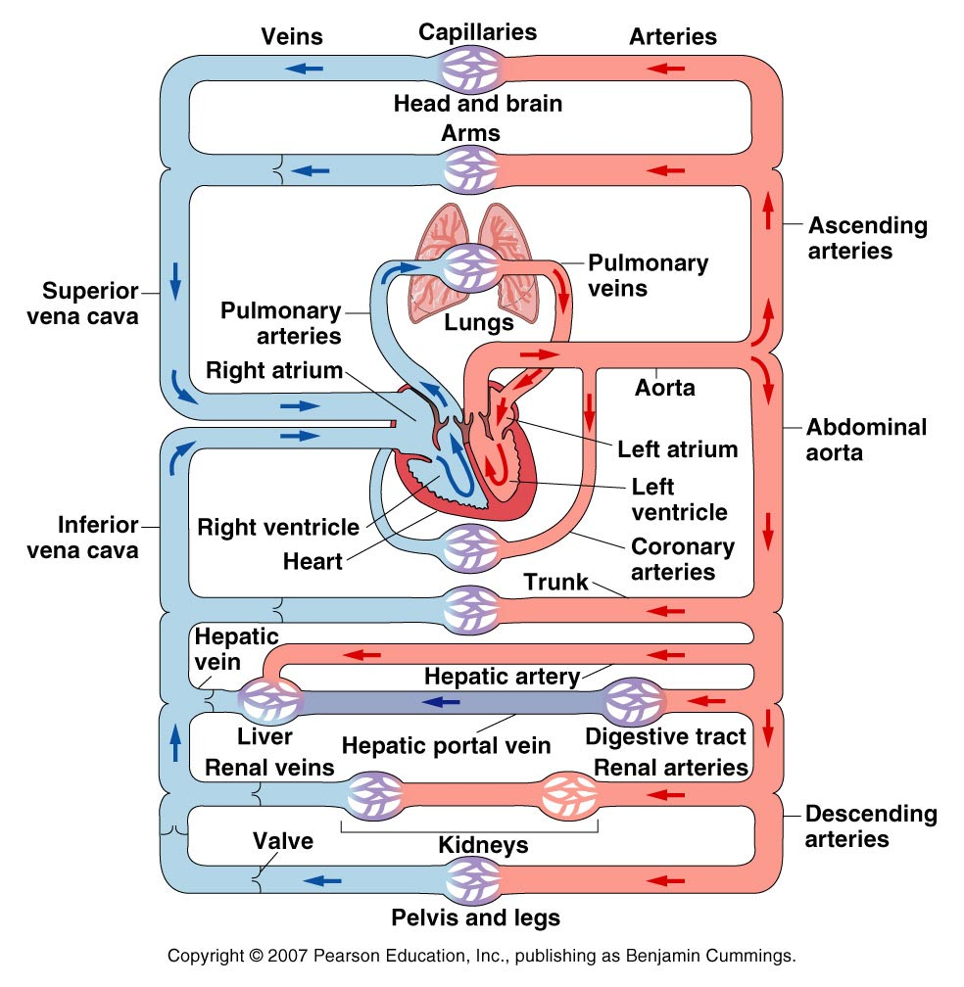
Circulation Review

Slide 6
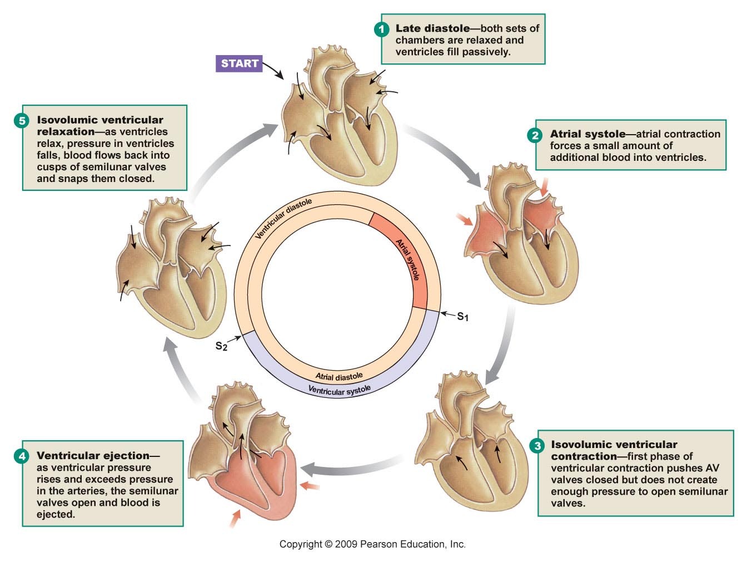
Cardiac cycle

Slide 7
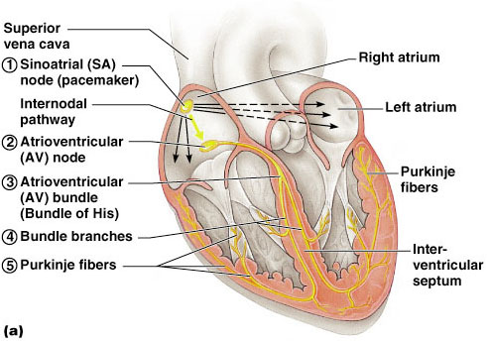
The Conduction system
Figure 18.14a

Slide 8
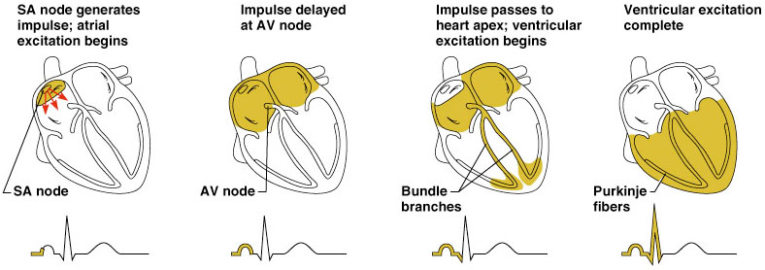
Heart Excitation Related to ECG

Slide 9
Anatomy of Respiratory System

Slide 10
Respiration
Respiration is the act of breathing:
inhaling (inspiration) - taking in oxygen
exhaling (expiration) - giving off carbon dioxide

Slide 11
Respiratory system
The respiratory system is made up of the organs involved in breathing and consists of the:
nose
pharynx
larynx
trachea
bronchi
lungs

Slide 12
Upper respiratory tract
nose
nasal cavity
ethmoidal air cells
frontal sinuses
maxillary sinus
larynx
trachea

Slide 13
Lower respiratory tract
lungs
bronchi
alveoli

Slide 14
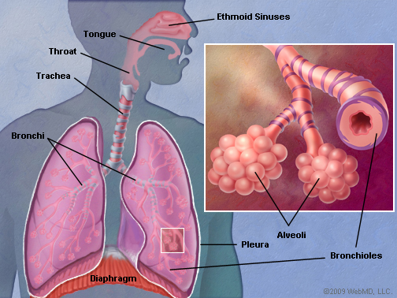
The lungs are separated from each other by the mediastinum, an area that contains the following:
heart and its large vessels
trachea (windpipe)
esophagus
thymus
lymph nodes

Slide 15
Anatomy
The right lung has three sections, called lobes. The left lung has two lobes. When we breathe, the air:
enters the body through the nose or the mouth
travels down the throat through the larynx (voice box) and trachea (windpipe)
goes into the lungs through tubes called main-stem bronchi

Slide 16
one main-stem bronchus leads to the right lung and one to the left lung
in the lungs, the main-stem bronchi divide into smaller bronchi
and then into even smaller tubes called bronchioles
bronchioles end in tiny air sacs called alveoli

Slide 17
Respiration
Inspiration
Active process – by muscular action
Contraction of diaphragm
Increase in vertical diameter
Contraction of intercostals muscles
Elevation of ribs and sternum
Increase in antero-posterior and transverse diameter
Expansion of lungs due to negative pressure
Air drawn inwards
Expiration
Passive process
Elastic recoil of the lungs due to Relaxation of diaphragm and inter costal muscle.
Positive pressure created in lungs
Internal intercoastals, rectus abdominus, transverse abdominus, internal and external oblique.
Control of Respiration
Control of Inspiration and Expiration by medulla oblongata

Slide 18
Lung Volumes
The volume of air normally exhaled or inhaled with each breath during quiet breathing is called TIDAL VOLUME. (500ml)
The additional volume of air that can be taken into the lungs beyond the normal tidal inhalation is called INSPIRATORY RESERVE VOLUME (3000ml)
The additional volume of air that can be let out beyond the normal tidal exhalation is called EXPIRATORY RESERVE VOLUME (1100)
The volume of air that remains in the lungs after a forceful expiratory effort is called RESIDUAL VOLUME (1200ml)

Slide 19
Lung Capacities
The INSPIRATORY CAPACITY is the maximum amount of air that can be inhaled after a normal tidal exhalation (TV + IRV) (3500ml)
FUNCTIONAL RESIDUAL CAPACITY is the amount of air remaining in the lungs at the end of normal tidal exhalation (ERV +RV) (2300ml)
VITAL CPACITY is the maximum amount of air that can b e exhaled, following a maximum inhalation (IRV+TV+ERV) (4600ml)
TOTAL LUNG CAPACITY is the sum of all the pulmonary volumes (5800ml)

Slide 20
Pulmonary Volumes:
Tidal volume 500ml
Inspiratory reserve volume 3000ml
Expiratory reserve volume 1100ml
Residual volume 1200ml
Pulmonary capacities:
Inspiratory reserve capacity : 3500ml
Vital capacity : 4600ml
Functional residual capacity : 2300ml
Total lung capacity : 6000ml

Slide 22
Dead Spaces
Some of the air the person breathes never reaches the gas exchange areas but simply fills respiratory passages where gas exchange does not occur, such as the nose, pharynx, and trachea.
This air is called dead space air because it is not useful for gas exchange.
The normal dead space air in a young adult man is about 150ml. This increases slightly with age.

Slide 23
Ventilation
Exchange of air between the lungs and the ambient air
Tidal volume is 500ml
Breathing frequency 15th breaths/ min
Total ventilation 7500ml/min
Anatomical dead space 150ml
Total ventilation 5250ml/min

Slide 24
Analysis of gases in respiration
O₂ N₂ CO₂
Inspired air 21% 79% -
Exhaled air 16% 79% 5%

Slide 25
Lung Compliance
The extent to which the lungs will expand for each unit increase in transpulmonary pressure is called the lung compliance.
(transpulmonary pressure: difference between alveolar pressure and pleural pressure)
Lung compliance: expandibility of lungs
Lung elastic recoil: tends to collapse

Slide 26
Surface Tension
Surfactant is fluid present in alveoli excreted by alveolar type 2 epithelial cells.
is a complex mixture of several phospholipids, proteins and ions.
The most important components are phospholipid dipalmitoyl phosphatidyl choline, surfactant apoproteins and calcium ions.
Increases lung compliance, prevents collapse of alveoli and decreases the work of breathing.

Slide 27
Diffusion
The passive tendency of molecules to move from an area of high concentration to an area of lower concentration
Responsible for the passage of oxygen and carbon dioxide between the alveoli and pulmonary capillary blood.

Slide 28
Oxygen Transport
Oxygen diffuses through the pulmonary alveolar capillary membrane and is then carried to the tissues in two forms:
Physically dissolve in plasma
Chemically bound to hemoglobin

Slide 29
Carbon Dioxide Transport
Carbon dioxide diffuses through the tissue capillary membrane and is often carried to the lungs in three forms:
Physically dissolved
Bound to proteins as carbamino compounds
In bicarbonate form

Slide 30
Ventilation -Perfusion
Three criteria must be satisfied
Alveoli must be ventilated,
Perfused, and
Ventilation must match perfusion

Slide 31
Cardiac Output (CO) and Reserve
Cardiac Output is the amount of blood pumped by each ventricle in one minute
CO is the product of heart rate (HR) and stroke volume (SV)
HR is the number of heart beats per minute
SV is the amount of blood pumped out by a ventricle with each beat
Cardiac reserve is the difference between resting and maximal CO

Slide 32
Frank Starling Law of the Heart
The more cardiac muscle is stretched within physiological limits, the more forcibly it will contract.
Rubber band analogy
Increasing volumes of blood in ventricles increase the stretch & thus the force generated by ventricular wall contraction.
Greater stretch means more blood volume is pumped out, up to physical limits.
Notes:
The Frank Starling Law of the Heart states that * the more cardiac muscle is stretched within its physiological limits, the more forcibly it will contract. *
This characteristic of cardiac muscle might be compared to a rubber band. The more you stretch the rubber band, the greater the force that is generated upon release. However if the rubber band is stretched too far, it may break. * With respect to the heart’s ability to pump blood, increasing volumes of blood in the ventricles increasingly stretch the ventricular myocardium, generating greater force. * The greater the force, the greater the volume of blood that is pumped out of the ventricle, up to the physiological limits of the myocardium. * *

Slide 33
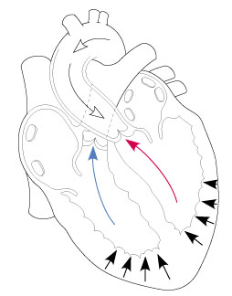
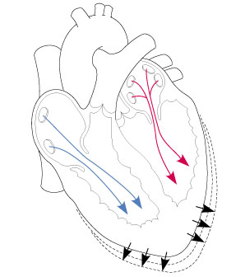
Frank Starling Law of the Heart
=
Increased blood volume = increased stretch of myocardium
Increased force to pump blood out.
Notes:
To illustrate this in a more graphic way, * increasing the volume of blood flowing into the ventricles, will increasingly stretch the myocardium. * * This will result in a corresponding increase in the force generated by the myocardium * to increase the volume of blood * that will be pumped out of the ventricles. *

Slide 34
Thanks

