Slide 1
Equilibrium

Slide 2
Equilibrium
When a body is in equilibrium, the resultant of all forces acting on it is zero.
The above condition is called translational equilibrium.
When resultant couple M acting on the body is zero, the body will be in rotational equilibrium.

Slide 3
Equilibrium

Slide 4
System isolation and free body diagram
Isolation of a body or combination of bodies from all surrounding bodies for the purpose of analysis is called system isolation.
Such system is called Mechanical system.
This isolation is accomplished by means of free-body diagram

Slide 5
System isolation and free body diagram
Diagrammatic representation of the isolated system treated as a single body is called free body diagram.
The diagram shows all forces applied to the system by mechanical contact with other bodies, which are imagined to be removed.
Equilibrium conditions can only be written after drawing such diagram.

Slide 6
System isolation and free body diagram

Slide 7
System isolation and free body diagram
Before drawing a free-body diagram, we must recall the basic characteristics of force.
Forces can be applied either by direct physical contact or by remote action.
Forces can be either internal or external to the system.
Application of force is accompanied by reactive force

Slide 8
System isolation and free body diagram
The principle of transmissibility permits the treatment of force as a sliding vector due to its external effects on a rigid body.

Slide 15
Free Body Diagram Exercises

Slide 16
Equilibrium conditions
The condition in which the resultant of all forces and moments acting on a body is zero.
ΣFx =0 ΣFy =0 ΣMo = 0
These are the necessary and sufficient conditions for complete equilibrium in two dimensions.
The equations relating force and acceleration for rigid-body motion are developed in Newton’s second law of motion.

Slide 17
Equilibrium conditions
If a body moves with constant velocity (zero acceleration), the resultant force on it must be zero, and the body may be treated as in a state of translational equilibrium.

Slide 18
Categories of Equilibrium
Category 1:
Equilibrium of collinear forces clearly requires only the one force equation in the direction of the forces (x-direction).
Category 2:
Equilibrium of forces which lie in a plane (x-y plane) and are concurrent at a point O, requires the two force equations only. The moment sum about a z-axis through O, is necessarily zero.

Slide 19
Categories of Equilibrium
Category 3:
Equilibrium of parallel forces in a plane, requires the one force equation in the direction of the forces (x-direction) and one moment equation about an axis (z-axis) normal to the plane of the forces.
Category 4:
Equilibrium of a general system of forces in a plane(x-y), requires the two force equations in the plane and one moment equation about an axis (z-axis) normal to the plane.

Slide 21
Two- and Three-Force Members
For a two-force member to be in equilibrium, the forces must be equal, opposite, and collinear.
The shape of the member does not affect this requirement.
we consider the weights of the members to be negligible compared with the applied forces.

Slide 22
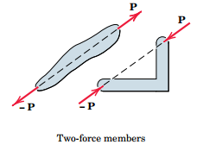

Slide 23
Two- and Three-Force Members
For a three-force member, body will be under the action of three forces.
Equilibrium requires the lines of action of the three forces to be concurrent.
When the three forces are parallel, then point of concurrency to be at infinity.

Slide 24
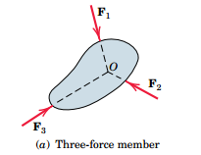

Slide 25
Two- and Three-Force Members
The principle of the concurrency of three forces in equilibrium is of considerable use in carrying out a graphical solution of the force equations.
In this case the polygon of forces is drawn and made to close.
A body in equilibrium under the action of more than three forces may be reduced to a three-force member by a combination of two or more of the known forces.

Slide 26
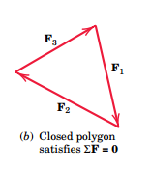

Slide 27
Alternative Equilibrium Equations
There are two other ways to express the general conditions for the equilibrium of forces in two dimensions.
Consider the following examples

Slide 28
