Slide 1
Outline: Definition of cytoskeleton. its explanation. structure of cytoskeleton. types of cytoskeleton. microfilaments. Intermediate filaments. Microtubules. functions of cytoskeleton.

Slide 2
Defination: a microscopic network of protein filaments and tubules in the cytoplasm of many living cells, giving them shape and coherence.

Slide 3
Explanation:
The cytoskeleton is a complex, dynamic network of interlinking protein filaments present in the cytoplasm of all cells , including bacteria and archea.
It extends from the cell nucleus to the cell membrane and is composed of similar proteins in the various organisms.
In eukaryotes, it is composed of three main components, microfilaments, intermediate
the filaments and microtubules, and these are all capable of rapid growth or disassembly dependent on the cell's requirements.

Slide 4
By definition, the cytoskeleton is composed of proteins that can form longitudinal arrays (fibres) in all organisms. These filament forming proteins have been classified into 4 classes.
Tubulin-like,
actin-like,
Walker A cytoskeletal ATPases (WACA-proteins),
and intermediate filaments.
Tubulin-like proteins are tubulin in eukaryotes and FtsZ , TubZ , RepX in prokaryotes.
Actin-like proteins are actin in eukaryotes and MreB, FtsA in prokaryotes. An example of a WACA-proteins, which are mostly found in prokaryotes, is MinD.
Cytoskeletal proteins are usually correlated with
cell shape,
DNA segregation
and cell division in prokaryotes and eukaryotes.

Slide 5
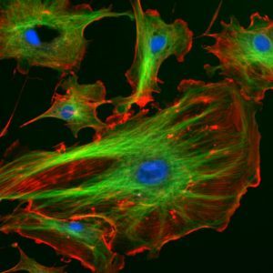
structure of cytoskeleton:
The eukaryotic cytoskeleton consists of three types of filaments, which are elongated chains of proteins: microfilaments, intermediate filaments, and microtubules
The microfilaments of this cell are shown
in red, while microtubules are shown in
green. The blue dots are nuclei.

Slide 6
EUKARYOTIC CYTOSKELETON:
All cells have a cytoskeleton,
but usually the cytoskeleton of eukaryotic cells is what is meant when discussing the cytoskeleton. Eukaryotic cells are complex cells that have
a nucleus and organelles.
Plants, animals, fungi, and protists have eukaryotic cells.
PROKARYOTIC CYTOSKELETON:
Prokaryotic cells are less complex,
with no true nucleus or organelles except ribosomes,
and they are found in the single-celled organisms bacteria and archaea.

Slide 7
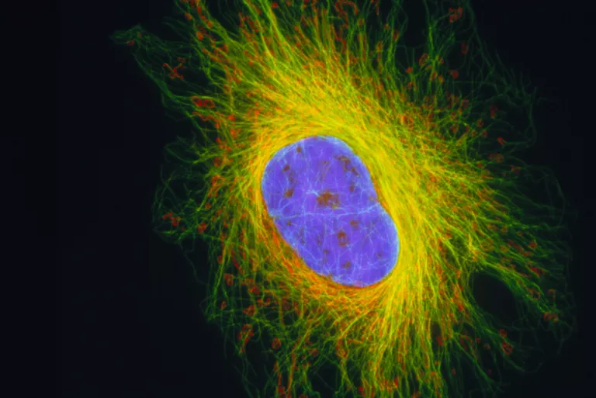

Slide 8
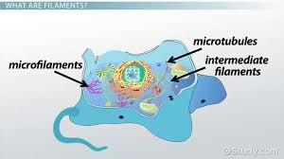
Types OF cytoskeleton:
There are three types of cytoskeleton:
Microfilaments
Intermediate Filaments
Microtubules

Slide 9
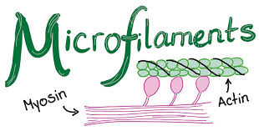
MICROFILAMENTS:
Microfilaments are also called actin filaments because they are mostly composed of the protein actin. They are about 7 nanometers thick.
Microfilaments have many functions.
They aid in cytokinesis.
They aid in cell motility.
They are also involved in cytoplasmic streaming.

Slide 11
INTERMEDIATE FILAMENTS:
Intermediate filaments are about 8-12
nm wide; they are called intermediate
because they are in-between the size
of microfilament sand microtubules.
Intermediate filaments are made of different proteins such as keratin.
Intermediate filaments have many functions:
The intermediate filaments in the cytoplasm maintain the cell’s shape.
It bear tension.
and provide structural support to the cell.

Slide 13
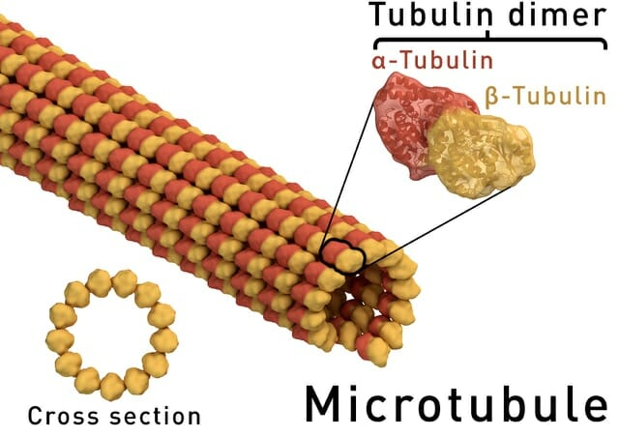
Microtubules:
Microtubules are the largest of the cytoskeleton’s fibers at about 23 nm. They are hollow tubes made of alpha and beta tubulin. Microtubules form structures like flagella, which are “tails” that propel a cell forward. They are also found in structures like cilia, which are appendages that increase a cell’s surface area and in some cases allow the cell to move.
Microtubules have many functions:
Microtubules are important in forming the spindle apparatus (or mitotic spindle), which separates sister chromatids so that one copy can go to each daughter cell during cell division.
They are also involved in transporting molecules within the cell and in the formation of the cell wall in plant cells.

Slide 14
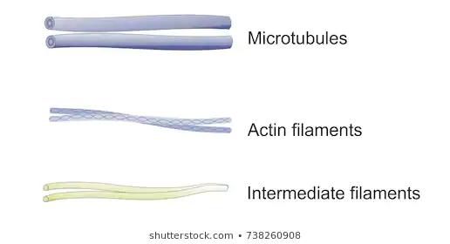

Slide 15
Function of cytoskeleton:
The cytoskeleton has several functions.
Cell shape :
First, it gives the cell shape. This is especially important in cells without cell walls, such as animal cells, that do not get their shape from a thick outer layer.
It can also give the cell movement.
The microfilaments and microtubules can disassemble, reassemble, and contract, allowing cells to crawl and migrate, and microtubules help form structures like cilia and flagella that allow for cell movement.
2. Cell organization:
The cytoskeleton organizes the cell and keeps the cell’s organelles in place, but it also aids in the movement of organelles throughout the cell.
For example, during endocytosis when a cell engulfs a molecule, microfilaments pull the vesicle containing the engulfed particles into the cell.
Similarly, the cytoskeleton helps move chromosomes during cell division.

Slide 16
FUNCTIONS…….
3. Frame building:
One analogy for the cytoskeleton is the frame of a building.
Like a building’s frame, the cytoskeleton is the “frame” of the cell, keeping structures in place, providing support, and giving the cell a definite shape.

