Slide 1
Information Security
By Farhana Sharief

Slide 2
Information Security
Information security, sometimes shortened to InfoSec, is the practice of defending information from unauthorized access, use, disclosure, disruption, modification, inspection, recording or destruction. It is a general term that can be used regardless of the form the day may take (e.g. electrnic or physical).

Slide 3
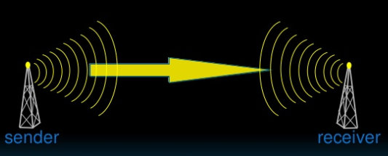
CIA Principles
Confidentiality
Integrity
Availability

Slide 4
Security Threats
Destruction
Disclosure
Modification of data
Denial of Services

Slide 5
Confidentiality
Confidentiality is the term used to prevent the disclosure of information to unauthorized individuals or systems.
Data should be kept secret. The owner of the data has to decide who can only access the data and who can’t.

Slide 6
Integrity
It means that data can’t be modified undetectably.
Unauthorized persons should not modify the data without owner’s permission. Not only modification, they should not remove the data and add the false data

Slide 7
Availability
The ability of infrastructure to function according to business expectations during its specified time of operation

Slide 8
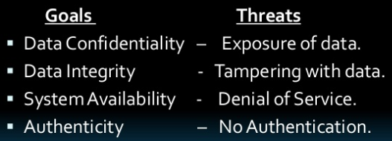
Goals with corresponding threat to them

Slide 9
Security in different aspects
Data Security
Computer Security
Network Security

Slide 10
Common Internet Security Issues
1. HACKERS
Hackers are people who attempt to breach or avoid online security measures for a number of reasons.
Their motives are, occasionally, honorable in that they merely wish to highlight shortfalls to corporations and other website owners so that they can tighten their security up.
Other hackers look to make financial gains by copying private information, whilst others are purely out to cause mischief.
Irrespective of the hacker’s reasons for doing what they do, they can pose a serious threat to your security.

Slide 11
Common Internet Security Issues
2. VIRUSES
Computer viruses are programs which are designed in order to gain entry onto unsuspecting users’ computers.
Once they have gained a foothold within a computer system they will then attempt to duplicate themselves before spreading via email, networks and/or removable storage devices.
Typically, their remit is to corrupt or destroy data or otherwise damage the operation of the machine on which they reside.
Viruses can be acquired in many ways but some of the more popular ones are through email, peer-to-peer downloading, internet messaging services and downloading infected files found on the internet.

Slide 12
Common Internet Security Issues
3. SPYWARE
Spyware can prove to be a major annoyance as it’s goal is usually to collect personal information and browsing habits in order to deliver targeted advertising to you as you browse the web
Spyware is software and, like a virus, is often deceptively added to the user’s machine.
In addition to increasing the amount of advertising you are likely to see, or affecting the type of adverts served to you, it can also impact upon the performance of your computer by hogging resources.

Slide 13
Common Internet Security Issues
4. WORMS
A worm is a self-replicating program which will attempt to spread itself around your network, either via routers, the internet or by email.
Unlike a virus, a worm does not need to attach itself to another program in order to spread.
While a virus has to attach itself to an existing program, a worm does not – it can replicate and spread on its own.
Worms too can cause disruption to computer systems because of the excessive amount of bandwidth that they sometimes use.

Slide 14
Common Internet Security Issues
5. PHISHING
In some respects, phishing is a confidence trick, designed by would-be thieves in order to part unsuspecting computer users from their most precious personal and/or financial information.
Traditionally, phishing attempts looked to acquire data such as bank account details, social security numbers, and credit card numbers, either for direct financial gain or to facilitate identity theft (more on that below).
Over the last few years, however, other forms of data and information have become valuable too.

Slide 15
Common Internet Security Issues
6. Spam is any form of unsolicited message, be it email, private forum message or even Tweet.
Those behind spam know that the response rate to their rubbish will be incredibly low.
They continue, however, because they can send many thousands of spam messages out every hour of the day at next to no cost.
Therefore, even an incredibly tiny response rate can lead to huge profits for the spammers.
Spam messages don’t usually pose any threat to your security but can be incredibly annoying and distracting.

Slide 16
Common Internet Security Issues
7. IDENTITY THEFT
Identity theft is a growing problem, both online and off.
This crime can seriously damage a victim’s finances for many years.
Identity thieves acquire information about someone through a variety of means of which the favourite is phishing.
If they can get personal data, such as names, dates of birth, social security numbers, etc, then they can quite literally steal the identity of the owner of that information.
That fake identity can then be utilized in a variety of other crimes, such as credit card fraud, bank fraud and a whole host of other financial misbehaviors, all of which will be blamed upon the victim who will then have an incredibly hard job of clearing their name, recovering the money they have lost and then repairing their credit file.

Slide 17
How to fix Internet Problems
Manage Browser’s Cache
Clear your google search history
Stop ads and spam
Avoid Bugs
Restrict Certain sites
Speed up your connection
Secure your wireless network
Avoid compulsory registration and login

