Slide 1
WHITE COLOR CRIMES

Slide 2
WHITE COLOR CRIMES
Background
The meaning of white collar crime, like that of other abstract terms like, coercion, violence, victim, is deeply contested in legal, social science, and philosophical domains.
Definitions vary both across and within disciplines and linguistic practices.
Several contexts in which the term “white collar crime” has been used i.e. by social scientists; among law enforcement officials, prosecutors, and defense attorneys; in the law schools and, in substantive criminal law legislation.

Slide 3
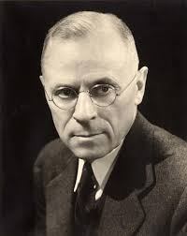
WHITE COLOR CRIMES
Background
The term was first used only sixty-five years ago by Edwin Sutherland, the most influential American criminologist of his day, in a presidential address to the American Sociological Association. Sutherland was famously vague and inconsistent in saying exactly what the term should mean.
But even if he had been precise and consistent in his usage, it seems likely that the term would still have generated uncertainty and misunderstanding among other users of the term.
The concept that Sutherland was the first to put a label on is one that is so inherently complex and multifaceted that it seems unlikely that one single definition could ever prevail.

Slide 4
WHITE COLOR CRIMES
What Constitute White Color Crime
Three critical issues that have arisen in the battle over the meaning of white collar crime
Does the term refer only to activity that is actually criminal, or also to other forms of non-criminal deviance?
Does the term refer to behavior (whether criminal or not) engaged in exclusively or primarily by particular kinds of actors, such as those who occupy certain jobs or have a high socioeconomic status; or should it refer to some particular kinds of acts?
Assuming that the term should refer to a particular category of criminal acts or other deviant behavior (rather than to actors), what factors should determine that which of the above acts will be included?

Slide 5
What Constitute White Color Crime
Legal Perspective
To lawyers, the term “crime” denotes a legal category. A particular kinds of conduct that our legal institutions recognize as “criminal.”
Defined in a particular manner.
Employing characteristics in the sense that a wrong is committed against the public or a particular individual.
Various actors playing distinctive roles, employing distinctive procedures and burdens of proof.
Involves distinctive procedural rights.
To lawyers, therefore, it seems obvious that when one talks about “white collar crime”. one should be talking about some subcategory of criminal conduct that reflects specific ccriminal characteristics covered by the criminal laws.

Slide 6
What Constitute White Color Crime
Sociological Perspective
Sociologists are concerned less with legal labels and categories than with describing patterns of behavior, its causes, and society’s attitudes towards it.
Thus, for Sutherland and many of his fellow sociologists, white collar crime is not “crime” in the legal sense of the term.
Much of the activity he was concerned with, such as restraint of trade, violation of copyrights, unfair labor practices, and adulteration or misbranding of food and drugs, and misuse of authority either was not subject to criminal sanctions at all, or, if it was, was rarely prosecuted as such.
Indeed, this was precisely Sutherland’s point: a good deal of conduct that is at least harmful or wrongful than what has traditionally been viewed as criminal.
Subject to a range of procedures and penalties that differ from those used for traditional crimes.

Slide 7
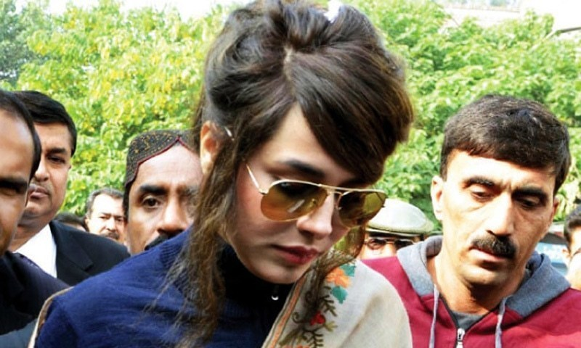
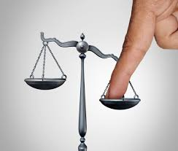
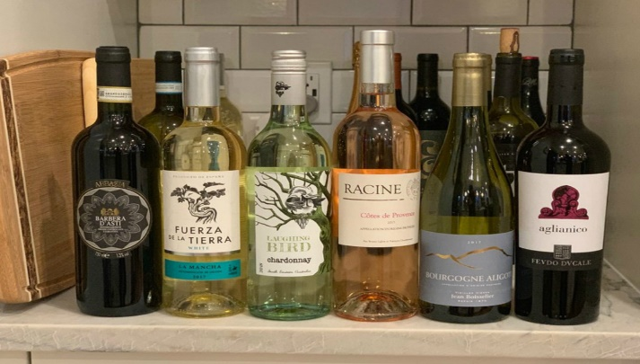
What Constitute White Color Crime
Sociological Perspective
The second is to set aside the term “white collar crime” and instead use terms such as “elite deviance” to refer not only to actual crimes committed by the elite but also to deviant activities of the elite that do not violate the criminal law. This is elaborated as:-
Much of the conduct we are dealing with here could be treated either as
A crime (having a legislatory cover)
A non-criminal violation of law i.e. a misdeed, breach of contract, or statutory violation, or:
A merely “deviant,” aggressive, or anti-social act which is violative of some informal norm but is not contrary to either criminal or civil law.
Holy Water ..? No Sir
Its Honey

Slide 8
Investigator’s Approach to WCC
Sociological Perspective
From the perspective of the criminal law, however, such an approach is once again problematic. Deeply rooted equal protection-type norms forbid us from distinguishing among offenders on the basis of wealth, occupation, race, gender, ethnicity, or other personal characteristics.
There are special immunity rules that apply to certain kinds of governmental actors.
such an approach is not at all foreign to the criminal law. For example, one cannot commit the offense of receiving a bribe unless one is a member of National or Provincial Assembly, a juror, a witness, or “an officer or employee or person acting on behalf of the state (diplomatic immunity), or any department, agency or branch of Government.

Slide 9
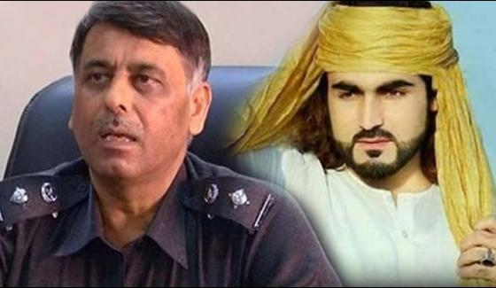
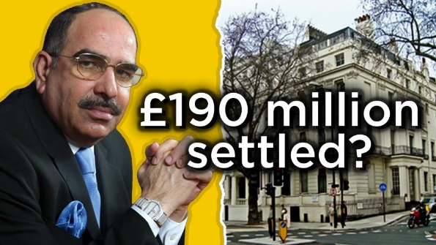
Problems in Investigations
Sociological Perspective
Create a host of other problems. Much of what could presumably be included within the category of “occupational” crime including theft of office equipment, workplace assaults, police brutality, and serial killings of patients by doctors and nurses, would not ordinarily be regarded as white collar crime.
Even more problematic is the fact that a great many white collar crimes have nothing at all do with either corporations or a defendant’s occupation. Indeed, falsification, obstruction of justice, the offering of bribes, extortion, false statements, criminal contempt, tax evasion, and most intellectual property offenses are only rarely committed by person with weak background.
In short, there is a vast range of presumptively white collar crime that falls outside the categories of both corporate and occupational crime.
Encounter Specialists

Slide 10
THANK YOU

