Slide 1
Remote Sensing And Its Applications
L

Slide 2
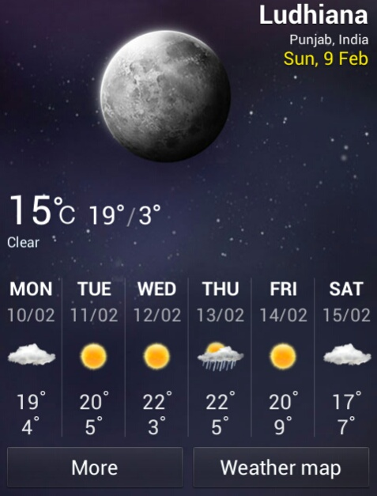
Google mapping
Remote Sensing
Weather forecasting
Notes:
Google mapping

Slide 3
Remote Sensing?
Remote sensing is defined as the technique of obtaining information about objects through the analysis of data collected by special instruments that are not in physical contact with the objects of investigation.
Collection of information about an object without coming into physical contact.
The information needs a physical carrier to travel from the objects/events to the sensors through an intervening medium.
The electromagnetic radiation is normally used as an information carrier in remote sensing.
The output of a remote sensing system is usually an image representing the scene being observed.

Slide 4
History
The technology of modern remote sensing began with the invention of the camera more than 150 years ago.
The idea and practice of looking down at the Earth's surface emerged in the 1840s when pictures were taken from cameras secured to tethered balloons for purposes of topographic mapping.
Satellite remote sensing can be traced to the early days of the space age (both Russian and American programs) and actually began as a dual approach to imaging surfaces using several types of sensors from spacecraft.
The term "remote sensing," first used in the United States in the 1950s by Ms. Evelyn Pruitt of the U.S.

Slide 5
Elements involved in Remote sensing
1. Energy Source or Illumination (A)
2. Radiation and the Atmosphere (B)
3. Interaction with the Object (C)
4. Recording of Energy by the Sensor (D)
5. Transmission, Reception and Processing (E)
6. Interpretation and Analysis (F)
7. Application (G)

Slide 6
Remote Sensing Sensors
Active Remote Sensors :-
Active remote sensing uses an artificial source for energy.
For example the satellite itself can send a pulse of energy which can interact with the target.
In active remote sensing, humans can control the nature (wavelength, power, duration) of the source energy. Active remote sensing can be carried out during day and night and in all weather conditions.

Slide 7
Conti…
Passive remote sensing:-
Passive remote sensing depends on a natural source to provide energy.
For example sun is the most powerful and commonly used source of energy for passive remote sensing.
The satellite sensor in this case records primarily the radiation that is reflected from the target.

Slide 8
ACTIVE & PASSIVE REMOTE SENSING

Slide 9
Platforms
Platforms :
The base on which remote sensors are placed to acquire information about the Earth surface is called platforms.
Ground based
Airborne
Space borne

Slide 10
Platforms used for Remote Sensing
Ground-based platforms: ground, vehicles and/or towers => up to 50 m
Airborne platforms: airplanes, helicopters, high-altitude aircrafts, balloons => up to 50 km
Space borne: rockets, satellites, shuttle => from about 100 km to 36000 km
Space shuttle: 250-300 km
Space station: 300-400 km
Low-level satellites: 700-1500 km
High-level satellites: about 36000 km

Slide 11
Advantages of remote sensing:-
Provides a regional view (large areas).
Provides repetitive looks at the same area.
Remote sensors "see" over a broader. portion of the spectrum than the human eye.
Provides geo-referenced, digital, data.
Some remote sensors operate in all seasons, at night, and in bad weather.

Slide 12
DISADVANTAGE OF REMOTE SENSING:-
Expensive to build and operate
Needs ground verification
Not the best tool for small areas
Needs expert system to extract data

Slide 13
Applications of Remote sensing
Meteorology
Profiling of atmospheric temp. and water vapor
Measuring wind velocity
Oceanography
Measurements of sea surface temperature
Mapping ocean currents
Glaciology
Mapping motion of sea ice and ice sheets
Determining the navigability of the sea
Geology
Identification of rock types
Location of geological faults and anomalies

Slide 14
Applications of Remote sensing
Agriculture
Monitoring the extend and type of vegetation
Mapping soil types
Hydrology
Assessing water resources
Forecasting melt water run-off from snow
Disaster control
Warning of sand and dust storms, flooding
Monitoring of pollution

Slide 15
Thank you for your kind attention!!!
7528

