Slide 1
Dash Diet

Slide 8
One teaspoon of table salt has about 2,300 mg of sodium, and 2/3 teaspoon of table salt has about 1,500 mg of sodium.

Slide 11
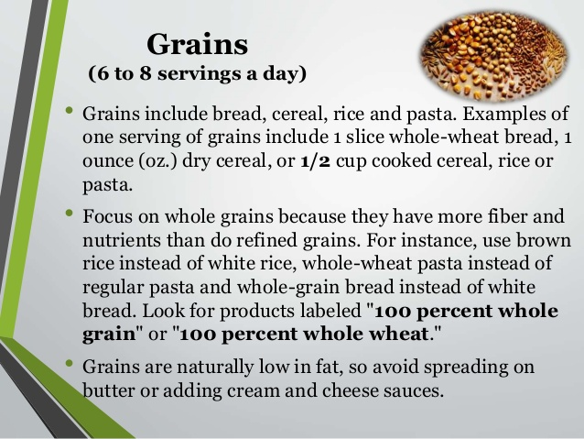

Slide 15
