Slide 1
Sudden cardiac arrest
Sudden cardiac arrest (SCA) is the sudden and unexpected cessation of the heart’s pumping activity.
A medical emergency with absent or inadequate contraction of the left ventricle of the heart that immediately causes body wide circulatory failure.

Slide 2
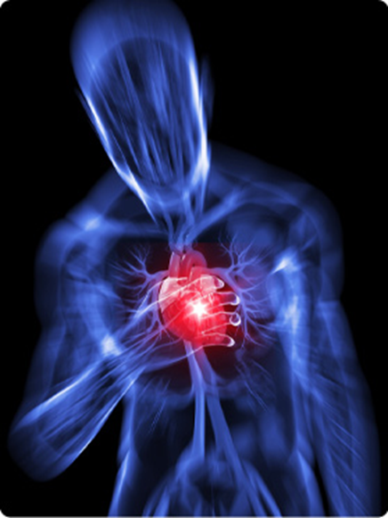

Slide 3
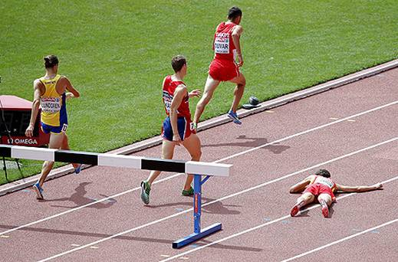

Slide 4
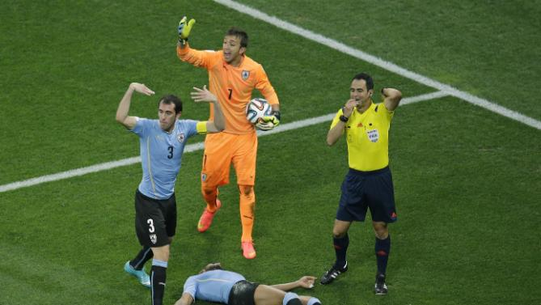

Slide 5
signs and symptoms
Loss of consciousness; (20-30 sec) secondary to lack of blood flow
rapid shallow breathing progressing to apnea
profound hypotension with no pulses that can be felt over major arteries; and no heart sounds
Brain damage in about 4-6 min(if untreated)
Fatal condition if not treated in about 10 min

Slide 6
When the heart is not pumping blood, there is no delivery of oxygen or glucose to any of the body’s tissue—including the heart itself because the heart tissue is perfused by blood flowing from the aorta into the coronary arteries.
When sudden cardiac arrest results in death, it is termed sudden cardiac death.
overall survival rate is about 5% to 7%.

Slide 7
Sudden Death in General Population
In the general population, SCA most often occurs in people age 50 to 75 years, which is consistent with the development of ischemic heart disease and congestive heart failure.
About two thirds of people who experience SCA have coronary artery disease; SCA is often the first manifestation of underlying heart disease.

Slide 8
Sudden Cardiac Arrest in Athletes
Exercise-related SCA has been defined as sudden cardiac arrest occurring within 1 hour of participation in sport or exercise
Consistent with the low prevalence of cardiovascular disease in people younger than 35 years of age, the frequency of sudden death in athletes is considered to be very low but not precisely known.
The vast majority (85%) of sudden deaths in athletes are a result of underlying cardiovascular conditions.

Slide 9
SCA in athlete
300 deaths annually in the United States among 10 to 15 million athletes participating in competitive sports.
25 to 125 deaths each year among 25 million competitive athletes

Slide 10
Hypertrophic cardiomyopathy is common
90% of died athlete were male
68 % were football & basketball

Slide 11
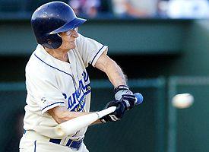

Slide 12
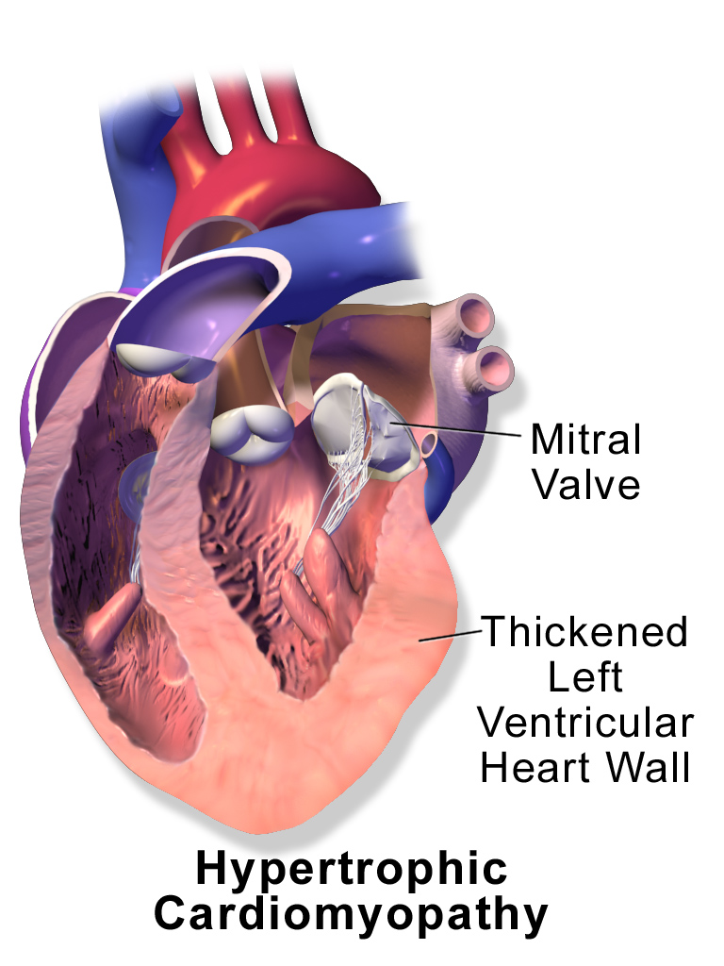

Slide 13
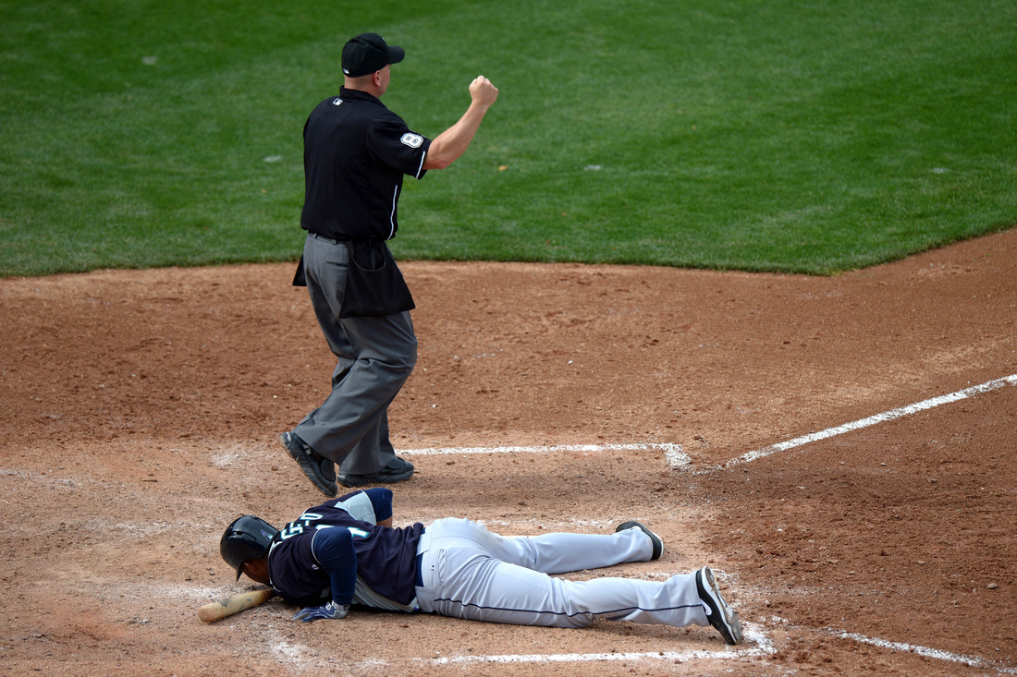

Slide 14
Sudden Cardiac Arrest(SCA) Rhythms
Ventricular fibrillation (VF)
Pulseless electrical activity
Asystole
SCA should be differentiated from a “heart attack.” The medical term for a heart attack is myocardial infarction. This condition results in the death of some heart muscle resulting from total (or near total) occlusion of a coronary artery

Slide 15
Ventricular fibrillation (VF) 60%
The most common causes of cardiac arrest are electrical problems in the heart with ventricular fibrillation representing the major type.
Higher in athletes
Ventricular fibrillation is the most common initial rhythm,occurring in about 60% of cases when assessed by an on-site automated external defibrillator.

Slide 16
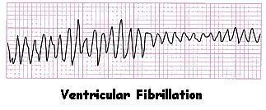
In ventricular fibrillation, there is loss of coordinated ventricular contractions leading to immediate loss of effective output of blood by the heart, resulting in circulatory arrest.

Slide 17
VF treated by high energy shock
By AED
Survival rate of 74% when Defibrillation within 3 min of collapse
CPR proves helpful in the mean time till

Slide 18
Pulseless Electrical Activity
Pulseless electrical activity (PEA) is the term used for any other electrocardiographic (ECG) rhythm, including normal sinus rhythm, when there is no associated cardiac contraction.
This may be amenable to treatment when a reversible condition is the cause, such as hypovolemia or hyperkalemia, but the mortality from this condition is higher than for VF

Slide 19
Asystole
Asystole, or “flatline,” means the absence of any cardiac electrical activity and therefore the absence of any mechanical cardiac function.
Patients found in this rhythm have a grim prognosis, with most studies reporting survival of only 0% to 2%

Slide 20
In about 2% of deaths, no structural abnormality can be
found, and these are considered primary arrhythmic deaths (often referred to as sudden arrhythmic death syndrome [SADS] or autopsy-negative sudden unexplained death [SUD]).
These cases result from conditions that disrupt the
electrical system on the cellular level, including long QT,
short QT, and Brugada syndromes and familial catecholaminergic polymorphic ventricular tachycardia.

Slide 21
Commotio cordis
The provocation of ventricular fibrillation or ventricular tachycardia by a blow to the anterior chest over or near the heart.
The impact must occur at a specific point in the cardiac electrical cycle, called the vulnerable period of repolarization (during the second half of the T wave)
This is usually caused by a solid object such as a
baseball and may occur with only mild or moderate force.This seems to occur most commonly in the early teens.
Notes:
Since 1995 224 cases are reported by US

Slide 22
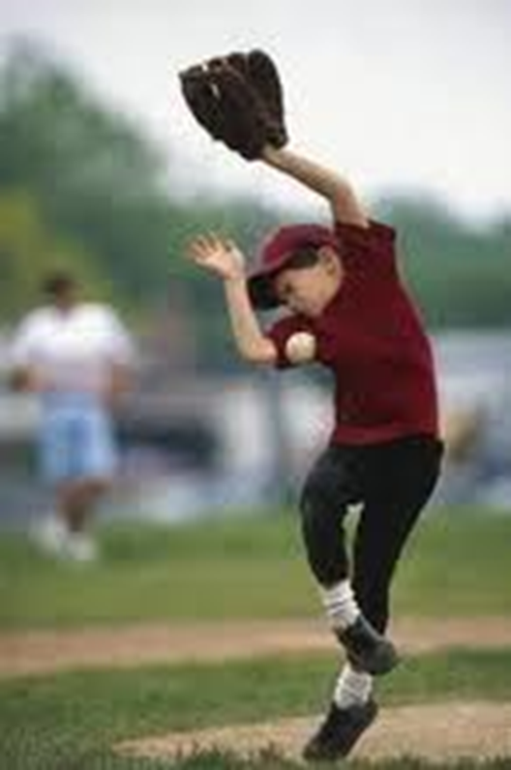

Slide 23
An important predisposing factor to SCA, particularly in
the setting of sports and exercise, is the use of performance enhancing and recreational substances, including anabolic steroids, Ma Huang, bitter orange, cocaine, and other stimulants.
It should also be recognized that sports venues and fitness facilities have been identified as one of the most common locations where SCA occurs in general

Slide 24
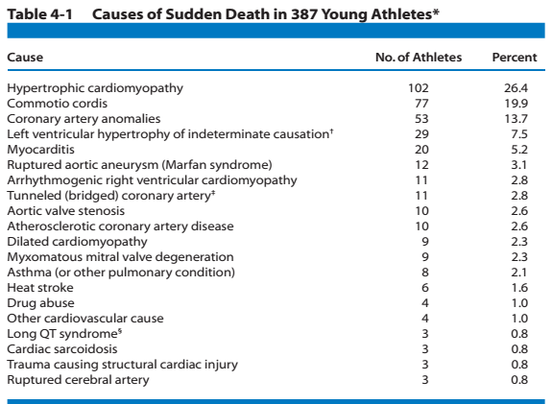

Slide 25
Screening & recognition of cardiac warning signs
Participation screening
For vigorous physical activity through screening of Cardiovascular etc that may predispose to illness or death
MO that throughly takes history to role out symptoms like

Slide 26
Screening & recognition of cardiac warning signs
Screening :
Every person who intends to participate in vigorous physical activity, especially competitive sports, should receive thorough screening for cardiovascular and other disorders that might predispose to illness or even death.

Slide 27
Symptoms
Syncope,
Palpitations,
Exertional dyspnea,
Exertional chest pain,
Early fatigue

Slide 28
Recognition of cardiac warning signs
Lightheadedness
Dizziness
Syncope or near-syncope
Chest pain or pressure
Palpitations (fluttering in chest)
Nausea/vomiting (unrelated to other illness)
Fatigue/weakness (disproportionate to baseline or to others)
Shortness of breath
Note: These symptoms are particularly worrisome if they occur during or immediately after exertion.

Slide 29
ECG
Family history of CV disease
These include counseling on avoidance of performance enhancing drugs and supplements (especially androgenic steroids), alcohol, and caffeine and other stimulants and
excessive use of vitamin supplements; ensuring proper nutrition, hydration, and rest; and paying attention to environmental stress.

Slide 30
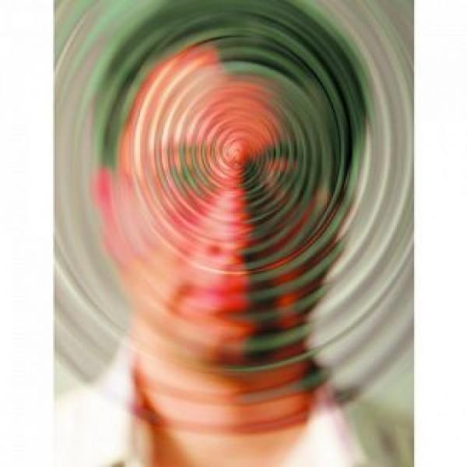
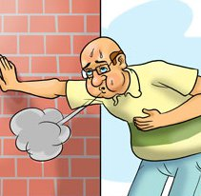
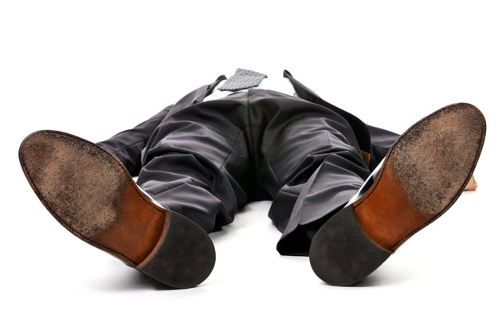

Slide 31
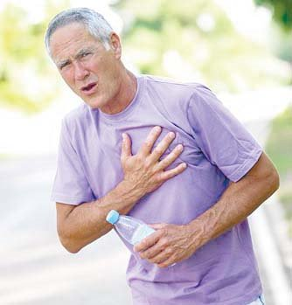
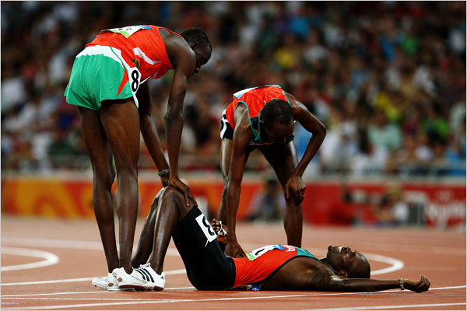

Slide 32
Preparation for Cardiac Emergencies
SCA awareness
Call to 1122
Ventilation aids
CPR training
AED deployment throughout the campus

Slide 33
Defibrillators
Defibrillators are of two main types: manual and automated
Manual defibrillators must be used by medical personnel with specific training in cardiac rhythm recognition and management and in operation of the defibrillator.
This type of defibrillator requires the user to interpret the ECG rhythm and determine if an electric counter shock should be delivered; if so, the user must be able to set the energy level, activate the charging process, and then push a button to deliver the shock.

Slide 34
The other type is typically referred to as automated external defibrillator or AED .
These devices can be used by virtually anyone, even without prior training, although training is highly advised
These portable, battery powered devices provide verbal and visual prompts to the user once the device is turned on.

Slide 35
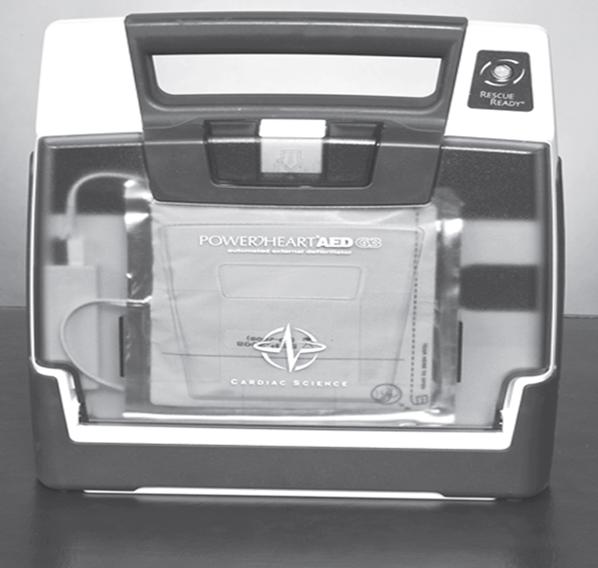

Slide 36
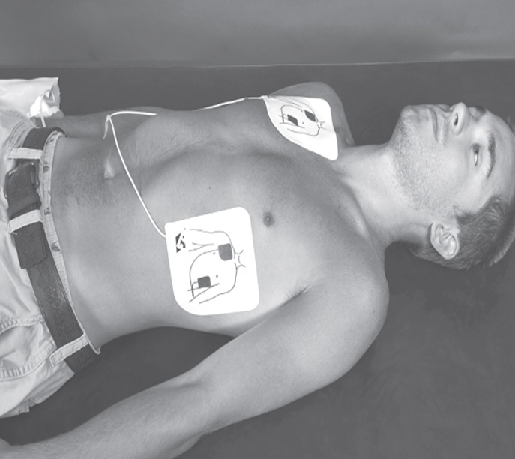

Slide 37
The most important user action is to place the two ECG sensing defibrillation pads onto the proper locations on the patient’s chest .
Some models require the user to push an “analyze” button and/or a “shock” button to deliver the electric shock (semiautomatic) and some perform analysis, charging, and shock delivery without further user action (fully automatic).

Slide 38
All models shock VF and rapid ventricular (wide complex) tachycardia (VT). At least one model has the capability to also perform synchronized cardioversion of supraventricular (narrow complex) tachycardia.
The specificity of these algorithms approaches 100%
(i.e., it is extremely rare that a shock is advised or delivered inappropriately), whereas the sensitivity is generally more than 90% (i.e., the device will recommend shock at least 90% of the time when a shockable rhythm is present)

Slide 39
Equipment and Supplies
Defibrillators
Ventilation aids
Telephone or other communications equipment to call emergency centers or hospitals.

Slide 40
Ventilation Aids
Protection from blood and body fluid during mouth to mouth resuscitation
Facilitate better ventilation
The simplest adjuncts are a variety of face shields and masks that cover the victim’s mouth and nose and provide a port for the rescuer’s mouth
Many of these have a one-way valve either incorporated or as an attachment to prevent air and fluid exchange from the victim to the rescuer.

Slide 41
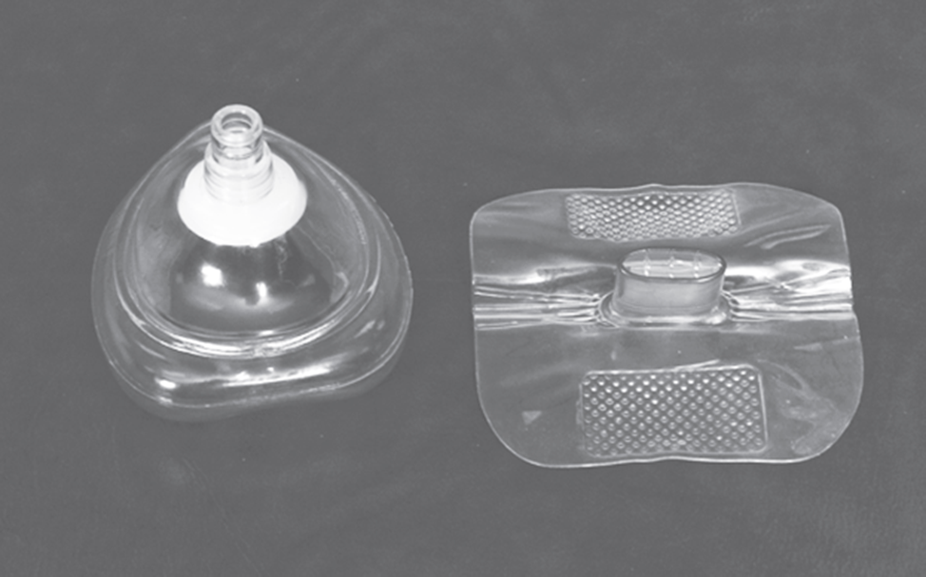
Example of a pocket mask (left)
and a face shield (right).

Slide 42
Management of Sudden Cardiac Arrest
Successful resuscitation of the victim of SCA requires the proper interventions to be provided in a very short time. The actions that must occur have been called the “Chain of Survival.”
Early recognition of SCA and call to emergency services
Early CPR
Early defibrillation
Early Advanced Life Support

Slide 43
Recognition of SCA and Activation of Local EMS
Ask the person if he/she is ok,no response
Gently shake if there is any response
Make sure no injury is suspected
Activate Emergency Medical Service (EMS)
Open the air way (Head tilt, chin lift maneuver)
In case of C/Spine injury jaw trust maneuver should be used to open the air way)
Begin CPR

Slide 44
Cardiopulmonary resuscitation (CPR)
It is an emergency procedure which is attempted in an effort to return life to a person in cardiac arrest.
It is indicated in those who are unresponsive with no breathing or only gasps.
Checking for breathing is best done by leaning over and placing your face close to the victim’s face while looking to see the chest rise and fall, listening for air movement, and feeling for air movement against your cheek (look, listen, and feel).

Slide 45
Rescue breathing should be started.
This can be done mouth to mouth initially, but a barrier device or bag valve mask device should be used if trained.
Two breaths for 1 second each should be provided, with each breath just large enough to make the victim’s chest rise.

Slide 46
CPR involves chest compressions at a rate of at least 100 per minute in an effort to create artificial circulation by manually pumping blood through the heart.
A universal compression to ventilation ratio of 30:2 is recommended for adult ,children and infant if only a single rescuer is present.
If at least 2 rescuers are present a ratio of 15:2 is preferred in adults, children and infants.
In newborns a rate of 3:1 is recommended.

Slide 47
Transfer of Care
Documentation and Reporting

Slide 48
An implantable cardioverter-defibrillator (ICD) or automated implantable cardioverter defibrillator (AICD) is a device implantable inside the body, able to perform cardioversion , defibrillation, and (in modern versions) pacing of the heart.
The device is therefore capable of correcting most life-threatening cardiac arrhythmias. The ICD is the first-line treatment and prophylactic therapy for patients at risk for sudden cardiac death due to ventricular fibrillation and ventricular tachycardia

Slide 49
Debriefing and Follow-Up
This comprises commendation for actions well
done, constructive recommendations for areas of improvement, and information on the disposition of the patient.
The benefit of responders participating in a Critical
Incident Stress Management (CISM) or similar program
should be considered, especially for incidents involving a
death or other significant stressors.
Finally, it is important that everyone involved in the
planning and response to SCA realizes that despite the best preparation and treatment, many victims will still die.

Slide 50
Even in the most ideal situations, it is likely that only about one third of those in shockable rhythms and even fewer in non shockable rhythms will survive this life-threatening event.
Everyone involved should be made aware of this during initial orientation and training to avoid unmet and unrealistic expectations.

