Slide 1
ABORTIONS
INCIDENCE 15%

Slide 2
DEFINITION
EXPULTION OR EXTRACTION OF A FETUS FROM ITS MOTHER BEFORE 24 COMPLETED WEEKS OF GESTATION OR AN EMBRYO WEIGHING 500gm OR LESS

Slide 3
SPONTANEOUN ABORTION
CAUSES
FETAL
CHROMOSOMAL ABNORMALITIES
NUMBER
TRISOMY 16 18 21(DAWN SYNDROM) 47
MONOSOMY (TURNER SYNDROM) 45
TRIPLOIDY 69
STRUCTURE
PLACENTAL CAUSES

Slide 4
MATERNAL CAUSES
UTERINE ABNORMALITIES
BICORNUATE ,,SUBSEPTATE ,CX INCOMPETENCE
INFECTION
TORCH( TOXOPLASMA GONDI, RUBELLA ,CYTOMEGALO VIRUS ,HERPES)
OTHERS
CHRONIC AILMENTS
OVARIAN CYSTECTOMY
PERITONITIS

Slide 5
causes Of BLEEDING
ABORTION | P/V BLEEDING | PAIN | OTHERS | ABDOMINAL | P/S | P/V | INVESTIGATION | TREATMENT | OUTCOME
THREATENEDABORTION | + | PAINLESS |  | FHT =DATE | FRESH BLOOD + | CERVICAL OS CLOSED | FHS=+ | REST | REESOLUTION,INEVITABLE,MISSE
INEVITABLE ABORTION | ++ | PAIN ++ |  | FHT=DATES | BLEEDING +++ | OS OPEN | FHS + | EVACUATION OF UTEROUS
INCOMLETE ABORTION | +++ | +++ |  | LESS THAN DATES | POC + | OS OPEN | USS =POC + | E&C
COMPLETE ABORTION | + | + |  | “ | OS CLOSED | OS CLOSED | USS= EMPTY | CONSERVATIVE
MISSED ABORTION | _ | _ | FHS___ | “””” | “ | “ | USS | < 12 WK= E&C >12WK= EXPULSION

Slide 6
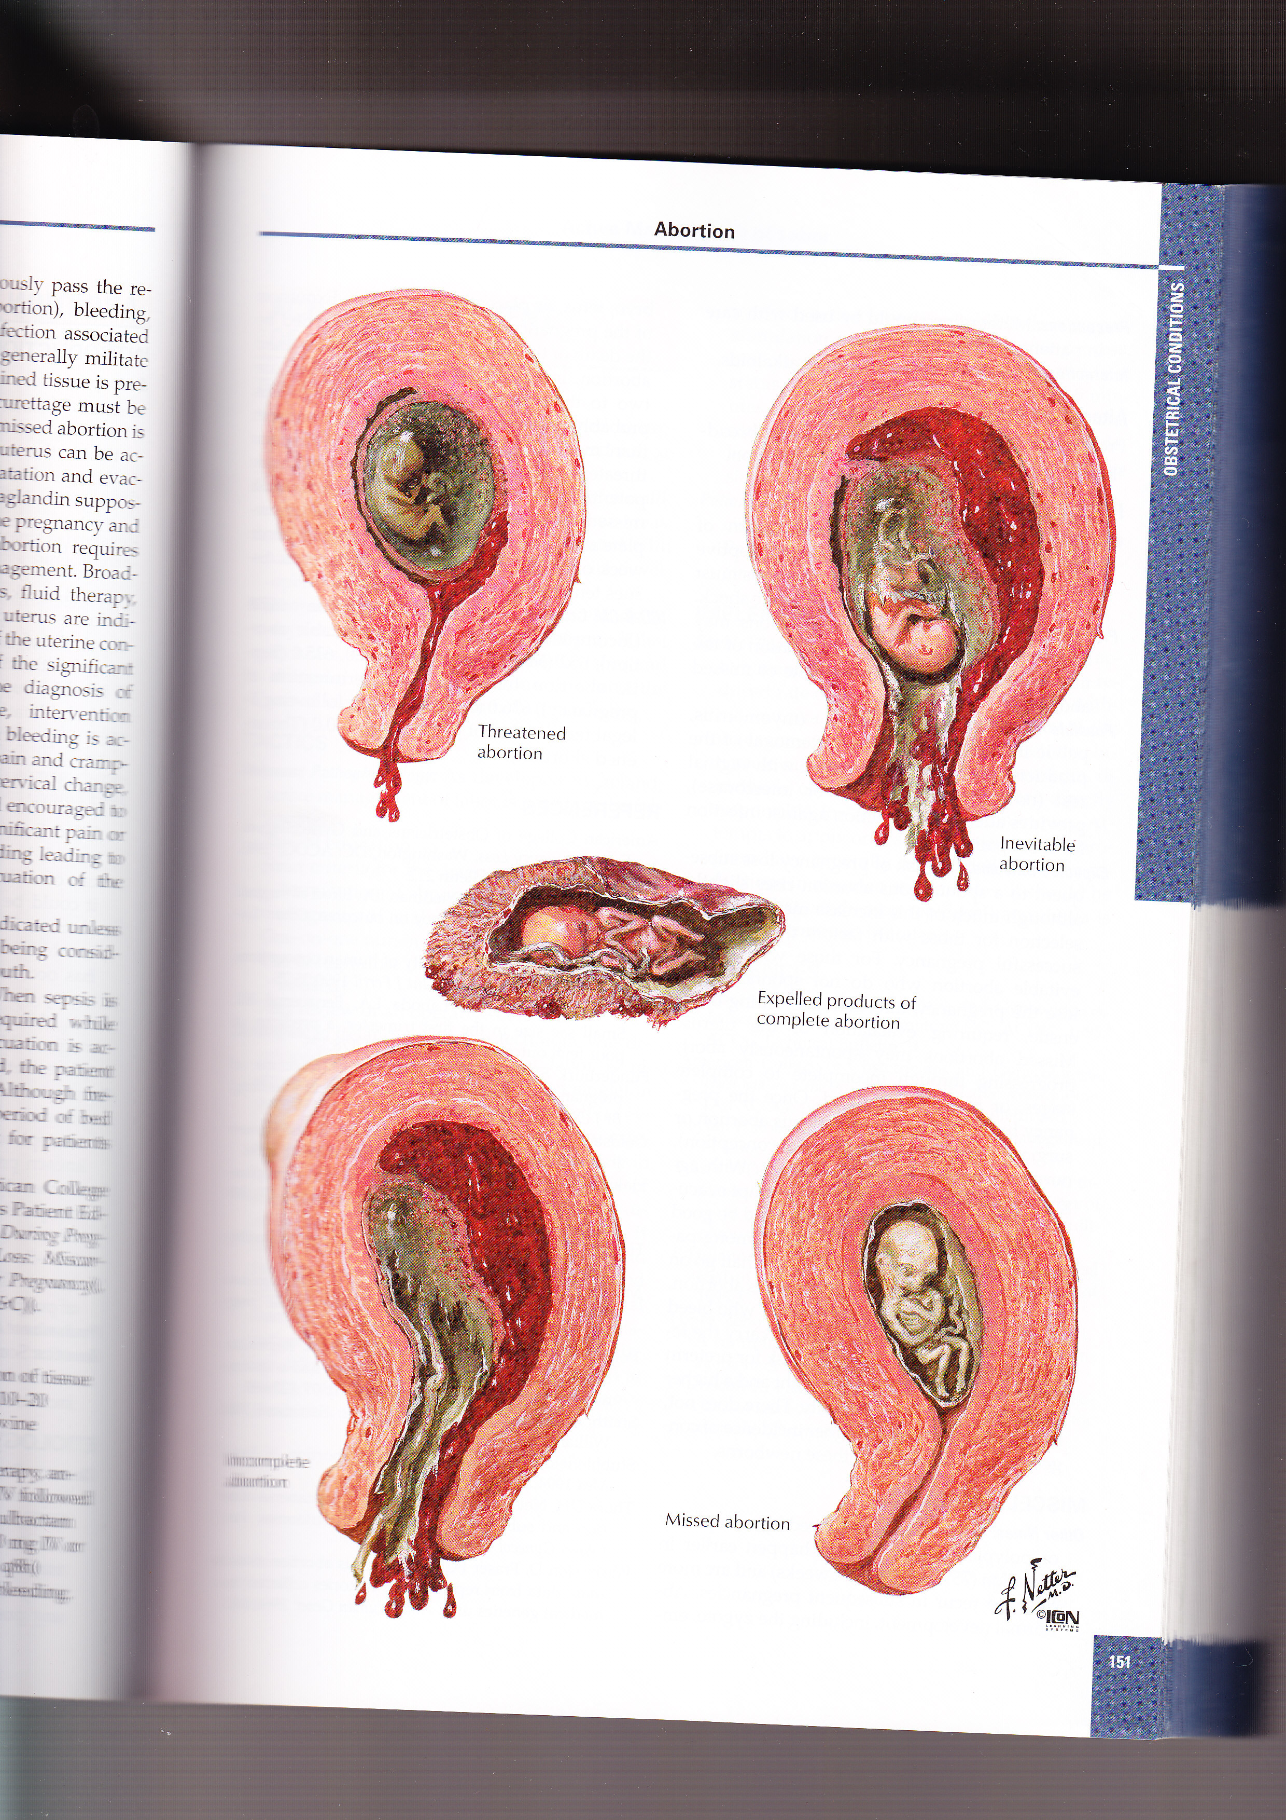

Slide 7
DIFFERENTION DIAGNOSIS
ECTOPIC PREGNANCY
HYDATIFORM MOLE
LOCAL CAUSES

Slide 8
INVESTIGATIONS
USS
BLOOD TESTS
BLOOD GROUP
HB
BSL
HEPATITIS SCREENING

Slide 9
COMPLICATION
HAEMRRHAGE
SEPSIS
COAGLUPATHY
RENAL FAILURE
COMPLICATION OF T/M
PERFORATION OF UTEROUS
ASHERMAN SYNDROM

Slide 10
PSYCHOLOGICAL ASPECT OF ABORTION

