Slide 1
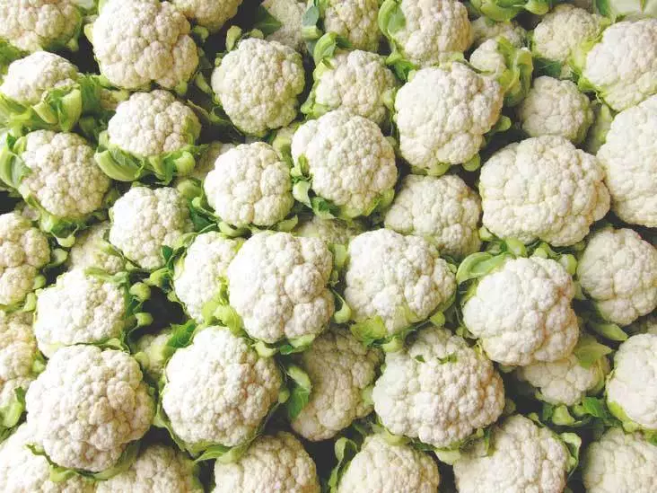
Post harvest management of Cauliflower Prof. Dr. Sarfraz Hussain FST 508 01-04-2020

Slide 2
Botanical name
Brassica olerace var. Botrytis
Family
Brassicaceae/cruciferae

Slide 3
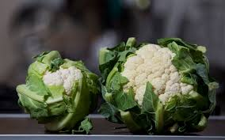
Introduction
Cauliflower produces an edible head of malformed and condensed flowers (the curd) whose stalks are short, fleshy, and closely crowded.
It requires cool temperatures
Plenty of moisture
Good fertility to produce quality heads.

Slide 4
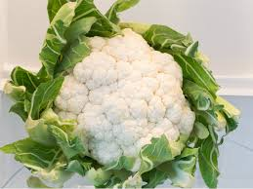
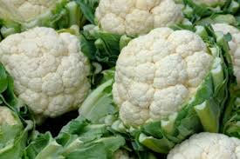
Quality Characteristics and Criteria
Heads of high quality are white to cream in color, firm, and compact. The curds should be free of mechanical damage, decay, browning, or yellowing, which can result from sun exposure. Heads should be surrounded by a whorl of trimmed green, turgid leaves.

Slide 5
Horticultural Maturity Indices
Harvest maturity is based on head diameter and compactness.
Mature heads are larger than 15 cm (6 in) in diameter.
Signs of over maturity include “riciness” caused by protruding immature floral parts and browning or spreading of the curds.

Slide 6
Grades, Sizes, and Packaging
Grading is based on size, external appearance, decay, damage, and trimming
Cauliflower is packed in the field
leaves are trimmed closely to the head
heads are overwrapped with a perforated plastic film to allow adequate ventilation but minimize dehydration.

Slide 7
Precooling Conditions
Cauliflower is mostly vacuum-cooled or hydro cooled prior to storage or marketing.
Vacuum cooling works well for field-packed heads and is more effective if cauliflower is wetted before cooling
Forced air cooling can also be used.

Slide 8
Optimum Storage Conditions
Commercial storage at 0 °C (32 °F) with 95 to 98% RH can maintain good quality for up to 3 weeks or more depending on initial quality.
Increasing RH to 98 to 100% can further reduce weight loss and maintain turgidity of the heads
Free water accumulation on the curd must be avoided.
Storage life is about 7 to 10 days at 5 °C (41 °F), 5 days at 10 °C (50 °F), and 3 days at 15 °C (59 °F)
Loss of quality in prolonged storage is wilting, browning, and spreading of curds, yellowing of leaves and decay

Slide 9
Controlled Atmosphere (CA) Considerations
The benefits from CA and modified atmosphere are modest
Low O₂ (below 2%) in combination with 3 to 5% CO₂ may delay leaf yellowing and the onset of curd browning, injury may occur at below 2% O₂ and/or above 5% CO₂ and develop off flavors.
Storage at CO₂ levels above 10% can induce injury within 2 days.

Slide 10
Retail Outlet Display Considerations
Bottom-icing of refrigerated displays enhance shelf-life of cauliflower
Plastic overwraps are also important to minimize wilting during marketing.
Chilling Sensitivity Cauliflower is not chilling sensitive.

Slide 11
Ethylene Production and Sensitivity
Cauliflower has a very low ethylene production rate,
Respiration Rates
Temperature mg CO2 kg-1 h-1
0 °C 16 to 18
5 °C 20 to 22
10 °C 32 to 36
15 °C 42 to 50
20 °C 74 to 84
25 °C 86 to 98

Slide 12
Physiological Disorders
Black speck is a disorder in which necrotic lesions 0.5 to 4 mm (0.02 to 0.16 in) in diameter appear on the surface of branches or flower stalks in the interior of the curds. This disorder is more prevalent on certain cultivars and is most severe in cauliflower produced during warm weather and rapid growth
Boron deficiency can result in brownish discoloration of the curd and pith of the stems and may result in hollow stems. In addition, blisters and cracks may form on the midribs of leaves and curds may taste bitter

Slide 13
Continued. . . .
Ricyness is a developmental disorder in which elongation of flower stems causes flower clusters to separate, making the head appear granular
Over maturity and storage at elevated temperatures encourages development of ricyness, which can be reduced by timely harvest and storage at 0 °C (32 °F)
Heads are susceptible to freezing injury, which appears as water-soaked and grayish curds, if held below 0.8 °C (30.6 °F).

Slide 14
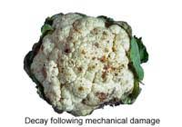
Postharvest Pathology
The major causes of postharvest decay are bacterial soft rot caused by Erwinia and Pseudomonas spp.
Brown rot caused by Alternaria spp.
Storing only good quality, disease-free heads and maintaining good temperature control can best control these decay organisms.

Slide 15
Special Considerations
Growing conditions can strongly influence the quality of fresh cauliflower
Heads must be protected from the sun, normally by tying leaves subtending the head together, to prevent yellowing and strong flavor development in the curd
Only high-quality heads should be stored or shipped long distances
Heads must be handled gently to avoid bruising, which results in rapid browning and decay.

Slide 16
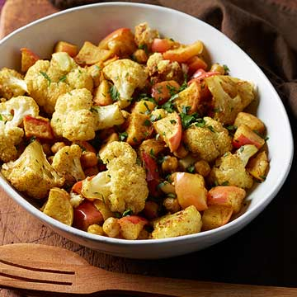
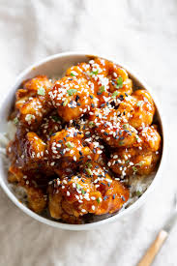
Uses
Cauliflower is used to prepare dishes
Seedling is used for salads and greens
Curd is used for curry soups and pickles
Curd is cut into pieces dried and preserved for off season

