Slide 1
Uv-printing
Unique Form Of Digital Printing
A presentation
TANZEEL MAHMOOD
ZUNAIR AHMAD
MANZOOE ILAHI
NOMAN KHALID

Slide 2
What is uv-printing?
VU-printing stands for ultraviolent printing.
A commercial type of printing that involves a special type of ink which dries out when exposed to ultraviolent light.

Slide 3
process of uv-printing
When the wrapping material passes through substrate receiving wet ink that instantly dries out as soon as it receives uv-light
IT is taken special care that ink doesn’t seeps down or spread across the paper. As a consequence content is printed in a sharper look.

Slide 4
Inventor of uv-printing
Michael caza first introduced this technique into the market in mid-1990’s.

Slide 5
Evolution on uv-printing
First of all mercury vapor lamps were used. User’s could only look downside due to speed and depth of machine, but there was a drawback of this machine that it took a lot of time to heat up and vice versa.
Comparing from the early ages of uv printing more compatible inks are invented; due to the diversity of raw material available at doorstep.
Improvement includes improvement in the versatility of Uv-inks that includes improvement in monomers, digomers and photo initiators which the ink will adhere.
Most wide format printers can now print on anything these days. Uv-printing is the dominant technology

Slide 6
Usage of uv-printing
Due to its absorption theme, UV-printing can be used comfortably on a wide range of substrate such as fabric, canvas, glass, wood, plastic, p.v.c, aluminum polystyrene and more.
Uv-printing is beneficially used in making good quality printing banners. It is often used at displays, billboards and proportional clothing as well.
In the past, it was limited to paper, card and acrylics but new technology has enabled to print ink directly onto metals and ceramics tiles.
It can be applied to anything, from clothing, home décor, instruments and cars too.

Slide 7
Why it is superior?
Faster, weather resistant as well as air resistant.

Slide 8
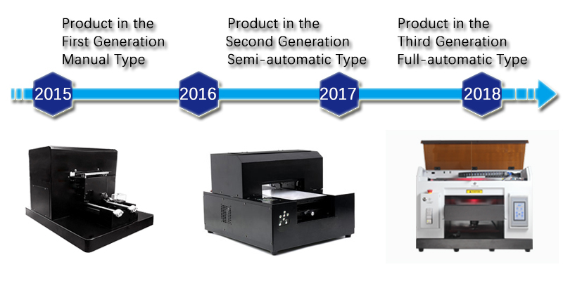

Slide 9
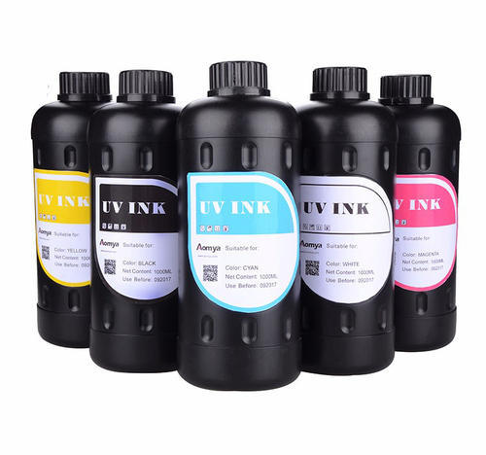

Slide 10
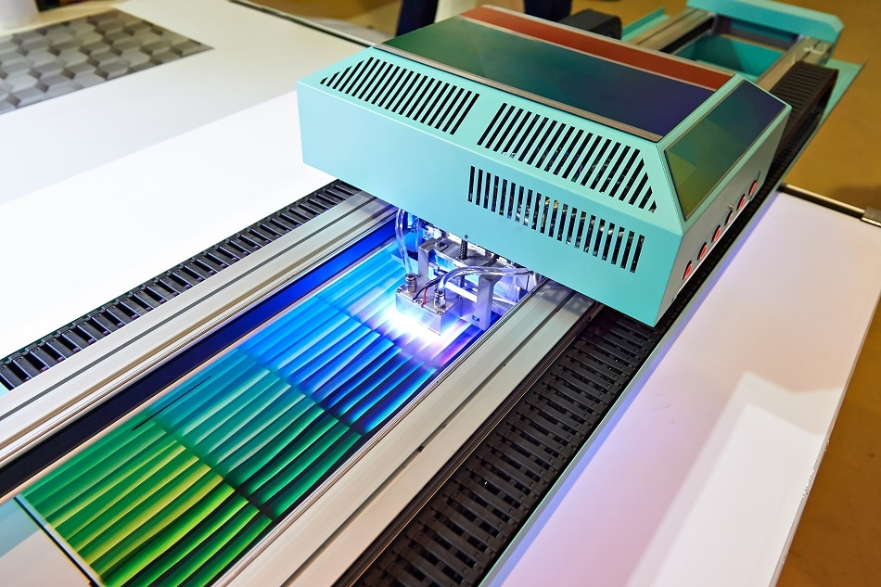

Slide 11
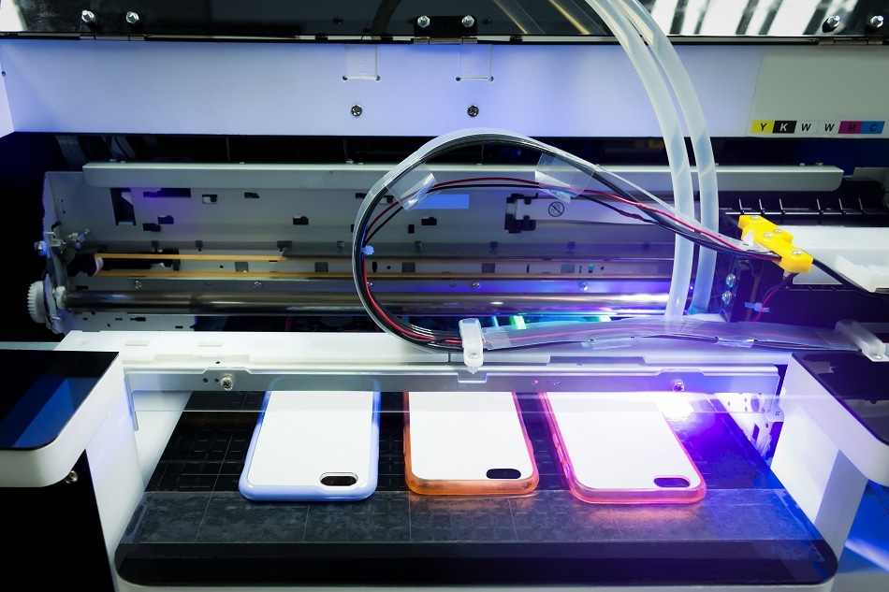

Slide 12
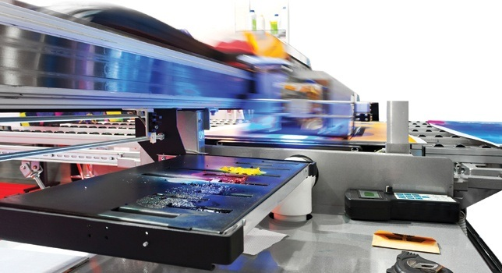

Slide 13
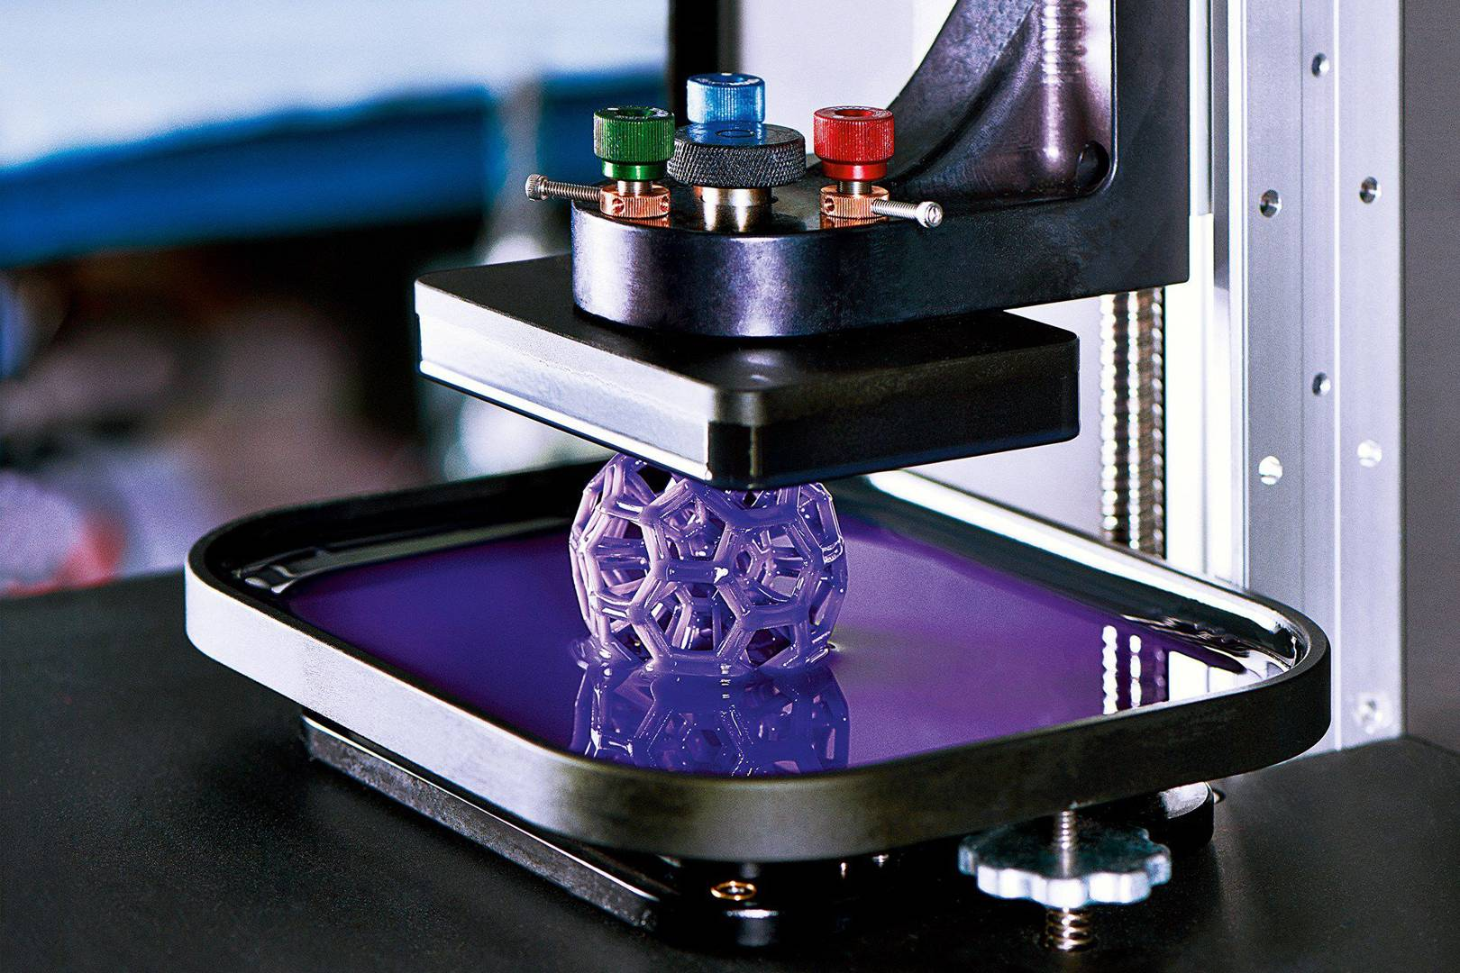

Slide 14
For furtherer studies
https://youtu.be/ZSXutz0pDL8

Slide 15
The end
THANKYOU

