Slide 1
Relationships between culture and SHRM: do values have consequences?
Chapter no 6:

Slide 2
Summery diagram of the chapter contents…

Slide 3
Understanding culture…
Organizations do not exist within a cultural vacuum, their operations are affected by ‘interacting spheres of culture’, including national or regional cultures, industry cultures, functional or professional cultures.
All these spheres impact each other as well as the culture of the organization consequently the management of human resources.
Understanding of these spheres of culture and their interactions is central to the success of business activities, such as mergers and acquisitions, joint ventures and the like.

Slide 4
Defining culture…
A pattern of shared basic assumptions that a group learns as it solves its problems of external adaptation and internal integration, it is considered valid to be taught to new members as the correct way to perceive, think and feel in relation to those problems.
OR the pattern of beliefs, values and learned ways of coping with experiences that have evolved during the course of an organization's history, and are manifested in material arrangements and behaviors of its members.
culture is attributed to both shared patterns of behaviors and the meanings that are assigned to these behaviors. The interrelationship between meanings and behaviors is crucial for understanding cultures.
Not only that the same shared behavior can have different meanings but also that different shared behaviors can have the same meaning.

Slide 5
Typologies of national cultures and their implications for managing human resources strategically
I- THE INFLUENCE OF NATIONAL CULTURES – CONVERGING OR DIVERGING?
II- HOFSTEDE’S DIMENSIONS
III- TROMPENAARS AND HAMPDEN-TURNER’S DIMENSIONS

Slide 6
I-THE INFLUENCE OF NATIONAL CULTURES –CONVERGING OR DIVERGING?
CONVERGENCE emphasizes that due to advances in telecommunications, the world is becoming smaller.
The rapidly increasing use of technology and the growing numbers of multi-national organizations has resulted in a convergence of organizational configurations in terms of strategy, structure and management practices.
DIVERGENCE on the other hand argues that organizations need to be aware of differences in national cultures, these differences have influences upon the organization's culture subcultures, policies, procedures and management practices.
Increasing culturally diverse workforce within countries further emphasizes the need to understand the implications of national cultures within organizational HR practices, such as training and development and compensation management.

Slide 7
II- HOFSTEDE’S DIMENSIONS
Table 6.1, Page 210
● Power distance
● Individualism/Collectivism
● Masculinity/Femininity
● Uncertainty avoidance
Subsequent research in the 1980s (Bond, 1988) resulted in a fifth dimension:
● CONFUCIAN dynamism (long term, short term orientation)

Slide 8
III- TROMPENAARS AND HAMPDEN-TURNER’S DIMENSIONS
Fig: 6.3, Page:212, Table 6.2, Page 213.
1. universal v. particular (rules v. relationships); 2. collectivism v. individualism; 3. range of emotions expressed (neutral v. emotional); 4. specific v. diffuse relationships (specific is when people compartmentalize their lives into separate spheres like work and home) 5. method of according status to other people (by performance or social status); 6. inner v. outer directedness (the degree to which individuals feel that they have control over their environment.) 7. emphasis placed upon the past, present and future
These dimensions are grouped into three distinct areas: ● relationships with people; ● attitudes to time; ● attitudes to the environment.

Slide 9
frameworks for understanding organizational cultures
The deepest level of culture is invisible and extremely difficult to discover, it provides the base upon which the more visible ‘practices’ or ‘artifacts’ of organizational culture are built.
Hofstede refers to them as ‘values’ and ‘core element of culture’, and Schein refers to them as ‘basic underlying assumptions. They are communicated to new employees, thereby transferring the culture to the next generation.
In order for SHRM interventions to be aligned with an organization's culture, it is necessary to ensure that not only are the practices or artifacts appropriate but that they are also internalized as values or basic underlying assumptions by individual employees.

Slide 10
Frameworks for understanding organizational cultures Cont…

Slide 11
perspectives for looking at organizations' cultures
● Integration
All members of an organization share a common culture and there is consensus regarding the beliefs held and the behaviors expected
● Differentiation
Different employee groups have different beliefs about some aspect of the organization, subcultures are formed around different work groups
● Fragmentation
When a little cultural consensus exists among employees like in case of downsizing, such issues change over time , as a consequence, cultures are ambiguous and uncertain.
This emphasizes that culture is not a static entity but an organic process that is created, sustained and changed by people

Slide 12
typologies of organizational cultures and their implications for managing human resources strategically
I. STRUCTURAL VIEWS
When structural artifacts or symbols are used as outward expressions of an organization's culture, These artifacts can be used to help explore the cultural implications for managing the employment relationship.
Handy proposed four main types of such organizational culture:
● Power: Authority comes from the resources controlled and the leader’s charisma, strength of the culture comes from the willingness of employees to defer to the leader.
● Role: Power comes from the rules and procedures and the logic and rationality of the way functions are structured.
● Task: Power is based upon employees’ expertise rather than charisma, such cultures can are changed into a power or role culture with rules, procedures or internal political influences becoming the dominant way of managing employees.
● Person: Authority lies within each of the individual members, rules and procedures being of minimal importance. Occurs in very few organizations e.g. people who decide that it is in their own interests to come together as a cluster of individuals like doctors’ or solicitors’ practice.

Slide 13
typologies of organizational cultures and their implications for managing human resources strategically
II. Competing values
Focuses upon how things are done rather than assigning status to the individuals or groups within the organization. It is concerned with the manner in which these transactions are conducted and the set of values or norms, which reflect the basic underlying assumptions within the organization.
Following four generic cultures are determined by the dominant values: ● Rational or ‘market’ culture; ● Ideological culture or ‘adhocracy’; ● Consensual or ‘clan’ culture; ● The hierarchical culture – ‘hierarchy’.

Slide 14
II. Competing values
i. RATIONAL OR ‘MARKET’ CULTURE
A market culture is directive and goal oriented, with individuals being judged according to their output and achievement.
These values are likely to be reflected in artifacts such as pay and reward systems.
The ‘boss’ is firmly in charge of the organization and their competence is the basis of authority.
Decisions are made decisively and intuitively, and compliance is guaranteed by employees.

Slide 15
II. Competing values
ii. IDEOLOGICAL CULTURE OR ‘ADHOCRACY’
In this kind of culture individuals are judged according to their intensity of effort, rather than achievement.
Authority is maintained by charisma and power comes from the organizational values.
iii. CONSENSUAL OR ‘CLAN’ CULTURE
Over here authority is based upon the informal status of organizational members.
Consultation and participation are valued.
Employees complying with decisions as they were involved in making them.
Individuals are evaluated in terms of the quality of relationships they enjoy with others and are expected to show loyalty to the organization.

Slide 16
II. Competing values
iv. THE HIERARCHICAL CULTURE – ‘HIERARCHY’
Over here authority is vested in the rules, and those with technical knowledge exercise power.
Decisions are made on the basis of factual analysis and leaders are conservative.
Compliance of employees is maintained by surveillance and control, and they are evaluated against formally agreed criteria.

Slide 17
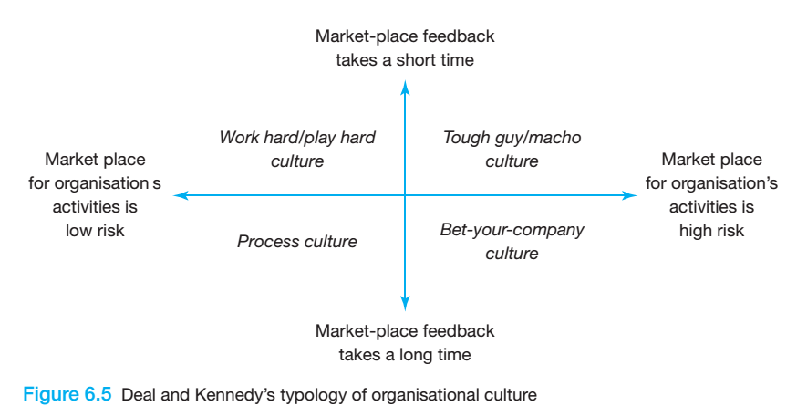
III. The external environment
Four generic cultures are formed based upon the interaction of two marketplace factors:
● Degree of risk associated with organization's activities;
● Speed at which the organization and employees receive feedback on their decisions and strategies.

Slide 18
III. The external environment
TOUGH GUY/MACHO CULTURES
In such cultures the focus is on speed and the short-term, which places enormous pressures on employees to take risks and get results quickly.
Internal competition, tension and conflict are common suggesting both masculine and individualist dimensions in which employees are unlikely to make a long-term commitment to the organization.
WORK HARD/PLAY HARD CULTURES
Focus on short-term feedback for performance but at the same time each individual action does not have high risks for the organization as a whole.

Slide 19
III. The external environment
BET-YOUR-COMPANY CULTURES
Are associated with risk but feedback takes a long time.
As a consequence, decision-making tends to be top-down and there is a strong respect for authority, leading to power distance and uncertainty avoidance dimensions.
THE PROCESS CULTURE
Such culture is a low risk and slow feedback culture.
Operates well in a known predictable environment, with employees receiving relatively little feedback on their work.
Employees of such organizations tend to be orderly, punctual and attentive to detail.

Slide 20
IV. Johnson and Scholes’ cultural web
Johnson and Scholes (2003) refer the following factors and their interrelationships as the cultural web which defines the core values and beliefs of the organization. : ● Stories; ● Symbols; ● Power structures; ● Organizational structures; ● Control systems; ● Rituals and routines

Slide 21
IV. Johnson and Scholes’ cultural web

Slide 22
Human resource strategies for managing organizational cultures
FRAMEWORKS FOR CULTURAL ALIGNMENT
The process of alignment of the current culture and strategic direction of the organization consists of:
Working out the desired culture
Ensuring that the HR strategy and desired culture match
Identifying gaps between actual and desired culture
Taking steps to move the actual culture to the desired culture Lewin’s (1952) three steps of unfreezing, moving and refreezing

Slide 24
Human resource strategies for managing organizational cultures cont…
In order to align SHRM interventions to an organization's culture, a variety of elements need to be taken into account.
Bate (1995) groups these into five foci:
The need to have a clear appreciation of the existing culture, to understand the ways in which it has developed.
Learning from past experience as well as avoiding ‘corporate amnesia.
life-cycle stage of the culture in the organization, either to develop the existing culture or to have a transformational change into a new culture.
External environment will have an impact upon individuals’ behaviors and an organization's culture.
It contrasts what people in an organization want with that of organization's needs.

Slide 25
Strategies for cultural alignment: top-down or bottom-up?
TOP-DOWN APPROACH or Programmatic Change
When the decision flows from the top to lower level layers of hierarchy… Programs involving top-down culture change suffer from three interrelated paradoxes:
First, messages of initiative, autonomy and innovation are usually conveyed through highly bureaucratic methods.
Second, transformation to the new culture is often seen as the task of a new leader.
Third, if the values espoused by senior management are not aligned with employees’ sense of reality the response towards the new culture may not be internalized into employees’ basic underlying assumptions.

Slide 26
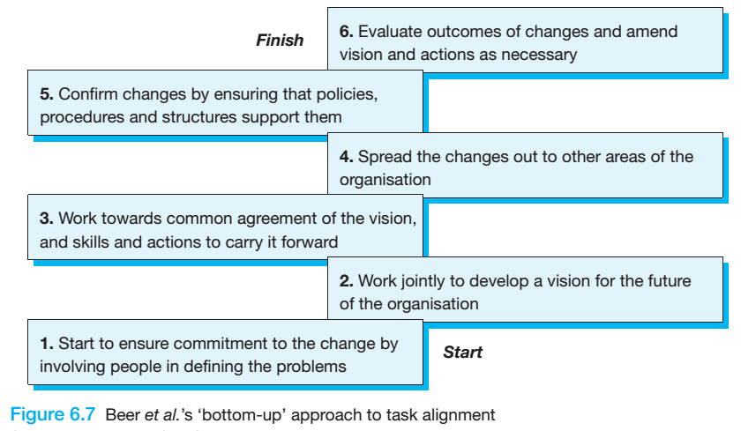
Strategies for cultural alignment: top-down or bottom-up?
BOTTOM-UP APPROACH or Incremental Approach
Change that starts away from corporate headquarters, in such situations the role of senior management is to specify the general direction providing a climate for change and to spread lessons from both successes and failures.

Slide 27
