Slide 1
Extraction

Slide 2
Rotary Evaporator
Efficient and gentle removal of solvents from sample
Invented by Lyman C. Craig
Commercialized in 1957

Slide 3
Components
Motor
Vapor duct
Vacuum system
Heated fluid bath
Condenser
Condensate collecting flask
Mechanical or motorized mechanism to uplift flask

Slide 4
Theory
Low boiling point
Low pressure

Slide 5
Safety
Avoid contact with rotating parts
Cracks
Leakages

Slide 6
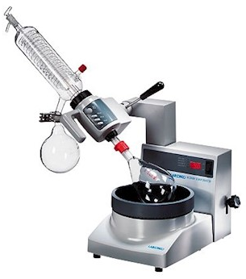
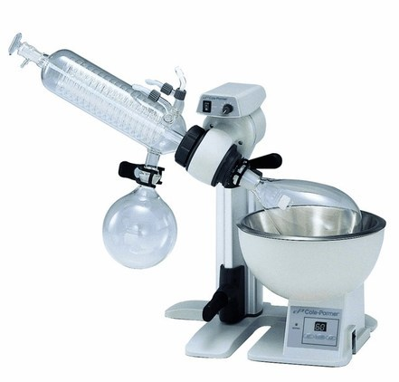

Slide 7
Soxhlet extractor
1879 - Franz von Soxhlet
Extraction of lipids from solid material
Limited solubility in solvent

Slide 8
Description
Percolator (boiler and reflux) which circulates the solvent
A thimble (usually made of thick filter paper) which retains the solid to be extracted
Siphon mechanism, which periodically empties the thimble

Slide 9
Assembly
The source material containing the compound to be extracted is placed inside the thimble.
The thimble is loaded into the main chamber of the Soxhlet extractor.
The extraction solvent to be used is placed in a distillation flask.
The flask is placed on the heating element.
The Soxhlet extractor is placed atop the flask.
A reflux condenser is placed atop the extractor

Slide 10
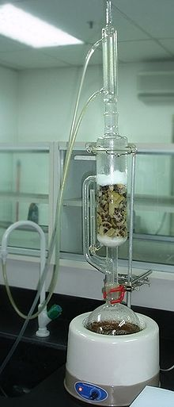

Slide 11
