Slide 1
Farm Business Analysis (Financial Records)
By Hanzala Zulfiqar

Slide 5
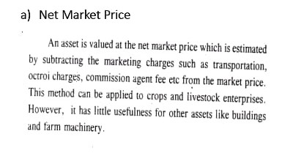

Slide 6
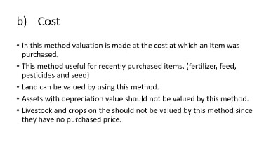

Slide 8
d)

Slide 9
e)

Slide 10
f)

