Slide 1
Excretory System of Insects
Dr. M. Asam Riaz
Assistant Professor
Entomology, College of Agriculture
University of Sargodha, Sargodha, Pakistan

Slide 2
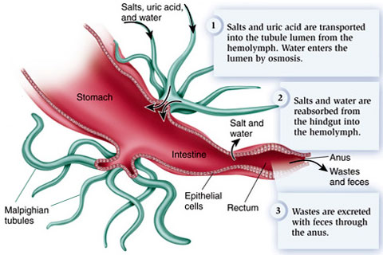

Slide 3
The excretory system in insects
The basic organs through which insects excrete are the malpighian tubules.
Excretion:
It is a process in which unwanted chemical and substances are excreted into the gut and removed along with the feces materials in insects.
Defecation:
Process of discharging feces from the body.
http://cronodon.com/BioTech/insects_excretion.html

Slide 4
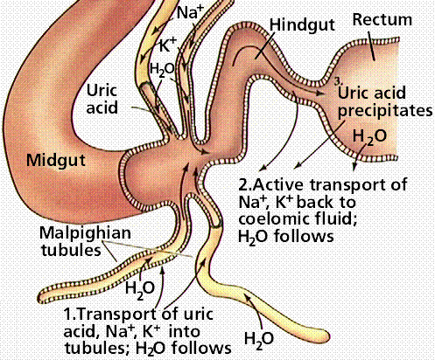

Slide 5
Function and reasons of the excretion
Excretion is helpful because plants poisons and salts saturation in the body are harmful for insects.
Basic function of excretion involves the elimination of abundance of (Nitrogen).
Ammonia saturation is harmful for insects so the aquatic insects release it in water because it is highly soluble in water.
Terrestrial organism eliminates the ammonia by solution which requires waters.
.

Slide 6
Insects Excretion Organ (Malpighian tubules)
The basic organs through which insects perform their function of excretion are the malpighian tubules.
Malpighian tubules are tube like structures which are generally the outgrowths of the insect’s gut.
Every Malpighian tubule has an indescribable ending whose lumen is fused to the lumen of the gut.
Every tubule comprises of a single layer of epithelial cells which is enclosed by a membrane which is fibrous and porous protein mesh.

Slide 7
Function of Malpighian Tubules
These tubules are in connection with the insect body fresh fluid (haemolymph) which is circulating in the body.
The function of the malpighian tubules is to filtrate the haemolymph, keep it clean and remove the toxins and excrete the unwanted chemicals and plant toxins like alkaloids into the gut lumen to keep the insect safe and alive.

Slide 8
Working of Malpighian tubules
The excess of water and unwanted products pass through the malpighain tubules
There are present pump proteins in the cell which pump proton from the malpighian tubules.
These proteins are present as ATP and called proton secreting V-AT.
Removal and addition of positively charged proton is occurred and the removal of proton is balanced by the addition of potassium ion.
Potassium ion comes from the haemolymph and this potassium ion is also removed later on to the lumen.

Slide 9
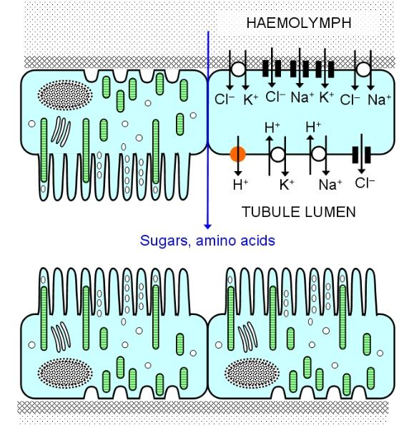

Slide 10
Working of Malpighian tubules
The epithelial cell contain some finger like projections towards lumen tubule called microvilli.
Some green rods which are stripy and actually these produce ATP that is required by the pumps.
The removal of proton causes increases in negative charged cytoplasm of the epithelial cell.
To balance the charge of cytoplasm positive ions are drawn either from the haemolymph(transcellular pathway)or through water(paracellular pathway) source present.

Slide 11
Working of Malpighian tubules
The haemolymph has two hormones 5-hydroxytryptamine (5-HT) and the other one is peptide hormone.
The function of these hormones is to stimulate the urine producing hormones.
The required amount of water, amino acid sugars and certain protons is absorbed by the rectum .
Finally urates, small organic substances (alkaloids) are excreted with or without the fecal matter.

Slide 12
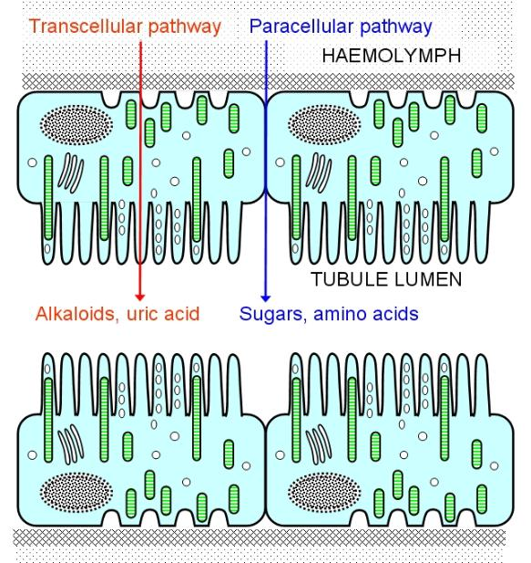

Slide 13
Excretory Products
Orthoptera, Dermaptera, Odonata, Lepidoptera, Hymenoptera,Diptera:
Uric Acid
Allantoic Acid
Allantoin
Urea
Ammonia
Amino acids
Lepidoptera:
Uric acid
Allantoic Acid
Allantoin

Slide 14
Additional points
Some minute insects like aphids, spring tail and silver fish have no involved malpighian tubules in their body system .
Another variation is that stick insects have malpighian tubules of three different types.
Some insects store the excretion material in the store cells as stable form which is not harmful for them.

