Slide 1
Powdery Mildew of Wheat
Erysiphe graminis

Slide 2
Symptoms
White pustules----cottony growth (conidia) = upper leaf surface
Cholorosis (underside)
Powdery growth on stem and heads

Slide 3
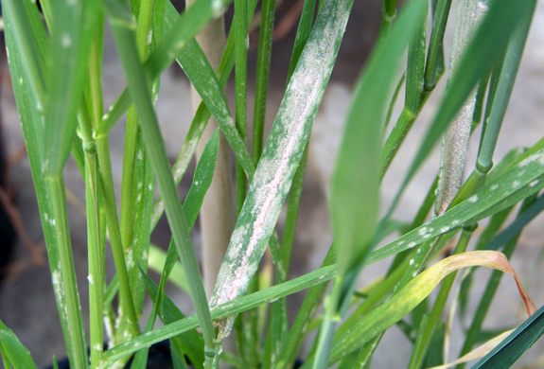

Slide 4
Epidemiology
Mild Temperature (15–22°C)
High Relative Humidity
Dense
Between stem elongation & heading

Slide 5
Disease Cycle
Crop residue (Cleistothecia)
Spores (F.E)
Wind

Slide 6
Management
Balanced Fertilizers
Sanitation

